Slide 1
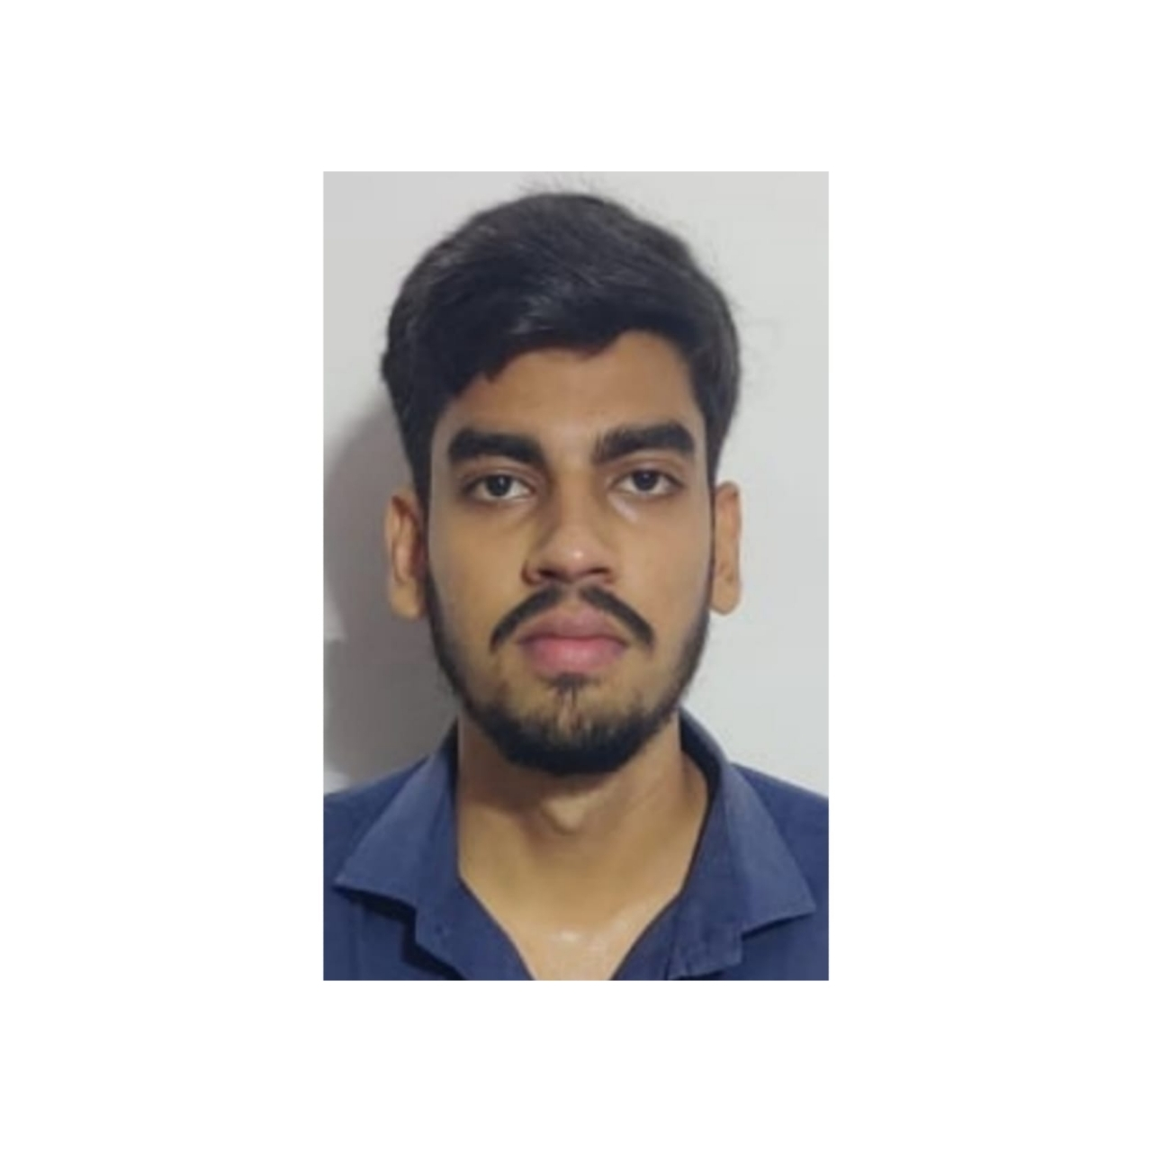
Himanshu Singh
Analyst/Software Engineer
Bachelor of Engineering in Computer Science : 2018 - 2022
Skills Java 11
Spring Boot, MVC
Spring Security
JPA CRUD
Rest Api's
MEAN Stack
Angular
MongoDB
Database
SQL database – MySQL
No SQL database – MongoDB
Web Technologies
HTML5 & CSS3
Javascript
AddOns
Github
Maven
Postman
Additional Details
Communication Skills
Team management
Mumbai
himanshu.satyendraprasad-singh@capgemini.com
+917972568214
A4
Software Engineer who is Strong in design and integration with intuitive problem-solving skills. Passionate about implementing and launching new projects.
Hands on experience in creating microservices with Springboot, SpringSecurity, Api Gateway, Eureka server.
Ready to learn new technologies and implement them to further improve my knowledge.
Eager to work in a team of dedicated people and serve a key role in the enhancement and development of the project.
Working knowledge on Angular Framework and Java Microservice Development using Spring framework.
1. Shopping Cart App Web Application
Completed end to end case study of Deals and Coupons Finder App along with JWT authentication, Swagger and payment testing using Spring Boot and MEAN Stack. Material-UI and Bootstrap used for user interface.
2. Backend (MongoDB), Midware (Spring Boot) and Frontend (Angular) at Capgemini Degreed Platform
Learned and recompiled all concepts of the backend, middleware and frontend to polish my skills to work on real –time projects.
3. Driver's Drowsiness Detection System using Python
Developed an AI base project using Python language with help of OpenCV & Keras library.
4. AWS Cloud Practitioner Certified.
5. GCP(Cloud Digital Leader) Certified.

