Slide 1

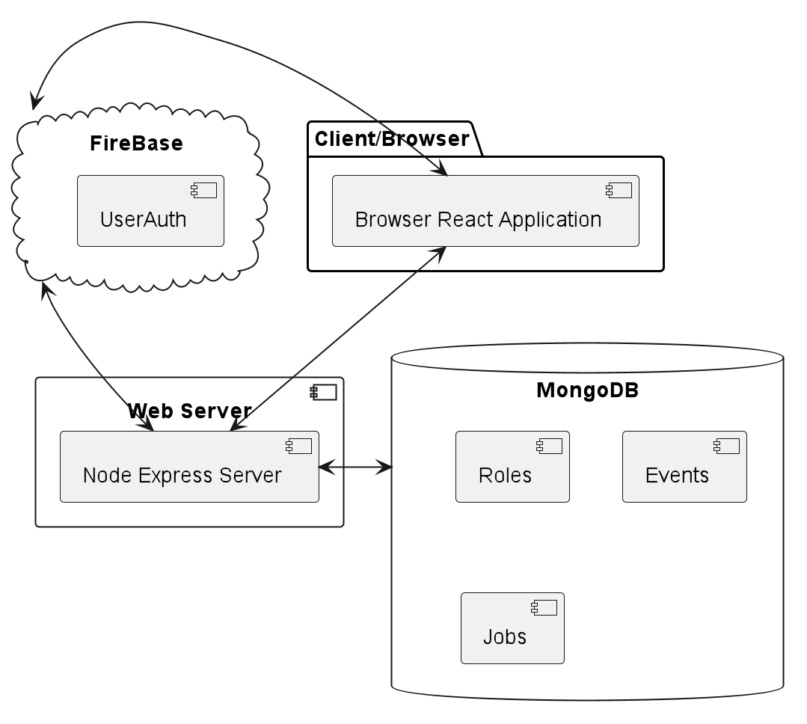
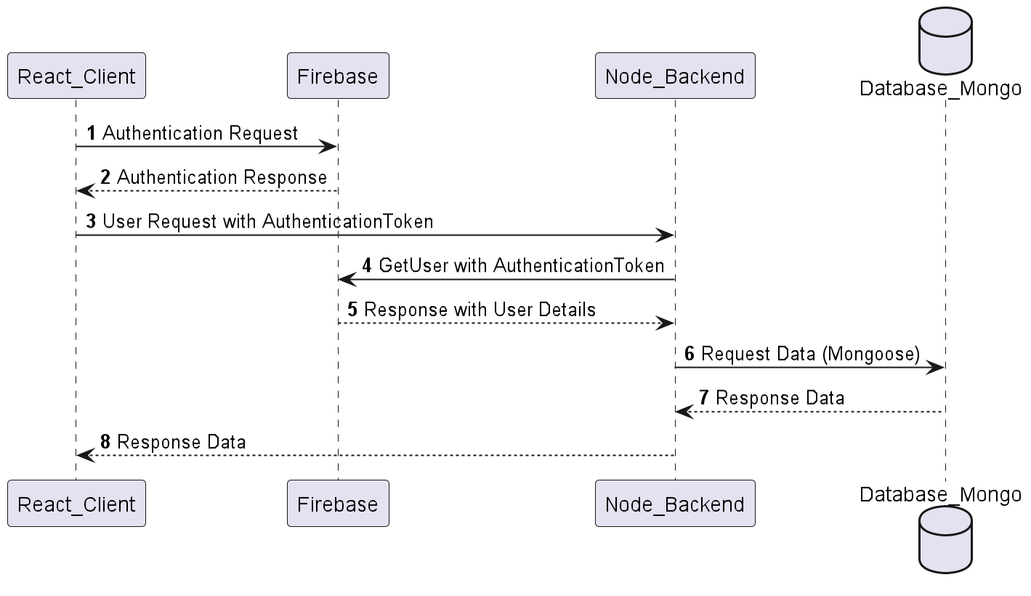
CSEGSA Event Portal
Himanshu, Waris, Abhinand, Kiet
Introduction
Customer: Computer Science and Engineering Graduate Student Association
Goal: A modern and user-friendly platform to display events for CSEGSA members as well as a centralized job portal to provide students opportunities in the job search journey.
Key Features Implemented:
Event Registration and RSVP feature.
Job Posting.
User Authentication and Role Management
Design Diagram
About the Customer and Need for the portal
CSEGSA as an association caters to the computer science graduate students representing the graduate student body.
Hosts social events, provides professional opportunities and help improve graduate life.
CSEGSA has been missing a modern and user-friendly platform to:
Display events for members.
Have a centralized job portal to provide students opportunities in the job search journey.
Secure API Flow
Features Implemented
Home Page:
Introduce the organization
List all the officer’s information together with their contact information.
Interface to directly contact the CSEGSA representatives through the webpage.
Events Page
Display a calendar showing upcoming events.
Allow logged-in students to RSVP for events.
Allow admins to set up new events.
Admins can keep track of participants’ headcount.
Job Posting:
Display list of available opportunities.
Admins can add/delete jobs
Login Page:
Authenticate only @tamu.edu emails.
Provide security and ensure only TAMU students can view and register events.
Special Admin access to modify job postings, add events and administer the site.
Retrospective : What went well
Pair Programming: Helped enforce better coding practices and early detection of errors and bugs.
Team Collaboration: Ease in collaboration through well defined individual user stories enabled independent development
Client Interaction: Gave better understanding of their requirements.
Iterative Development
Retrospective : Challenges
Test cases for frontend UI automation
Better command over git would have saved times
Node and JavaScript environment with the version used caused challenges in integration of Code Quality tools

