Slide 1
Himanshu Yadav
NYAYA-LOOP (Presented by TeamTimer)
AI Automation with n8n

Slide 2
Solution
NYAYA-LOOP: an autonomous agent that chases your grievance until it is resolved
Problem
Indian law gives citizens deadlines: an RTI reply is due in 30 days, and bank and insurance complaints have fixed windows too.
People don't know which authority to approach, can't write a formal letter, and lose track of deadlines.
The work is repetitive, scattered across many portals, and needs a decision at every step.
Our solution
A citizen sends text or a voice note on Telegram in Hindi, Hinglish or English. NYAYA-LOOP then:
Understands the problem and finds the correct authority and legal route.
Sets the legal deadline and plans an escalation ladder.
Drafts a formal complaint.
Asks the citizen to approve.
Generates the PDF, files it, and saves the deadline for tracking.
What makes it different
A stateful, deadline-driven agent, not a one-shot automation.
Routing is grounded in a knowledge base of 15 legal routes (RTI, CPGRAMS, UP IGRS, scholarships, consumer, banking and more), so the AI does not invent portals.
A human approval gate; the letter uses only facts the citizen gave.
BUILT intake, routing, case state, letter, approval, PDF, filing
ROADMAP deadline wait, reply monitoring, stalling detection, auto-escalation, public board

Slide 3
Tech Stack & Architecture
Layer | Technology | Role
Orchestration | n8n | The whole workflow: routing, branching, approval, filing
Interface | Telegram Bot | Text and voice in, buttons and PDF out
AI | Google Gemini Flash-Lite | Routing agent, letter drafting, voice transcription
Retrieval | Gemini embeddings + Supabase pgvector | Searches the grievance-route knowledge base
State | Supabase Postgres | Cases, event timeline, anonymised public views
Files | Supabase Storage | Private bucket for complaint PDFs
Documents | PDFShift | HTML to PDF
Filing | Gmail | Sends the complaint (demo mode: only to your own inbox)
Design decisions
The agent returns schema-validated JSON, not free text.
A database trigger writes the case timeline, so no step can forget to log.
Approval checks chat ID and case status, so a double tap does nothing.
demo_mode means nothing reaches a real authority during the demo.

Slide 4
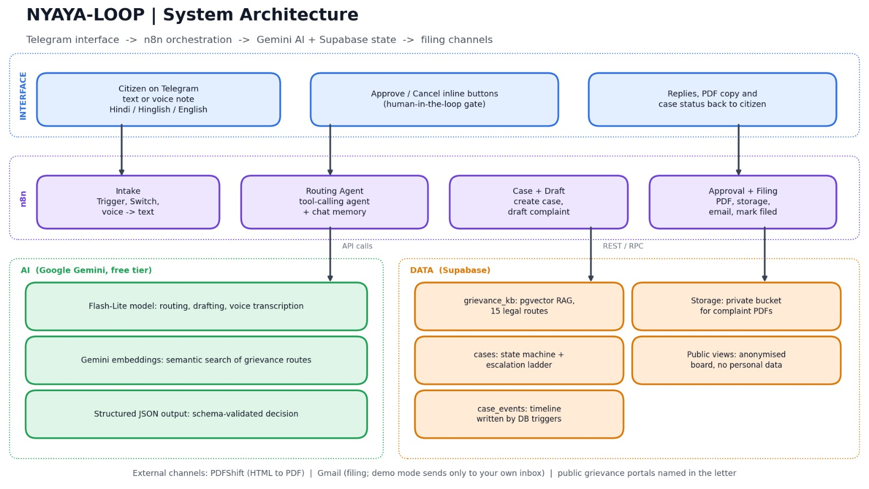
Architecture Diagram
Telegram interface, n8n orchestration, Gemini AI and Supabase state, with human approval before any filing.

Slide 5
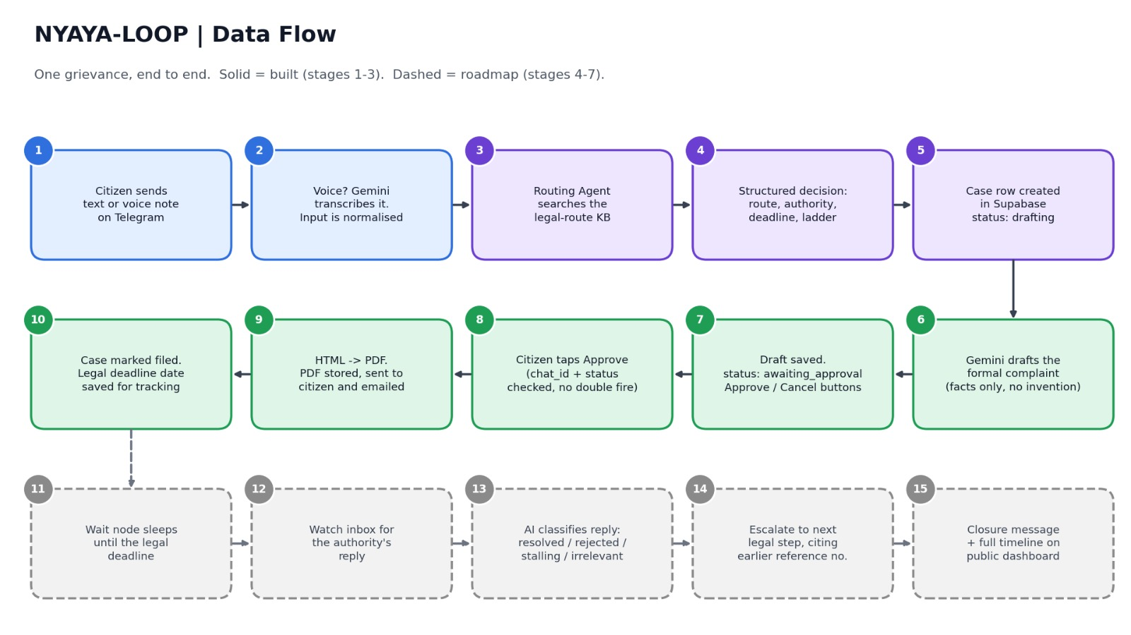
Data Flow Diagram
Steps 1-10 are built. Steps 11-15 (dashed) are the roadmap.

Slide 6
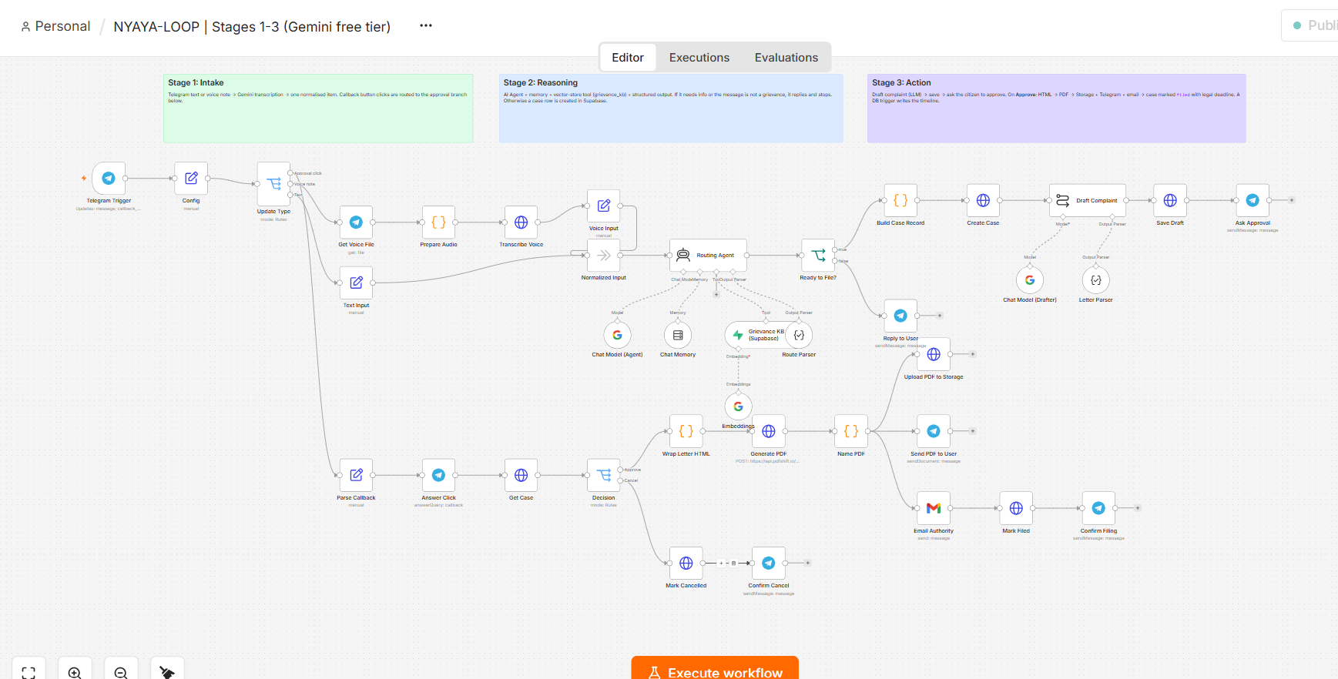
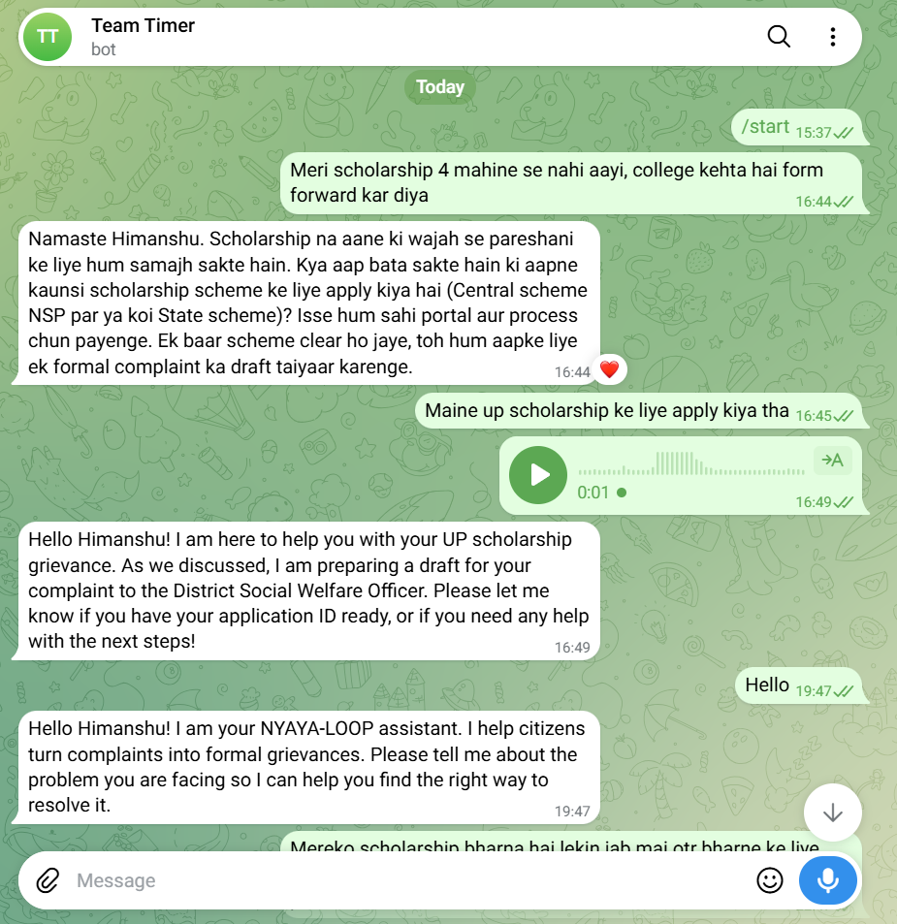
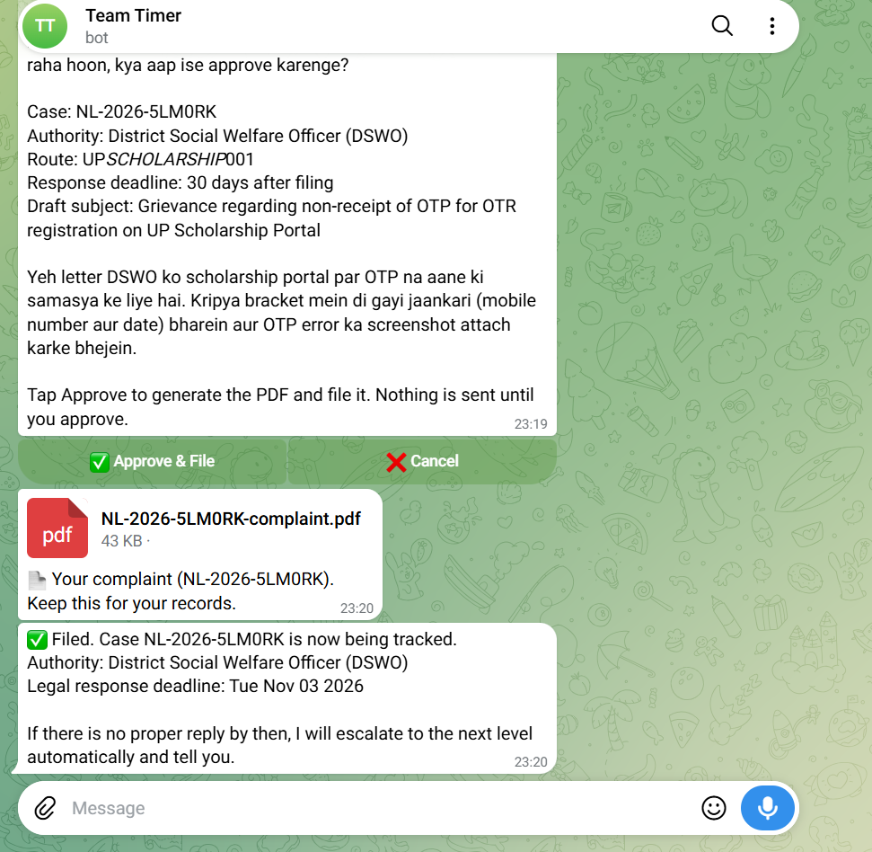
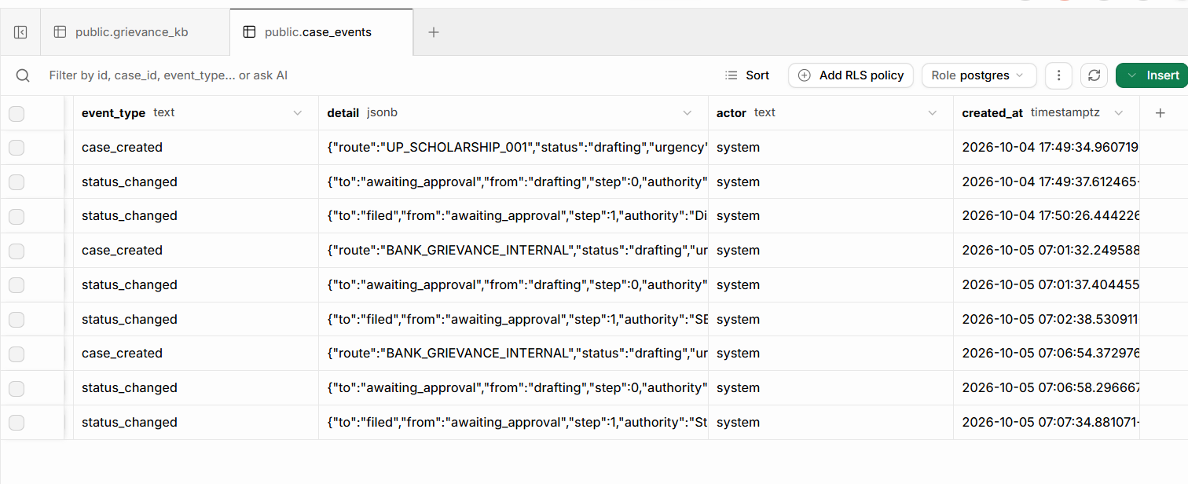
Screenshots of Project
2 Insert screenshot
3 Insert screenshot
. n8n canvas: full workflow, all three stage notes visible
Supabase case_events table: the automatic timeline
Telegram: your message and the bot's reply with authority, deadline, Approve / Cancel
Telegram: confirmation after Approve, with the PDF

Slide 7
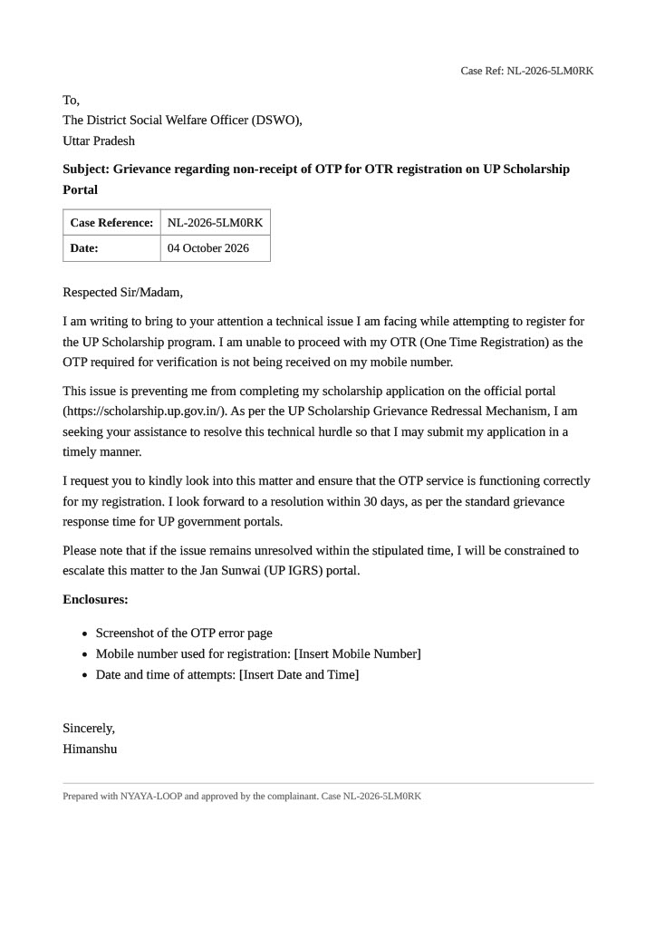
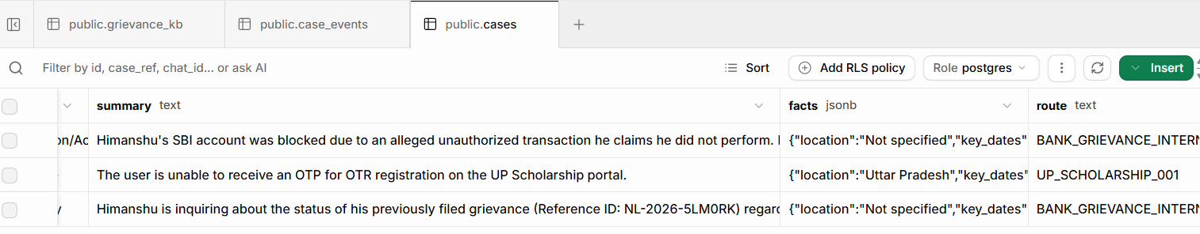
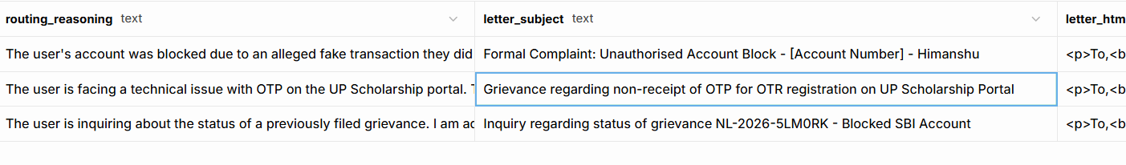
Screenshots of Project
Supabase cases table: route, authority, deadline, status = filed
Generated PDF: complaint letter (fake data)

Slide 8
Roadmap , Safety , Ethics And Limits
Roadmap (stages 4-7)
A Wait node sleeps until the legal deadline.
A reply monitor reads the authority's response.
An AI classifier labels it resolved, rejected, stalling or irrelevant.
Auto-escalation: the next legal step, citing the earlier reference number.
A public board showing which departments respond fastest.
Safety and ethics
Nothing is filed without the citizen's approval.
No impersonation; only public grievance channels.
A drafting aid, not legal advice.
The public board is anonymised: no names or messages.
Limits and future
Route notes must be verified against official sources before real use.
Gemini's free tier caps daily requests.
Next: WhatsApp, more Indian languages, partnership with legal-aid groups.
GitHub: github.com/HimanshuYadav5998
GitHub repo : https://github.com/HimanshuYadav5998/TeamTimer.git

