Slide 1

Phishing Awareness Essentials
Understanding Threats and Learning Prevention
By: Himanshu Dixit

Slide 2

Introduction to Phishing
Phishing is a deceptive technique used by cybercriminals to obtain confidential information.
Common platforms: Emails, fake websites, messages.

Slide 3
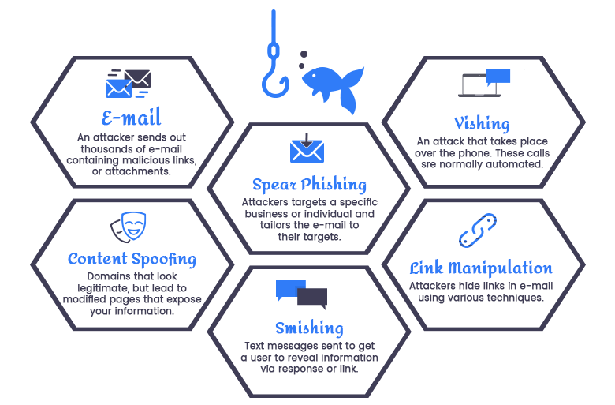
Categories of Phishing Attacks

Slide 4
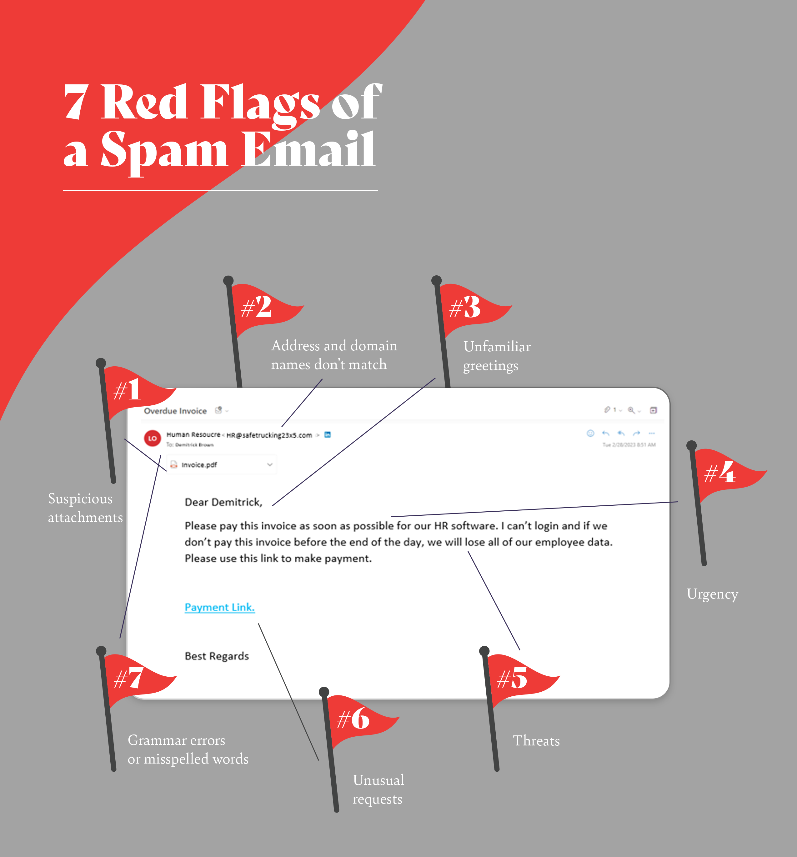
Email Red Flags

Slide 5
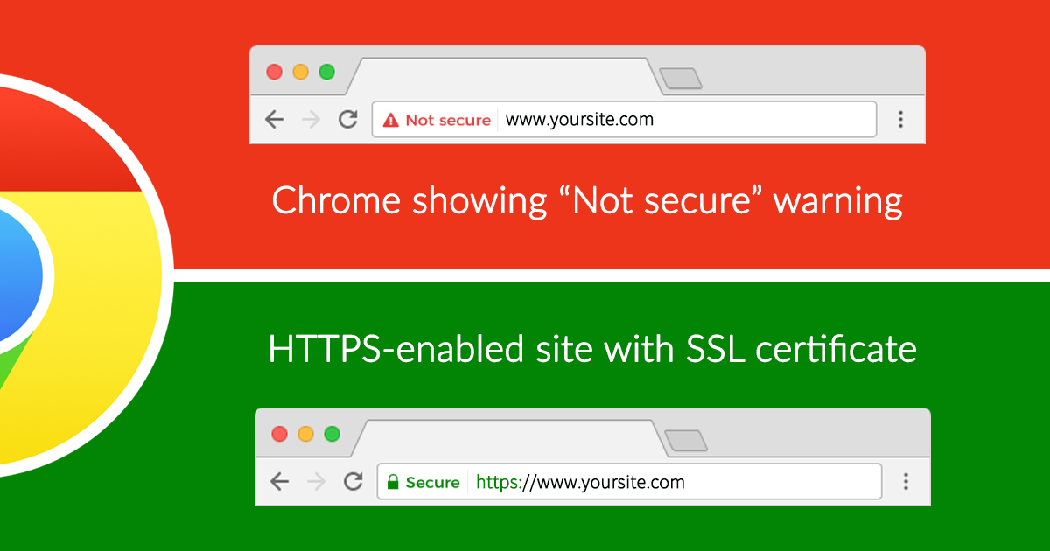
Fake Website Signs
Slightly misspelled domain names
No SSL certificate (no HTTPS)
Popups requesting personal info
Poor web design

Slide 6
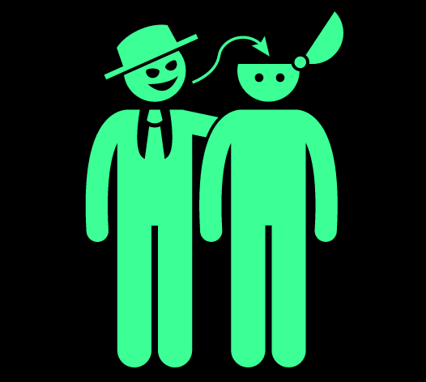
Manipulation Methods
Cyber attackers often:
Pretend to be trusted sources
Use fear and urgency
Tempt with rewards or false alarms

Slide 7

Protection Tips
🔒 Check senders carefully
🔒 Avoid clicking unknown links
🔒 Use strong passwords and 2FA
🔒 Report suspicious messages

Slide 8
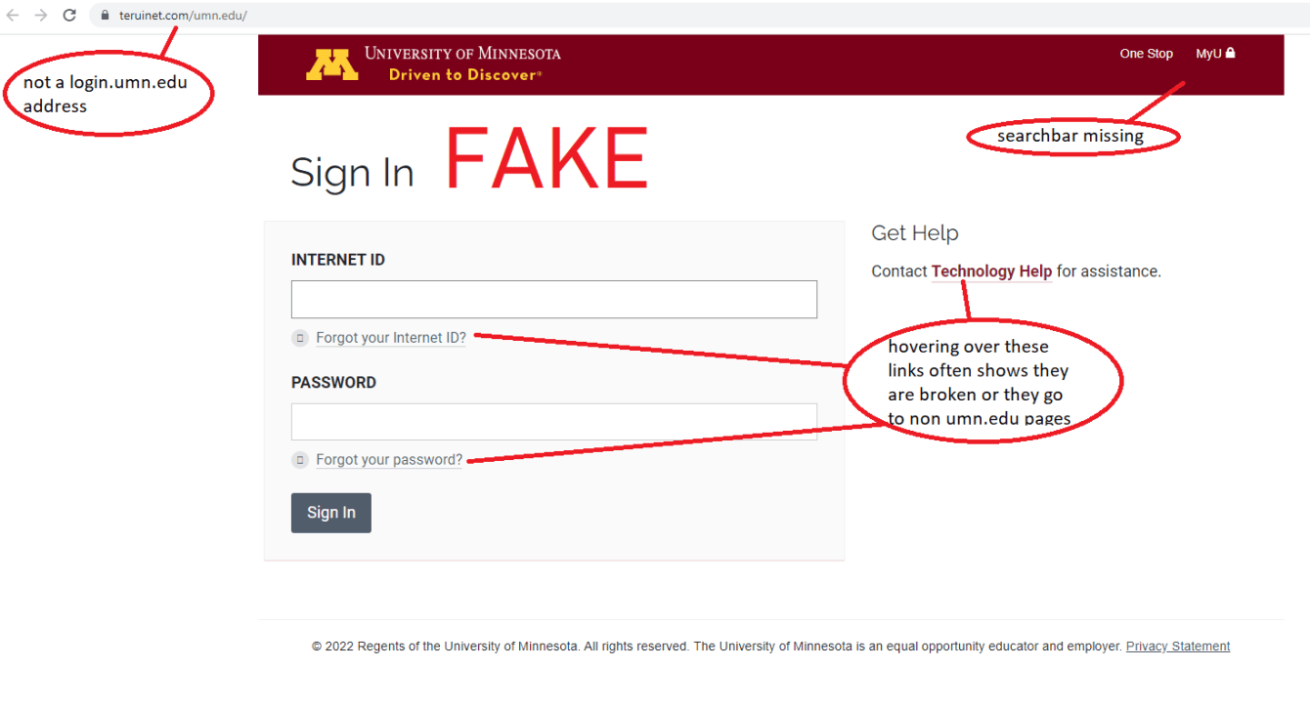
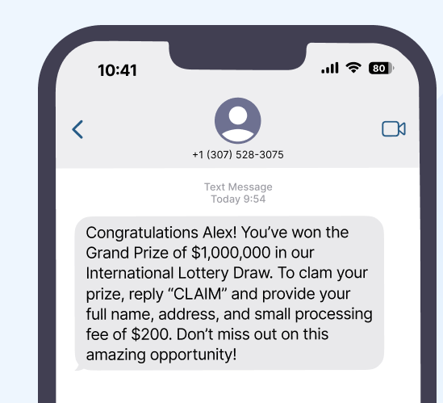
Case Examples
Fake lottery phishing
Impersonated PayPal login page

Slide 9

Knowledge Check
Ask yourself:
Does the email demand urgent action?
Is the domain correct?
Would a legit site ask for this info?

Slide 10
Recap
✔ Phishing can trick even smart users
✔ Always pause and verify
✔ Prevention starts with awareness

Slide 11
Thank You !

