Slide 1
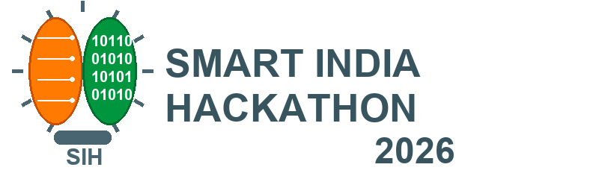

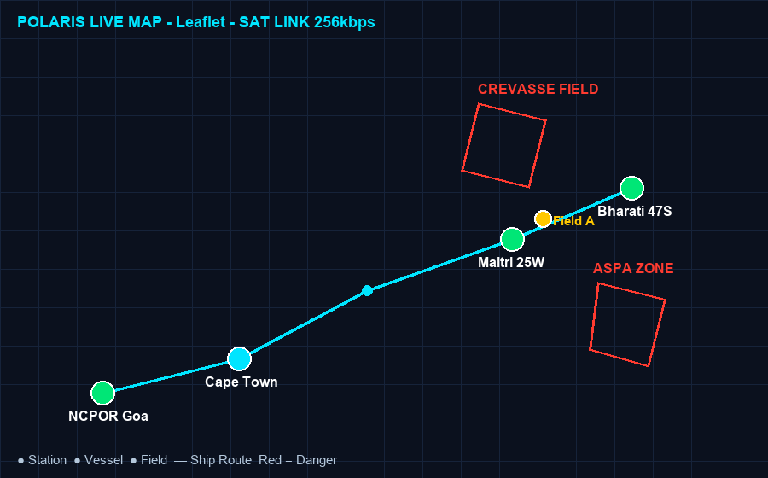
SMART INDIA HACKATHON 2026
• Problem Statement ID- 26062
• Problem Statement Title-
Integrated Polar Expedition Logistics and Asset Management System (MoES / NCPOR).
• Theme-
Smart Automation
• PS Category-
Software
• Team ID-
XXXXX (to be allotted)
• Team Name:
POLARIS
POLARIS Mission Control
Maitri • Bharati • Himadri - Live

Slide 2




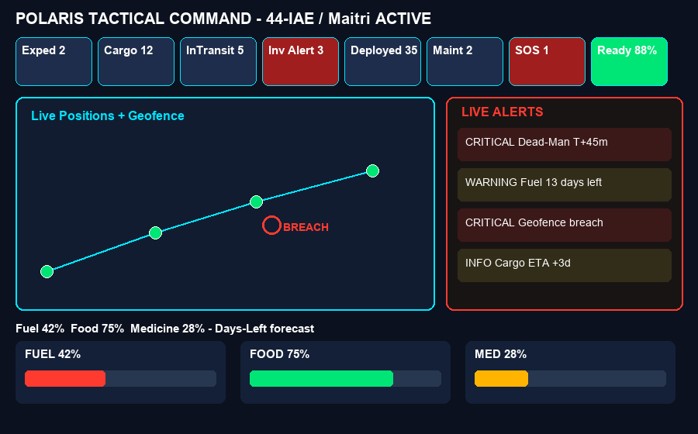
Team
POLARIS
POLARIS
LINK TO PROTOTYPE:
Click Here ☞
💡
Idea / Solution / Prototype
USP
Innovation & Uniqueness
• Automated Mission Control: Central MERN platform automates expedition planning, cargo, inventory, personnel & SOS for Maitri / Bharati / Himadri.
• Stage Identification:
Auto-detects expedition stage (Planning / InTransit / Active / Winter-Isolated) & stock (Optimal / Warning / Critical).
• User-Input Driven:
Takes expedition code (44-IAE), station, team-size, manifest, consumption, GPS check-in to drive forecasting.
1. Live Polar Map + Geofence: Leaflet map with stations, field parties, crevasse / ASPA danger polygons. Breach = instant alert.
2. Depletion Forecaster:
Days Left = Stock / Daily Use. Auto Draft Resupply Manifest before 8-month winter cut-off.
3. Autonomous Safety Engine:
5 rules - Dead-Man (45-min), ETA slip, maintenance, geofence, depletion. Acts without human click.
Solution Approach
Flow of expedition activities & automation -
• Remote Monitoring: NCPOR Goa / MoES Delhi remotely track cargo (Goa → Cape Town → Ship → Ice Shelf → Station), stock & people.
• Efficient Tracking:
Winter isolation readiness, reduces delays, lost cargo & stock-out aborts of year-long missions.
• Interactive Dashboard:
Tactical dark dashboard with KPIs, Socket.IO live alerts & downloadable readiness reports.
Planning
→
Cargo
→
Inventory
→
Personnel
→
SOS
44-IAE, Maitri
35 men, quotas
CRG-012
InTransit→Station
Fuel/Food
Days-Left calc
Check-in + GPS
Dead-Man 45m
Roll-call +
MEDEVAC
Planning → Cargo → Receipt → Consumption → Forecast → Resupply / Emergency
2

Slide 3

Team
POLARIS
TECHNICAL APPROACH
ARCHITECTURE
TECH STACK
INPUT ▾
React 19 • Node + Express • MongoDB
Socket.IO • Leaflet Polar Map • JWT/RBAC
Tailwind Tactical Dark • PWA + IndexedDB
Expedition 44-IAE
Expedition Created
Activities
Station Maitri/Bharati
Team-size + quotas
→
Cargo
Inventory
Personnel
Assets
Geo-map
SOS
Cargo manifest
Daily consumption
Select Activity → Upload / Check-in / GPS telemetry
METHODOLOGIES
Automation Engine Used
Dead-Man
45-min
Geofence
ASPA
Depletion
Stock/Rate
ETA Slip
Weather
Maint.
Hours
• Dead-Man Switch: No ping in 45 min → CRITICAL + last GPS + refuge.
• Geofence:
Point-in-polygon vs crevasse / ASPA → breach alert.
• Depletion Forecaster:
Stock / daily-rate vs next resupply → SAFE/RISK.
• ETA Slip:
Weather-window miss → P1 airlift for fuel/medicine.
• Predictive Maint.:
Hours ≥ max-25 → service + spares check.
Prediction: Days Remaining, Risk (SAFE/RISK/CRITICAL), Readiness %, SOS triage + live alert
Demo harness: Simulate Crevasse Stray | Simulate Dead-Man Timeout | Drop Fuel Below 20%
3

Slide 4
Team
POLARIS
FEASIBILITY AND VIABILITY
Feasibility Analysis
Potential Challenges & Risks
Overcoming Challenges
• Technological Feasibility: Proven MERN + Socket.IO + Leaflet. No special hardware; deterministic rules work even without AI.
• Integration: REST APIs integrate with NCPOR logs, port manifests, vessel AIS, IMD weather.
• Scalability: Cloud MongoDB + stateless Express scale to multi-expedition, multi-station. Offline-first for winter.
• Connectivity: 128-512 kbps intermittent satellite, whiteout blackouts delay sync.
• Data Accuracy: Wrong consumption entry / GPS drift in -60°C causes false alerts.
• Privacy & Safety: Personnel health + location needs strict RBAC + audit; false negative can be fatal.
• Offline-First: IndexedDB queue + delta-sync (updatedAt), lean JSON, sync status.
• Quality Assurance: Validation on every write, transaction log, timeline never overwritten.
• Training + Simulation: Role switcher + 3 demo buttons for judges (crevasse / dead-man / fuel).
Revenue Sources
Link to
Business Model
• Subscription Fees: Annual SaaS per station / expedition for NCPOR / MoES. • Customization: One-time port / vessel / ASPA-mapping + training fee. • Analytics as a Service: Winter-survival analytics & audit reports as premium add-on.
Click Here ☞
4

Slide 5
Team
POLARIS
IMPACT AND BENEFITS
◉ POTENTIAL IMPACTS
BENEFITS
Target Audience
SOCIAL
• NCPOR & MoES: Streamlined governance, better monitoring, lower cost, data-driven winter decisions.
• Expedition Leaders / Logistics:
Higher efficiency, coordination, fewer delays & compliance costs.
• Field Scientists:
Greater safety, one-click SOS, MEDEVAC checklist, fewer disruptions.
• Environmental Agencies:
ASPA compliance tracking, lower emissions via planned logistics.
• Transparency & accountability in national missions.
• Life-safety for 25 winter / 65 summer crew (Illustrative, NCPOR).
ECONOMIC
• Saves emergency airlifts, prevents cargo loss, optimizes fuel/food use.
• Protects year-long research investment.
ENVIRONMENTAL
• Fewer rescue trips → lower footprint.
• Paperless manifests; ASPA geofence protects ecology.
5

Slide 6
Team
POLARIS
RESEARCH AND REFERENCES
DATASET
Seed + operational data only (no real personal data): Stations Maitri / Bharati / Himadri / Field Camps; Expeditions ANT-2027 (Active) / ANT-2028 (Planning); Containers C-001 Food / C-002 Fuel / C-003 Medicine; Assets - PistenBully, Generator, Drone; Personnel badgeId + GPS tracks; Fuel/food consumption logs.
RESEARCH PAPERS
• NCPOR / MoES - Indian Scientific Expedition to Antarctica (ISEA) advisories & station handbooks: Maitri (1989, Schirmacher Oasis), Bharati (2012, Larsemann Hills, ~3000 km east of Maitri); ship access Nov-Mar only; winter isolation 8-9 months.
• Antarctic Treaty - ASPA / ASMA protected-area guidelines (basis for geofencing).
• Offline-first + delta-sync (updatedAt) patterns for INMARSAT / Iridium low-bandwidth links (128-512 kbps, Illustrative estimate).
Existing Systems
• Fragmented Excel + Paper + Satellite Email (status-quo): scattered rosters/manifests, no live tracking, no depletion forecast - risky in winter cut-off.
• Generic ERP (SAP / Oracle-type): costly, not built for polar nodes (Goa → Cape Town → Ship → Ice Shelf → Station), no dead-man switch, no ASPA geofence, no life-support forecasting - hence POLARIS.
6

