Slide 1
Courier Management System
1918_Himashul keshri

Slide 2
User Manual
Main aim to demonstrate the use of create, read, update and delete MySQL operations through this project.
The project starts by adding details of Booking shipment from different branch and staffs working in their respective branches. The staff then adds sender and receiver details of that parcel i,e. Booking details. Then, the parcel is scheduled for delivery. Now, when the parcel is received by the receiver branch, they deliver the parcel and delivery status is shown.

Slide 3
Login Module
In this project there are three user
1. public Users which have no login access they have only option of tracking consignment
2. Staff user have login access but created/Approved by admin
Data entry staff : can manage the shipment Booking CURD Operation
Delivery- Boy staff : can upload the status of delivery
3. Admin user have full access of data.

Slide 4
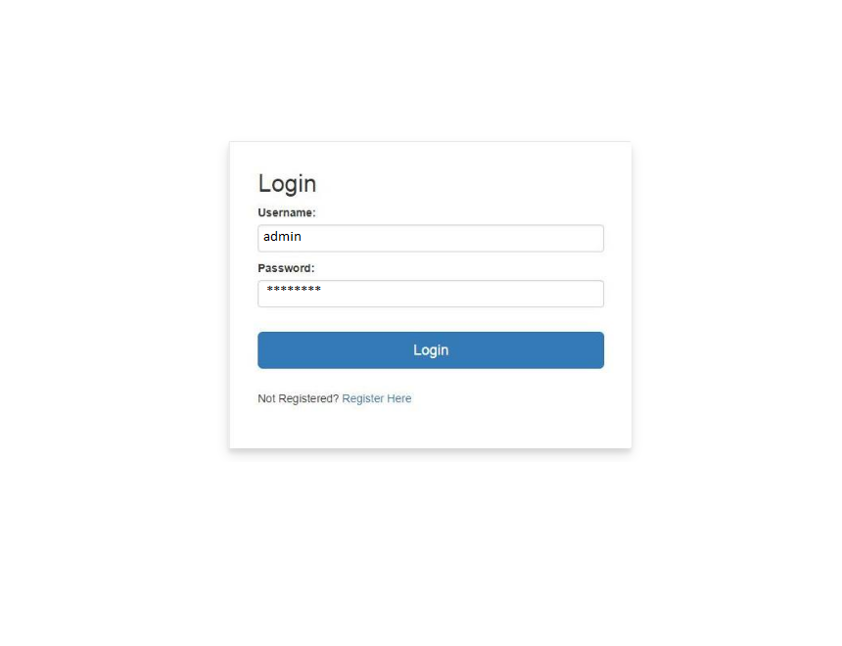
Login Form Module

Slide 5
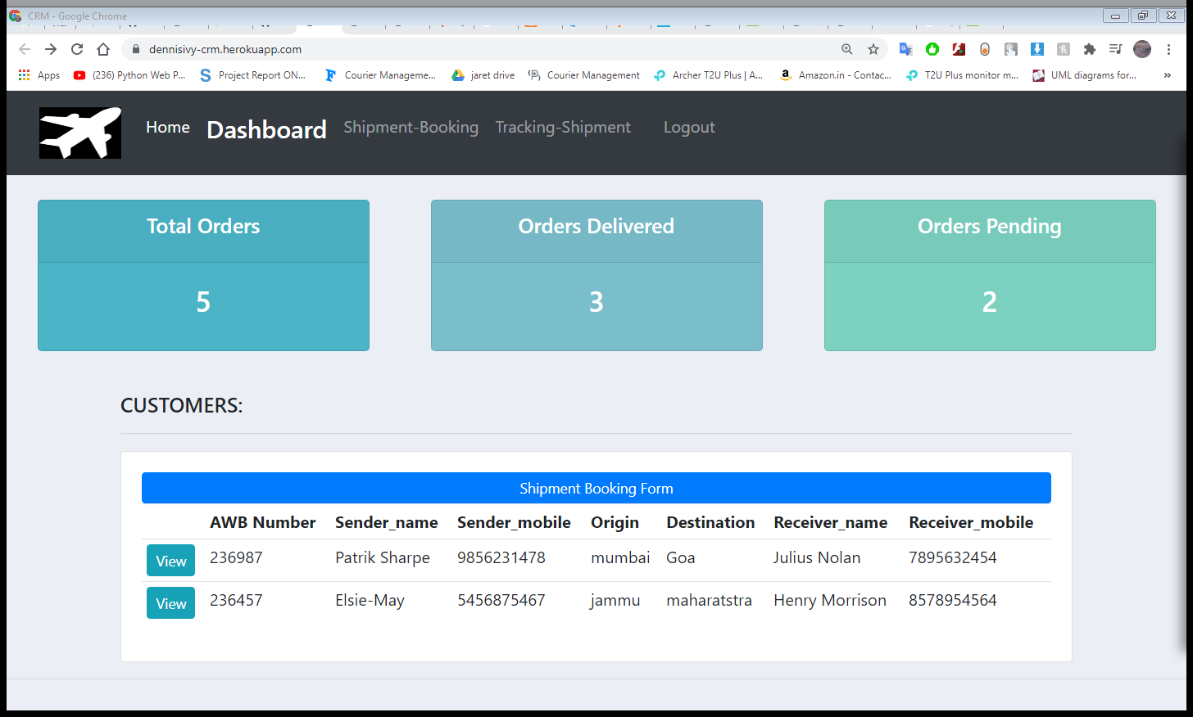
Dash Board of Staff User

Slide 6
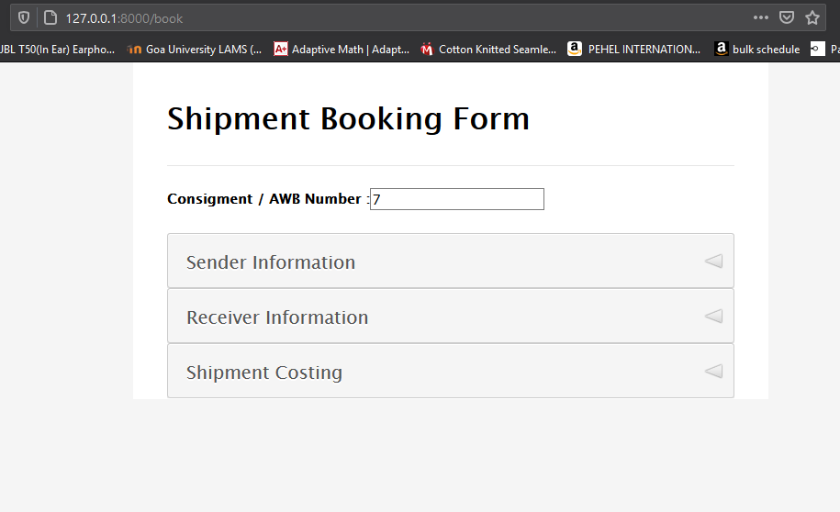
Shipment Booking Form

Slide 7
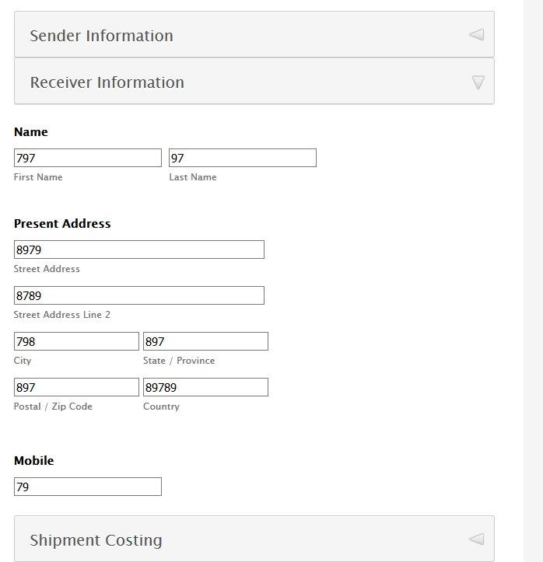
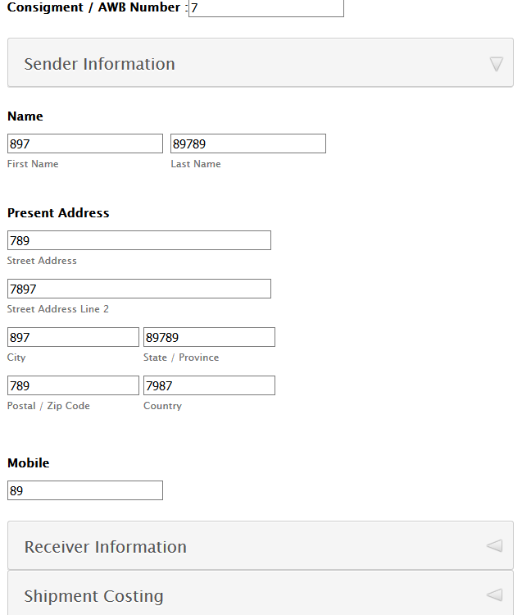

Slide 8
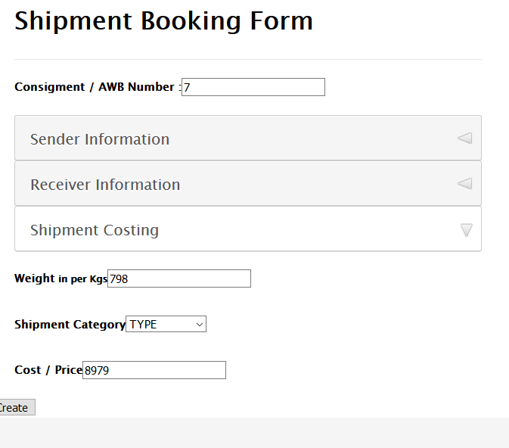

Slide 9
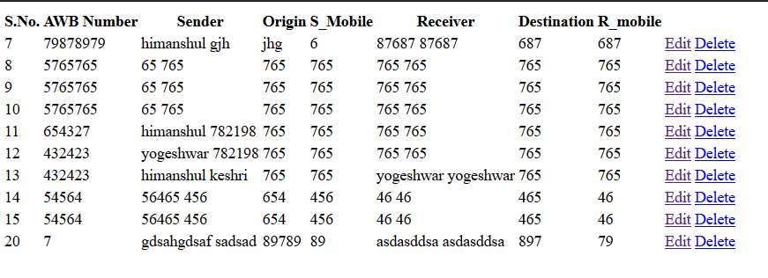
Database show module

Slide 10
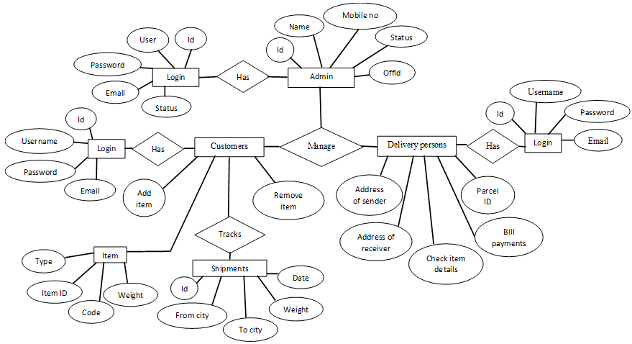
ERD Diagram

Slide 11
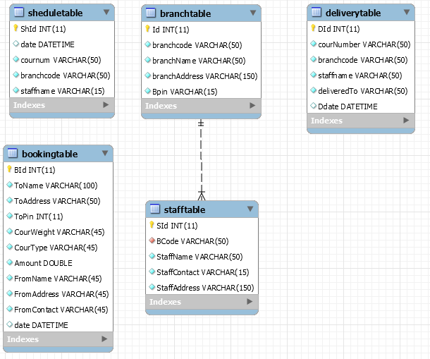

Slide 12
Implementation of Table Creation page:
The tables created are:
Booking
Show
Staff
Shedule
Login management
Tariff calculate
some are left to create……

Slide 13
Booking Shipment Table implementation
class Booking(models.Model): AWB = models.IntegerField() sfname = models.CharField(max_length=20) slname = models.CharField(max_length=20) streetadd = models.CharField(max_length=30) streetadd2 = models.CharField(max_length=30) scity = models.CharField(max_length=20) sstate = models.CharField(max_length=20) scountry = models.CharField(max_length=20) spostal = models.IntegerField() smobile= models.IntegerField() Rfname = models.CharField(max_length=20) Rlname = models.CharField(max_length=20) Rstreetadd = models.CharField(max_length=30) Rstreetadd2 = models.CharField(max_length=30) Rcity = models.CharField(max_length=20) Rstate = models.CharField(max_length=20) Rcountry = models.CharField(max_length=20) Rpostal = models.IntegerField() Rmobile = models.IntegerField() weight = models.FloatField() shiptype = models.CharField(max_length=10,choices=SHIP_TYPE, default='type') cost = models.FloatField()

Slide 14
• Hardware specification
Processor : i5 Core Processor
Clock speed : 3.2GHz
Monitor : 1024 * 768 Resolution Color
RAM : 8 GB
Input Output Console for interaction

Slide 15
• Software specification
Backend : MySQL Libraries using Xampp Editor : PyCharm Frontend : Django web frame work server Operating system : Windows10

Slide 16
Reports
Tracking search using key AWB number
Count orders from booking
Count pending Delivery from schedule table

