Slide 1



ARTEMIS HACKATHON 2026
TITLE PAGE
Problem Statement No –2
Problem Statement Title- Smarter Defence Through Innovation
PS Category- Software
Team Name - Cybbies

Slide 2
PROBLEM STATEMENT
1. Problem Description
Today, many harmful and risky interactions happen online and in digital communication. These include cyber threats, fake messages, suspicious activities, and harmful content. Most systems either detect too late or invade user privacy too much. We need smart tools that can detect danger early, protect people, and still respect privacy.
2.Who Faces This Problem?
.Defence and military organizations
Government agencies
Cybersecurity teams
Social media platforms
Companies and organizations
Common people using internet and digital platforms
3. Current Challenges
Difficult to detect threats in real-time
Too much data to monitor manually
Risk of privacy violation
Many false alerts (false positives)
Lack of smart and automated systems
Attackers use advanced techniques to hide harmful activity
4. Real-World Relevance
Security

Slide 3
PROPOSED SOLUTION
AegiAI is an AI-powered security system designed to detect risky interactions and harmful digital content in real time while maintaining user privacy. It uses smart technologies like NLP, anomaly detection, and risk scoring to identify suspicious patterns without excessive surveillance. The system follows a simple process—Monitor, Detect, Alert, and Protect—providing actionable insights through a secure dashboard. This ensures early threat detection, faster response, and a safer digital environment for organizations and individuals.

Slide 4
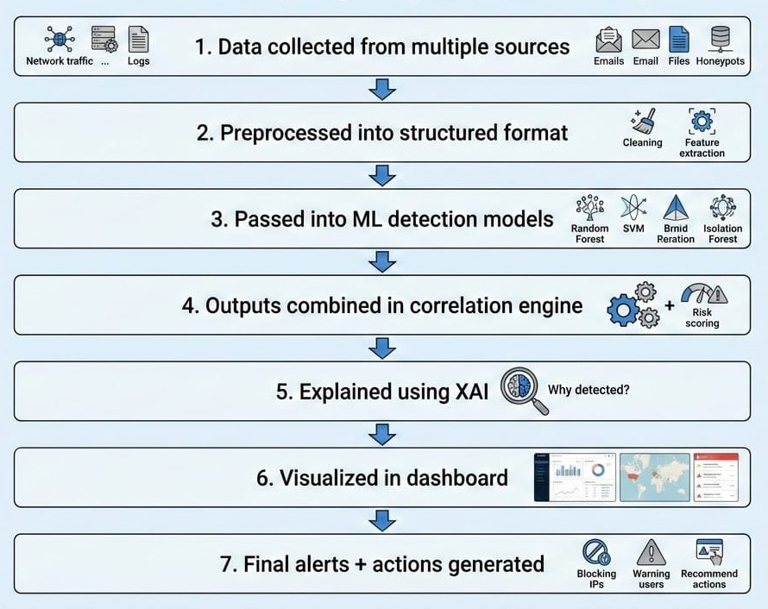
TECHNICAL APPROACH
1.AI-powered threat detection using Gemini LLM
2.Privacy-preserving analysis with anonymized data
3.Real-time monitoring using MongoDB database
4.Honeypot system to capture malicious behavior
5.Risk scoring dashboard with actionable insights

Slide 5
FEASIBILITY AND VIABILITY
VIABILITY:
1.High Market Demand -
Growing need for online safety, cyberbullying detection, and workplace risk monitoring.
2.Strong Revenue Potential -
Subscription-based SaaS model, enterprise licensing, and API monetization options.
3.Clear Competitive Advantage-
Differentiates from surveillance-heavy tools by focusing on insights rather than monitoring.
4.Scalable Business Model-
Once developed, AI systems have low marginal cost and high scalability.
FEASIBILITY:
1.Existing AI & NLP Capabilities -
Current Natural Language Processing and Machine Learning models can already detect harmful, abusive, or risky content.
2.On-Device & Privacy-Preserving Technologies -
Techniques like federated learning and edge computing (used by companies such as Apple and Google) allow analysis without excessive data collection.
3.Scalable Cloud Infrastructure -
Platforms like Amazon Web Services support secure, scalable deployment.
4.API & SDK Integration Model -
The tool can be easily integrated into existing apps, platforms, or enterprise systems.

Slide 6
CHALLENGES & RISKS
Privacy Risk
Protecting user data while detecting harmful or suspicious content.
False Positives
The system may wrongly identify normal content as harmful.
False Negatives
Dangerous or harmful content may not be detected.
Data Security Threats
Hackers may try to access or manipulate sensitive data.
Accuracy Issues
AI models may not always give correct predictions.
Bias in AI Models
The system may show unfair results due to biased training data.
Scalability Problem
Handling large volumes of data in real-time is difficult.
Performance Limitations
High processing requirements may slow down the system.
Legal and Ethical Issues
Must follow laws and avoid misuse or excessive surveillance.
System Reliability Risk
System failure may lead to missing critical threats.

Slide 7
IMPACT AND BENEFITS
Potential Impact on the Target Audience
Improved Safety and Security
The solution helps identify harmful or suspicious activities early, which protects people from cyber threats, fraud, and online crimes.
Increased Trust in Digital Platforms
Users will feel safer while using social media, websites, and online services because harmful content is detected and controlled.
Privacy Protection
The system protects users while respecting their privacy and avoids unnecessary surveillance.
Faster Response to Threats
Authorities or organizations can quickly take action when suspicious activities are detected, reducing damage.
Support for Students, Organizations, and Society
Schools, colleges, companies, and communities can use the platform to maintain a safe and secure environment.
Benefits of the Solution
Social Benefits
Reduces cyberbullying, online harassment, and harmful content
Creates a safer digital environment for everyone
Protects vulnerable users like children and students
Economic Benefits
Prevents financial fraud and cybercrime losses
Saves money for organizations by detecting threats early
Improves productivity by reducing security risks
Environmental Benefits
Digital monitoring reduces the need for physical surveillance systems
Saves resources like paper and physical security equipment
Technological Benefits
Uses AI and smart technology for better threat detection
Helps in building advanced and secure digital systems

Slide 8
TARGET USERS
1. Government
To monitor threats and protect national security
To detect cybercrime, terrorism, and illegal activities
To make better security decisions using insights
3. Students
To protect from cyberbullying, online harassment, and scams
To detect harmful or unsafe online content
To create a safe online learning environment
4. Hospitals
To protect patient data from hackers
To detect suspicious access to medical records
To ensure privacy and security of health information
5. Urban Citizens
To stay safe from online fraud, fake news, and cyber threats
To detect suspicious messages, calls, or online activities
To improve personal digital safety and privacy

Slide 9
FUTURE SCOPE
Better Online Safety
In the future, these tools can protect people from cyberbullying, scams, fraud, and harmful content on social media and websites.
It will make the internet safer for students, families, and organizations.
Use of Artificial Intelligence (AI)
Advanced AI can automatically detect suspicious behavior faster and more accurately.
AI can learn new types of threats and improve protection over time.
Protection in Schools, Colleges, and Workplaces
These systems can monitor harmful messages or unsafe activities and alert authorities.
It helps create a safe digital environment.
Privacy-Focused Security
Future tools will protect users without spying on personal data.
They will use smart methods to detect threats while keeping personal information secure.
Cybercrime Prevention
These systems can help police and cybersecurity teams detect cyber attacks early.
This reduces hacking, identity theft, and online fraud.
Smart Integration with Apps and Platforms
These tools can be added to social media, banking apps, and websites.
This will provide real-time protection to users.
Use in National Security
Governments can use these tools to detect threats and protect national digital systems.
It helps improve overall cyber defence.

Slide 10
BUSINESS MODEL / PROFIT STRATEGY
AegiAI is being built as an open-source platform so that it is transparent, collaborative, and accessible to all. The reason why the system is being made open source is that it allows the developers and researchers to view the code and make the security features better and also add new models for detection to make it more secure.

Slide 11
RESEARCH AND REFERENCES
Infosecurity Magazine
: https://www.infosecurity-magazine.com/news-features/top-10-cyberattacks-of-2025/
Cybersecurity Ventures
: https://cybersecurityventures.com/blog/
Wikipedia
: https://en.wikipedia.org/wiki/2025_Paraguay_ransomware_attack
Wikipedia
: https://en.wikipedia.org/wiki/2025_cyberattack_on_Polish_power_grid
Times of INDIA:
https://timesofindia.indiatimes.com/

