Slide 1

MedWeb
Team coding_wizqards
Himanshu Salagre
Harshal Raikwar

Slide 2

Problem Statement
With the rise of people getting affected with Covid-19 we were looking at data on the level of healthcare people all around India was receiving and one of the things we found that people in rural areas are clueless about the symptoms of the disease and also lack proper medical supervision/care.

Slide 3

Solution Overview
Provide a platform for people to keep track of their health.
A smart AI Disease prediction system.
Easy appointment of Doctor.
Search of Doctors in your.
Available in multiple languages.

Slide 4
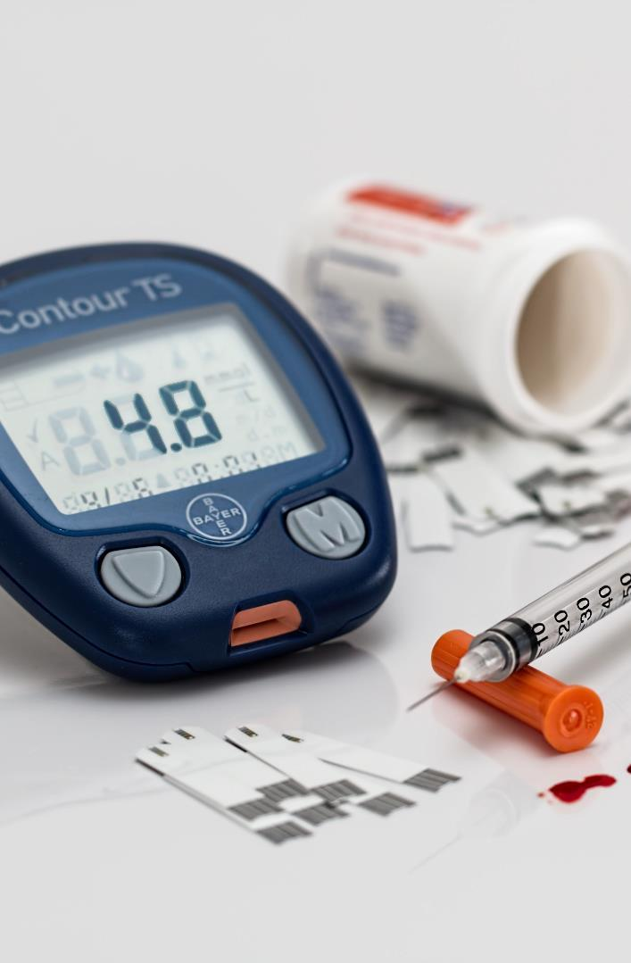



Methodology
Frontend
Disease Detection
Styling
For creating frontend we have used React
We have used Flask for Disease Prediction.
For styling we have used CSS and Bootstrap

Slide 5
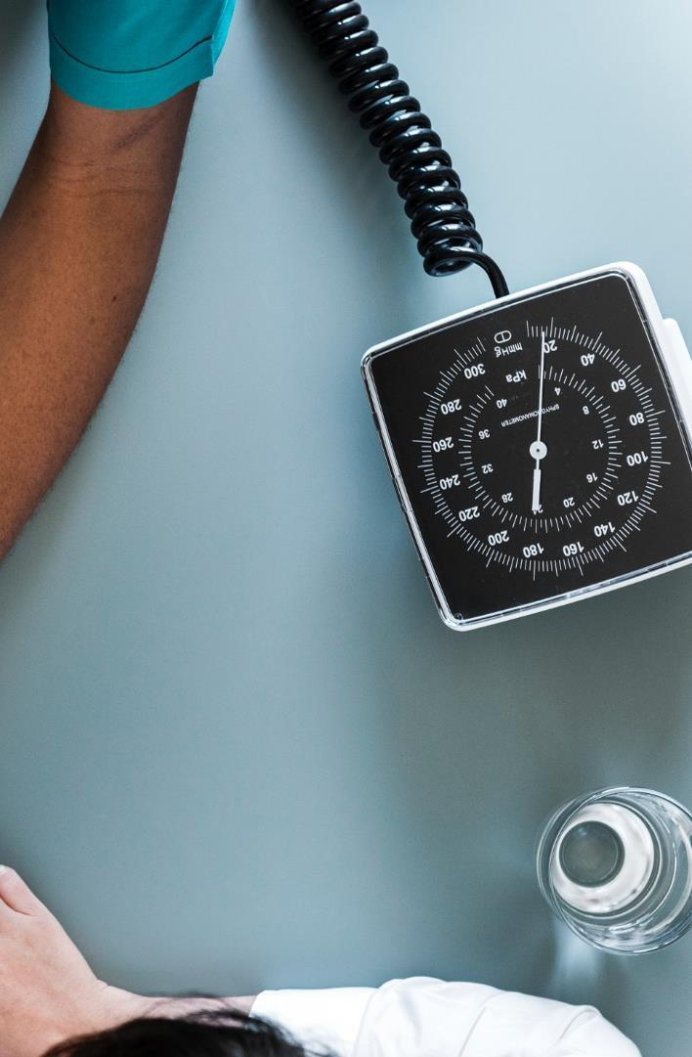




Features
Easy to use
Multilingual
Easy steps to be followed for keeping track.
Available in multiple languages.
Save time
Privacy
As you don’t need to stand and wait you your number for checkup, you can do assessment online.
All the information provided to the application are secured

Slide 6

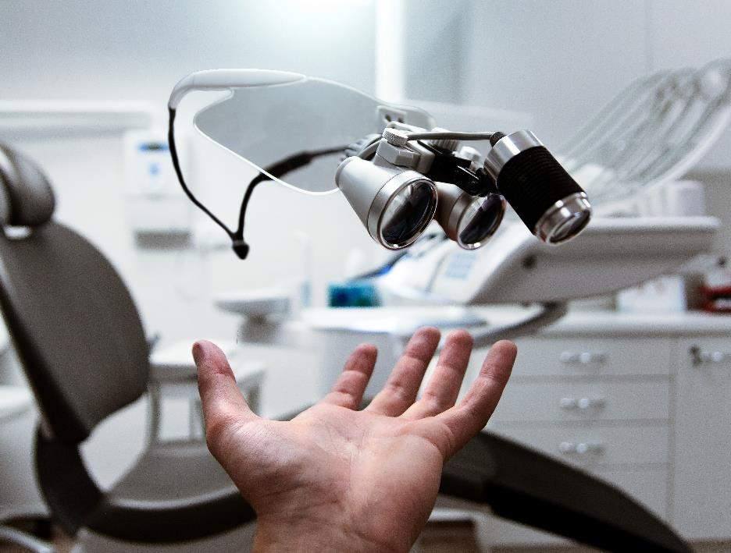
Impact
Easy to keep track on your health.
Easy disease detection.
Easily find Doctor in your area.
Save time

Slide 7

Future Scope
BMI measurement
Direct Meeting Platform from Doctor

Slide 8
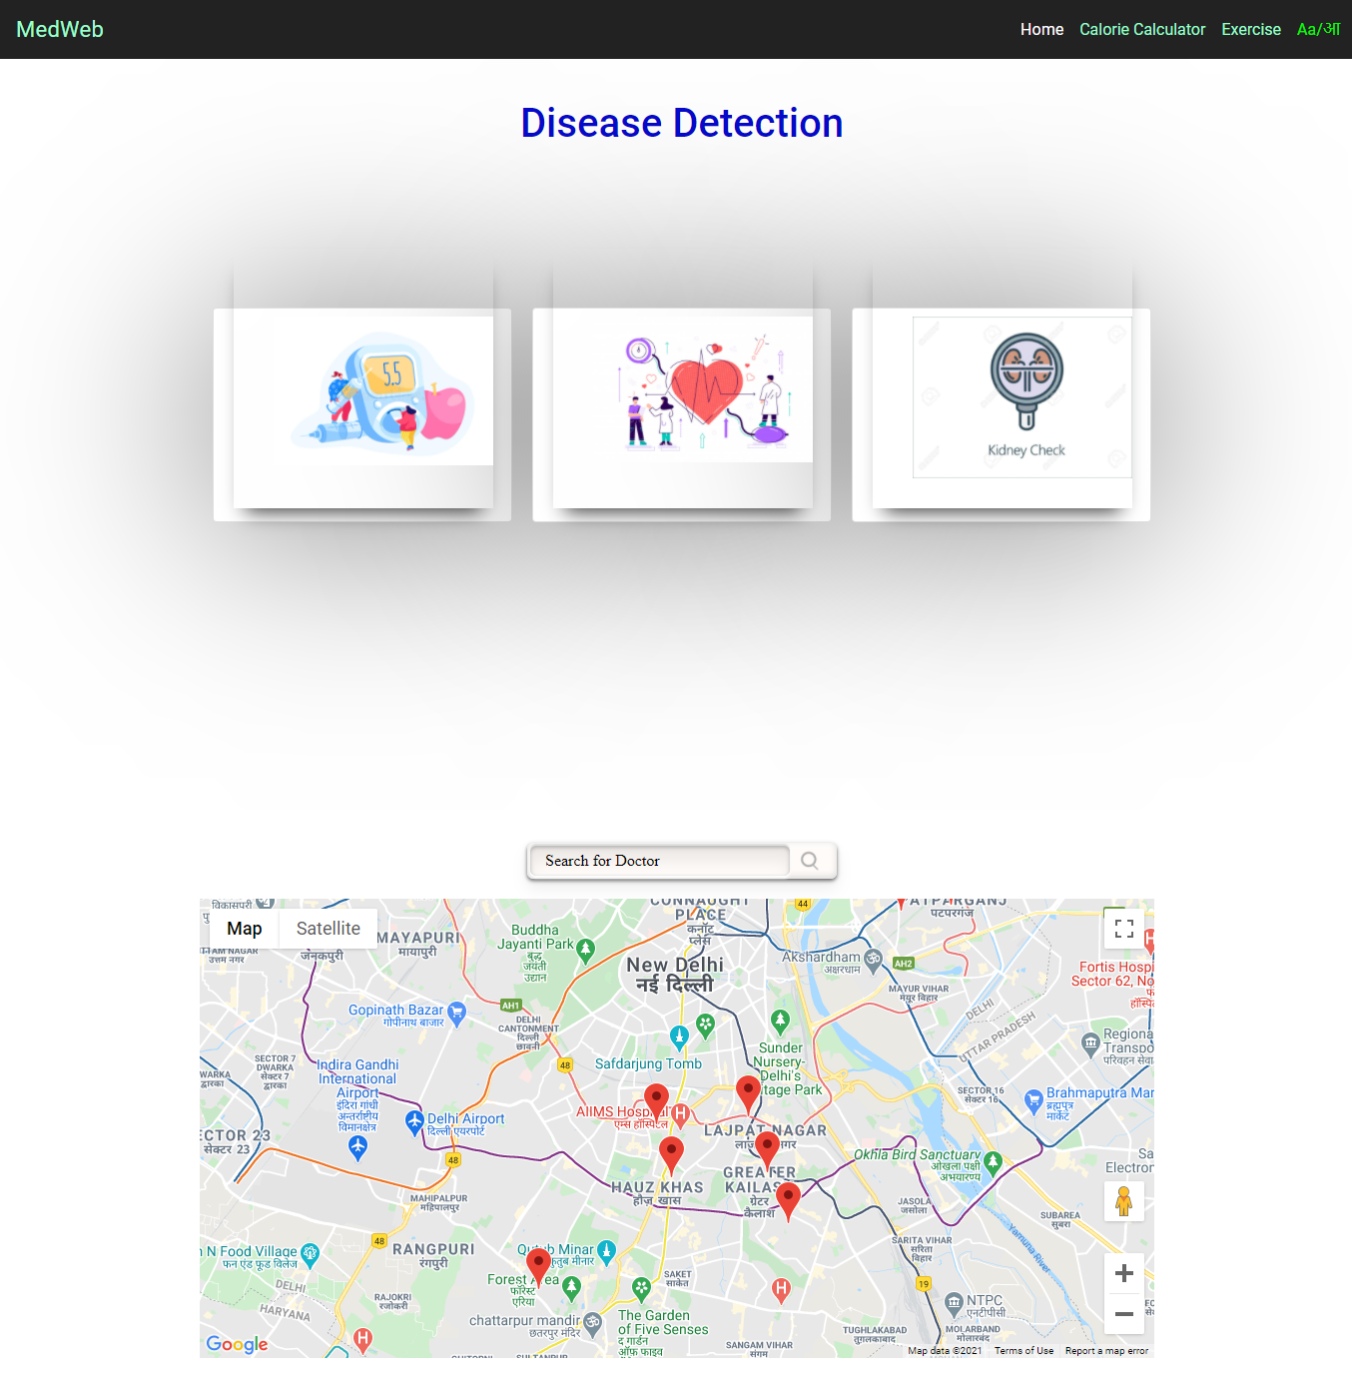
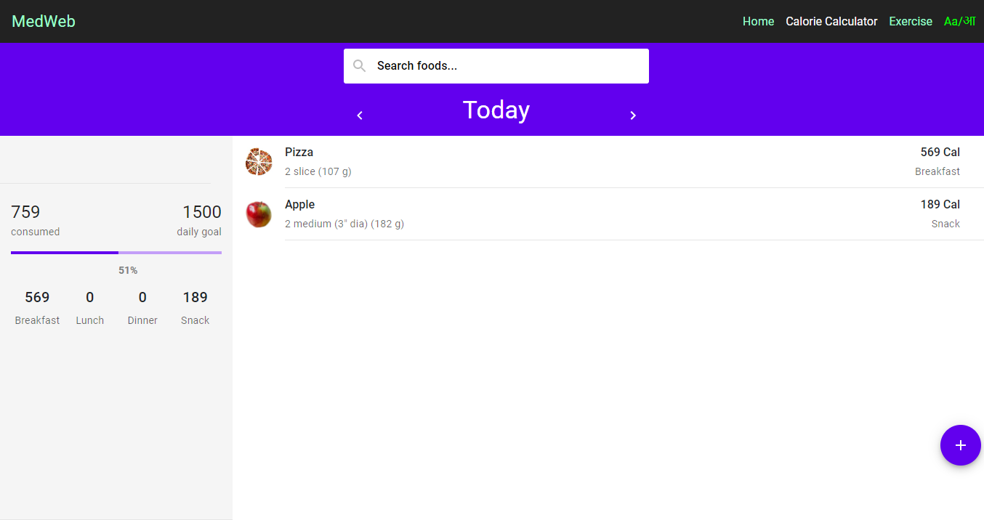

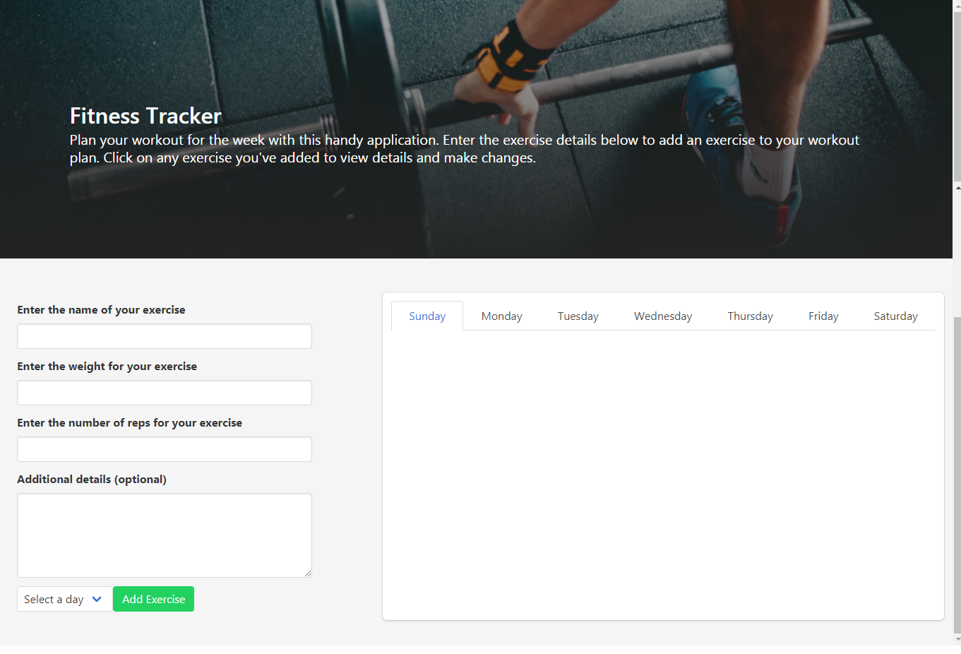
Gallery

Slide 9

Thank You
https://github.com/Himanshusalagre/SVPCET-Technex-Hackathon-2021-coding_wizards

