Slide 1

ASSIGNMENT Name: Himanshu Singh
Problem Statement The sales pipeline conversion percentage at TechnoServe (a tech SaaS startup) has dropped from 35% at the end of last fiscal (FY 2017-18) to 25% at present.
Assignment Objective
Understand the problem, come up with a hypothesis for low conversions faced by TechnoServe, and analyse the dataset provided to arrive at possible solutions to increase it.
Notes:
Problem Statement

Slide 2
PART I : 1. Understanding the Problem Sales Pipeline Conversion at a SaaS Startup
Who?
Techno Serve’s sales team, management, and potential customers.
Investors and stakeholders concerned with declining conversions.
What?
The sales pipeline conversion rate has dropped from 35% to 25%.
Potential customers are not converting into paying users at the expected rate.
When?
The decline has been observed from the end of FY 2017-18 to the present.
Where?
Within Techno Serve’s sales pipeline, likely across multiple sales stages.
How?
Analyzing sales data to identify key drop-off points.
Understanding customer objections and refining sales strategies.
Improving lead qualification and nurturing processes.

Slide 3
PART I : 2. Understanding the Problem Sales Pipeline Conversion at a SaaS Startup
Situation
What are your current software solutions, and how are they performing ?
How does your team currently manage relevant problem Techno Serve solves ?
What features do you look for when evaluating a SaaS platform ?
Problem
What challenges do you face with your existing SaaS solutions ?
Have you experienced inefficiencies or issues that impact your business goals ?
Are there any limitations in your current system that slow down your operations ?
Implication
How do these inefficiencies impact your team’s productivity ?
Have you calculated the revenue loss due to these challenges ?
How does the lack of an optimal solution affect your customer satisfaction?
Need-Payoff
How valuable would it be if you had a seamless solution for pain point ?
Would an automated system reduce your team’s workload and improve efficiency ?
If you could resolve these challenges, what would be the impact on your business?
Notes:
Provide at least three questions under each branch.

Slide 4
PART II : Formulating Hypotheses Sales Pipeline Conversion at a SaaS Startup
Framework Used :
For this analysis, I will use the Issue Tree Framework, a structured problem-solving approach that helps break down a broad issue into its root causes and subcomponents.
Reason for using the selected framework
It helps visualize all possible factors contributing to the problem.
By dividing the issue into branches, we can systematically identify root causes.
Enables prioritization of hypotheses based on impact and feasibility.
How you have used the framework here
The problem is divided into four major branches based on insights from the 5W framework :
Market & Competitive Factors :- External influences affecting conversion rates.
Customer-Related Factors :- Issues on the customer side impacting conversion.
Sales Process & Execution :- Internal inefficiencies in the sales pipeline.
Product & Pricing :- Techno Serve’s SaaS product offering and pricing structure.
Notes:
All the frameworks that are used should be mentioned.
A suitable reason is a must to provide here

Slide 5
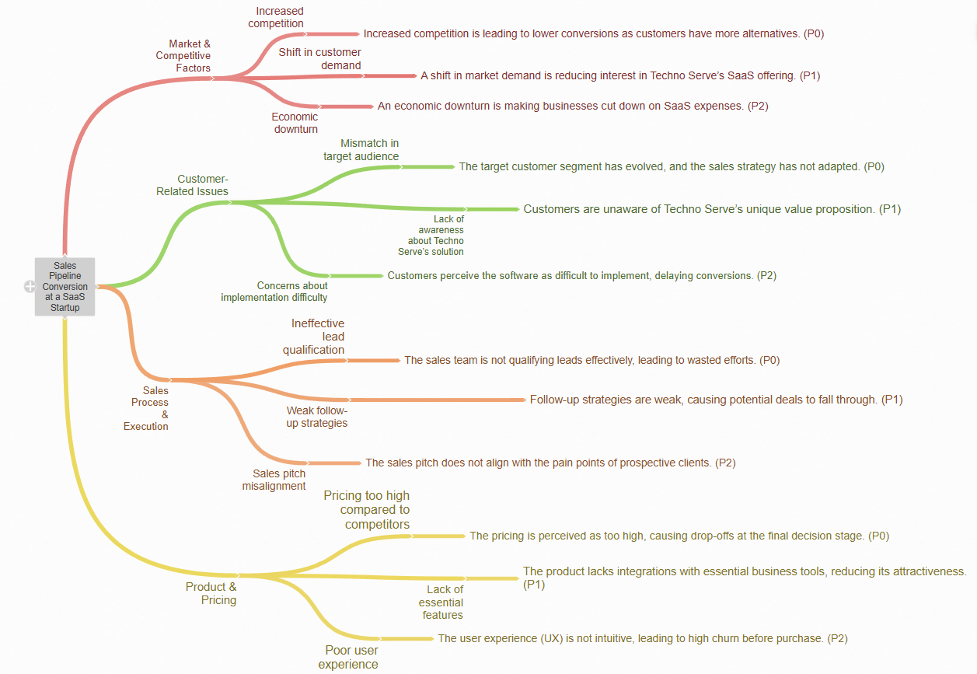
PART II : Formulating Hypotheses Sales Pipeline Conversion at a SaaS Startup
Notes:
Use the “download as” feature of Coggle if you are using the tool.
Provide one image with complete tree along with separate elements where the text is readable.
Copy the slide if you require more space

Slide 6
PART II : Formulating Hypotheses Sales Pipeline Conversion at a SaaS Startup
Problem : Drop in Sales Pipeline Conversion Rate
Branch 1 : Market & Competitive Factors
Sub-Branch 1.1 : Increased competition : (H1) Increased competition is leading to lower conversions as customers have more alternatives.
Sub-Branch 1.2 : Shift in customer demand : (H2) A shift in market demand is reducing interest in Techno Serve’s SaaS offering.
Sub-Branch 1.3 : Economic downturn : (H3) An economic downturn is making businesses cut down on SaaS expenses.
Problem: Drop in Sales Pipeline Conversion Rate
Branch 2: Customer-Related Issues
Sub-Branch 2.1 : Mismatch in target audience : (H4) The target customer segment has evolved, and the sales strategy has not adapted.
Sub-Branch 2.2 : Lack of awareness about Techno Serve’s solution : (H5) Customers are unaware of Techno Serve’s unique value proposition.
Sub-Branch 2.3 : Concerns about implementation difficulty : (H6) Customers perceive the software as difficult to implement, delaying conversions.
Notes:
Each branch must follow this naming pattern: Problem – Branch 1 – Sub-branch 1 – Sub-branch 2 – …… – Hypotheses
There must be minimum 10 hypotheses in total and at least 1 in each branch.

Slide 7
PART II : Formulating Hypotheses Sales Pipeline Conversion at a SaaS Startup
Problem: Drop in Sales Pipeline Conversion Rate
Branch 3 : Sales Process & Execution
Sub-Branch 3.1 : Ineffective lead qualification : (H7) The sales team is not qualifying leads effectively, leading to wasted efforts
.
Sub-Branch 3.2 : Weak follow-up strategies : (H8) Follow-up strategies are weak, causing potential deals to fall through.
Sub-Branch 3.3 : Sales pitch misalignment : (H9) The sales pitch does not align with the pain points of prospective clients.
Problem: Drop in Sales Pipeline Conversion Rate
Branch 4: Product & Pricing
Sub-Branch 4.1: Pricing too high compared to competitors : (H10) The pricing is perceived as too high, causing drop-offs at the final decision stage.
Sub-Branch 4.2: Lack of essential features : (H11) The product lacks integrations with essential business tools, reducing its attractiveness.
Sub-Branch 4.3: Poor user experience : (H12) The user experience (UX) is not intuitive, leading to high churn before purchase.
Notes:
Each branch must follow this naming pattern: Problem – Branch 1 – Sub-branch 1 – Sub-branch 2 – …… – Hypotheses
There must be minimum 10 hypotheses in total and at least 1 in each branch.

Slide 8
PART III A : Generating Insights Sales Pipeline Conversion at a SaaS Startup
Variable
Technology Primary
B2B Sales Medium
Client Revenue Sizing
Opportunity Sizing
Business from Client last year
Insights if any
An unusually large number of opportunities come from ERP Implementation category and they have a better than average opportunity conversion rate.
Most Opportunities are from Marketing and Enterprise Sellers with the Enterprise Sellers having a better than average opportunity conversion rate.
An unusually large number of opportunities come from clients who are less in revenue size(100K or less).
The opportunity conversion rate is significantly higher for clients with potential revenue in 0-30K range.
The conversion rate is higher for existing customers despite the number of opportunities unusually large from newer customers.
Pattern of Insight
Significant Outliers
Significant Outliers
Significant Outliers
SurprisingComparison
SurprisingComparison/Significant Outliers
Notes:
Analyse the variables in the dataset, find the insights and mention the pattern of insights in the data. Make more copies of this slide if needed.

Slide 9
PART III A : Generating Insights Sales Pipeline Conversion at a SaaS Startup
Variable under consideration:
Technology Primary :-
Analysis :-
Segmented leads based on primary technology offering.
valuated distribution of Opportunity Status (Won, Lost, Dropped, In Progress) per tech type.
Results :-
AI/ML and Cloud technologies had a significantly higher share of ‘Won’ status compared to IoT and On-Premise.
On-Premise projects had the highest percentage of ‘Dropped’ opportunities.
Visualization :-
Clustered column chart with Technology on X-axis, % Opportunity Status (stacked) on Y-axis, colored by status category (Won, Lost, Dropped, In Progress).
Notes:
For each variable that produced an interesting insight, explain you analysis bit here – the results you got from excel and the necessary visualisations. Note: it is compulsory for you to mention the results of the analysis on these variables - 'Technology Primary', 'B2B Sales Medium', 'Client Revenue Sizing', 'Opportunity Sizing' and 'Business from Client last year’.

Slide 10
PART III A : Generating Insights Sales Pipeline Conversion at a SaaS Startup
Variable under consideration:
B2B Sales Medium :-
Analysis :-
Grouped opportunities by sales medium.
Evaluated share of each Opportunity Status type.
Results :-
Referral and Webinar leads had the highest share of ‘Won’.
Cold Calling had the highest Lost or Dropped rates.
Visualization :-
Clustered column chart showing B2B Sales Medium VS Opportunity Status distribution.
Notes:
For each variable that produced an interesting insight, explain you analysis bit here – the results you got from excel and the necessary visualisations. Note: it is compulsory for you to mention the results of the analysis on these variables - 'Technology Primary', 'B2B Sales Medium', 'Client Revenue Sizing', 'Opportunity Sizing' and 'Business from Client last year’.

Slide 11
PART III A : Generating Insights Sales Pipeline Conversion at a SaaS Startup
Variable under consideration:
3. Client Revenue Sizing :-
Analysis :-
Categorized clients by revenue brackets.
Compared Opportunity Status distribution within each size bracket.
Results :-
Large clients had more ‘Won’ opportunities.
Small clients had a larger share of ‘Dropped’ or ‘Lost’ statuses.
Mid-sized clients had the highest percentage of ‘In Progress’, indicating longer decision cycles or engagement issues.
Visualization :-
Stacked bar chart showing Revenue Sizing VS Opportunity Status distribution.
Notes:
For each variable that produced an interesting insight, explain you analysis bit here – the results you got from excel and the necessary visualisations. Note: it is compulsory for you to mention the results of the analysis on these variables - 'Technology Primary', 'B2B Sales Medium', 'Client Revenue Sizing', 'Opportunity Sizing' and 'Business from Client last year’.

Slide 12
PART III A : Generating Insights Sales Pipeline Conversion at a SaaS Startup
Identify trends in deal closures based on opportunity size.
Variable under consideration:
4. Opportunity Sizing :-
Analysis :-
Grouped data by deal size
Assessed status trends across value buckets.
Results :-
Large opportunities had a higher proportion of 'In Progress', showing slower closures.
Medium-sized opportunities had the most balanced status split, with more deals won.
Small opportunities had higher dropout rates.
Visualization :-
Stacked bar chart showing Opportunity Sizing VS Opportunity Status distribution.
Notes:
For each variable that produced an interesting insight, explain you analysis bit here – the results you got from excel and the necessary visualisations. Note: it is compulsory for you to mention the results of the analysis on these variables - 'Technology Primary', 'B2B Sales Medium', 'Client Revenue Sizing', 'Opportunity Sizing' and 'Business from Client last year’.

Slide 13
PART III A : Generating Insights Sales Pipeline Conversion at a SaaS Startup
Indicates strong brand loyalty and trust among existing clients.
Variable under consideration:
5. Business from Client Last Year :-
Analysis :-
Split clients into returning vs new
Compared Opportunity Status categories.
Results :-
Returning clients had the highest ‘Won’ opportunity ratio.
New clients accounted for most of the ‘Lost’ and ‘Dropped’ statuses.
Visualization :-
Stacked bar chart comparing new vs. returning client conversions.
Notes:
For each variable that produced an interesting insight, explain you analysis bit here – the results you got from excel and the necessary visualisations. Note: it is compulsory for you to mention the results of the analysis on these variables - 'Technology Primary', 'B2B Sales Medium', 'Client Revenue Sizing', 'Opportunity Sizing' and 'Business from Client last year’. Make more copies of this slide if needed.

Slide 14
PART III A : Generating Insights Sales Pipeline Conversion at a SaaS Startup
Recommendations
Focus on the following categories for newer leads for ensuring high conversion rate.
Prioritize Enterprise Sellers as the main B2B sales medium.
Target Low Revenue Clients (annual revenue ≤ $100K).
Focus on Smaller Deal Sizes (Opportunity size ≤ $30K).
Engage Existing Clients with retention-based strategies.
Corresponding Insights
Among all the solution types, ERP implementation shows a higher proportion of ‘Won’ status, indicating better performance in closing deals.
Compared to other mediums (e.g., Marketing, Cold Calling), they exhibit a greater share of 'Won' opportunities and fewer 'Lost' statuses, suggesting more effective conversions.
Despite their smaller size, these clients show a healthy ratio of ‘Won’ to ‘Dropped/Lost’ statuses, making them a reliable and responsive segment.
Opportunities in the 0–30K range show the highest win rate (i.e., largest share of ‘Won’ opportunities).
Existing clients have a much higher share of ‘Won’ statuses than new clients.
Notes:
For each recommendation explain the insights that form the reasoning for giving that recommendation. Make more copies of this slide if necessary.

Slide 15
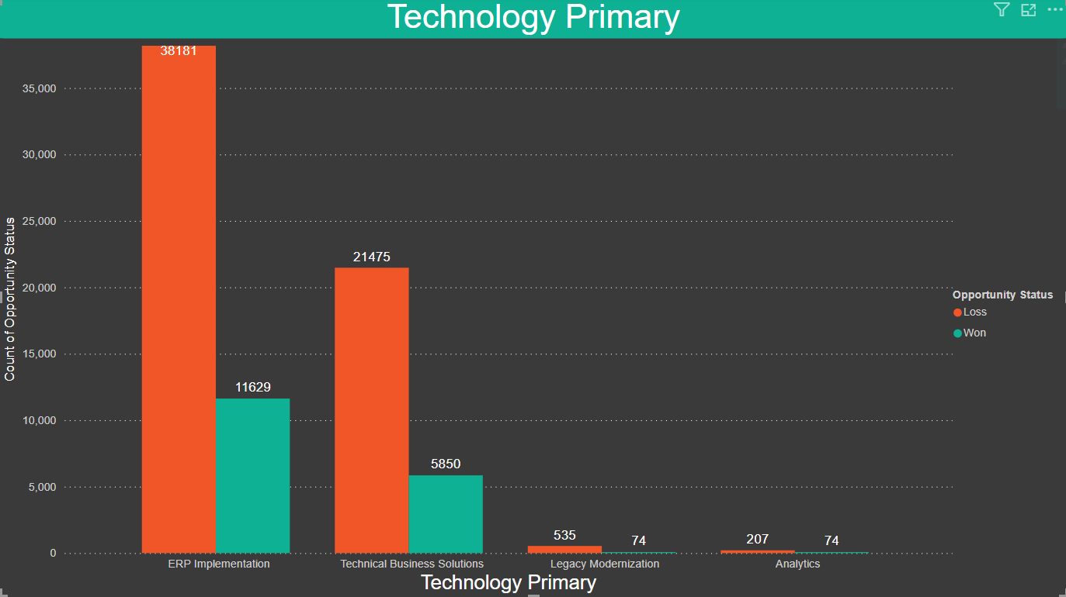
PART III B : Presenting Findings Sales Pipeline Conversion at a SaaS Startup

Slide 16
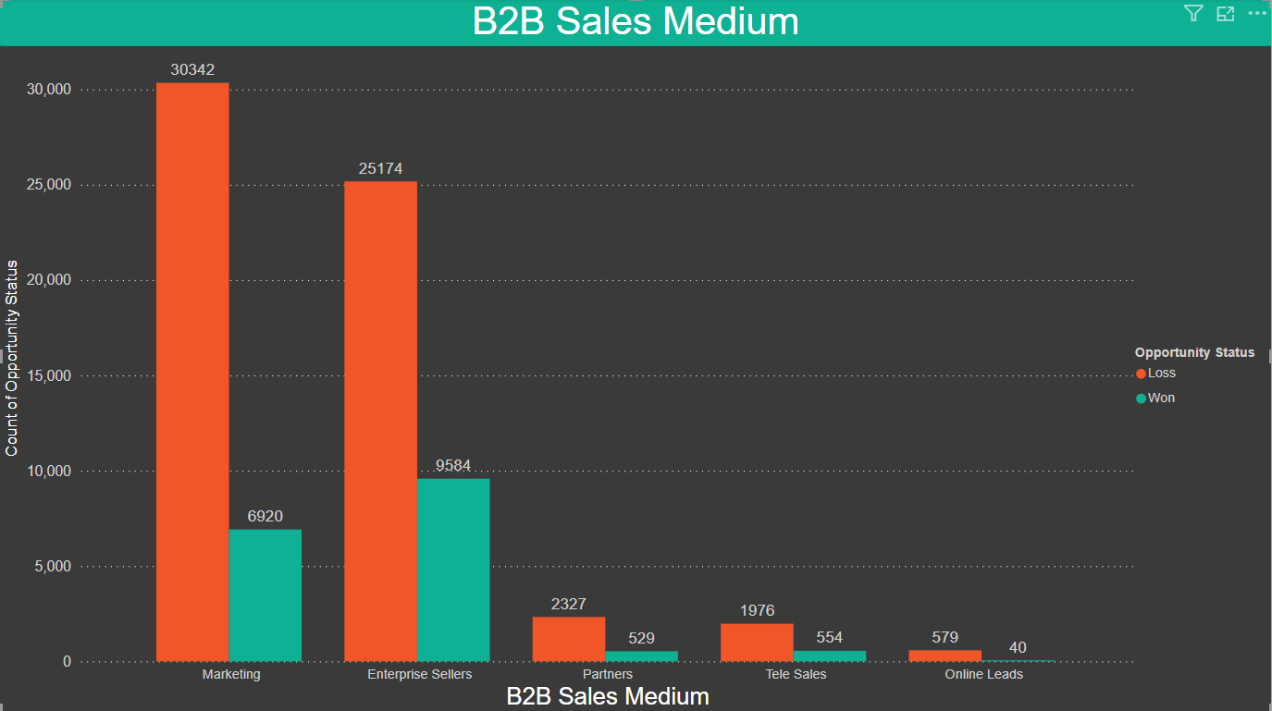
PART III B : Presenting Findings Sales Pipeline Conversion at a SaaS Startup

Slide 17
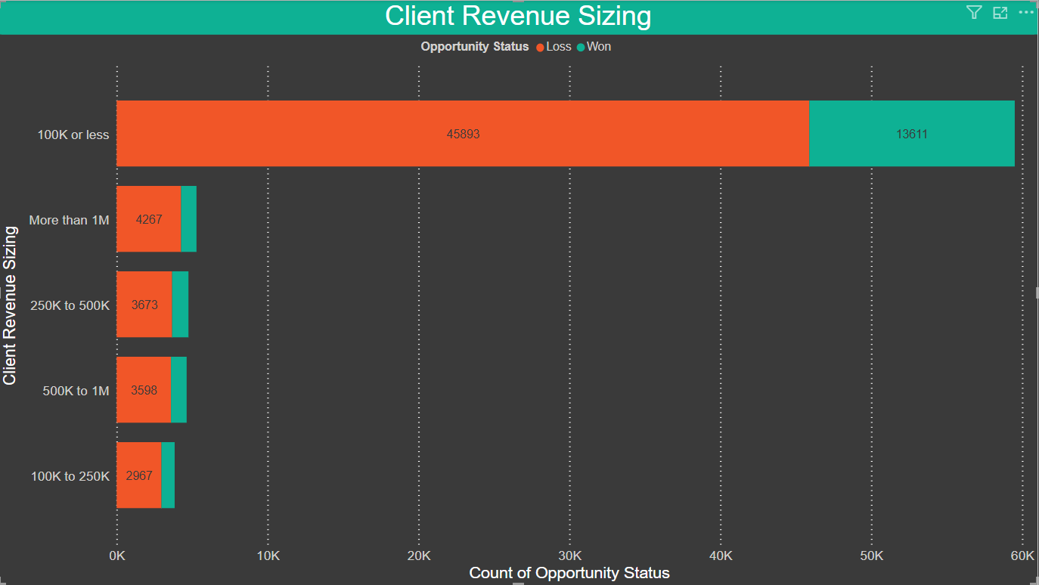
PART III B : Presenting Findings Sales Pipeline Conversion at a SaaS Startup

Slide 18
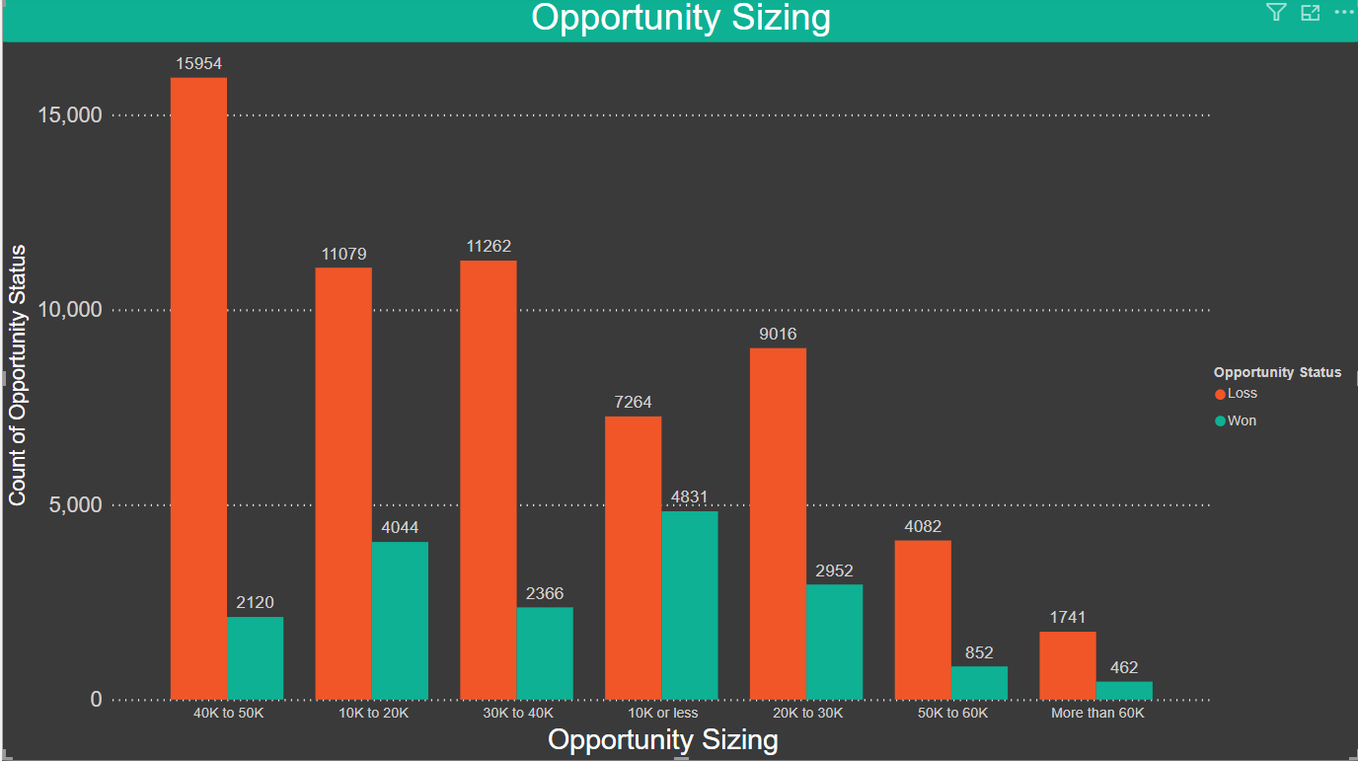
PART III B : Presenting Findings Sales Pipeline Conversion at a SaaS Startup

Slide 19
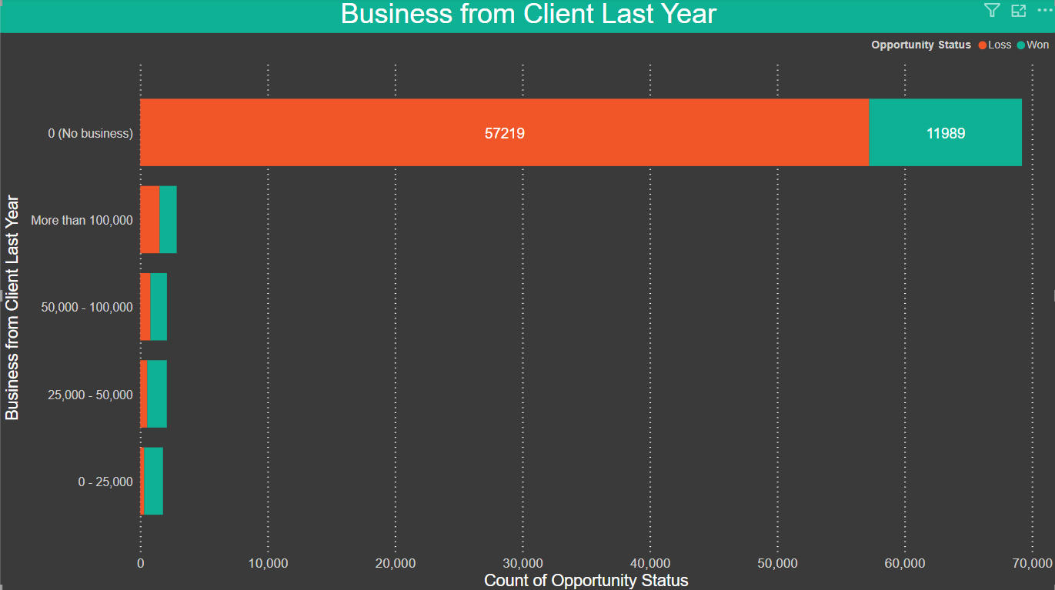
PART III B : Presenting Findings Sales Pipeline Conversion at a SaaS Startup

Slide 20
PART III B : Presenting Findings Sales Pipeline Conversion at a SaaS Startup
Strategies to Boost Sales Pipeline Conversion
Elevating Product Quality
Expanding Market Research
Client-Centric Pricing
Improve product readiness and internal capability
Better lead targeting through refined insights
Align pricing strategy with client expectations and market norms
Up-skill employees to ensure better conversions.
Conduct quality checks before client engagement.
Run market campaigns for higher-quality leads.
Train teams to understand and target specific segments.
Run market campaigns for higher-quality leads.
Train teams to understand and target specific segments.

