Slide 1
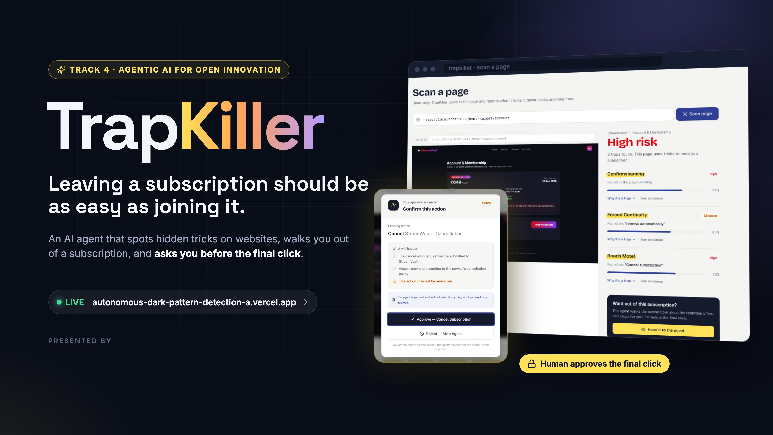
[Team name] · [Member names]
Notes:
Hi, we are [team name]. Our project is TrapKiller. One line: leaving a subscription should be as easy as joining it. TrapKiller is an AI agent that spots the hidden tricks websites use to keep you paying, walks you out of the subscription, and always stops to ask you before the final, irreversible click — exactly the approval screen you see here.

Slide 2
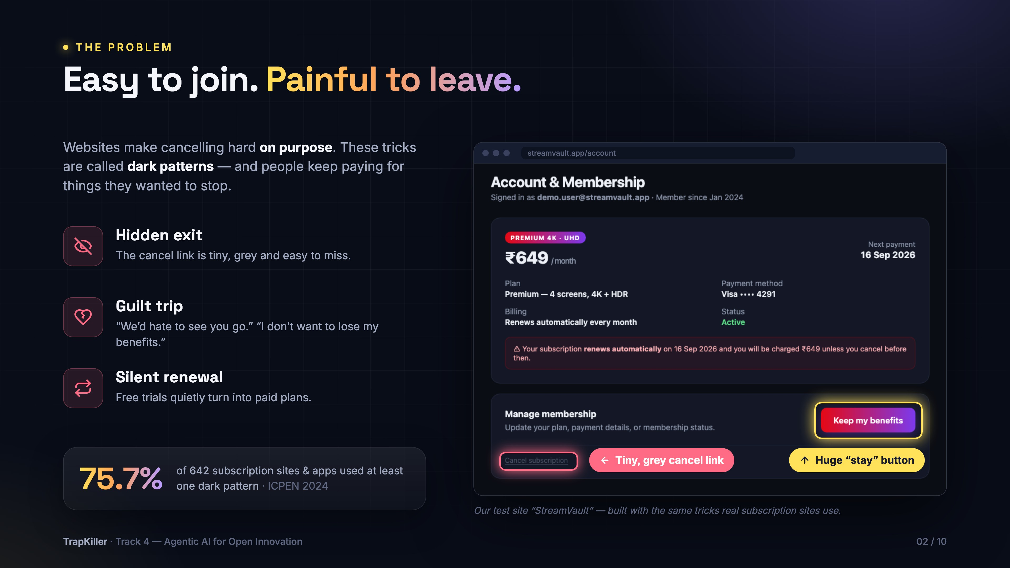
Notes:
The problem is simple: joining a subscription takes one click, leaving takes a maze. Companies design this on purpose — these tricks are called dark patterns. On the right is our test site StreamVault: the 'Keep my benefits' button is huge and bright, the real cancel link is tiny and grey. Add guilt-trip messages and silent renewals, and people keep paying for things they wanted to stop. And it's everywhere: an international check of 642 subscription sites and apps found 75.7% used at least one dark pattern.

Slide 3
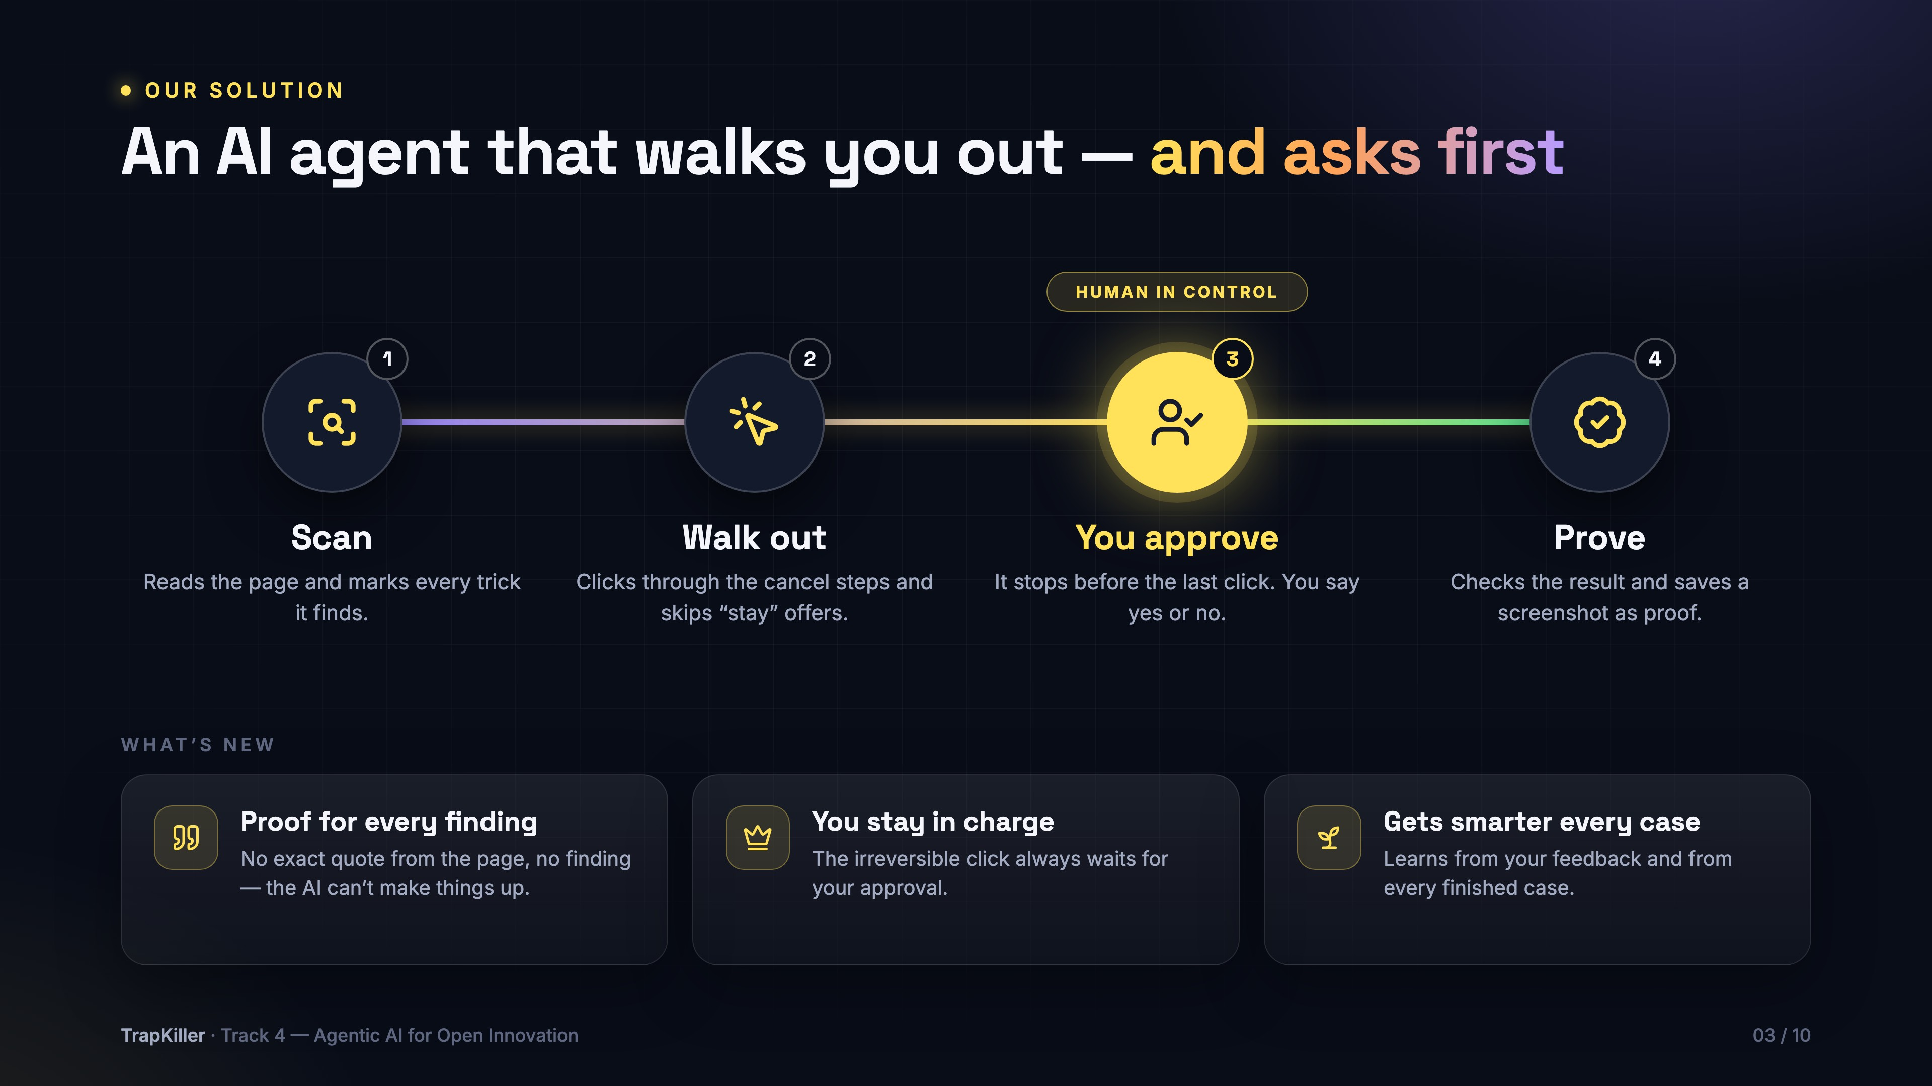
Notes:
Our solution, TrapKiller, works in four simple steps. One: it scans the page and marks every trick. Two: it walks through the cancel steps by itself and ignores the 'stay' offers. Three: before the final, irreversible click it stops and asks you. Four: it checks the result on the page and saves a screenshot as proof. What's new: every finding must quote the exact words from the page, so the AI can't invent things; you always have the last word; and it learns from every case.

Slide 4
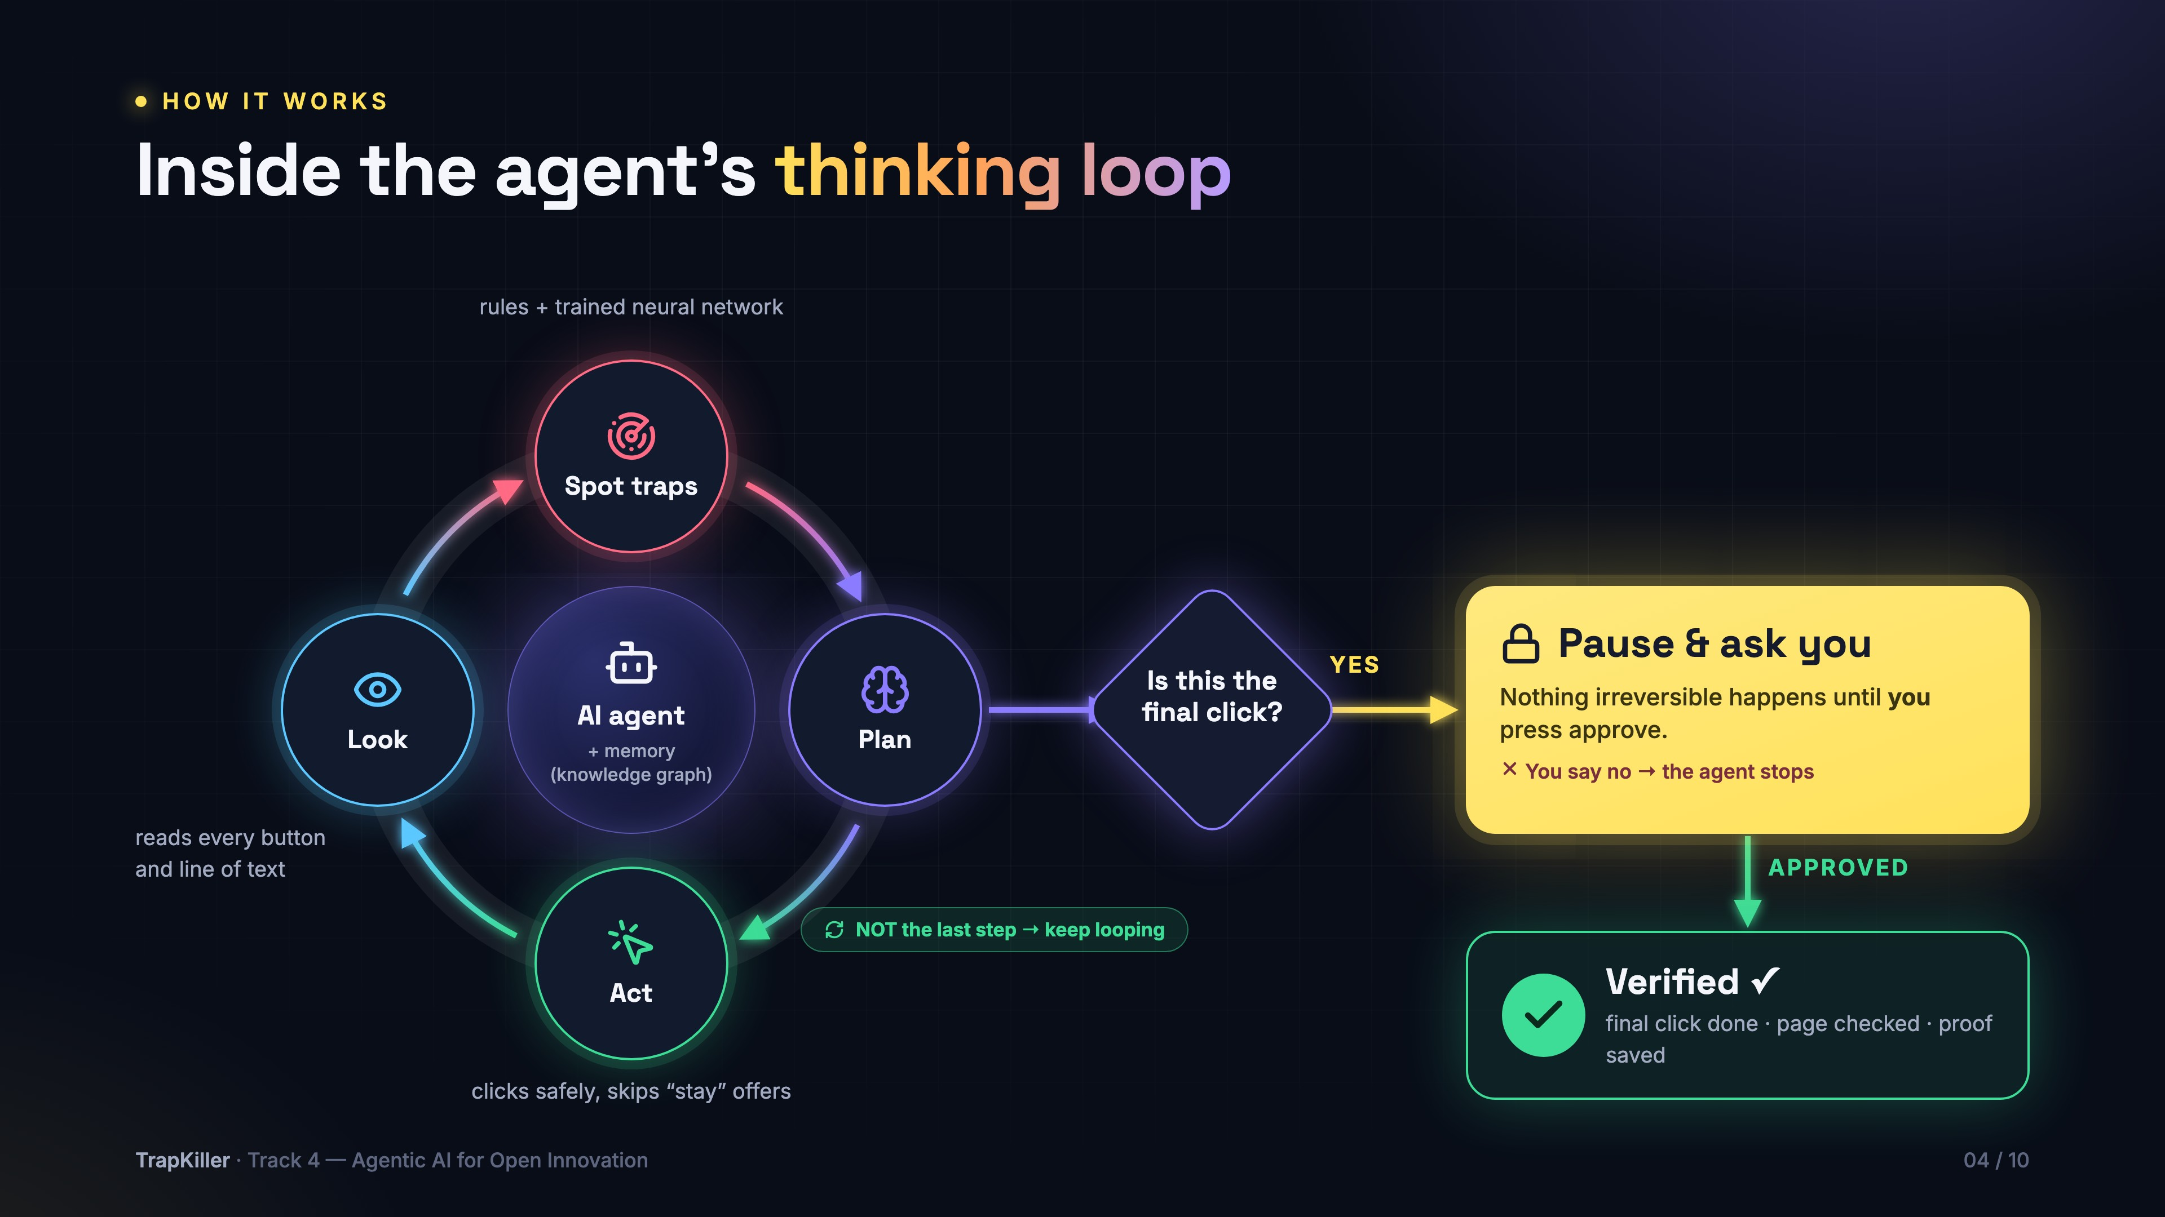
Notes:
This is how the agent thinks. It runs a loop around its brain and memory: Look at the page, Spot the traps with rules and our trained neural network, then Plan. If the next click is not the last step, it Acts — clicks safely — and loops again on the next page. When the plan says 'this is the final, irreversible click', it does not click. It pauses and asks you. If you say no, it stops. Only after you approve does it make the final click, then it verifies the result on the page and saves proof.

Slide 5
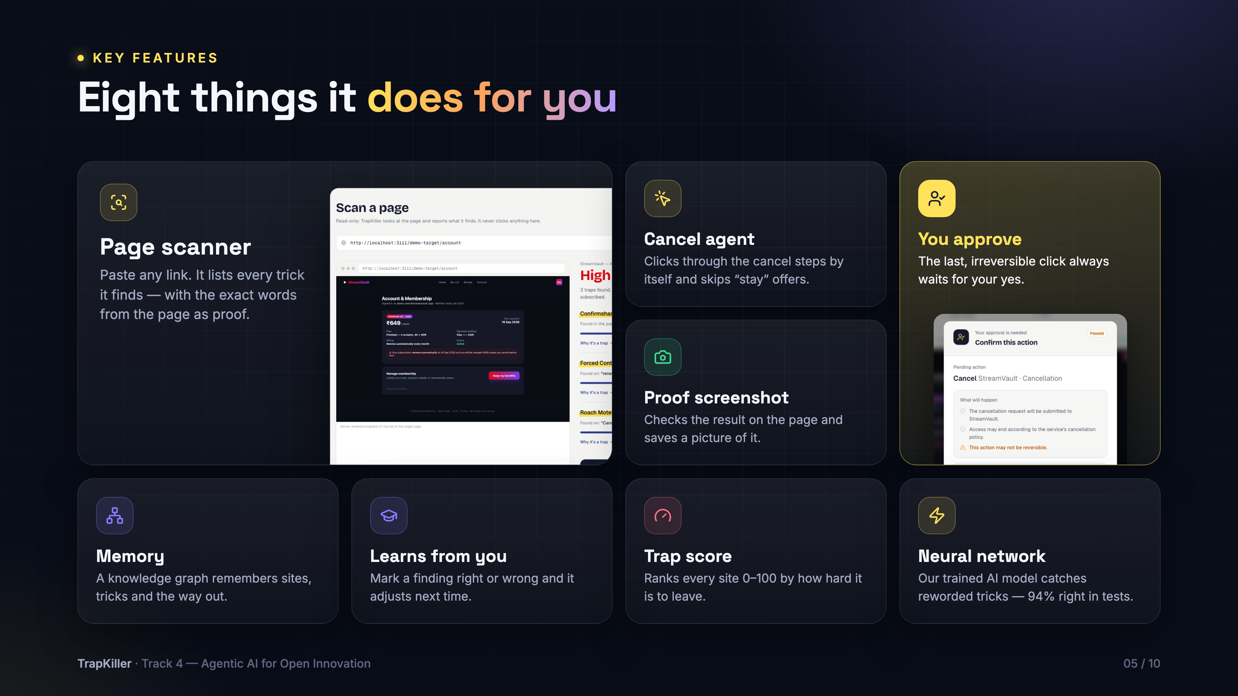
Notes:
Eight things TrapKiller does: a page scanner that lists every trick with the exact words as proof; a cancel agent that clicks through the steps by itself; the approval gate, so the last click always waits for you; a proof screenshot; a memory, our knowledge graph; it learns from your feedback; a trap score from 0 to 100 for every site; and a neural network we trained ourselves on a public dataset of about 2,300 labelled texts — 94 percent right on texts it had never seen.

Slide 6
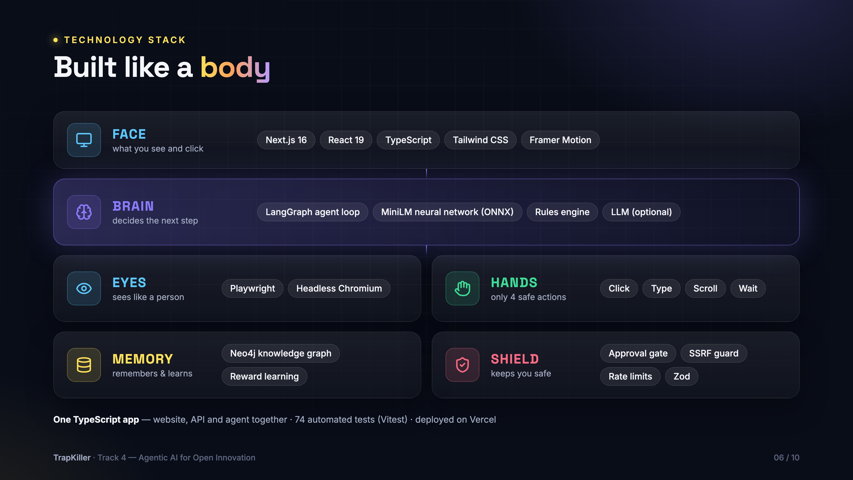
Notes:
Our tech stack, explained like a body. The face is what you see: Next.js 16 and React 19. The brain decides the next step: a LangGraph agent loop, our MiniLM neural network, a rules engine and an optional LLM. The eyes see the page like a person: Playwright driving a real Chrome browser. The hands can only do four safe things: click, type, scroll, wait. The memory remembers and learns: a Neo4j knowledge graph with reward learning. And the shield keeps you safe: the approval gate, protection against unsafe links, rate limits and input checks. It's all one TypeScript app with 74 automated tests.

Slide 7
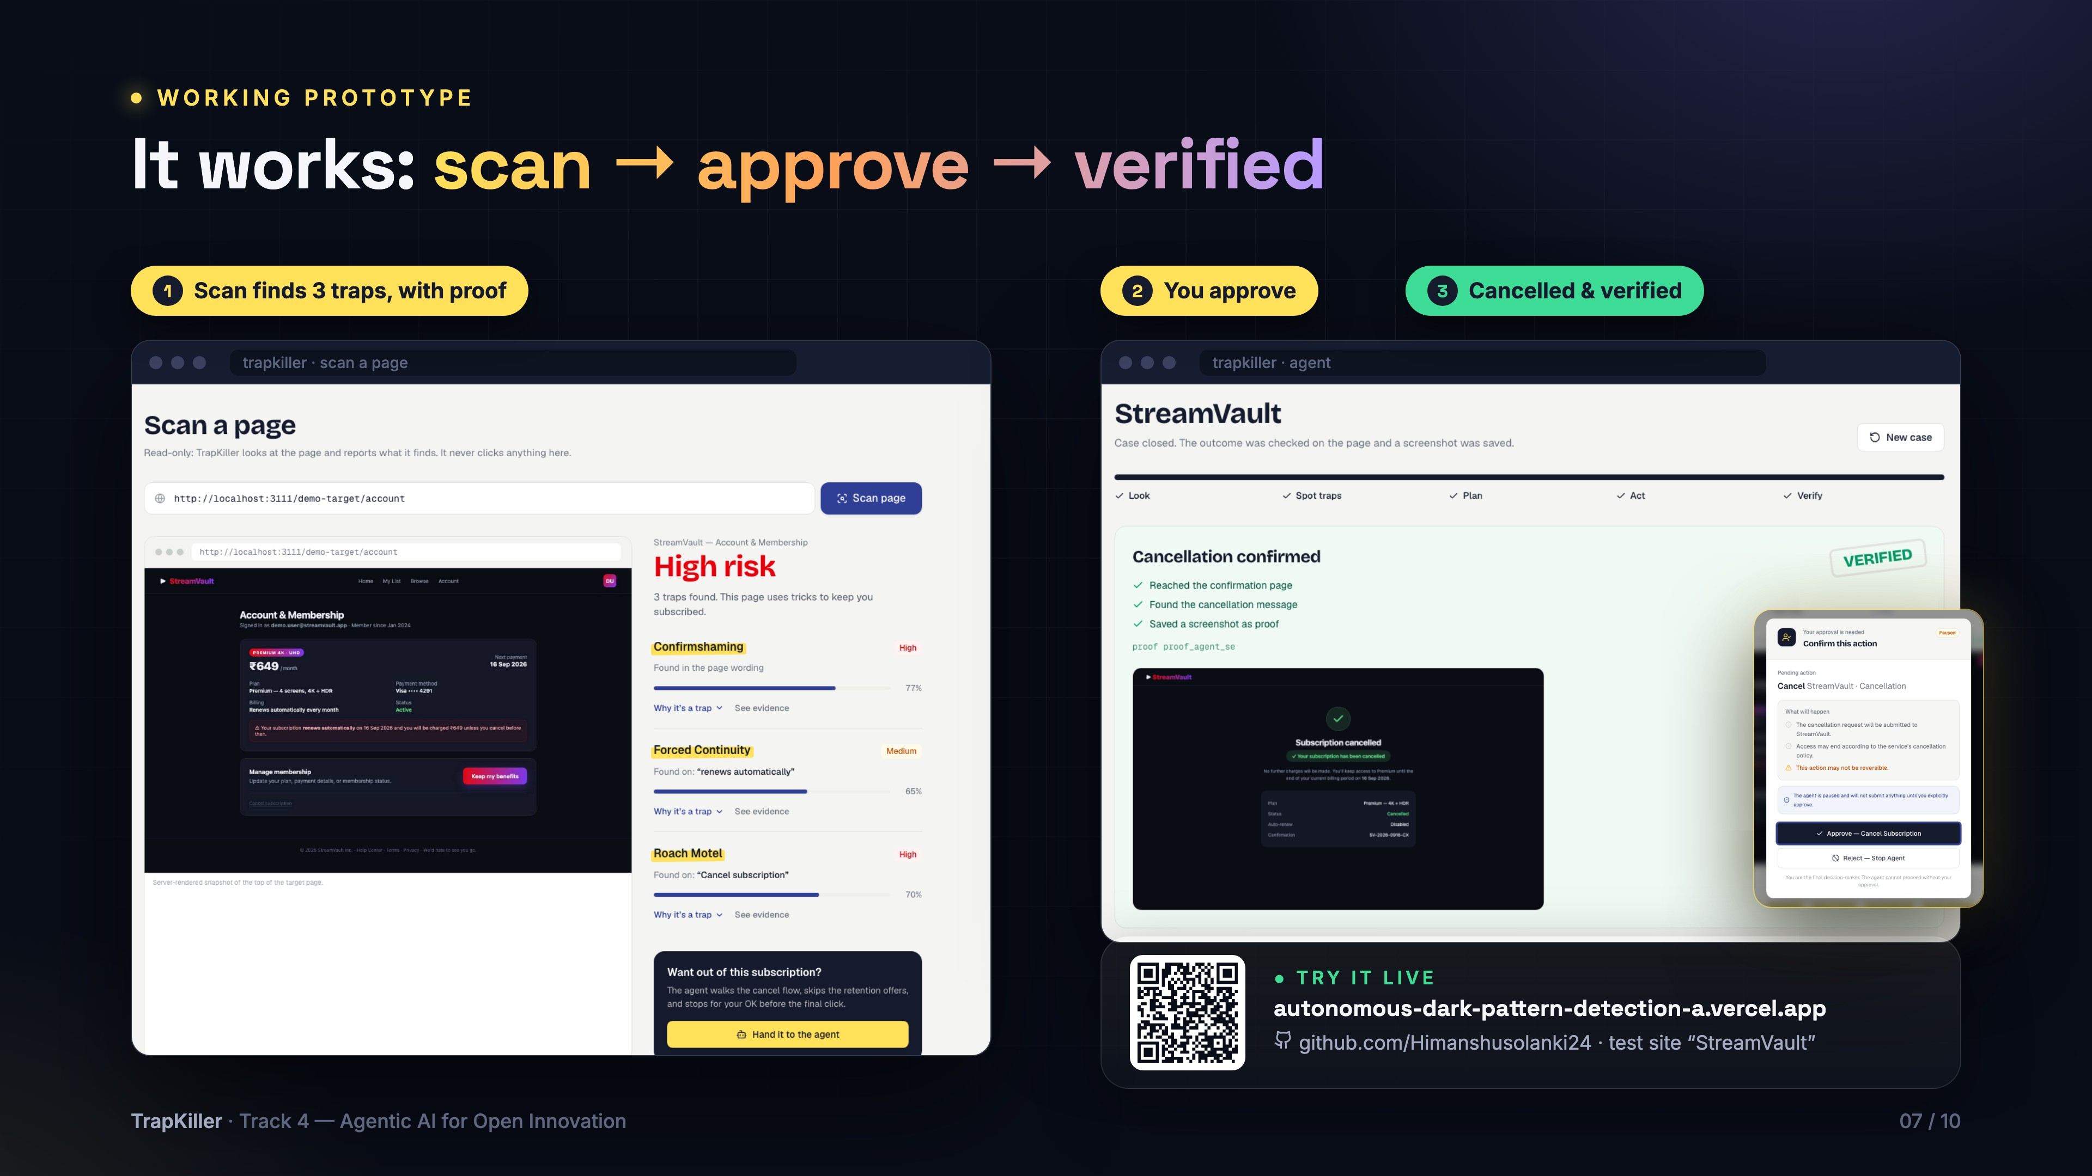
Notes:
This is the working prototype. Step 1: a real scan of our test site StreamVault — TrapKiller found three traps, each with the exact words as proof. Step 2: the agent walked through the cancellation and paused for our approval. Step 3: after we approved, it confirmed the cancellation on the page and saved a screenshot. You can scan the QR code to open the live site, and the full code is on GitHub.

Slide 8
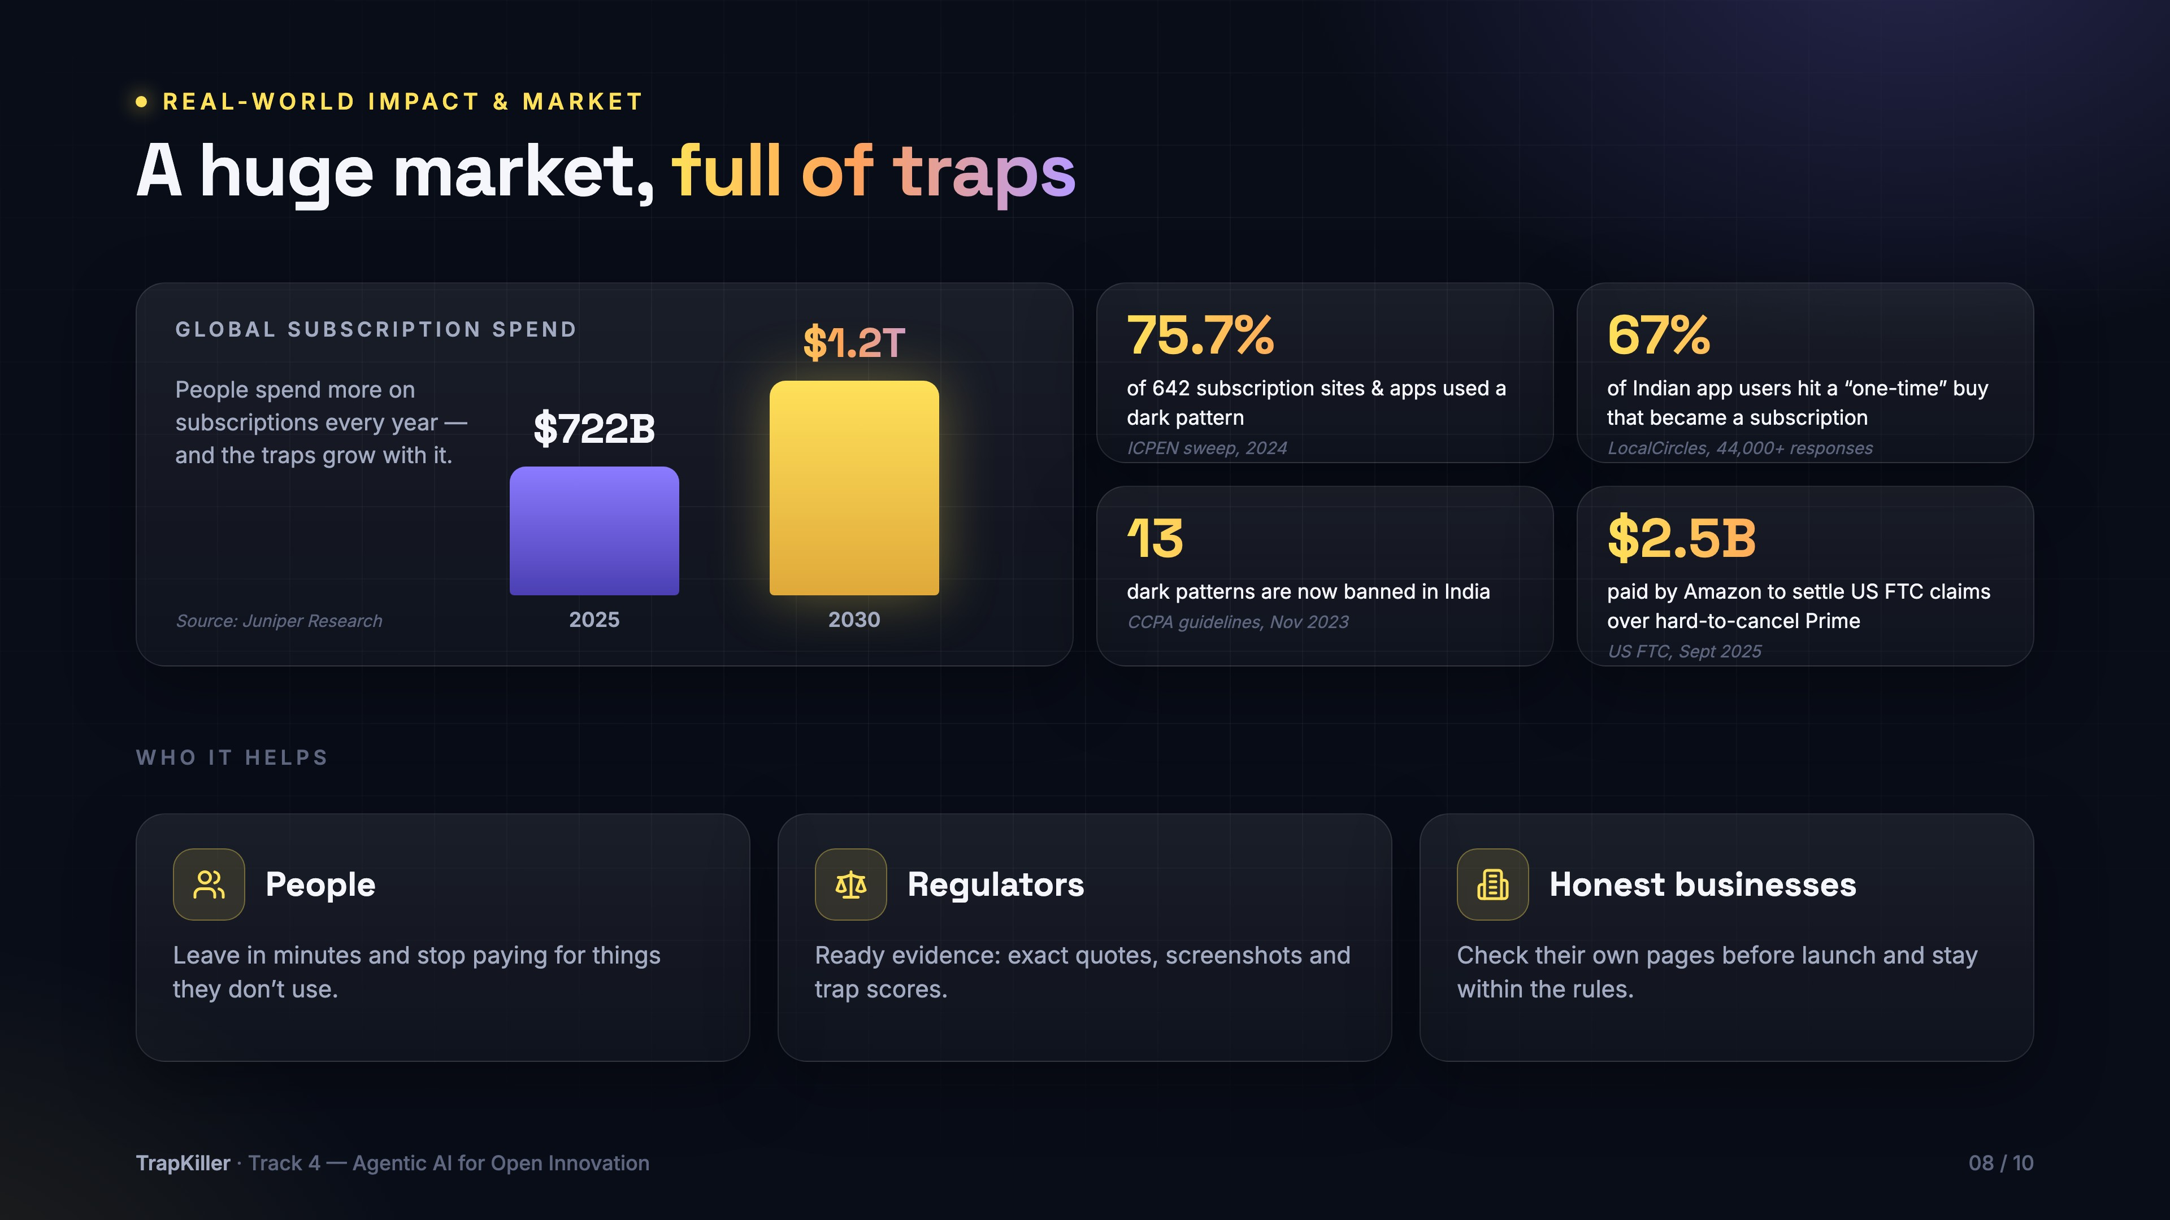
Notes:
Why this matters. Subscriptions are a huge market — Juniper Research puts global spend at about 722 billion dollars in 2025, heading to 1.2 trillion by 2030. And it's full of traps: 75.7 percent of 642 subscription sites and apps used a dark pattern in the 2024 ICPEN sweep. In India, a LocalCircles survey with over 44,000 responses found 67 percent of app users had a 'one-time' buy turn into a subscription. India's CCPA now bans 13 dark patterns, and Amazon paid 2.5 billion dollars to settle US FTC claims over Prime. TrapKiller helps people leave in minutes, gives regulators ready evidence, and lets honest businesses check their own pages.
Sources: ICPEN (icpen.org/news/1360); US FTC press release, July 2024; LocalCircles via Outlook Business; Juniper Research via Senal News; AP/ABC on the Amazon settlement, Sept 2025.

Slide 9
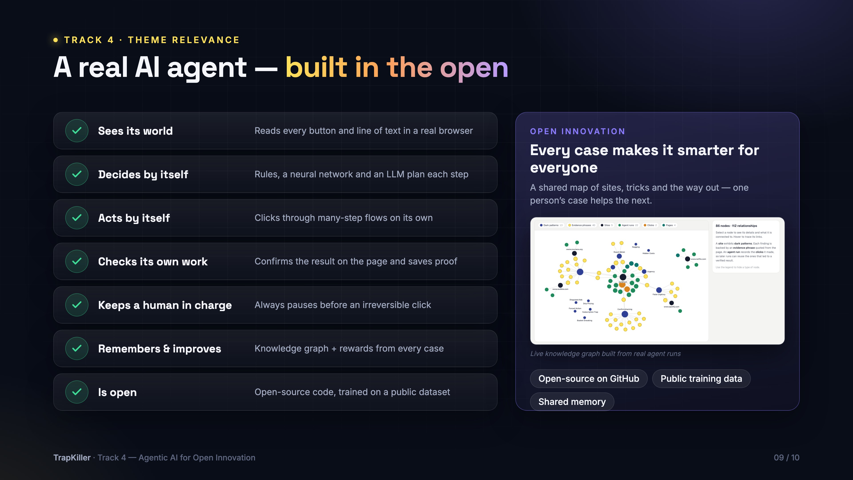
Notes:
Why this fits Track 4, Agentic AI for Open Innovation. TrapKiller is a real agent, not a chatbot: it sees its world in a real browser, decides by itself, acts by itself across many steps, checks its own work, and keeps a human in charge of the irreversible step. It remembers and improves through a knowledge graph and rewards. And it's open: open-source code, trained on a public dataset, and a shared memory — every case makes it smarter for everyone.

Slide 10
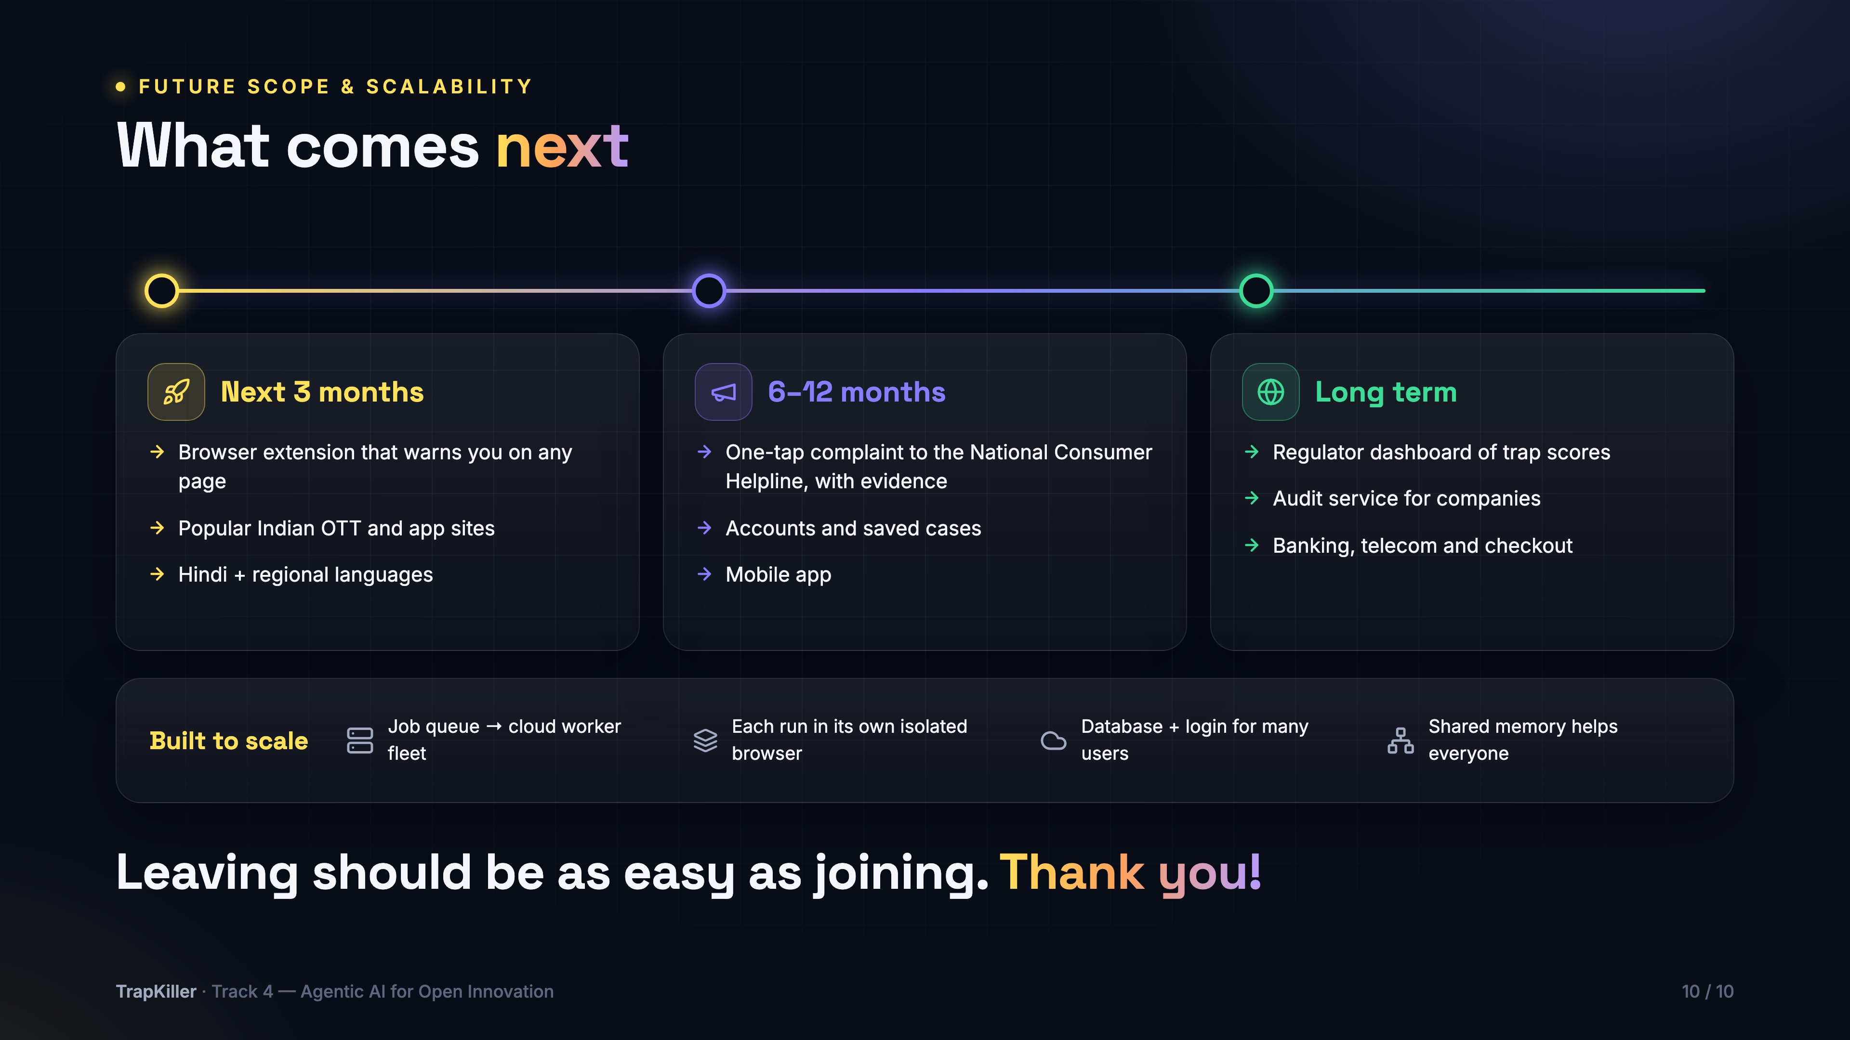
Notes:
What comes next. In the next three months: a browser extension that warns you on any page, support for popular Indian OTT and app sites, and Hindi and regional languages. In six to twelve months: a one-tap complaint to the National Consumer Helpline with the evidence attached, accounts, and a mobile app. Long term: a regulator dashboard of trap scores, an audit service for companies, and banking and telecom. It's built to scale: a fleet of cloud workers, an isolated browser for every run, and a shared memory that helps everyone. Leaving should be as easy as joining. Thank you!

