Slide 1
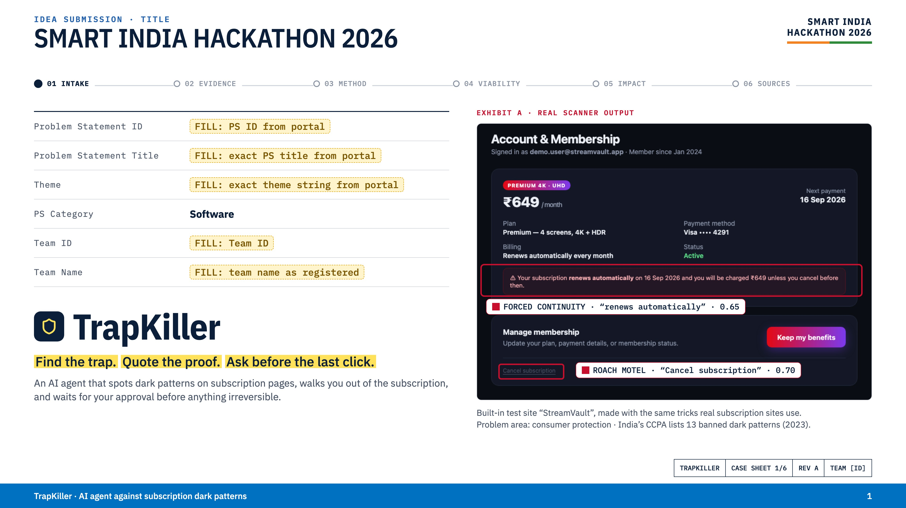
Notes:
Title slide. Fill every field from the portal before submitting — Team ID, PS ID, PS title and the exact theme string. Exhibit A is real output from our scanner on the built-in StreamVault test site: the roach motel (tiny grey cancel link) and forced continuity (auto-renew warning) are flagged with the exact words that prove them.

Slide 2
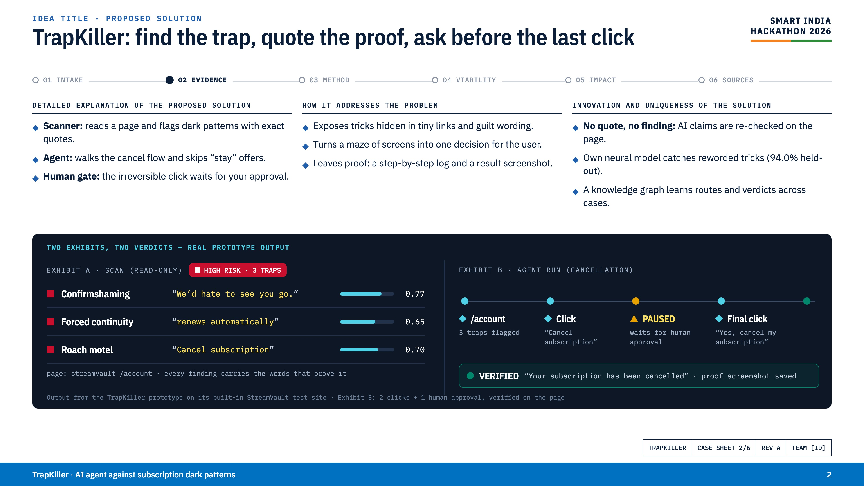
Notes:
Proposed solution. Three columns answer the template's three questions. The dark panel is the proof: Exhibit A is a real read-only scan — three traps, each with the quote from the page and a confidence. Exhibit B is a real agent run: it opened the cancel link, reached the final step, paused for human approval, made the final click only after approval, and verified 'Your subscription has been cancelled' with a screenshot.

Slide 3
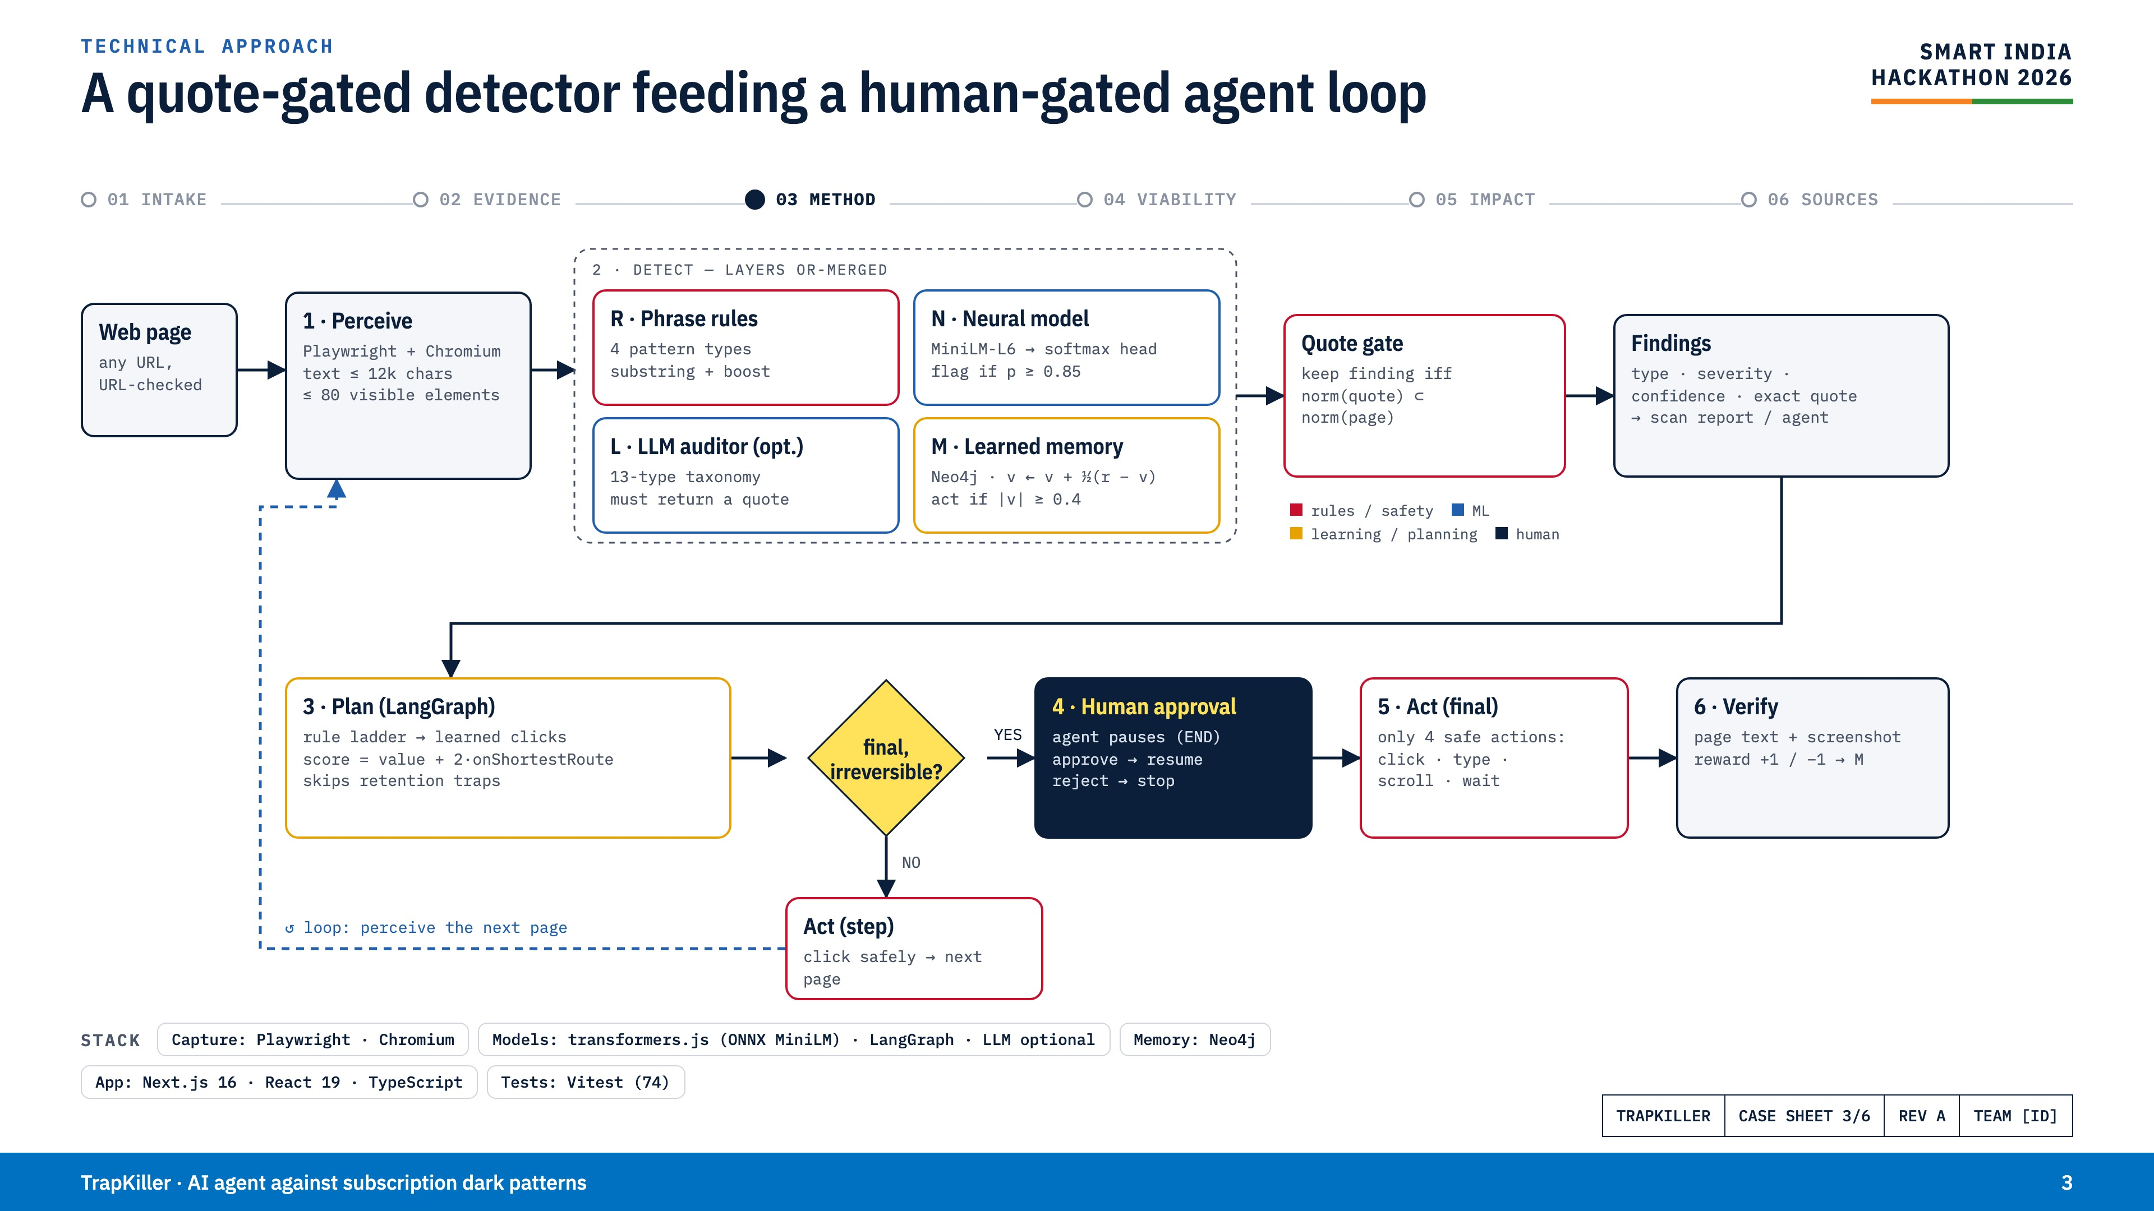
Notes:
Technical approach. A page is captured by Playwright. Four detection layers run and are OR-merged: phrase rules, our own neural model (MiniLM sentence encoder plus a trained softmax head, flag at p ≥ 0.85), an optional LLM auditor that must return a quote, and learned memory in a Neo4j graph. A quote gate keeps a finding only if its words are really on the page. The planner (LangGraph) chooses the next click; if it is the final irreversible step, the agent stops and a human approves or rejects. Only four safe actions exist. Verification checks the page and feeds a reward back into memory.

Slide 4
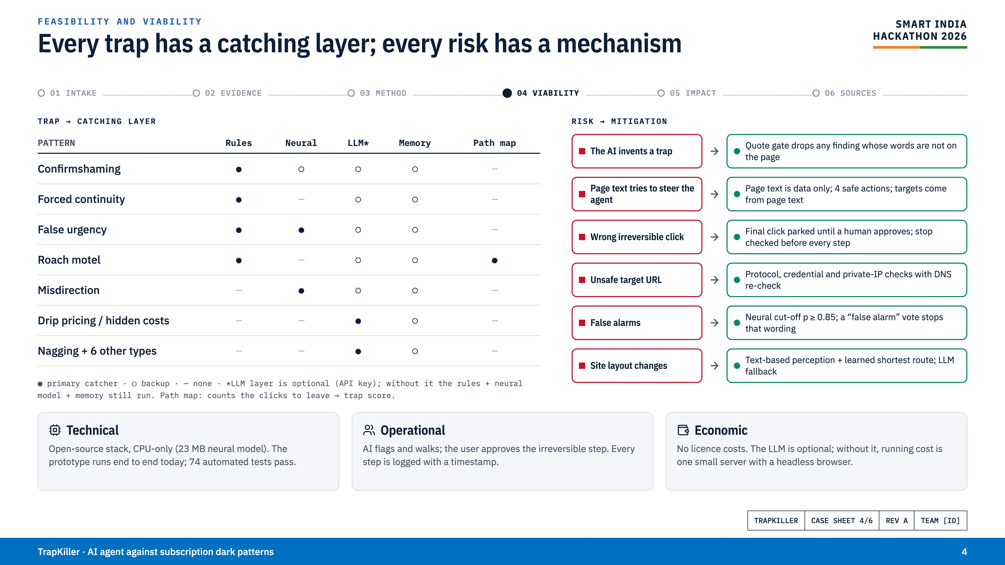
Notes:
Feasibility and viability. Left: which layer catches which trap — rules, the neural model, the optional LLM, learned memory, and the path map that counts clicks to leave. Right: each real risk is paired with the mechanism in the code that handles it. Bottom: it runs today on a CPU with open-source parts and 74 passing tests; the human always owns the irreversible step; there are no licence costs.

Slide 5
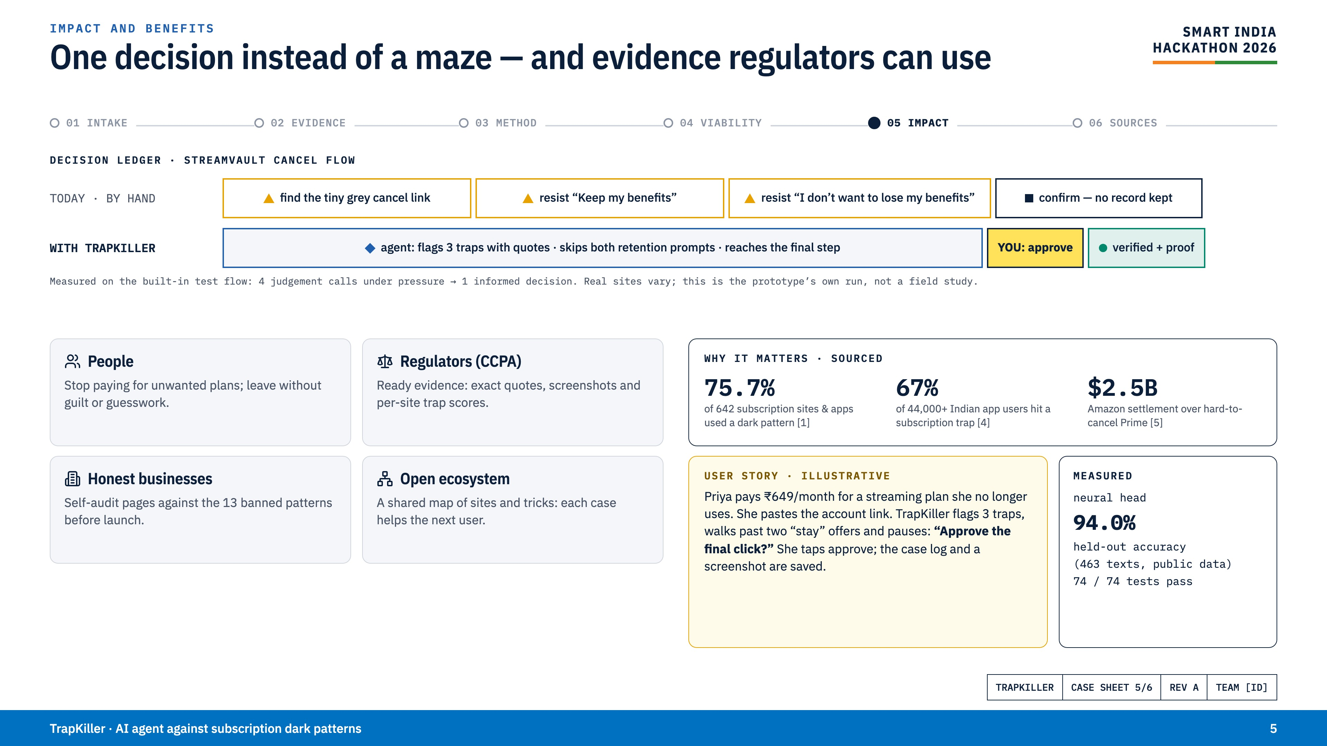
Notes:
Impact and benefits. On our test flow a person faces four judgement calls under pressure; with TrapKiller they make one informed decision and get proof. This is our prototype's own run, not a field study. Benefits for people, regulators under India's CCPA rules, honest businesses, and an open shared map. Sourced figures: 75.7% of 642 subscription sites used dark patterns (ICPEN 2024); 67% of 44,000+ Indian app users hit a subscription trap (LocalCircles); Amazon's $2.5B FTC settlement (2025).

Slide 6
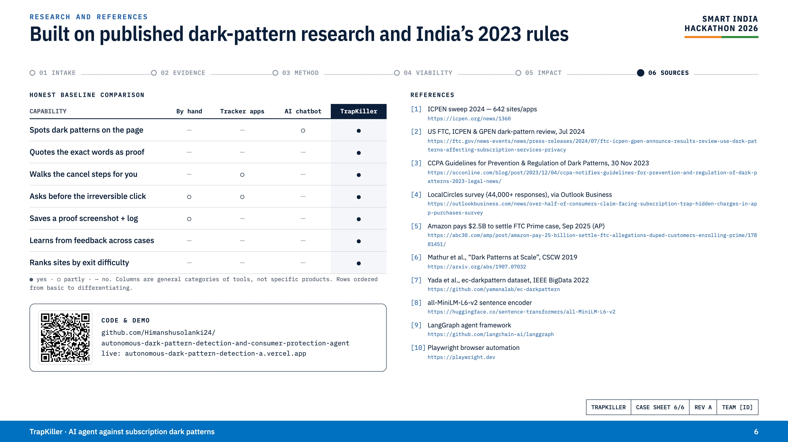
Notes:
Research and references. An honest comparison against general categories of tools — no row where we are weaker, and only capabilities the prototype demonstrates. References are printed with full URLs. The QR code opens the GitHub repository.

