Slide 1
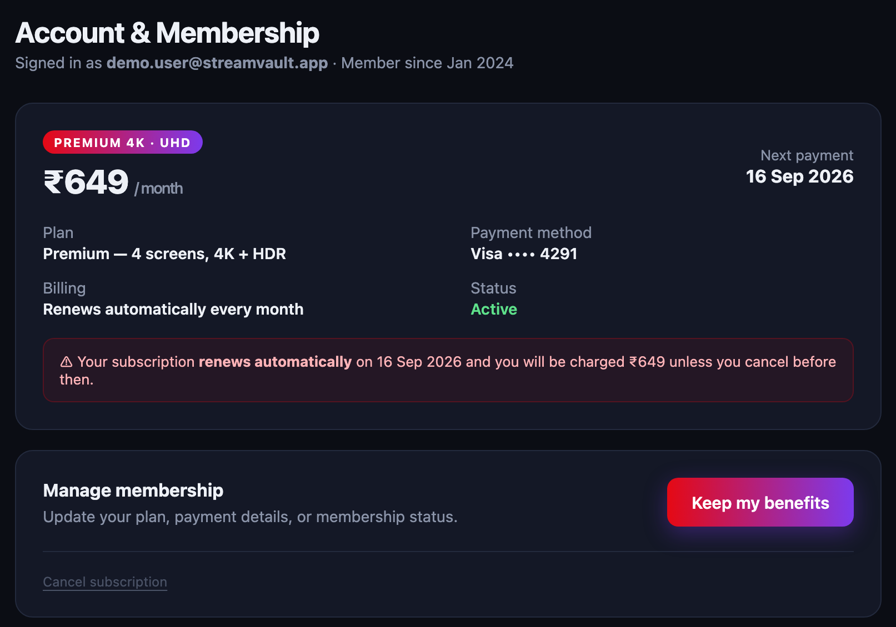
TRACK 1 · AI/ML — OPEN INNOVATION · STUDENT TRACK
TrapKiller
An AI agent that spots dark patterns on subscription pages, walks the cancel maze for you, and asks before the last click.
Detects 13 dark-pattern types, each backed by a quote from the page
Acts Steps around retention traps to reach the real cancel screen
Scales with TinyFish Hosted web agents run sweeps across thousands of sites
Roach motel: the exit is a faint link
Misdirection: the loud button keeps you paying
Team Panda · Track 1: AI/ML — Open Innovation
Our StreamVault test site, built with the same tricks real subscription pages use

Slide 2
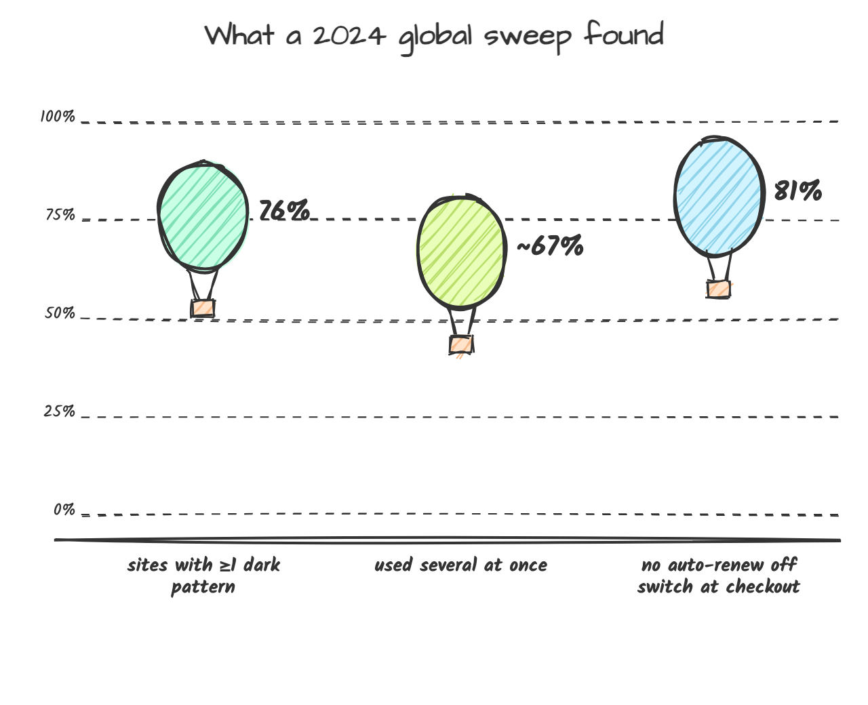
TrapKiller
AI/ML Track · Open Innovation · Built with TinyFish
01 · PROBLEM STATEMENT
Most subscription sites are built to keep you paying
Why it's still unsolved
1
India has rules, not reach.
13 dark patterns are banned since Nov 2023, but checking a site is still manual, one page at a time.
2
Every maze is fought alone.
Cancel links are hidden, the decline button guilt-trips, and auto-renew is on by default.
3
Tools either see or act, never both.
Blockers ignore cancel flows. Generic AI browser agents click straight through traps without flagging them.
Sources: FTC / ICPEN / GPEN review of 642 subscription sites and apps, July 2024 · CCPA Guidelines for Prevention and Regulation of Dark Patterns, 30 Nov 2023
2/11

Slide 3
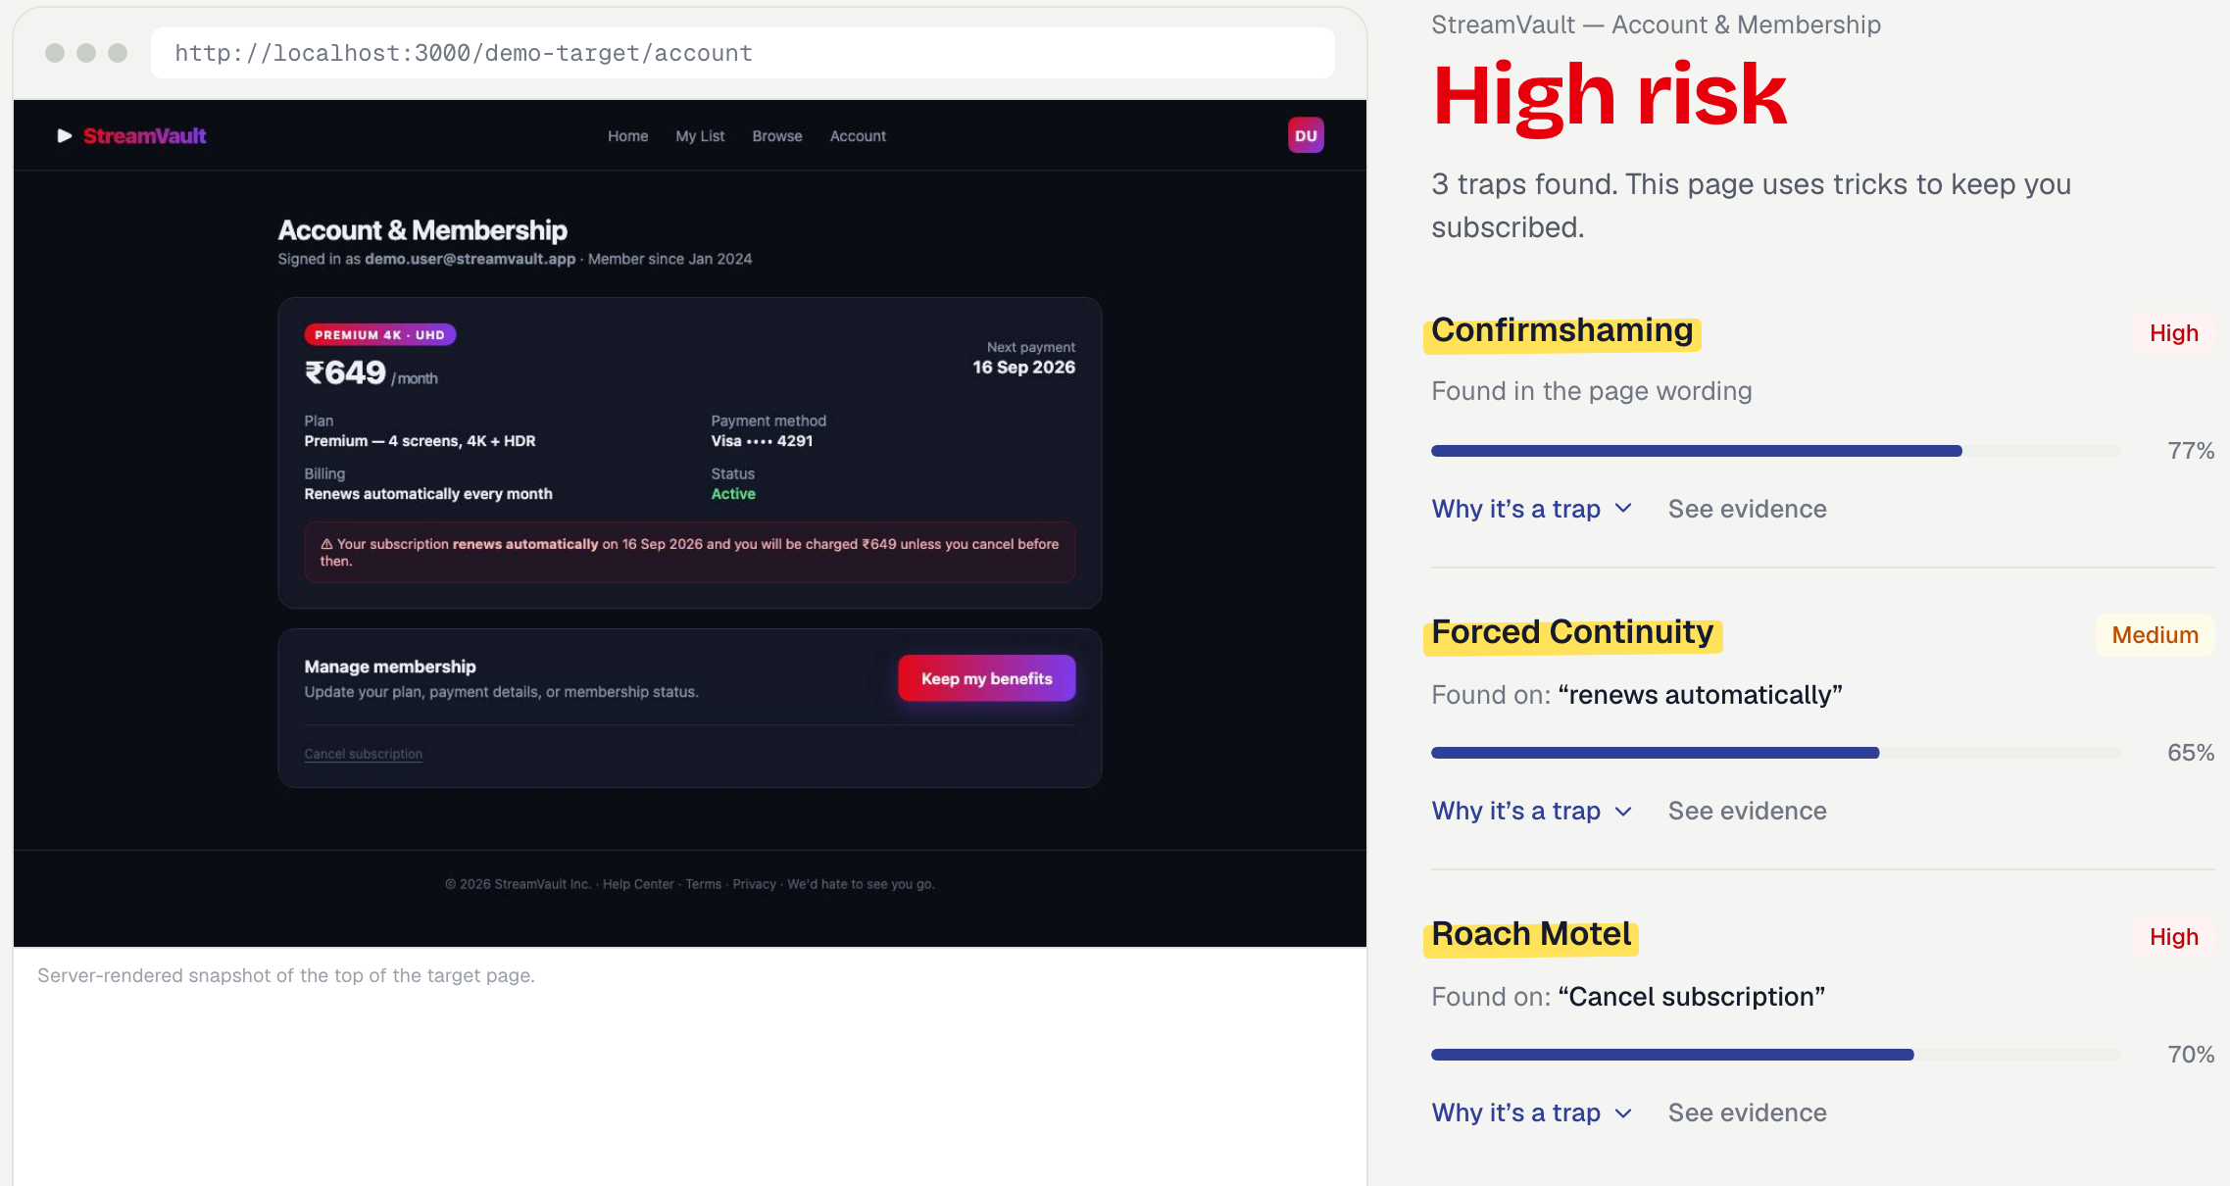
TrapKiller
AI/ML Track · Open Innovation · Built with TinyFish
02 · PROPOSED SOLUTION
Scan the trap, walk the cancel flow, stop for your approval
Real output, not a mockup
One product, three moves
1 Scan
Read-only verdict. Every finding shows its evidence quote and a confidence score.
2 Cancel
The agent reads each screen, declines retention offers, and heads for the real exit.
3 Prove
It parks the final irreversible click until you approve, then saves a proof screenshot.
Scanner run, 20 Oct 2026, on our test site: High risk, 3 traps, each tied to page text.
3/11

Slide 4
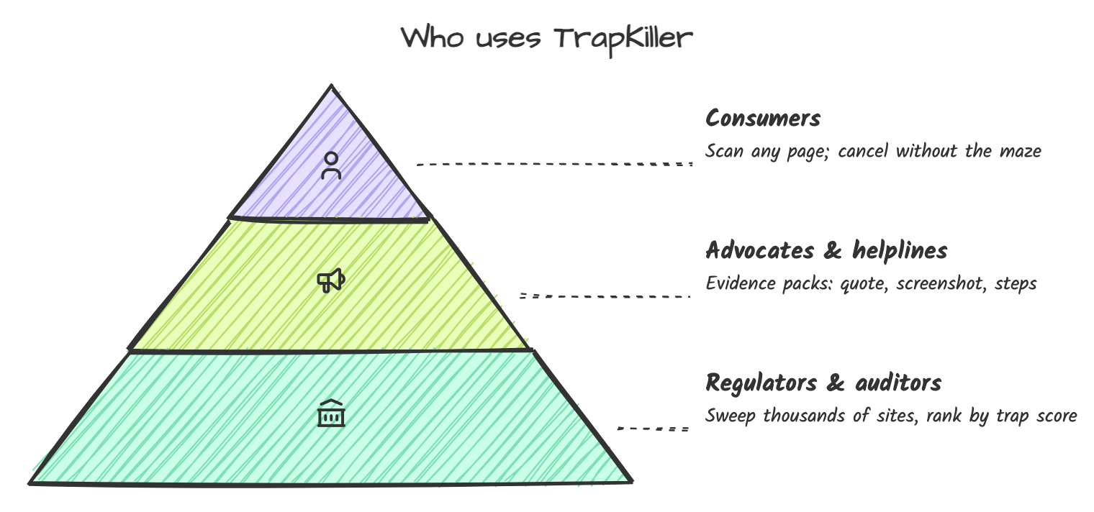
TrapKiller
AI/ML Track · Open Innovation · Built with TinyFish
03 · TARGET USERS AND USE CASE
Built for the person stuck in the maze, useful to those who police it
Use case: one stubborn subscription
1
Pastes the account page URL of a streaming service she no longer watches.
2
TrapKiller flags 3 traps a guilt-trip decline, a buried cancel link, silent auto-renew.
3
The agent walks the flow declines two retention offers, stops on the final confirm screen.
4
She taps Approve proof screenshot and every step are saved, ready if she is charged again.
Illustrative scenario; the flow matches what the agent does on the test site today.
4/11

Slide 5
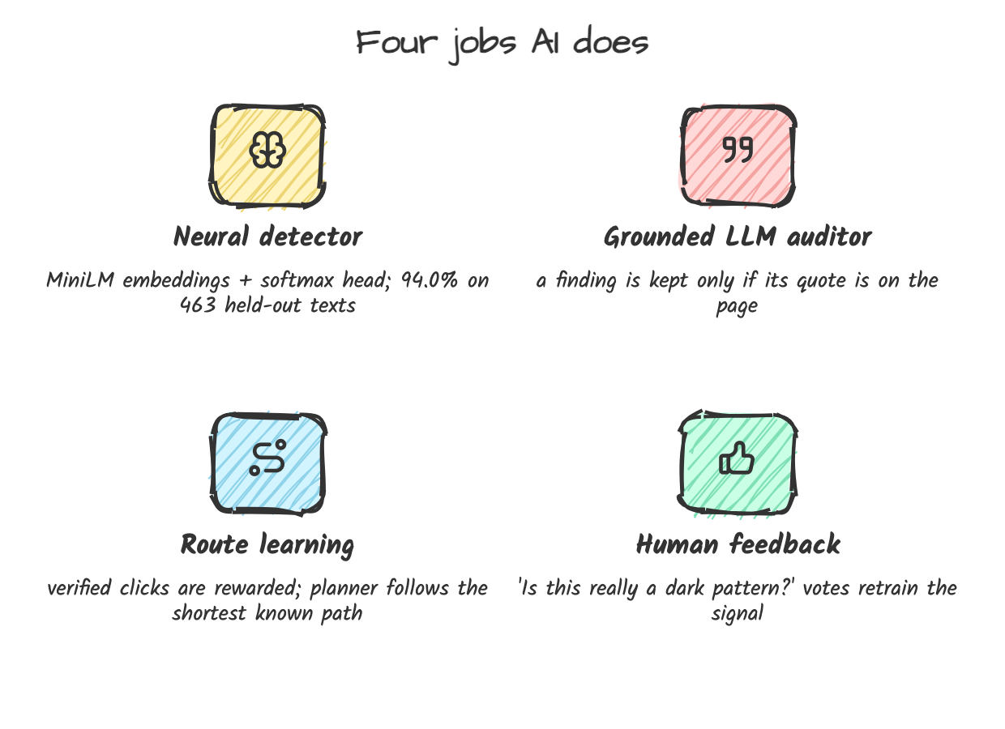
TrapKiller
AI/ML Track · Open Innovation · Built with TinyFish
04 · ROLE OF MACHINE LEARNING AND AI
AI decides what is a trap; rules and people keep it honest
Held-out accuracy by class (n = 463)
Harmless
211/214
98.6%
False urgency
128/132
97.0%
Social proof
57/64
89.1%
Misdirection
39/53
73.6%
Misdirection is our weakest class. So the model only reports findings above 85% confidence, and phrase rules plus a grounded LLM back it up.
Neural head trained on the ec-darkpattern dataset (Yada et al., IEEE BigData 2022): 1,850 training texts, 463 held out, 94.0% overall accuracy
5/11

Slide 6
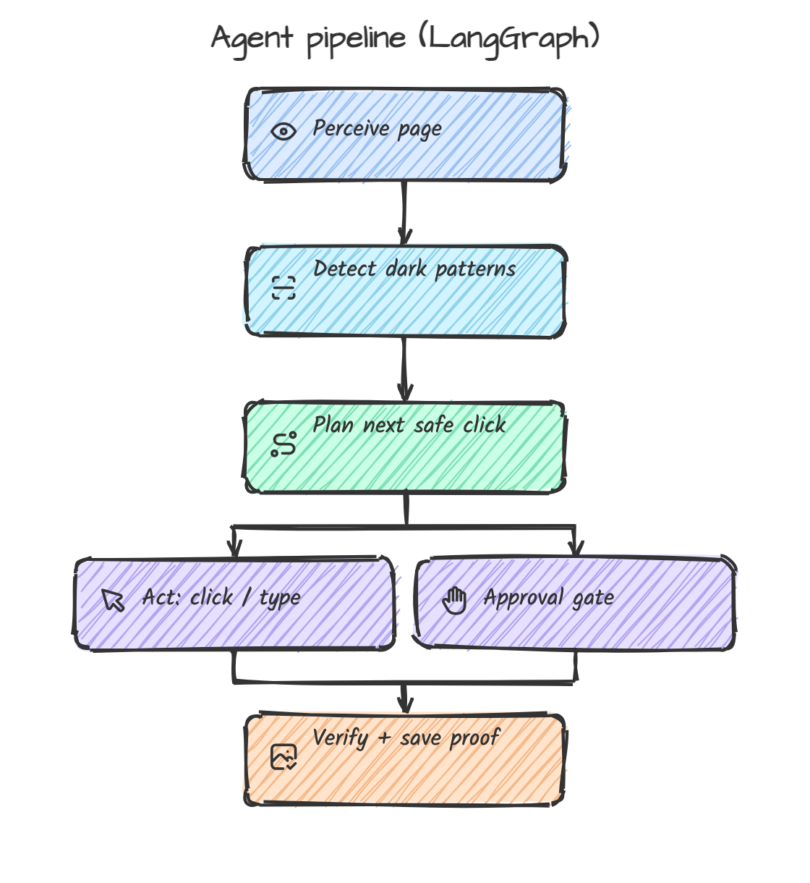
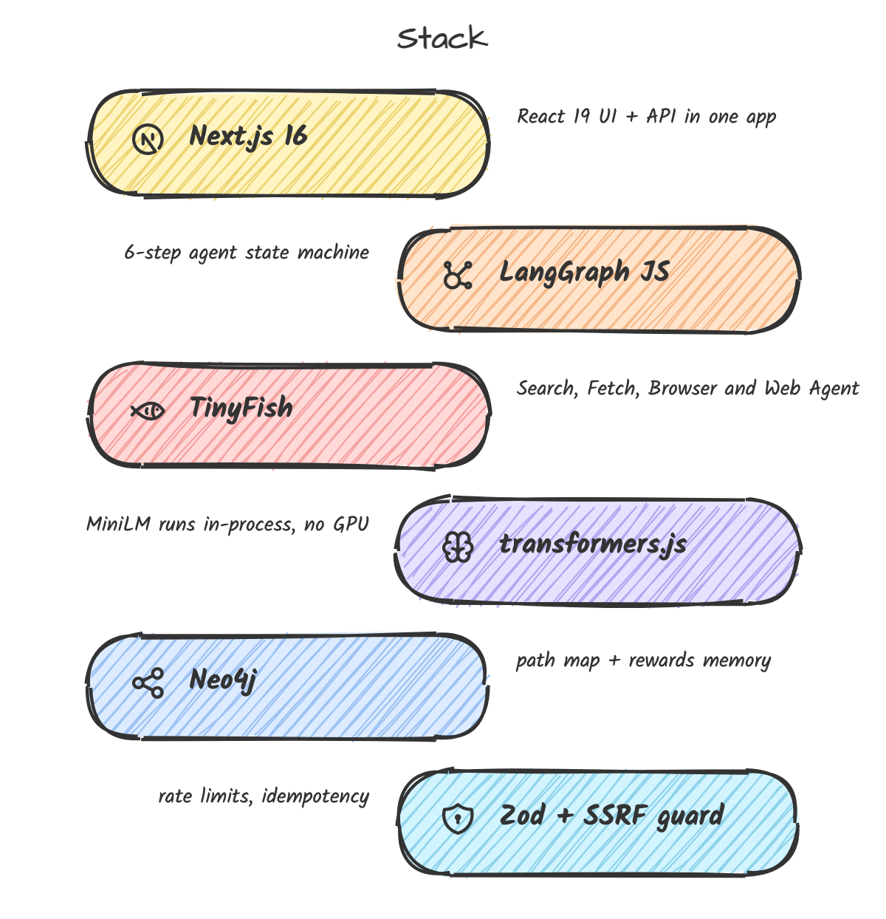
TrapKiller
AI/ML Track · Open Innovation · Built with TinyFish
05 · PROPOSED TECHNICAL APPROACH
A six-step agent loop on a stack two students can run on a laptop
Safety rule: the agent can only click, type, scroll and wait. Page text is data, never instructions.
6/11

Slide 7
TrapKiller
AI/ML Track · Open Innovation · Built with TinyFish
06 · TINYFISH INTEGRATION
All four TinyFish capabilities, each doing one real job
1
Search API
Finds the way in
2
Fetch API
Feeds the detector
3
Browser
Runs our own agent
4
Web Agent
Walks flows at scale
User types only "StreamVault". Search returns the account, cancel and help pages, plus public complaints about the service.
Fetches those pages as clean text (JS rendered, 10 URLs per call). Our neural detector scans every sentence for traps.
Our LangGraph agent drives a TinyFish cloud browser through Playwright over CDP, instead of a local Chromium.
Natural-language goal: "decline offers, stop before final confirm". Runs live for one user, or in batches for a sweep.
ONE SCAN, END TO END
Company name
Search
Fetch
Detect traps (ours)
Browser / Web Agent
You approve (ours)
Proof
Blue = TinyFish. Dark = TrapKiller's own AI and safety step. TinyFish gives us the live web; we decide what is a trap and when to stop.
TinyFish docs: docs.tinyfish.ai (Search API, Fetch API, Agent API, Browser API)
7/11

Slide 8
TrapKiller
AI/ML Track · Open Innovation · Built with TinyFish
06 · TINYFISH INTEGRATION
How TrapKiller calls each TinyFish API
API | Call | What we send | What we read back | Plugs into TrapKiller
1 Search | GET api.search.tinyfish.ai | query="StreamVault cancel" purpose, language="en" | results[].url results[].title, snippet → cancel + help pages | api/scanner/analyze name → page URLs
2 Fetch | POST api.fetch.tinyfish.ai | urls=[up to 10 pages] format="markdown" links=true, ttl=0 | results[].text results[].final_url errors[] per URL | detection/classifier.ts text → neural detector
3 Browser | POST api.browser.tinyfish.ai DELETE /{session_id} | url=<cancel page> timeout_seconds=300 | session_id, cdp_url → connectOverCDP(cdp_url) | browser/manager.ts replaces local Chromium
4 Web Agent | POST agent.tinyfish.ai /v1/automation/run-sse | url, goal="Decline offers; STOP before confirm" max_steps=40 | STREAMING_URL (live view) PROGRESS, COMPLETE /run-async for sweeps | agent/runner.ts queue/runner.ts (sweeps)
One scan: Search finds pages → Fetch gives clean text → our detector flags traps → Browser or Web Agent walks the flow → you approve → proof. If TinyFish is unreachable, the agent falls back to local Playwright.
Endpoints and fields from the TinyFish API reference (docs.tinyfish.ai). Every call sends X-API-Key: $TINYFISH_API_KEY from .env.local
8/11

Slide 9
TrapKiller
AI/ML Track · Open Innovation · Built with TinyFish
07 · EXPECTED IMPACT
Each scan turns a hidden trick into evidence someone can act on
Who gains what
How TrapKiller compares
 | Manual | Blocker extensions | Generic AI browser agent | TrapKiller
Flags dark patterns with evidence | — | — | ○ | ●
Walks the cancel flow | ● | — | ● | ●
Stops before the irreversible click | ● | — | ○ | ●
Saves a proof screenshot | ○ | — | ○ | ●
Learns the shortest route over runs | — | — | — | ●
Sweeps many sites at once | — | — | ○ | ○*
Consumers
Stop unwanted charges before the renewal date, without hours of clicking
Advocates & helplines
Complaint-ready packs: quote, screenshot, every step
Regulators
A ranked list of sites to inspect, instead of manual spot checks
The market
Public trap scores reward companies that design fairly
● does it ○ partly — no * planned with TinyFish · Comparison is our own assessment of typical tools in each category
9/11

Slide 10
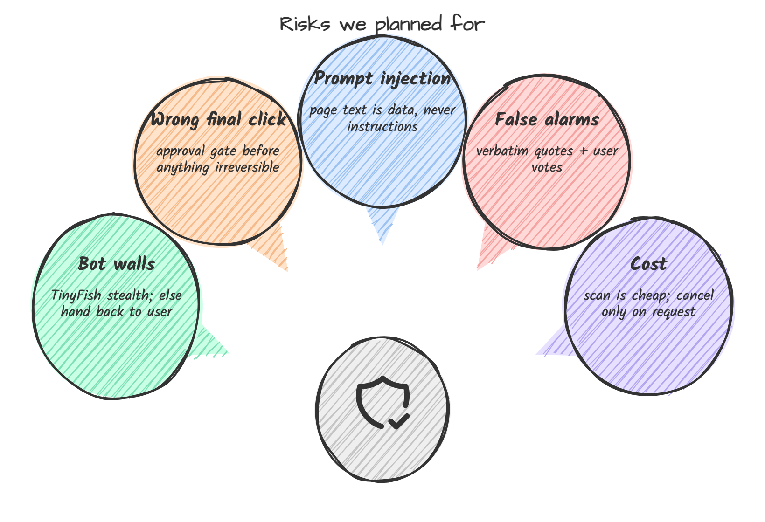
TrapKiller
AI/ML Track · Open Innovation · Built with TinyFish
08 · FEASIBILITY
It already runs end to end; the risks have named fixes
Working today
✓
Full loop on the test site: scan → agent → approval pause → proof
✓
74 of 74 automated tests pass
✓
Neural detector: 94.0% on held-out data, runs on CPU
✓
Zero paid services needed: LLM and Neo4j are optional
✓
13-type taxonomy uses the names in India's 2023 guidelines
Being fixed now: an unverified run can still be reported as cancelled, and Reject/Stop are not fully wired to the running agent.
Checked on 20 Oct 2026: npm test 74/74 passing; scan and agent run against the StreamVault test site
10/11

Slide 11
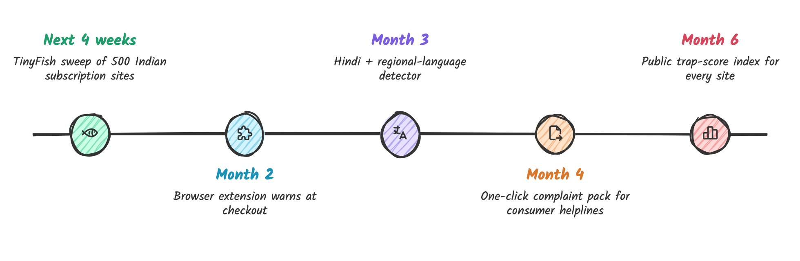
TrapKiller
AI/ML Track · Open Innovation · Built with TinyFish
09 · FUTURE SCOPE
From one test site to a public trap index
Our ask: TinyFish credits to run the first 500-site sweep, so we can publish India's first trap-score ranking of subscription services.
11/11

