Slide 1

NETWORKING BASICS
Internship / Course Completion Report
STUDENT NAME
ENROLLMENT NUMBER
HIMANSHU RAJ SOLANKI
25SCS1003003970
PROGRAM & SEMESTER
ORGANIZATION
CSE — 3rd Semester
CISCO NETWORKING ACADEMY
IILM UNIVERSITY

Slide 2

About the Organization
1
Global Reach
Operating in over 190 countries through partnerships with schools, colleges, and universities.
2
Hands-on Curriculum
Combines theory with simulations and lab exercises using tools like Cisco Packet Tracer.
Cisco Networking
Academy
Industry-Recognized
3
Certifications aligned with real-world IT and networking job roles.
A global IT skills and career-building program run by Cisco, teaching networking to millions of students worldwide.
4
Beginner Friendly
The "Networking Basics" course is designed as an entry point for students new to IT and networking concepts.

Slide 3
Course Overview
What "Networking Basics" set out to teach
Networking Basics is an introductory course offered through the Cisco Networking Academy program. It builds a foundation in how computers, devices, and networks communicate with one another — the same foundation used across almost every modern IT role. The course walks through core concepts step by step, moving from how data physically travels between devices to how it is addressed, routed, and secured.
Foundational
Hands-on
Industry
LEVEL
APPROACH
ALIGNED
No prior networking experience required
Simulations & real device concepts
Maps to entry-level IT job skills
Delivered by Cisco Networking Academy • Completed 30 August 2026

Slide 4






Key Topics Learned
Six core building blocks covered across the course
Networking Fundamentals
OSI & TCP/IP Models
IP Addressing & Subnetting
What a network is, and how devices exchange data end to end.
The layered models that describe how communication is structured.
IPv4/IPv6 addressing, subnet masks, and basic subnetting logic.
Devices & Topologies
Protocols & Standards
Network Security Basics
Routers, switches, hubs, and common physical/logical layouts.
How TCP/IP, HTTP, and other protocols govern data exchange.
Core threats and the basic safeguards used to defend a network.

Slide 5



Skills Gained
Practical takeaways from completing the course
Basic Device Configuration
Comfortable navigating how routers and switches are set up conceptually.
Troubleshooting Mindset
Able to reason through simple connectivity issues systematically.
Understanding Data Flow
Clear picture of how data moves from source to destination across a network.
Security Awareness
Recognizing common risks and the basic practices used to reduce them.

Slide 6
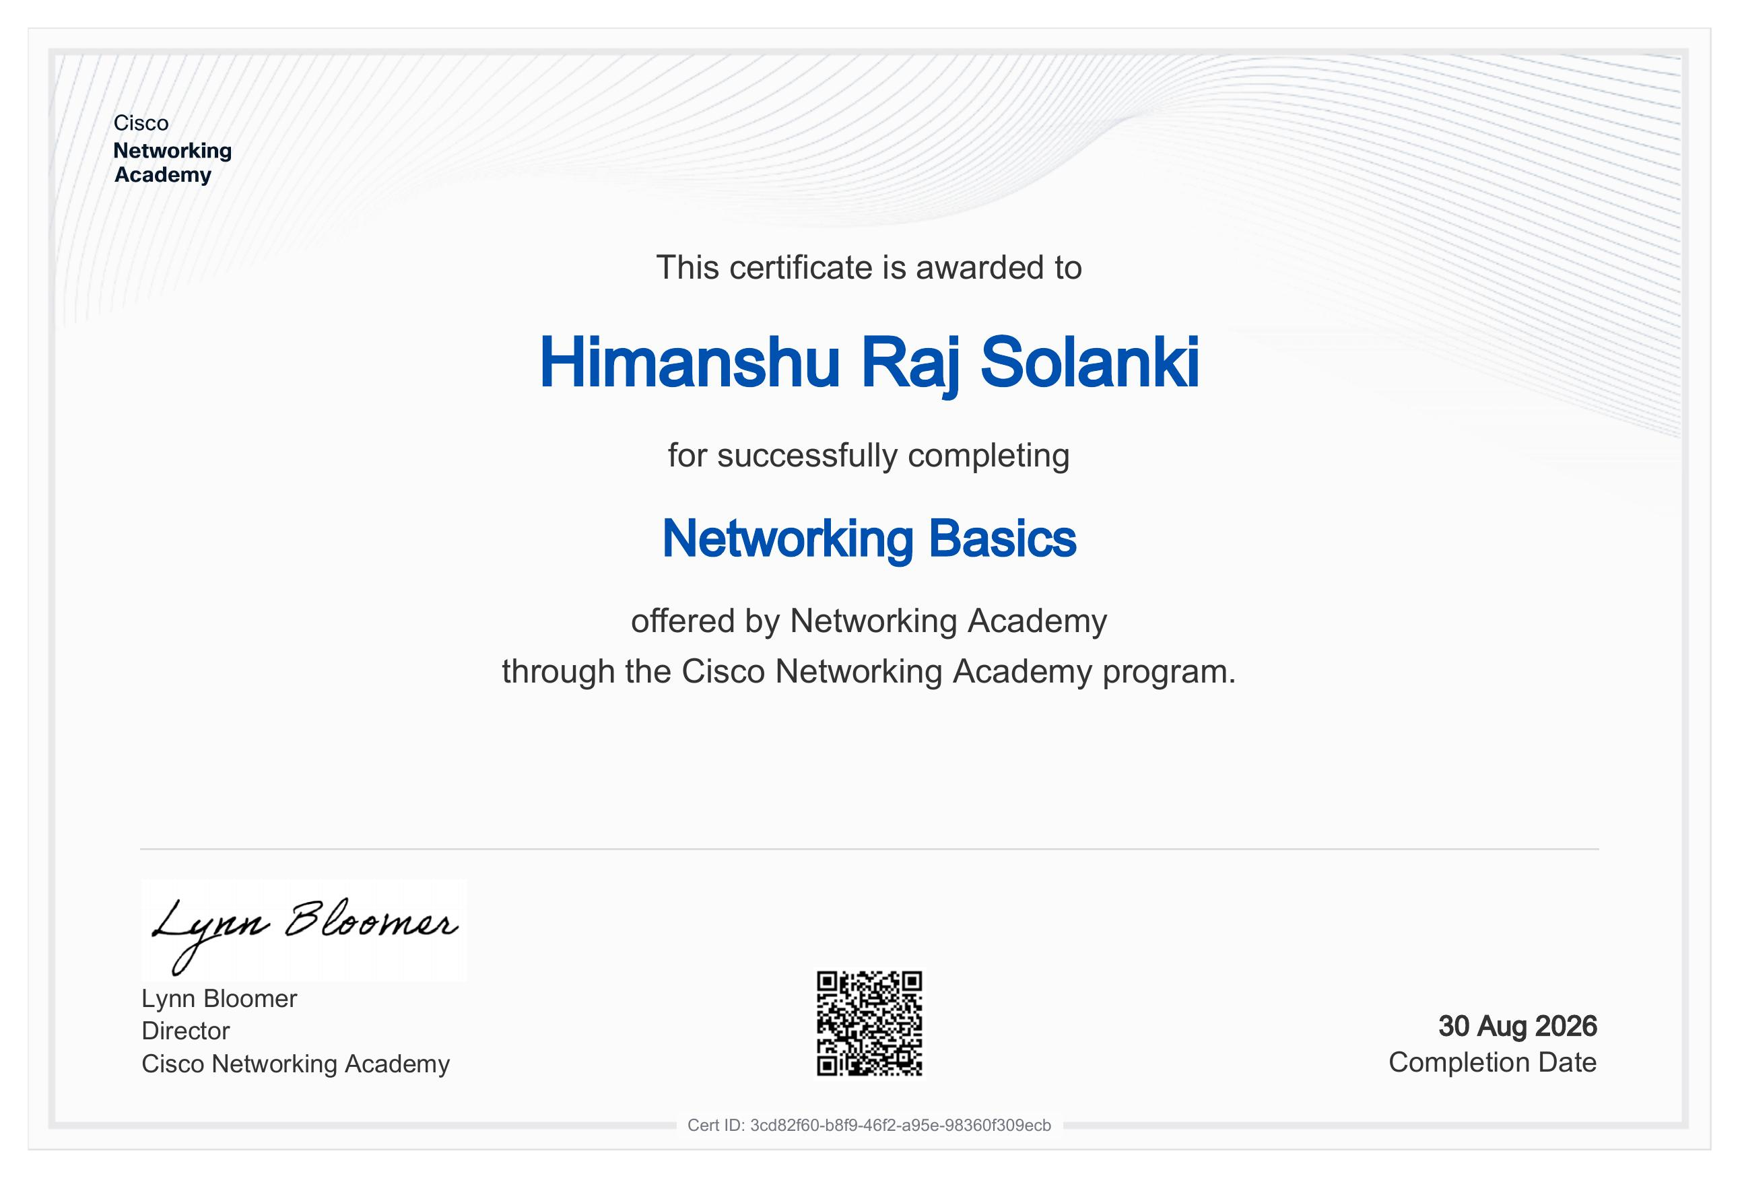
Certificate of Completion
Awarded by Cisco Networking Academy on 30 August 2026
Cert ID: 3cd82f60-b8f9-46f2-a95e-98360f309ecb

Slide 7

Completing Networking Basics gave me a clear, practical foundation in how networks actually work — knowledge I can now build on for more advanced networking and IT coursework.
HIMANSHU RAJ SOLANKI
CSE, 3rd Semester • IILM University
Thank You

