Slide 1
ANN

Slide 2
artificial neural network (ANN) is an information processing system which resembles in characteristics with a biological neural network.
ANNs possess large number of highly interconnected processing elements called nodes or units or neurons,
which usually operate in parallel
and are configured in regular architectures.
Each neuron is connected with the other by a connection link.
Each connection link is associated with weights which contain information about the input signal

Slide 3
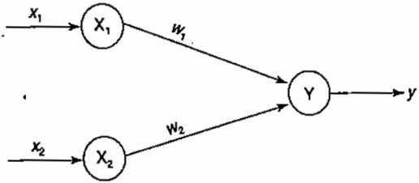
basic operation of a neural net
Here X1, and X2 are input neurons, which transmit signals, and Y is the output neuron
Input neurons X1, and X2 are connected to the output neuron Y, over a weighted interconnection links (W1, and W2)
the net input yin= XIWI +X2W2
output neuron Y can be obtained by applying activations over the net input,Y = f(yin)
The function to be applied over the net input is called activation function

Slide 4
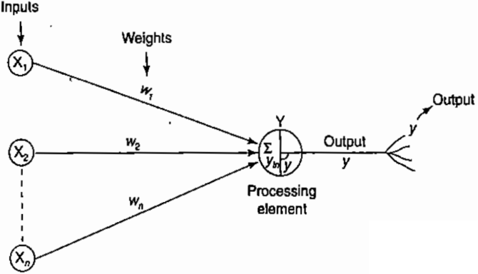

Mathematical model of artificial neuron
Figure shows a mathematical representation of the chemical processing taking place in an artificial neuron
In chis model, the net input is elucidated as
The weight represents the strength of synapse connecting the input and the output neurons.
A positive weight corresponds to an excitatory synapse, and a negative weight corresponds to an inhibitory synapse.

Slide 5
The model of ANN are specified by the three basic entities namely:
the model's synaptic interconnections
the training or learning rules adopted for adjusting the connection weights
their activation functions

Slide 6
Connections
There exist several types of neural network connections (network architecture)
There exist five basic types of neuron connection architectures.
1. single-layer feed-forward network
2. multilayer feed-forward network
3. single node with its own feedback
4. single-layer recurrent network
5. multilayer recurrent network

Slide 7
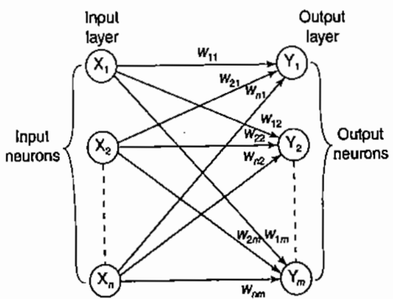
Single-Layer-feed-Forward network

Slide 8
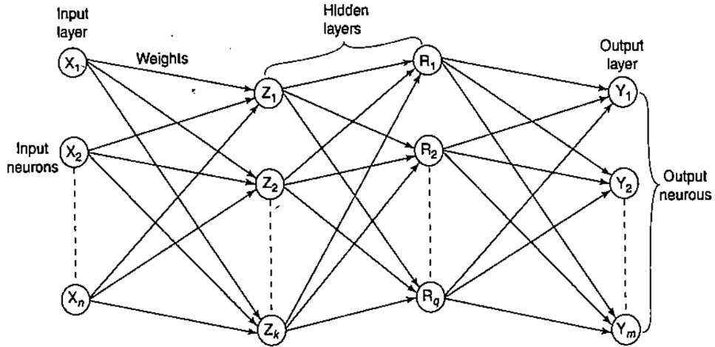
Multilayer feed-forward network

Slide 9
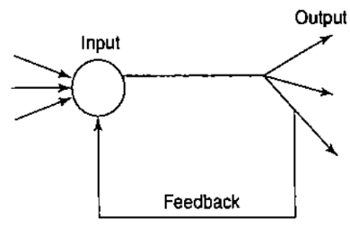
Single node with own feedback

Slide 10
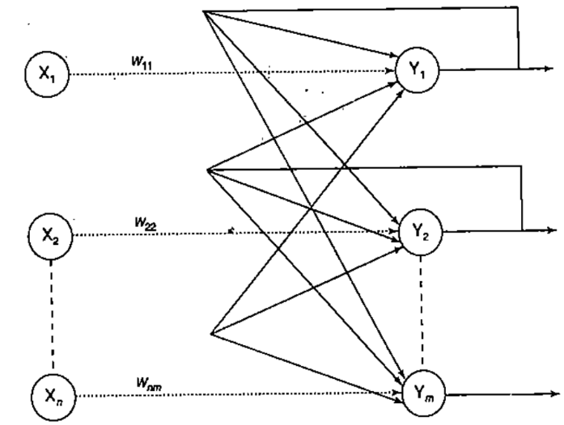
Single·layer recurrent network

Slide 11
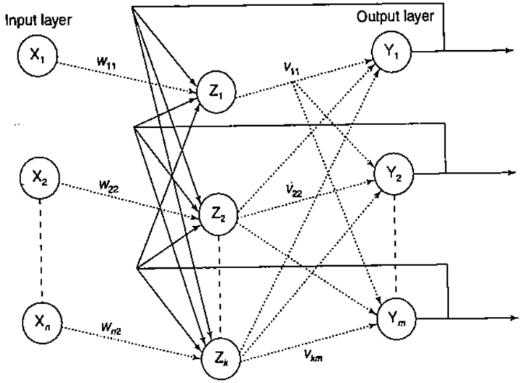
Multilayer recurrent network

Slide 12
Learning
The main property of an ANN is its capability to learn
Broadly, there are two kinds learning in ANNs:
Parameter learning: h updates the connecting weights in a neural net.
Structure learning: It focuses on the change in network structure (which includes the number of processing elements as well as their connection types).
ANN can be generally classified into three categories as:
supervised learning;
unsupervised learning;
reinforcement learning.

Slide 13
Activation Functions
This activation helps in achieving the exact output
Certain nonlinear functions are used to achieve the advantages of a multilayer network from a single-layer network.
When a signal is fed a multilayer network with linear activation functions, the output obtained remains same as that could be obtained using a network.
Due to this reason, nonlinear functions are widely used in multilayer networks compared to linear functions.

Slide 14
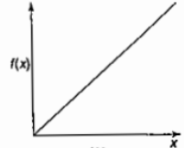
Activation functions: Identity function
It is a linear function and can be defined as
f(x)= x for all x
The output here remains the same as input.
The input layer uses the identity activation function.

Slide 15
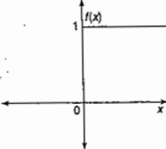

Activation functions: Binary step function
This function can be defined as
where Ө represents the threshold value.
This function is most widely used in single-layer nets to convert the net input to an output that is a binary (1 or 0).

Slide 16

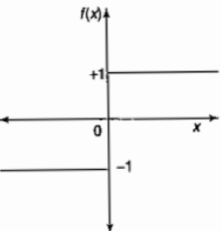
Activation functions: Bipolar step function
This function can be defined as
where Ө represents the threshold value.
This function is also used in single-layer nets to convert the net input to an output that is bipolar(+ 1 or -1).

Slide 17
Activation functions: Sigmoidal functions
The sigmoidal functions are widely used in back-propagation nets
because of the relationship between the value of the functions at a point and the value of the derivative at that point which reduces the computational burden during training

Slide 18
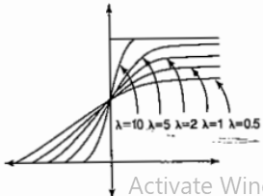

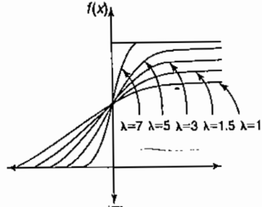


Sigmoidal functions are of two types:
Binary sigmoid function
It is also termed as logistic sigmoid function or unipolar sigmoid function.
It can be defined as
where λ is the steepness parameter
The derivative of this function is f’(x) = λf(x)[1-f(x)]
Here the range of the sigmoidal function is from 0 to 1
Bipolar sigmoid function
This function is defined as
where λ is the steepness parameter
sigmoidal function range is between -1 and + 1
The derivative of this function can be

Slide 19

The bipolar sigmoidal function is closely related to hyperbolic tangent function which is written as
The derivative of the hyperbolic tangent function is
If the network uses a binary data, it is better to convert it to bipolar form and use the bipolar sigmoidal activation function or hyperbolic tangent function.

Slide 20
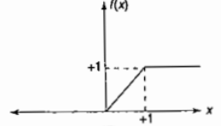

activation functions: Ramp function
The ramp function is defined as

Slide 21
McCulloch-Pitts Neuron
The McCulloch-Pitts neuron was the earliest neural network discovered in 1943.
It is usually called as M-P neuron.
The M-P neurons are connected by directed weighted paths.
It should be noted that the activation of a M-P neuron is binary, that is, at any time step the neuron may fire or may not fire.
The weights associated with the communication links may be excitatory (w > 0) or inhibitory (p < 0).

Slide 22
McCulloch-Pitts Neuron
There is a fixed threshold for each neuron, and if the net input to the neuron is greater than the threshold then the neuron fires.
Also, it should be noted that any nonzero inhibitory input would prevent the neuron from firing.
The M-P neurons are most widely used in the case of logic functions.

Slide 23

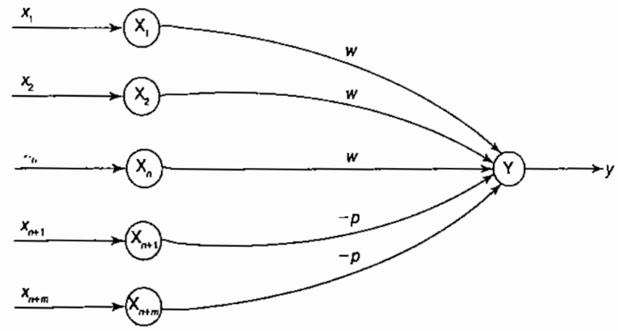
McCulloch-Pitts Neuron: Architecture
Since the firing of ilie output neuron is based upon the threshold,
The activation function here is defined as

Slide 24
McCulloch-Pitts Neuron
The M-P neuron has no particular training algorithm.
An analysis has to be performed to determine the values of the weights and the threshold.
Here the weights of the neuron are set along with the threshold to make the neuron perform a simple logic function
The M-P neurons are used as building blocks on which we can model any function or phenomenon, which can be represented as a logic function.

Slide 25

Linear Separability
An ANN does not give an exact solution for a nonlinear problem
However, it provides possible approximate solutions nonlinear problems.
Linear separability,
is the concept wherein the separation of the input space into regions is based on whether the network response is positive or negative.
A decision line is drawn to separate positive and negative responses.
Generally the net input calculated to the output Unit is given as

Slide 26

Linear Separability
if the bipolar step activation function is used over the calculated net input (yin) then the value of the function is 1 for a positive net input and -1 for a negative net input.
Also, it is clear that there exists a boundary between the regions where yin > 0 and yin < 0.
This region may be called as decision boundary and can be determined by the relation
On the basis of the number of input units in the network, the above equation may represent a line, a plane or a hyperplane.

Slide 27
Linear Separability
When can we conclude the problem is linear separable
If there exist weights (with bias) for which the training input vectors
having positive (correct:) response,+ l, lie on one side of the decision boundary and
all the other vectors having negative (incorrect) response, -1, lie on the other side of the decision boundary.

Slide 28
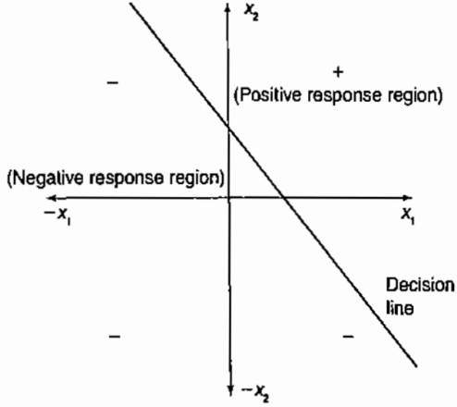
Linear Separability
Consider a network having positive response in the first quadram and negative response in all other quadrants (AND function) with either binary or bipolar data,
then the decision line is drawn separating the positive response region from the negative response region.

Slide 29
Hebb Network
For a neural net, the Hebb learning rule is a simple one.
Donald Hebb stated in 1949 that in the brain, the learning is performed by the change in the synaptic gap
Hebb explained it:
When an axon of cell A is near enough to excite cell B, and
repeatedly or permanently takes place in firing some growth process or
metabolic change takes place in one or both the cells such that As efficiency, as one of the cells firing B is increased.

Slide 30
According to the Hebb rule,
the weight vector is found to increase proportionately to the product of the input and the learning signal.
Here the learning signal is equal to the neuron's output.
In Hebb learning, if two interconnected neurons are 'on' simultaneously then the weights associated with these neurons can be increased by modification made in their synaptic gap (strength).
The weight update in Hebb rule is given by w_{i}(new)= w_{i}(old) + x_{i}y

Slide 31
The Hebb rule is more suited for data than binary data.
If binary data is used, the above weight updation formula cannot distinguish two conditions namely;
1. A training pair in which an input unit is "on" and target value is "off."
2. A training pair in which both the input unit and the target value are "off."
Thus, there are limitations in Hebb rule application over binary data.
Hence, the representation using bipolar data is advantageous.

Slide 32
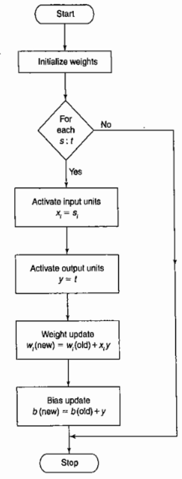
Flowchart of Training Algorithm of Hebb network
The training algorithm is used for the calculation and of weights.
s: t refers to each training input and target output pair.
Till there exists a pair of training input and target output,
the training process takes place;
Else
It is stopped.

Slide 33
Hebb Network: Training Algorithm
First initialize the weights. Basically in this network they may be set to zero, i.e., w_{i} = 0 for i= 1 to n where "n" may be the total number of input neurons.
Steps 2-4 have to performed for each input training vector and mger output pair, s: r.
Input units activations are set. Generally, the activation function of input layer is identity function x_{i}= s_{i}
Output units activations are set y=t
Weight and bias adjustments are performed
w_{i}(new)= w_{i}(old) + x_{i}y
b(new) = b(old) + y
The Hebb rule can be used for pattern association, pattern categorization, pattern classification and over a range of other areas.

Slide 34
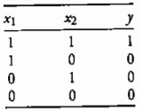
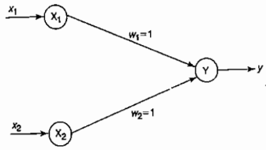
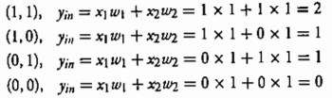
Example: Implement AND function using McCulloch-Pitts neuron
In McCulloch-Pires neuron, only analysis is being performed.
Hence, assume the weights be w1 = 1 and w2 = 1.
With these assumed weights, the net input is calculated for inputs
For inputs

Slide 35

For an AND function, the output is high if both the inputs are high
For this condition, the net input is calculated as 2.
Hence, based on the net input, the threshold is set, i.e. if the threshold value is greater than or equal to 2 then the neuron fires, else it does not fire.
So the threshold value is set equal to2(Ө= 2).
This can also be obtained by Ө≥ nw- p
Here, = 2, w = 1 (excitatory weights) and p = 0 (no inhibitory weights).
So Ө≥ (2x1)-0 ⇒ Ө≥2
Thus, the output of neuron Y can be written as

Slide 36
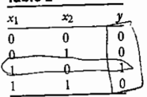
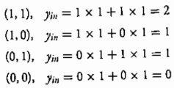
implement ANDNOT Using McCulloch-Pitts neuron
Case 1: Assume that both weights W1 and W2. are excitatory, i.e.,
W1=W2=1
Then for the four inputs calculate the net input using
yin=XIW1 + x2w2
For inputs

Slide 37
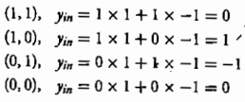
From the calculated net inputs, it is not possible to fire the neuron for input (1, 0) only. Hence, these weights are not suitable.
Assume one weight as excitatory and the other as inhibitory, i.e.,
WI =1, w2=-1
Now calculate the net input. For the inputs

Slide 38

From the calculated net inputs, now it is possible to fire the neuron for input (1, 0) only by fixing a threshold of 1, Y unit. Thus,
w1=l; w2=-1; Ө≥1
Thus, the output of neuron Y can be written as

Slide 39
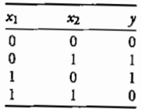
Assignment
Implement XOR function using McCulloch-Pitts neuron
XOR function cannot be represented by simple and single logic function;
It is represented as y=x1x2’ + x1’x2 = z1 + z2
Function1: z1 = x1x2’
Function2: z2 = x1’x2
Function3: y = z1 + z2
A single-layer net is not sufficient to represent the function. An intermediate layer is necessary.

Slide 40
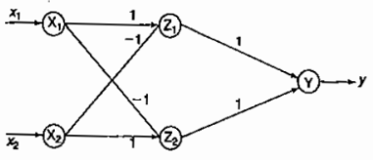
Neural net for XOR function (weights shown are obtained after analysis)

Slide 41
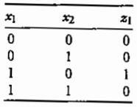
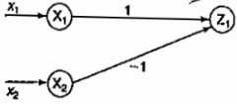
Neural net for Z1

Slide 42
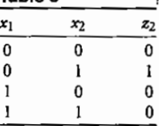
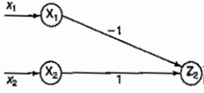
Neural net for Z2

Slide 43
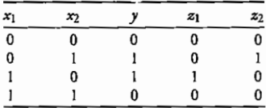
Neural net for XOR function (weights shown are obtained after analysis)

Slide 44
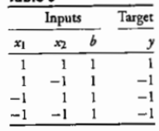
Example: Hebb net
Design a Hebb net to implement logical AND function (use bipolar inputs and targets).
initially the weights and bias are set to zero, i.e.,
W1 = w2 = b =0

Slide 45

First input [xi xz b] = [1 1 1] and target = 1
[i.e., y = 1]: Setting the initial weights as old
weights and applying the Hebb rule, we get

Slide 46

Second input [x, X2, b] = [1 - 1 1] and y = -1: The initial or old weights here are the final (new) weights obtained by presenting the first input pattern, i.e.,
[wi w, b] = [1 l 1]
The weight change here is

Slide 47

The new weights here are

Slide 48
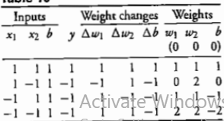
Similarly, by presenting the third and fourth
input patterns, the new weights can be calculated.
Final weights w1=2 w2 = 2 b = -2

Slide 49

Decision boundary for AND function using Hebb rule for each training pair
The separating line equation is given by
For all inputs, use the final weights obtained for each input to obtain the separating line.

Slide 50
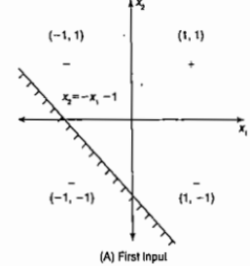

Decision boundary for AND function using Hebb rule for each training pair
For the first input [1 1 1], the separating line is given by

Slide 51

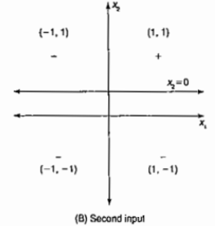
Decision boundary for AND function using Hebb rule for each training pair
Similarly, for the second input [ 1 -1 1], the separating line is

Slide 52
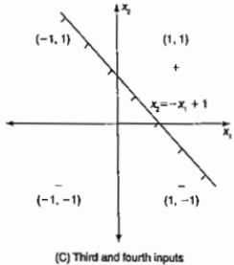

Decision boundary for AND function using Hebb rule for each training pair
For the third input[-1 1 1], the separating line is

Slide 53

Decision boundary for AND function using Hebb rule for each training pair
Finally, for the fourth input [ -1 - 1 1], the separating line is

Slide 54
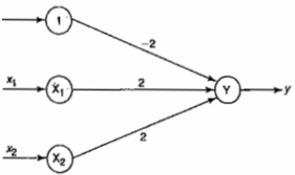
Hebb network for AND function
Final weights w1=2 w2 = 2 b = -2

