Slide 1
K-means++

Slide 2
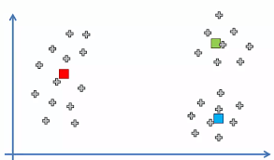
Random Initialization Trap

Slide 3
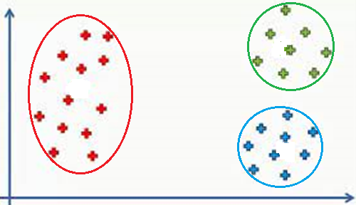
Clusters Found

Slide 4
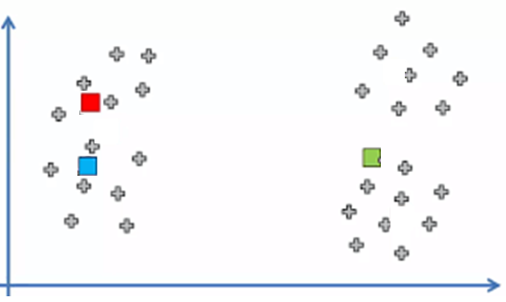
Another random Initialization

Slide 5
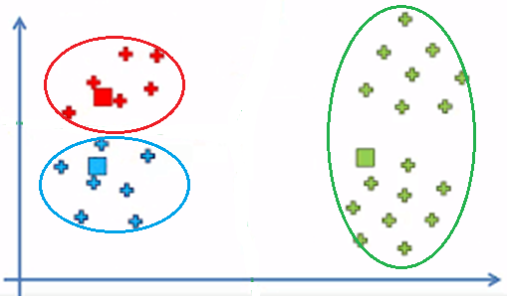
Different Clusters found

Slide 6
Solution
K-means++
The K-means++ algorithm is an extension of the popular k-means algorithm, which randomly selects initial cluster centroids.
K-means++, on the other hand, uses a more sophisticated approach to select the initial centroids.
Intuition-
By selecting the initial centroids in a smart way, we can improve the overall performance of the algorithm.
By choosing the initial centroids that are far apart from each other, we increase the chances of capturing the underlying structure of the data and producing better clusters.

Slide 7
The steps involved in the K-means++
Initialize the first centroid randomly from the dataset.
For each data point, compute the minimum squared distance (i.e., the distance squared between a data point and the nearest centroid) and store it in a list.
Randomly select the next centroid from the dataset using a probability distribution that is proportional to the minimum squared distance of each data point from the nearest centroid.
This means that the more distant a point is from the nearest centroid, the more likely it is to be selected as the next centroid.
Repeat steps 2 and 3 until all K centroids have been selected.
Run the standard K-means algorithm with the K initial centroids obtained from the above steps.

Slide 8
After finding probability of each points how to calculated cumulative distribution function
Sort the probabilities of each data point in ascending order.
Normalize the sorted probabilities so that they add up to 1. This can be done by dividing each probability by the sum of all probabilities.
Calculate the cumulative sum of the normalized probabilities. This can be done by adding up the normalized probabilities from the first data point to the last data point.
The resulting cumulative sum represents the CDF of the probability distribution.

Slide 9
How to select a random point based on the probability distribution calculated
To select a random point based on the probability distribution calculated in K-means++, we can use a weighted sampling approach.
The steps to do so are:
Calculate the cumulative distribution function (CDF) of the probability distribution obtained in K-means++. This can be done by summing up the probabilities from the first point to the last point.
Generate a random number between 0 and 1.
Use the CDF to find the data point whose cumulative probability is greater than or equal to the random number generated in step 2. This can be done using binary search or linear search algorithms.
Select the data point found in step 3 as the next centroid.

Slide 10
Example
Suppose we have a dataset of 10 two-dimensional points:
[(1, 1), (1, 2), (2, 1), (2, 2), (3, 3), (3, 4), (4, 3), (4, 4), (5, 5), (5, 6)]
We want to cluster these points into two clusters using K-means++.
The steps of K-means++ are as follows:
Select the first centroid at random from the dataset. Let's say we select the point (2, 2) as the first centroid.
Calculate the squared distance between each point and the first centroid. Assign each point a probability proportional to its squared distance from the first centroid. Normalize the probabilities so that they add up to 1.
Squared distances:
[2, 1, 1, 2, 13, 18, 13, 18, 32, 37]
Probabilities:
[0.0154, 0.0077, 0.0077, 0.0154, 0.2462, 0.3385, 0.2462, 0.3385, 0.5846, 0.6769]

Slide 11
3. Select the second centroid by randomly choosing a point from the dataset, with the probability of each point being proportional to its squared distance from the first centroid.
Suppose we generate a random number between 0 and 1 and it turns out to be 0.7.
We can use the CDF to find the data point whose cumulative probability is greater than or equal to 0.7:
CDF:
[0.0154, 0.0231, 0.0308, 0.0462, 0.2923, 0.6308, 0.877, 1.0, 1.0, 1.0]
Select data point at index 7: (4, 4)

Slide 12
4. Perform K-means clustering with the two centroids (2, 2) and (4, 4) to assign each point to its nearest centroid, and update the centroids based on the mean of the points assigned to each cluster.
5. Repeat steps 2-4 to select additional centroids, until the desired number of clusters is reached.
The final result after two iterations of K-means would be:
Cluster 1: [(1, 1), (1, 2), (2, 1), (2, 2), (3, 3), (4, 3)]
Cluster 2: [(3, 4), (4, 4), (5, 5), (5, 6)]

Slide 13
K-means++
It iteratively assigns each data point to its nearest centroid and updates the centroid location based on the new cluster assignments.
The k-means++ algorithm has been shown to perform better than the k-means algorithm on several datasets, especially when the number of clusters is not known a priori.

