Slide 1
Support Vector Machine
Linear Binary Classifier

Slide 2
SVM
Developed in 1960s
Used again 1990s
Now also very popular as different from other machine learning algorithms
Applicable in case of Linearly as well as non-linearly separable dataset even outlier detection
SVM is well suited for classification of complex but small or medium size datasets

Slide 3
How to separate these points?
Category 1
y
Category 2
x

Slide 4
How to separate these points?
Category 1
y
Category 2
out of these separating planes which is most preferred solution?
For that there is SVM
x

Slide 5
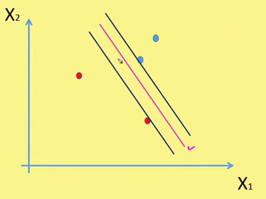
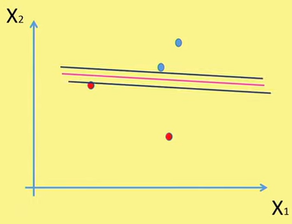
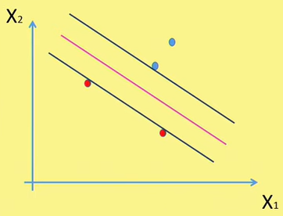
SVM without soft margin
The objective of the linear SVM without soft margin is to maximize this margin.

Slide 6
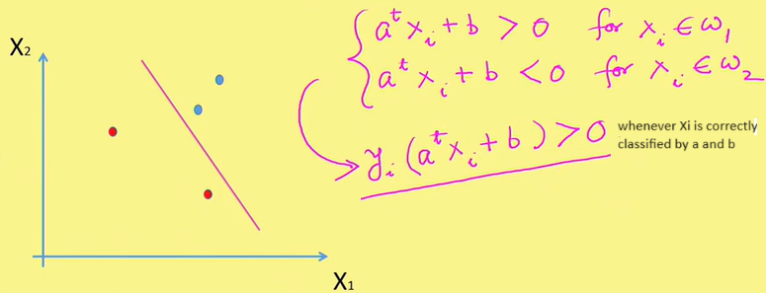
SVM: Binary Classification

Slide 7
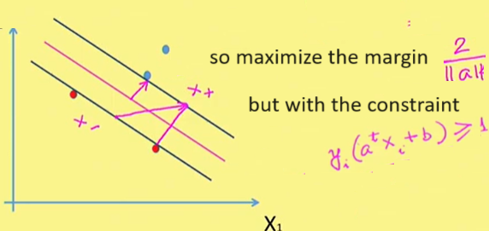
SVM: Binary Classification

Slide 8
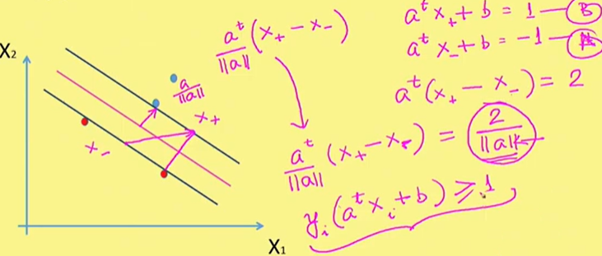
SVM: Binary Classification

Slide 9
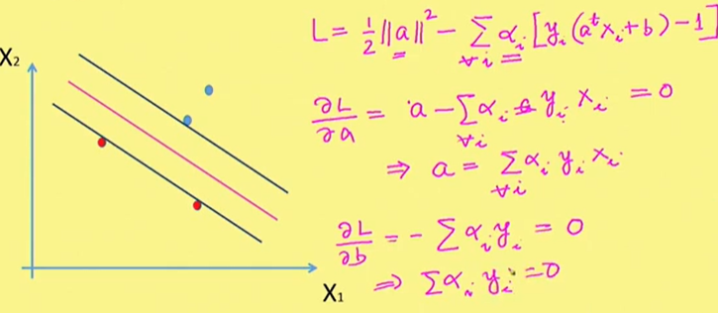
SVM: Binary Classification
so it becomes a constraint optimization problem so we need to use lagrangian
we need to minimize L w.r.t a and maximize w.r.t. ∝_{i}

Slide 10
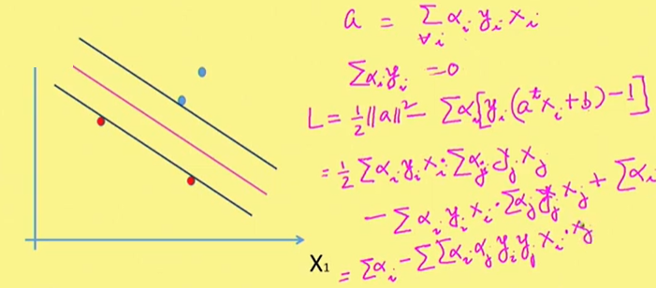
SVM: Binary Classification

Slide 11
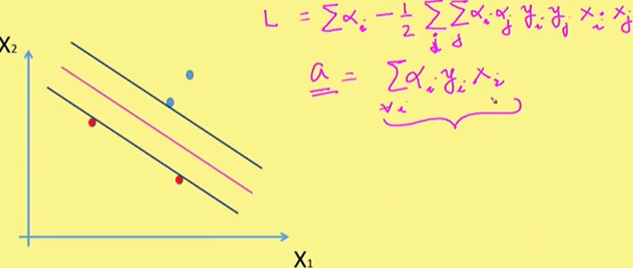
SVM: Binary Classification
we will find those α_{i}that maximizes L so for that we can use any optimization technique. and this value of a_{i} will give us a plane with maximum margin between vectors of two classes.

Slide 12
Formulation
The optimization problem for linear SVM without soft margin can be formulated as:
max_{w,b}M
Subject to the constraints:
y^{i}(w⋅x_{i}+b)≥M
Where
M represents the margin and must be maximized

Slide 13
Lagrangian Formulation
To solve this optimization problem, we use Lagrangian optimization with Lagrange multipliers α_{i}
L(w,b,α)=M −∑i=1 to n {α_{i}[y_{i}(w⋅x_{i}+b)−M]}
Subject to the constraints:
α_{i}≥0

Slide 14

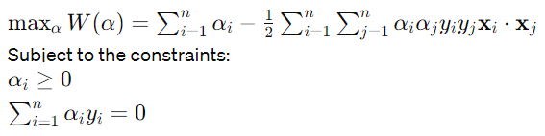
Deriving the Dual Problem
To find the optimal w and b, we take derivatives of the Lagrangian with respect to w and b, and set them to zero:
Substituting these into the Lagrangian, we obtain the dual optimization problem:

Slide 15
Computing the Decision Function
Once we have found the optimal α values, we can compute the decision function for a new data point x:
f(x)=sign(w⋅x+b)

Slide 16
linear SVM with soft margin
It extends the concept of SVM to handle cases where
the data is not perfectly separable by a hyperplane,
allowing for some misclassifications.
This is achieved by introducing slack variables and a regularization parameter.
The goal is
to find the optimal hyperplane that separates the data points while allowing for a certain degree of misclassification.
This is achieved by introducing slack variables, which represent the degree of misclassification for each data point.

Slide 17
linear SVM with soft margin
Given a training dataset{(xi,yi)}i=1 to n, where xi represents the feature vector and yi is the class label (∈{−1,+1}yi∈{−1,+1}), the decision boundary is represented by the equation of a hyperplane:
w⋅x+b=0
Where
w is the weight vector perpendicular to the hyperplane,
x is the input feature vector,
b is the bias term.
The objective is to maximize the margin between the hyperplane and the data points while minimizing the misclassification error, which is controlled by slack variables.

Slide 18
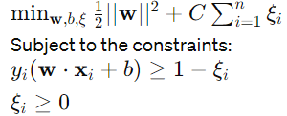
Formulation
The optimization problem for linear SVM with soft margin can be formulated as:
Where:
C is the regularization parameter that controls the trade-off between maximizing the margin and minimizing the misclassification,
ξi are slack variables representing the degree of misclassification for each data point.

Slide 19
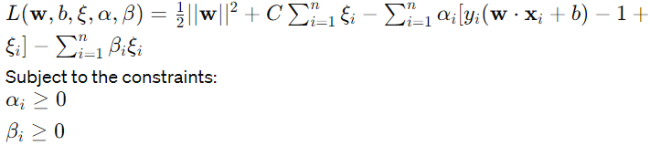
Lagrangian Formulation:
To solve this optimization problem, we use Lagrangian optimization with Lagrange multipliers αi and βi

Slide 20
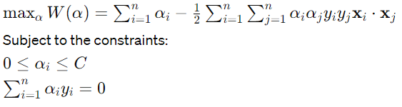
Deriving the Dual Problem
We find the saddle point of the Lagrangian by taking derivatives with respect to w, b, and ξi, and setting them to zero. Solving these equations leads to the dual optimization problem.
Dual Optimization Problem:
The dual optimization problem for linear SVM with soft margin becomes:

Slide 21
Computing the Decision Function
Once the optimal α values are found, we can compute the decision function for a new data point x:
f(x)=sign(w⋅x+b)

Slide 22
How SVM are different from other ML algorithms
Apple oranges classification
Other machine learning algorithms learn for apples (from most commonly looking apples) and same for oranges
SVM looks at oranges that are more like apples and apples that are very much like oranges and these are support vectors
So it looks very extreme cases (very close to the boundary) and thus it makes SVM algorithm very special and different
Thus most of the times SVM performs better than other ML algorithms

Slide 23
Importing the libraries
import numpy as np
import matplotlib.pyplot as plt
import pandas as pd

Slide 24
Importing the dataset
dataset = pd.read_csv('Social_Network_Ads.csv’)
x = dataset.iloc[:, :-1].values
y = dataset.iloc[:, -1].values
Age EstimatedSalary Purchased
19 19000 0
35 20000 0
26 43000 0
27 57000 0
19 76000 0
27 58000 0
27 84000 0
32 150000 1
25 33000 0
Total- 1000 entries

Slide 25
Splitting the dataset into the Training set and Test set
from sklearn.model_selection import train_test_split
x_train, x_test, y_train, y_test = train_test_split(x, y, test_size = 0.25, random_state = 0)

Slide 26
Feature Scaling
from sklearn.preprocessing import StandardScaler
sc = StandardScaler()
x_train = sc.fit_transform(x_train)
x_test = sc.transform(x_test)

Slide 27
Training the SVM model on the Training set
from sklearn.svm import SVC
classifier = SVC(kernel = 'linear', random_state = 0)
classifier.fit(x_train, y_train)

Slide 28
Predicting a new result
print(classifier.predict(sc.transform([[30,87000]])))
Output
[0]

Slide 29
Predicting the Test set results
y_pred = classifier.predict(x_test)
print(np.concatenate((y_pred.reshape(len(y_pred),1), y_test.reshape(len(y_test),1)),1))

Slide 30
Making the Confusion Matrix
from sklearn.metrics import confusion_matrix, accuracy_score
cm = confusion_matrix(y_test, y_pred)
print(cm)
accuracy_score(y_test, y_pred)
Output
[[66 2]
[8 24]]
0.9

Slide 31
Visualising the Training set results
from matplotlib.colors import ListedColormap
x_set, y_set = sc.inverse_transform(x_train), y_train
x1, x2 = np.meshgrid(np.arange(start = x_set[:, 0].min() - 10, stop = x_set[:, 0].max() + 10, step = 0.25),
np.arange(start = x_set[:, 1].min() - 1000, stop = x_set[:, 1].max() + 1000, step = 0.25))
plt.contourf(x1, x2, classifier.predict(sc.transform(np.array([x1.ravel(), x2.ravel()]).T)).reshape(x1.shape),
alpha = 0.75, cmap = ListedColormap(('red', 'green')))
plt.xlim(x1.min(), x1.max())
plt.ylim(x2.min(), x2.max())
for i, j in enumerate(np.unique(y_set)):
plt.scatter(x_set[y_set == j, 0], x_set[y_set == j, 1], c = ListedColormap(('red', 'green'))(i), label = j)
plt.title('SVM (Training set)')
plt.xlabel('Age')
plt.ylabel('Estimated Salary')
plt.legend()
plt.show()

Slide 32
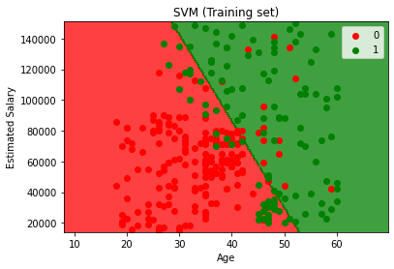
Output

Slide 33
Visualising the Test set results
from matplotlib.colors import ListedColormap
x_set, y_set = sc.inverse_transform(x_test), y_test
x1, x2 = np.meshgrid(np.arange(start = x_set[:, 0].min() - 10, stop = x_set[:, 0].max() + 10, step = 0.25),
np.arange(start = x_set[:, 1].min() - 1000, stop = x_set[:, 1].max() + 1000, step = 0.25))
plt.contourf(x1, x2, classifier.predict(sc.transform(np.array([x1.ravel(), x2.ravel()]).T)).reshape(x1.shape),
alpha = 0.75, cmap = ListedColormap(('red', 'green')))
plt.xlim(x1.min(), x1.max())
plt.ylim(x2.min(), x2.max())
for i, j in enumerate(np.unique(y_set)):
plt.scatter(x_set[y_set == j, 0], x_set[y_set == j, 1], c = ListedColormap(('red', 'green'))(i), label = j)
plt.title('SVM (Test set)')
plt.xlabel('Age')
plt.ylabel('Estimated Salary')
plt.legend()
plt.show()

Slide 34
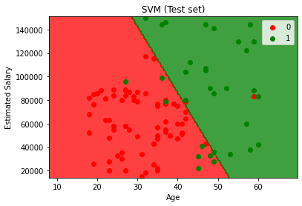
Output

