Slide 1
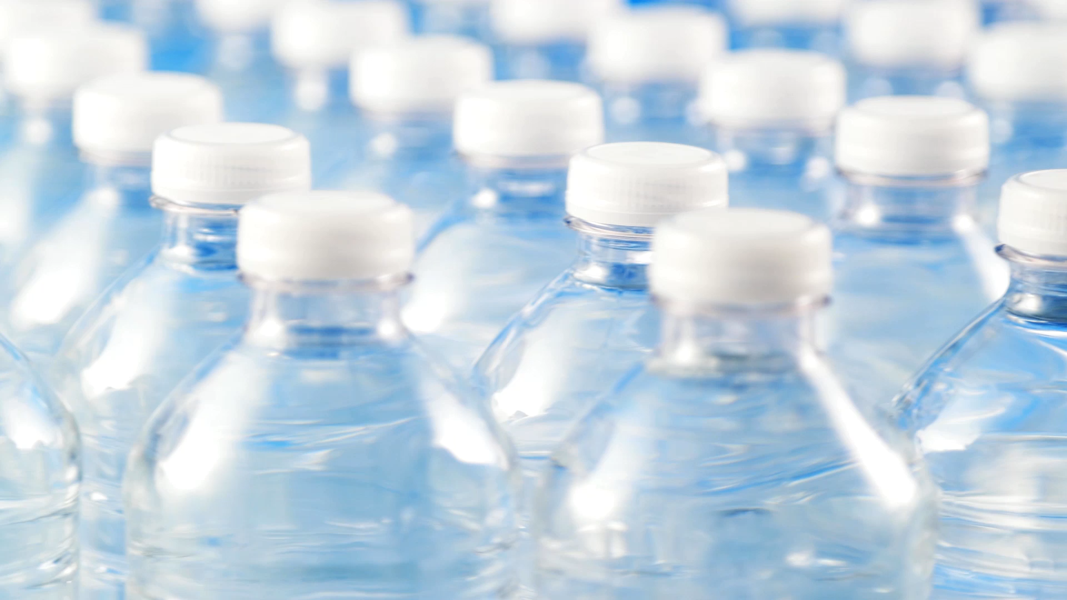
Acea Smart Water Analytics
Water flow depth prediction
Team
Abdullah
Shahiq
Himanth

Slide 2
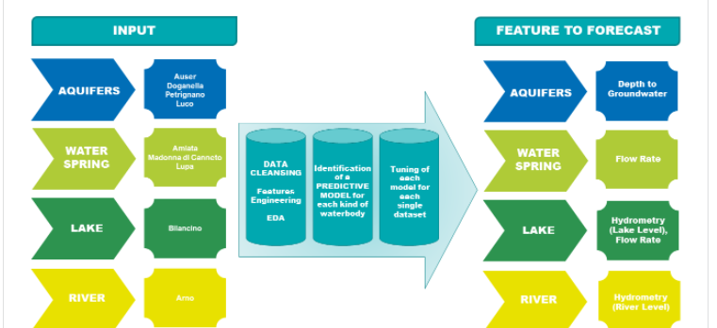
OBJECTIVE

Slide 3
Predicting waterbody depth and flow rate
.
Waterbody Type | Predicted Features
Water Spring | Flow Rate
Lake | Lake Level, Flow Rate
River | Hydrometry
Aquifer | Depth of Groundwater

Slide 4
Structure
Import the datasets
EDA
Pre-processing
Features selection
Machine learning models
Prediction

Slide 5
Machine Learning models
models
Regression
Decision Tree
Extra Trees
Random Forest
AdaBoost
Skl GBM
XGBoost
LightGBM
CatBoost

Slide 6
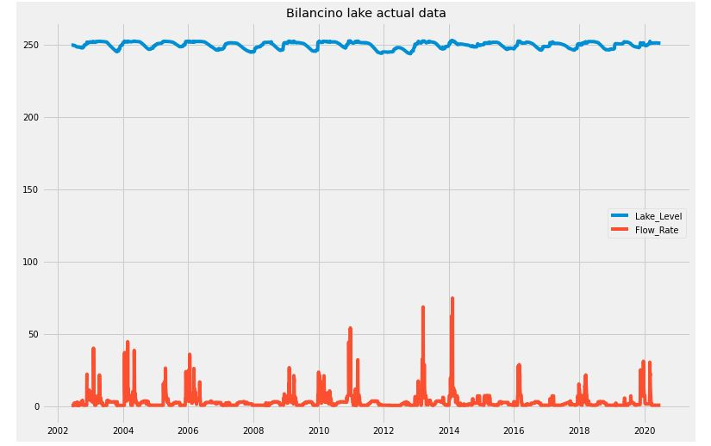
Bilancino lake

Slide 7
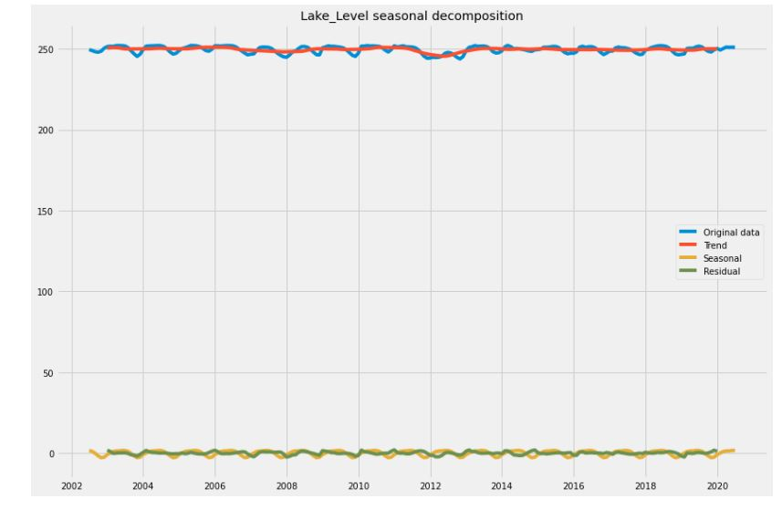

Slide 8
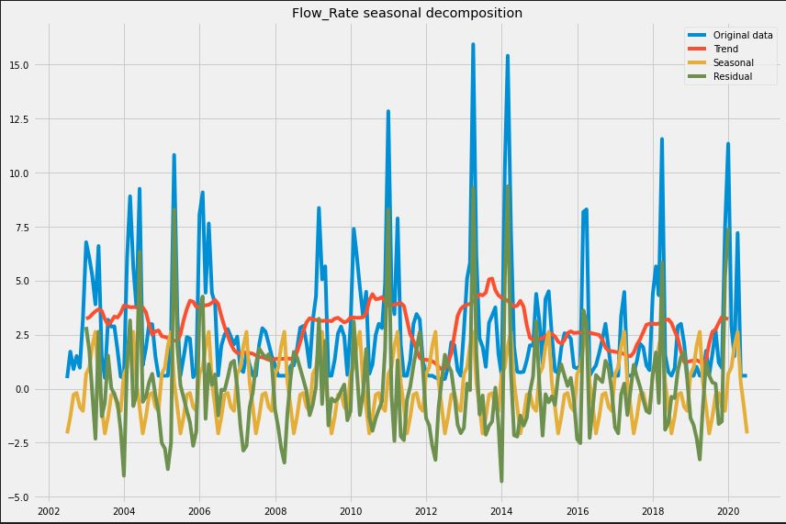

Slide 9
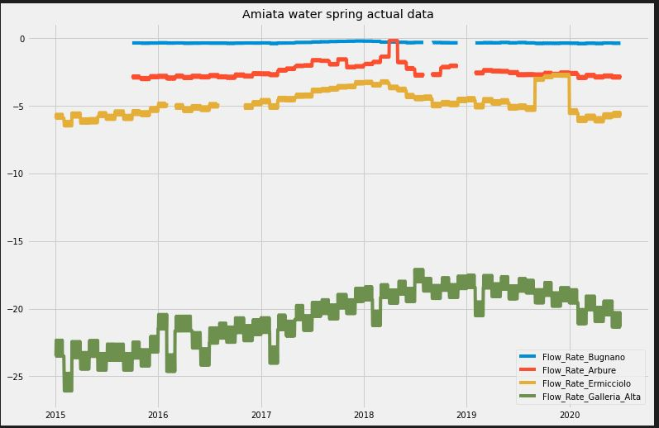
Waterspring AMIATA

Slide 10
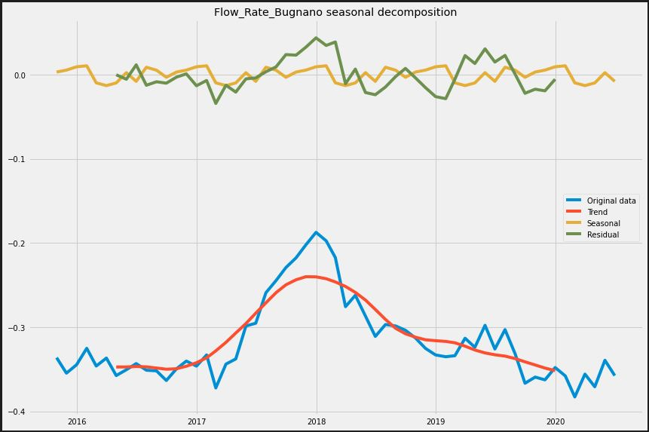

Slide 11
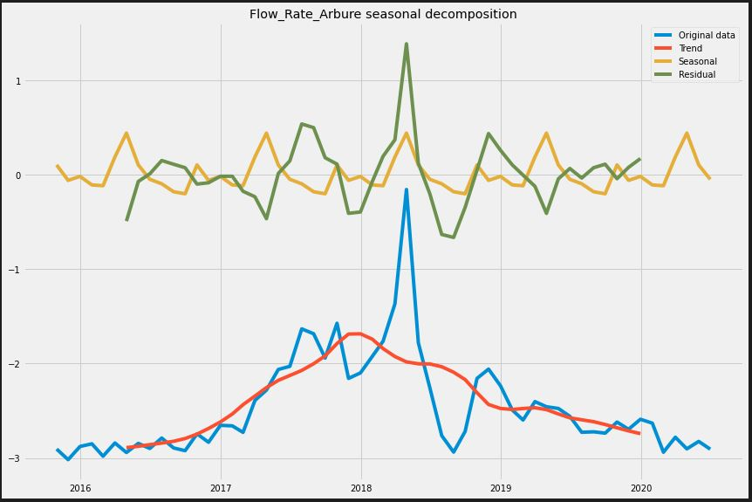

Slide 12
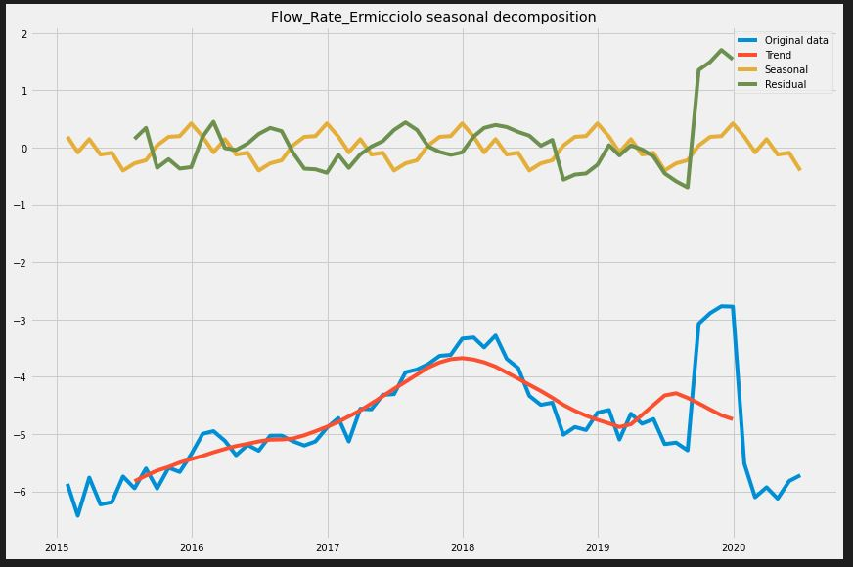

Slide 13
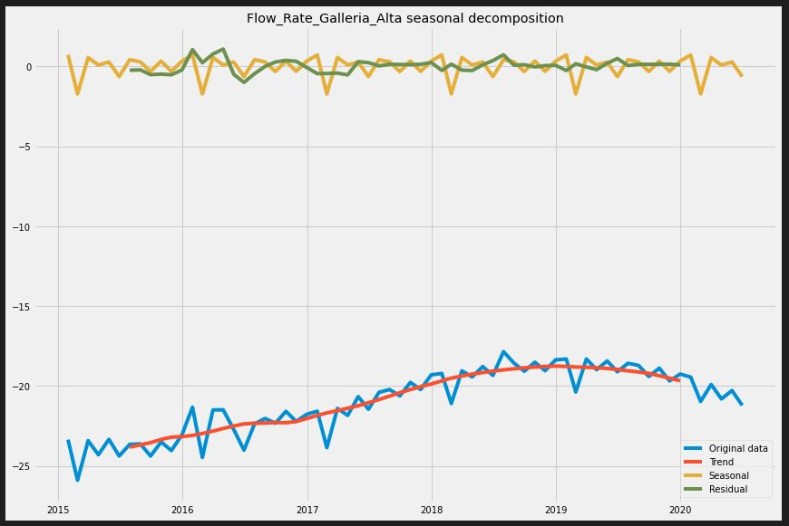

Slide 14
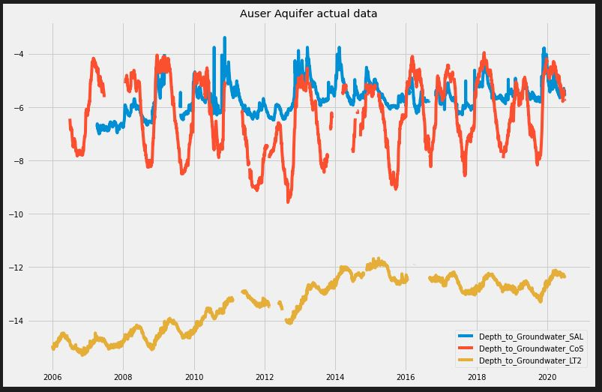
Aquifer Auser

Slide 15
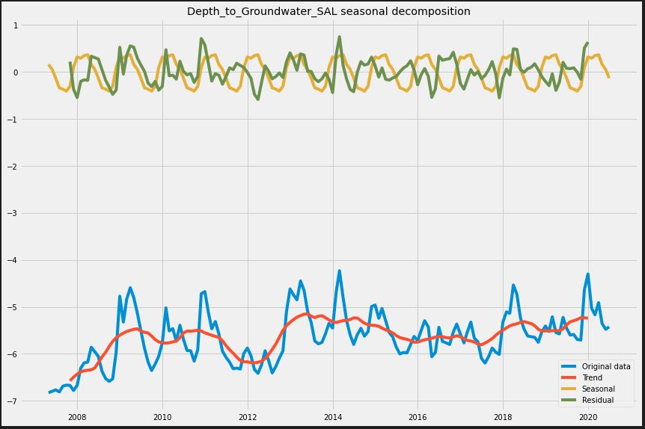

Slide 16
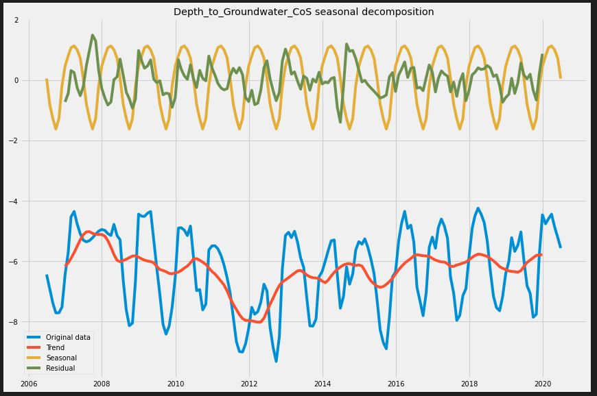

Slide 17
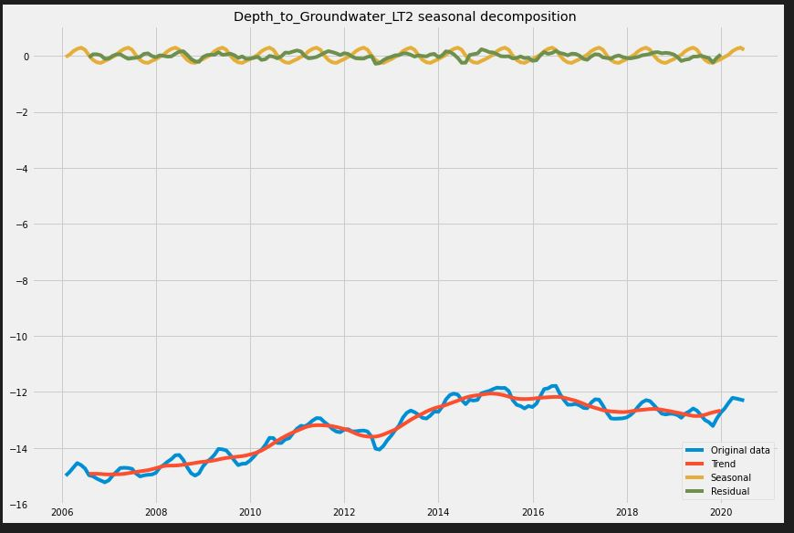

Slide 18
Thank YOU
Any Queries?

