Slide 1
Logistic Regression
Abdullah
Sohan
Himanth

Slide 2
Introduction
In statistics, the logistic model is used to model the probability of a certain class existing such as pass/fail, win/lose, alive/dead or healthy/sick.
This can be extended to model several classes of events such as determining whether an image contains a cat, dog, lion, etc.
Each object being detected in the image would be assigned a probability between 0 and 1, with a sum of one.

Slide 3
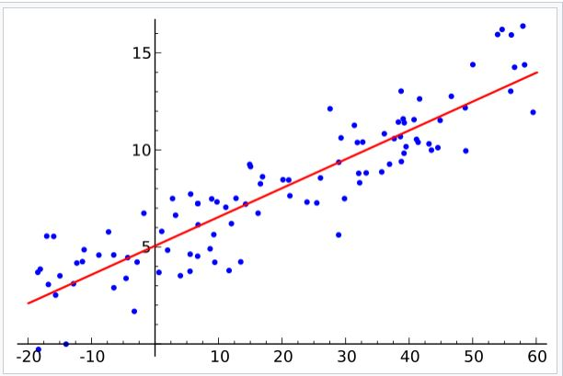
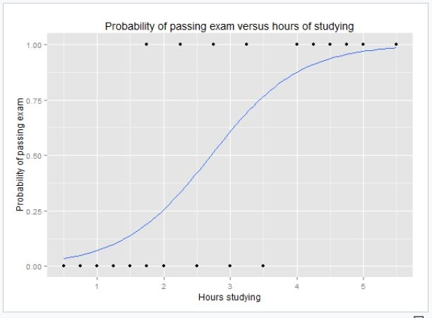
Linear regression to Logistic regression
Best fit line and segmoid

Slide 4


Slide 5
Pros
Makes no assumptions about distributions of classes in feature space
Easily extended to multiple classes (multinomial regression)
Natural probabilistic view of class predictions
Quick to train
Very fast at classifying unknown records
Good accuracy for many simple data sets

Slide 6
cons
Constructs linear boundaries

Slide 7
Thank you

