Slide 1
3.7 Stack, parameter passing and local variables

Slide 2
Stack frame
In the subroutine section, we learned how to:
  pass parameter in a subroutine
  return a value in a register
  preserve registers on a stack
The mechanism would not be sufficient if:
  we need more parameters than can be supported by built-in registers
  we need to set aside local variables within a subroutine
Stack frame is a more sophisticated mechanism for passing parameters, handling local variables and preserving registers.
Some concepts before introducing the stack frame …..

Slide 3
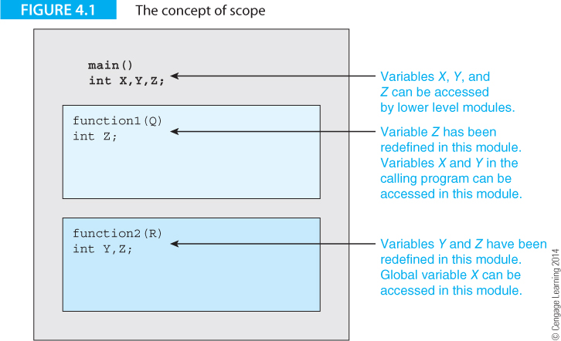
Local and global variables
The local variable Z is only accessible inside function1. The scope of the local variable Z is within function1.

Slide 4
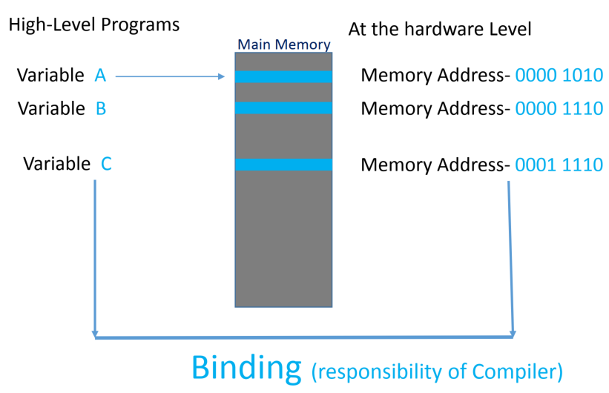
Binding
Binding: Associating a variable with its storage location
Static binding:
  this association is
  made at compile
  time.
Dynamic binding:
  this association is made at run-time.

Slide 5
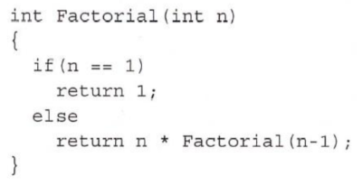

Recursion
Recursive function: a function calling itself.
The local variable n exists at different levels of the call.
Static binding does not permit recursion.
We need dynamic data storage discussed below.
$$N!=N×\left(N−1\right)!$$
Notes:
Like nested subroutine. If the variable n is stored in a fixed location determined at compile time (static binding), the variable n would be overwritten when a new subroutine is called.

Slide 6
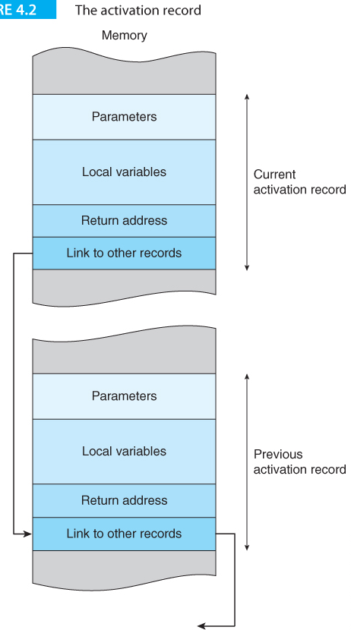
The stack and dynamic data storage
When a subroutine is called, it is said to be activated.
Each call is associated with an activation record (also called as stack frame)
The activation record is the subroutine’s view of the world.
Recursion requires dynamic data storage because storage must be allocated at runtime.
Executing a return from a subroutine deallocates or frees the storage taken up by the record.

Slide 7
Stack frame in subroutine calling
The stack frame involves three major registers:
Stack pointer (sp) contains the address (points to) the top of stack.
Link register (lr) keeps track of the program line to return to after the subroutine finishes.
Frame pointer (fp) provides a reference point in the current activation record for users to locate parameters, local variables, saved link registers and preserved registers.
Preserved Reg
Local Var
Old fp
fp
lr
Parameters
….

Slide 8
Stack frame prologue
The prologue of a subroutine consists of the following steps:
Push the fp and lr onto the stack
  fp is being preserved
  The subroutine is called by the Branch Link (bl) instruction, which stores the address of the instruction immediately following the subroutine call into lr.
Save the current sp to the fp.
Allocate local variable storage space on the stack.
Push register to preserve onto the stack
sp
Preserved Reg 3
Preserved Reg 2
Preserved Reg 1
sp
Local Var 3
Local Var 2
Local Var 1
sp
Old fp
fp
lr
sp
Parameters
….

Slide 9
After prologue
sp
Preserved Reg 3
Preserved Reg 2
Preserved Reg 1
Local Var 3
Local Var 2
Local Var 1
Old fp
fp
lr
Parameters
….

Slide 10
ARM code implementing prologue
Sub:
stmfd sp!, {fp, lr} //Step 1
mov fp, sp //Step 2
sub sp, sp, #4 //Step 3: assuming only one local variable
stmfd sp!, {r1-r3} // Step 4: assuming r1 to r3 are used in the subroutine
sp
Preserved Reg 3
Preserved Reg 2
Preserved Reg 1
Local Var 3
Local Var 2
Local Var 1
Old fp
fp
lr
Parameters
….

Slide 11
Stack frame epilogue
The epilogue of a subroutine consists of the following steps:
Pop preserved registers from the stack.
Deallocate local variable storage from the stack
Pop fp and pc from the stack
  the pc now contains the saved lr → Execution resumes at the line after the subroutine call
sp
Old fp
lr
Preserved Reg 3
Preserved Reg 2
Save to original
registers
Preserved Reg 1
sp
Local Var 3
Local Var 2
Local Var 1
sp
fp
[fp]←Old fp
[pc]←lr
sp
Parameters
….

Slide 12
ARM code implementing prologue
ldmfd sp!, {r1-r3} // Step 1
add sp, sp, #4 // Step 2
ldmfd sp!, {fp, pc} // Step 3

Slide 13
State after epilogue
The state of memory, except for the returned values in r0 and updated parameter values, should be the same as before the subroutine was called.
Local variables are called “local” because after the subroutine is done, references to all these local variables are removed (i.e., they cannot be accessed).
Note that popped and deallocated values are still there, as the stack frame does not “clean up” memory used in the stack, but they are no longer kept track of by sp and will be overwritten by other uses of the stack.
Old fp
lr
Preserved Reg 3
Preserved Reg 2
Preserved Reg 1
Local Var 3
Local Var 2
Local Var 1
sp
Parameters
….

Slide 14
Before and after calling a subroutine
Before calling the subroutine:
Push parameter(s) to the stack
After returning from the subroutine
Deallocate parameter(s) from the stack

Slide 15
Example 1: Putting it together
Write a program that calculates the value of f(x) where
  f(x) = g(x) + h(x),
  where g(x) = x² and h(x) = x+0x18
Use r1 to store g
Use r2 to store h
The output is stored in r0
Need to preserve r1 and r2
No local variable

Slide 16
.global _start
_start:
mov sp, #0
mov fp, #0
ldr r1, =0x08
stmfd sp!, {r1} // push parameter to stack (Point 1)
bl Sub
add sp, sp, #4 // Deallocate the parameter (Point 7)
_stop:
b _stop
Sub:
//Prologue
stmfd sp!, {fp, lr} // Step 1 (Point 2)
mov fp, sp //Step 2 (Point 3)
//Step 3: No local variable
stmfd sp!, {r1-r3} // Step 4: Preserve r1 and r2 (Point 4)
ldr r3, [fp, #8] // Retrieve parameter and store in r3
mul r1, r3, r3 // Use r1 to store g
add r2, r3, #0x18 // Use r2 to store h
add r0, r1, r2 // Compute sum of g and h and save in
// r0 as the return value.
//Epilogue
ldmfd sp!, {r1-r3} // Step 1 (Point 5)
// Step 2: No local variable
ldmfd sp!, {fp, pc} // Step 3 (Point 6)
.end

Slide 17

Pt | Stack | sp | fp
1 |  | FFFFFFFC | 0
2 |  | FFFFFFF4 | 0
3 |  | FFFFFFF4 | FFFFFFF4
4 |  | FFFFFFE8 | FFFFFFF4
5 |  | FFFFFFF4 | FFFFFFF4
6 |  | FFFFFFFC | 0
7 |  | 0 | 0

Slide 18
Example 2: Nested Subroutine Revisited
The following program calculates the value of f(0x08) where
  f(x) = g(x+0x18) + 0x05
  g(x) = x+0x12
No local variables in both subroutines
r0 is used to store the output

Slide 19
ldr sp, =0
ldr fp, =0
ldr r1, =0x08
stmfd sp!, {r1} //push parameter of f to stack (Point 1)
bl f
add sp, sp, #4 //deallocate parameter for f
(Point 14)
Here:
b Here
f:
// Prologue
stmfd sp!, {fp, lr} // Step 1 (Point 2)
mov fp, sp // Step 2 (Point 3)
// Step 3: No local variable
stmfd sp!, {r1} // Step 4 (Point 4)
ldr r1, [fp, #8] // Retrieve parameter of f
add r1, r1, #0x18 // generate parameter for g
stmfd sp!, {r1} // push parameter of g to stack (Point 5)
bl g
add sp, sp, #4 // deallocate parameter for g
(Point 11)
add r0, r0, #0x05 // Calculate output parameter and store in r0
//Epilogue
ldmfd sp!, {r1} // Step 1 (Point 12)
//Step 2: No local variable
ldmfd sp!, {fp, pc} // Step 3 (Point 13)
g:
// Prologue
stmfd sp!, {fp, lr} // Step 1 (Point 6)
mov fp, sp // Step 2 (Point 7)
stmfd sp!, {r1} (Point 8)
ldr r1, [fp, #8]
add r0, r1, #0x12 // Calculate output parameter and store in r0
//Epilogue
ldmfd sp!, {r1} // Step 1 (Point 9)
//Step 2: No local variable
ldmfd sp!, {fp, pc} // Step 3 (Point 10)
.end

Slide 20
Pt | Stack | sp | fp
1 |  | FFFFFFFC | 0
2 |  | FFFFFFF4 | 0
3 |  | FFFFFFF4 | FFFFFFF4
4 |  | FFFFFFF0 | FFFFFFF4
5 |  | FFFFFFEC | FFFFFFF4
6 |  | FFFFFFE4 | FFFFFFF4
7 |  | FFFFFFE4 | FFFFFFE4

Slide 21
Pt | Stack | sp | fp
8 |  | FFFFFFE0 | FFFFFFE4
9 |  | FFFFFFE4 | FFFFFFE4
10 |  | FFFFFFEC | FFFFFFF4
11 |  | FFFFFFF0 | FFFFFFF4
12 |  | FFFFFFF4 | FFFFFFF4
13 |  | FFFFFFFC | 0
14 |  | 0 | 0

Slide 22
Example 3: Pass by reference (Lab 6)
Suppose you have the following data:
.data
.align
x:
.word 15
y:
.word 9
You want to swap the two values.
You could pass the values 15 and 9 to the stack and swap their positions in the stack, but that is not what you want to achieve. This “pass-by-value” approach does not work.
You want to pass the addresses of 15 and 9 as parameters to the stack so that the values in the two memory locations get swapped. This is referred to as “pass by reference”.

Slide 23
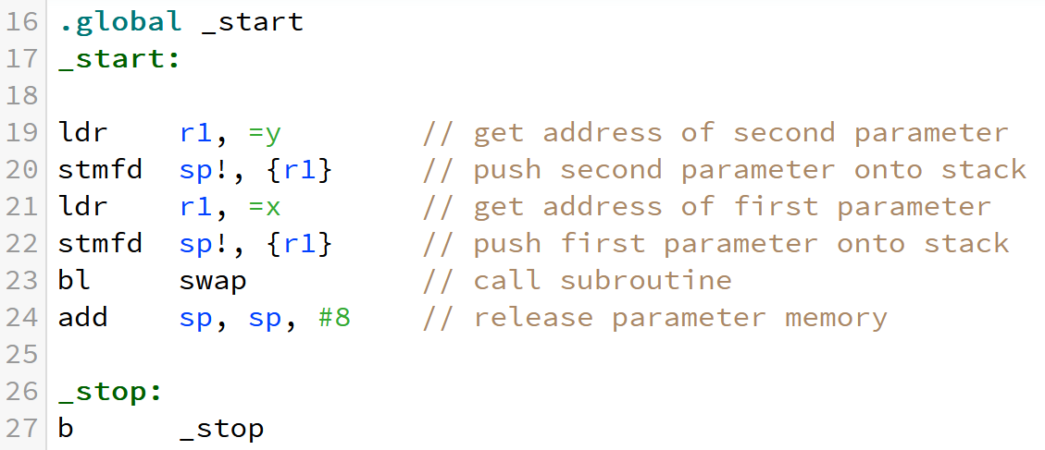
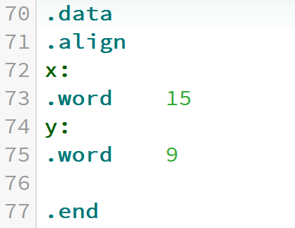
Swap: Pass by reference
Main Program
Data Storage

Slide 24
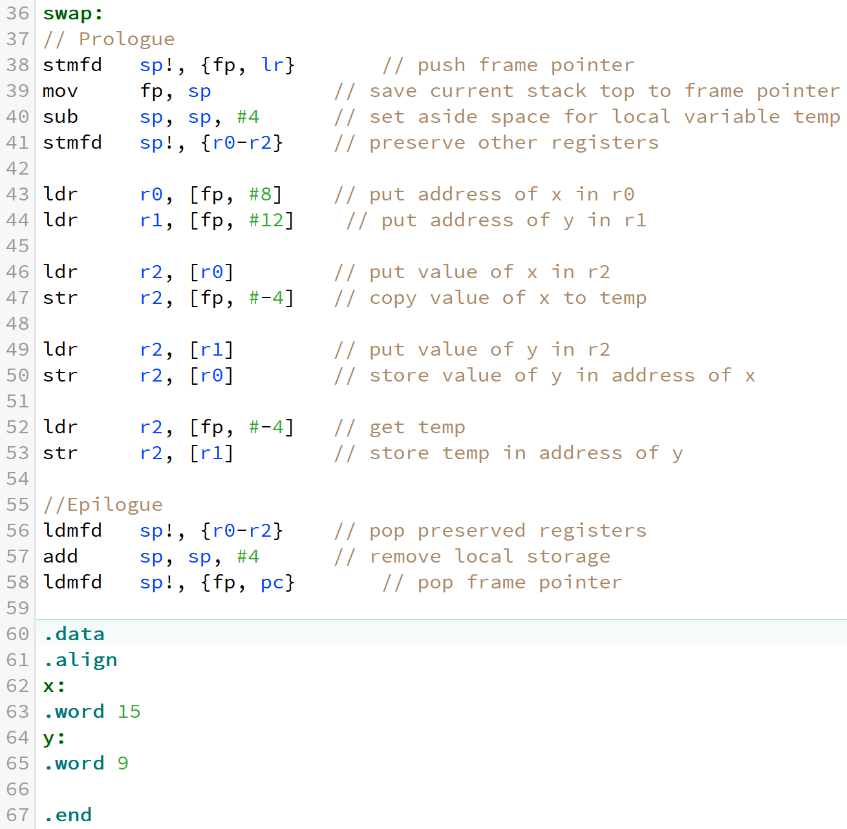
Swap: Pass by reference
--------------------------------------------------
swaps location of two values in memory.
--------------------------------------------------
Parameters:
[fp, #8] – address of x
[fp, #12] – address of y
Local variable
temp (4 bytes on stack)
Uses:
r0 - stores address of x
r1 - stores address of y
r2 - registers for swapping operations
-----------------------------------------------------

Slide 25
Swap: Pass by reference
Stack after prologue of swap
Position
w.r.t. fp
sp
r0
r1
r2
Old fp
lr
Address of x
Address of y
-16
-12
-8
-4
0
4
8
12
temp
15
fp
15
9
15
9
r2
15
9

Slide 26
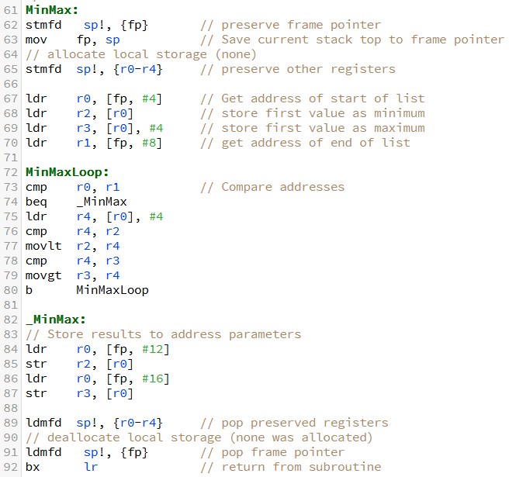
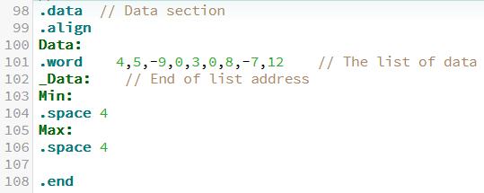
MinMax subroutine in Lab 6
-------------------------------------------------------
Finds the minimum and maximum values in a list.
Equivalent of: void MinMax (*start, *end, *min, *max)
Passes addresses of list, end of list, max, and min as parameters.
-------------------------------------------------------
Parameters:
start - start address of list (fp + 4)
end - end address of list (fp + 8)
min - address of minimum result (fp + 12)
max - address of maximum result (fp + 16)
Uses:
r0 - address of start of list
r1 - address of end of list
r2 - minimum value so far
r3 - maximum value so far
r4 - address of value to process
-------------------------------------------------------

Slide 27
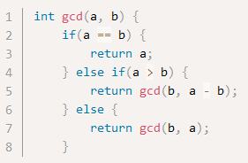
Example 3: Recursion (Lab 7)
The following C code implements the Eucildean algorithm in computing the Greatest Common Denominator (gcd) of two integers.

Slide 28
Example 3: Recursion (Lab 7)
Principle:
Condition 1:
  If a>b, the problem can be reduced using the following property:
    gcd (a, b) = gcd (b, a-b)
Condition 2:
  If b>a, reverse the order by calling gcd (b,a)
  Inside this gcd call, condition 1 would be satisfied, thereby reducing the problem.
Eventually, the two input arguments are equal and gcd (a,a) = a

Slide 29
Numerical Examples
Large-Small | 20 | 15
20-15 | 5 | 15
15-5 | 5 | 10
10-5 | 5 | 5
Large-Small | 60 | 36
60-36 | 24 | 36
36-24 | 24 | 12
24-12 | 12 | 12
gcd (20, 15)
gcd (15, 5)
gcd (5, 10)
gcd (10, 5)
gcd (5, 5)
Two arguments are the same.
gcd = 5
gcd (60, 36)
gcd (36, 24)
gcd (24, 12)
gcd (12, 12)
Two arguments are the same.
gcd = 12

Slide 30
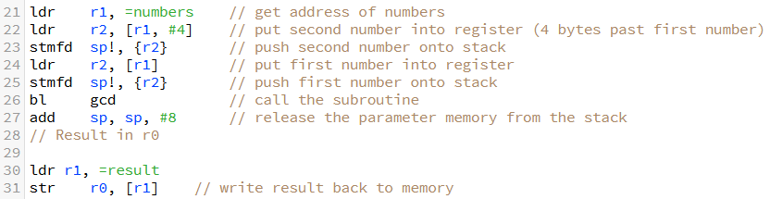
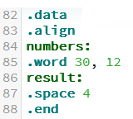
Example 3: Recursion (Lab 7)
Main Program
Before calling the subroutine:
Push second and then first parameter(s) to the stack
After returning from the subroutine
Deallocate parameter(s) from the stack
Data Section

Slide 31
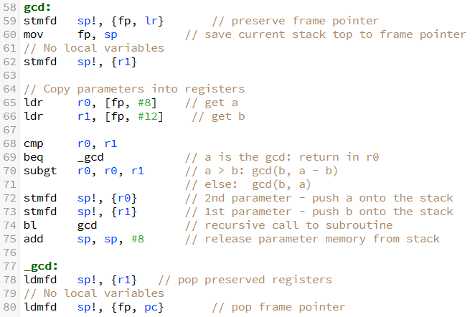
gcd subroutine
Finds the Greatest Common Denominator of two integers (recursive)
Uses simple recursive algorithm:
int gcd(a, b) {
if(a == b) {
return a;
} else if(a > b) {
return gcd(b, a - b);
} else {
return gcd(b, a);
}
-----------------------------------------------------
Parameters:
a - value of first number
b - value of second number
Returns:
r0 - GCD of a and b
Uses:
r0 - value of a - return value
r1 - value of b
-----------------------------------------------------
Notes:
if (a > b), a would become a-b, otherwise a is unchanged.

Slide 32
Skeleton of the subroutine
Standard Prologue
Just like before and after calling a subroutine in the main program, we need to:
Push parameters to stack before calling subroutine
Deallocate parameters when the subroutine finishes
Standard Epilogue

Slide 33
Example: gcd (18,12)
Sequence of calls:
gcd (18, 12) from main program
gcd (12, 6)
gcd (6, 6) → return 6

Slide 34

Example: gcd (18,12)
Call gcd (18, 12) from main program
State of the stack after the prologue of gcd:
sp
r1
fp
Old fp
lr
Parameters

Slide 35
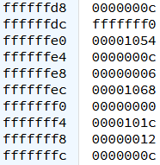
Example: gcd (18,12)
2. Call gcd (12, 6)
State of the stack after the prologue of gcd:
sp
r1
fp
Old fp
lr
Parameters

Slide 36
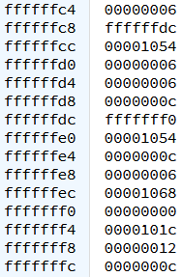
Example: gcd (18,12)
3. Call gcd (6, 6)
State of the stack after the prologue of gcd:
sp
r1
fp
Old fp
lr
Parameters

