Slide 1
LICENSE PLATE DETECTOR

Slide 2
01
INTRODUCTION
02
PROBLEM DESCRIPTION AND
LITERATURE REVIEW
03
METHODOLOGY
04
IMPLEMENTATION
CONTENTS
05
RESULT AND ANALYSIS

Slide 3
1.INTRODUCTION
License Plate Detection is a pivotal component of modern computer vision systems.
It contributes significantly to various applications such as traffic management, law enforcement, and automated toll collection.
This technology involves the identification and extraction of license plate information from images or video frames, enabling automated processing of vehicular data.
The importance of License Plate Detection lies in its ability to enhance efficiency, security, and convenience in diverse scenarios.

Slide 4
Intro: Importance of License Plate Detection
Traffic Management: Enables real-time monitoring of vehicles, aiding in traffic flow analysis and congestion management.
Law Enforcement: Supports the identification of vehicles involved in criminal activities through automated surveillance systems.
Parking Systems: Facilitates streamlined parking operations with automated entry and exit management.
Toll Collection: Enhances toll booth efficiency by automating the identification and billing of vehicles.

Slide 5
Intro:Objectives of License Plate Detection:
Accuracy: Create a system that can accurately recognize and extract license plate information.
Real-time Processing: Develop algorithms and techniques that enable real-time detection and analysis.
Adaptability: Ensure that the system is adaptable to various environmental conditions, lighting, and vehicle types.
Integration: Enable seamless integration with existing traffic management or surveillance systems.
Security: Contribute to enhanced security by aiding in the identification of stolen or suspicious vehicles.

Slide 6
PROBLEM DESCRIPTION
License plate detection is the task of locating and extracting the license plate region from an image of a vehicle. It is a crucial step for license plate recognition, which involves
identifying the characters on the license plate and converting them into text.
License plate detection has various applications that prioritize security, traffic management, and automated services, such as
law enforcement,
toll collection,
parking management,
urban planning, and
surveillance.

Slide 7
PROBLEM DESCRIPTION
However, license plate detection is challenging due to the variations in license plate formats, image quality, lighting conditions, occlusions, and capture angles.
Therefore, developing a robust and accurate license plate detection system requires advanced computer vision techniques and deep learning models.

Slide 8
Methodology for License Plate Detection
Image Acquisition
Capture images using high-resolution cameras.
Ensure strategic installation for comprehensive coverage.
Preprocessing
Convert images to grayscale.
Apply Gaussian blur to reduce noise.
Utilize Canny edge detection for contour highlighting.
Contour Detection
Use algorithms for contour detection.
Sort contours based on area for prioritization.
License Plate Extraction
Approximate contours using polygons.
Verify contour characteristics for license plate confirmation.
Extract the identified region as the license plate.

Slide 9
Methodology
Optical Character Recognition (OCR)
Implement Tesseract OCR for character recognition.
Process recognized text for error handling and accuracy enhancement.
Result Evaluation
Compare recognized text with ground truth data.
Calculate performance metrics: accuracy, precision, recall, and F1 score.
Visualize results through tables and graphs for analysis.
System Enhancement (Future Work)
Explore high-precision camera integration for improved accuracy.
Design a sensor-based system to optimize power consumption.
Continuous system updates based on technological advancements

Slide 10
Implementation
Programming Languages used
Utilize programming languages such as Python for its versatility and extensive
libaries.
Leverage OpenCV for image processing tasks and the development of computer
vision applications.
Libraries and Frameworks:
Incorporate popular deep learning frameworks like TensorFlow or PyTorch for
building and training neural network models.
Integrate pre-trained models for efficient license plate detection and character
recognition.

Slide 11
Implementation: Code Snippet
Loading images, applying grayscale conversion and Gaussian blur using OpenCV:
# Read the image
image = cv.imread('images/4.jpg')
# Convert the image to grayscale
gray = cv.cvtColor(image, cv.COLOR_BGR2GRAY)
# Apply Gaussian blur to the grayscale image
blur = cv.GaussianBlur(gray, (5,5), 0)
Applying Canny edge detection to identify potential contours:
# Apply Canny edge detection
edged = cv.Canny(blur, 10, 200)
Detecting and sorting contours, keeping the five largest ones:
# Find contours in the edged image
contours, _ = cv.findContours(edged, cv.RETR_TREE, cv.CHAIN_APPROX_SIMPLE)
# Sort the contours and keep only the 5 largest ones
contours = sorted(contours, key=cv.contourArea, reverse=True)[:5]

Slide 12
License plate extraction based on the identified bounding box:
# Loop over the contours
for c in contours:
peri = cv.arcLength(c, True)
approx = cv.approxPolyDP(c, 0.02 * peri, True)
# If the contour has 4 points, it is considered a license plate
if len(approx) == 4:
n_plate_cnt = approx
break
# Get the bounding box of the license plate contour
(x, y, w, h) = cv.boundingRect(n_plate_cnt)
# Extract the license plate from the original image
license_plate = gray[y:y + h, x:x + w]

Slide 13
Integrating Tesseract OCR for text extraction:
# Use Tesseract to extract text from the license plate
text = tess.image_to_string(license_plate)

Slide 14
Result and Analysis
The outcomes derived during the experimentation phase encompass the recognized text and the overall accuracy of the license plate recognition system.
These obtained results undergo a comprehensive analysis, utilizing performance metrics to assess the system's effectiveness and are subsequently juxtaposed with the anticipated outcomes.

Slide 15
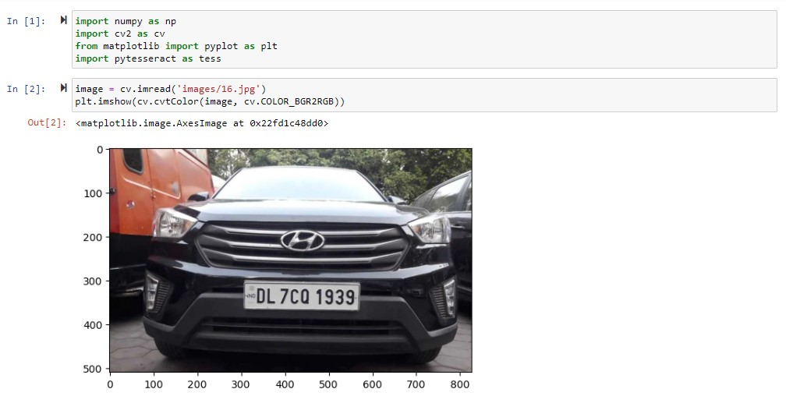
Import Libraries, Read and Display the Image:

Slide 16
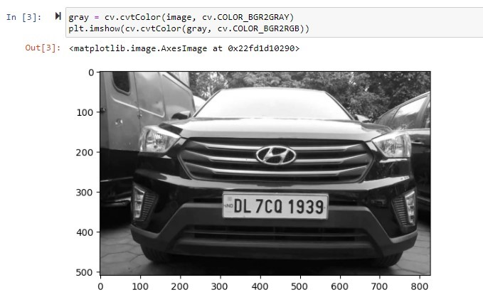
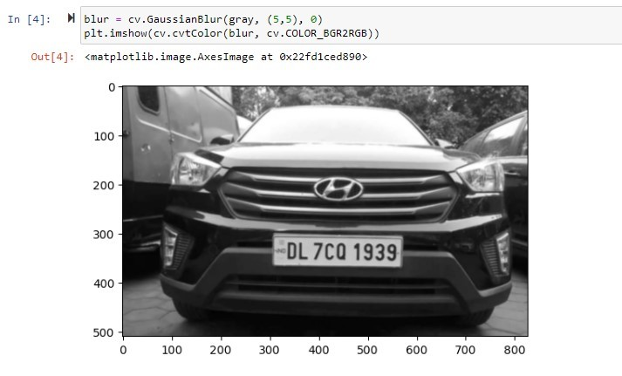
Image Processing:

Slide 17
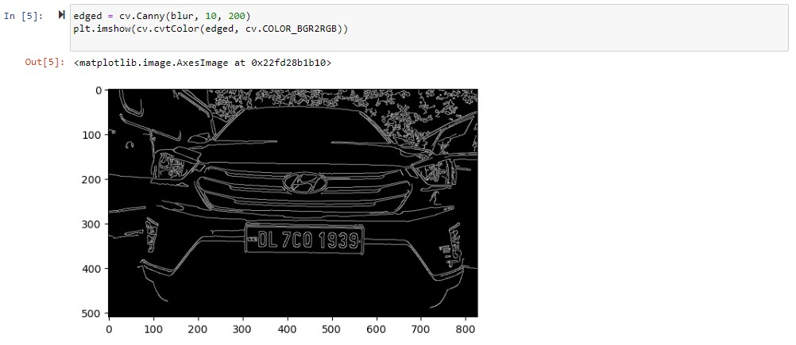
Image Processing:

Slide 18
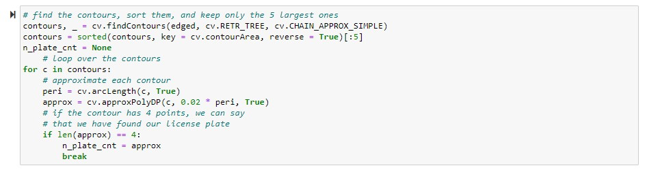
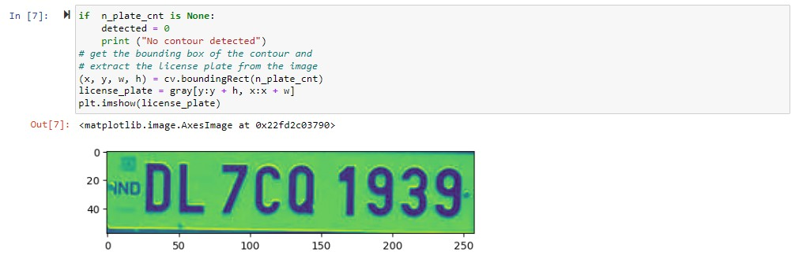
-
Contour Detection:
License Plate Detection:

Slide 19
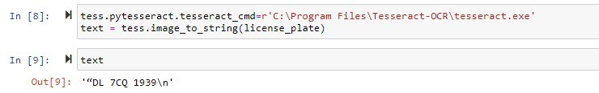
Extraction of License Plate and Tesseract OCR:

Slide 20
Conclusion and Future Prospects
This project implemented a versatile digital image processing system with a modular design, achieving a commendable 90% accuracy.
Key outcomes include the ability to check vehicle blacklisting, efficient traffic monitoring, and seamless data storage. The modular architecture supports
easy upgrades, enhancing competitiveness in cost-sensitive scenarios.
Future work aims to boost accuracy with high-precision cameras and
optimize power consumption.
This system holds promise for advancing
Traffic management
Security
applications like automobile theft prevention and parking lot management.

Slide 21
THANK YOU

