Slide 1




Case File Management & Analytics Portal (Legal Services)
Team : 11
P.Ruhitha 2520080053
M.Ananya 2520080069
S.Himasree 2520090181

Slide 2


Problem Statement
Legal case information is often maintained across multiple files, documents, and manual records, making it difficult to efficiently store, retrieve, update, and track case details. This can result in data duplication, inconsistent records, difficulty in monitoring hearings and case status, and delays in accessing important information. There is a need for a centralized database system that organizes legal case records and enables efficient retrieval, tracking, and analysis of case-related information.

Slide 3
Abstract
Legal case management involves handling a large amount of information, such as case details, clients, lawyers, judges, hearings, documents, and judgments. When these records are managed manually or stored across different files, it can become difficult to find information, track case progress, monitor hearings, and understand the workload of legal professionals. The proposed Case File Management & Analytics Portal is a centralized web application designed to make legal case management simpler and more organized. The system will store case-related information in a structured MySQL database, allowing users to easily add, update, search, and retrieve records. By connecting cases with their clients, lawyers, judges, hearings, documents, and judgments, the system provides a clear view of the complete history and current status of each case.

Slide 4
Abstract
The portal will also include SQL-based analytics to provide useful insights, such as pending and resolved cases, case distribution by type and status, active cases handled by lawyers, hearing statistics, document counts, and average case duration. These results will be presented through summary tables and dashboard metrics to make the information easier to understand. Overall, the project aims to improve the organization, consistency, accessibility, and retrieval of legal information while demonstrating key Database Management System concepts such as relational schema design, normalization, primary and foreign keys, constraints, joins, filtering, grouping, and aggregate queries. The system will be developed using React for the frontend, Node.js for the backend, and MySQL for database management.

Slide 5
Objectives
  To develop a centralized system for storing and managing legal case information.
  To reduce data duplication and inconsistencies caused by maintaining records across multiple files.
  To provide easy access to case details, clients, lawyers, judges, hearings, documents, and judgments.
  To enable efficient searching, updating, and retrieval of case information.
  To track case status, hearing schedules, and case progress.
  To generate useful analytics such as pending/resolved cases, case distribution, lawyer workload, and hearing statistics.
  To demonstrate DBMS concepts such as normalization, primary keys, foreign keys, constraints, joins, grouping, and aggregate queries.

Slide 6
Proposed System
Main Features:
  Case Management – Add, update, search, and track legal cases.
  Client Management – Maintain client information and link clients with their cases.
  Lawyer Management – Store lawyer details and track their active cases.
  Judge Management – Maintain information about judges handling cases.
  Hearing Management – Record hearing dates, outcomes, and next hearing dates.
  Document Management – Maintain case-related document records.
  Judgment Management – Store judgment details and final decisions.
  Analytics Dashboard – Display statistics about case status, types, hearings, workload, and duration.

Slide 7




Methodology
Requirement Analysis
Identify the information that needs to be managed, including cases, clients, lawyers, judges, hearings, documents, and judgments.
Frontend Development
Develop the user interface using React, HTML, CSS, and JavaScript. The interface will allow users to add, update, search, and retrieve case information.
Backend Development
Use Node.js to handle communication between the frontend and MySQL database and process user requests.
SQL-Based Analytics
Create SQL queries using joins, filtering, grouping, and aggregate functions to generate information such as pending/resolved cases, lawyer workloads, hearing statistics, document counts, and average case duration.
Dashboard & Testing
Present the analytical results through summary tables and dashboard metrics, and test the system to ensure that data can be correctly added, updated, retrieved, and analyzed.

Slide 8



Frontend Design
Role-Based Dashboards
Easy Navigation
Case Management
Separate interfaces for Lawyer and Client users.
Sidebar navigation for cases, hearings, documents and analytics.
Search, filter and track cases using clear status indicators.
Hearing Tracking
Data Visualization
User-friendly Interface
Upcoming hearings, dates, courts and case timelines.
Charts and dashboard cards present key case statistics.
Buttons, forms, search bars and controls improve usability.

Slide 9
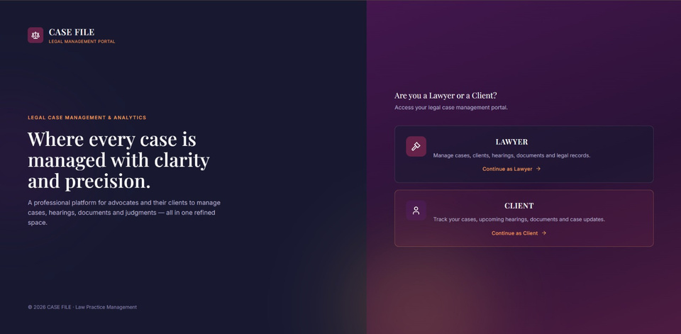
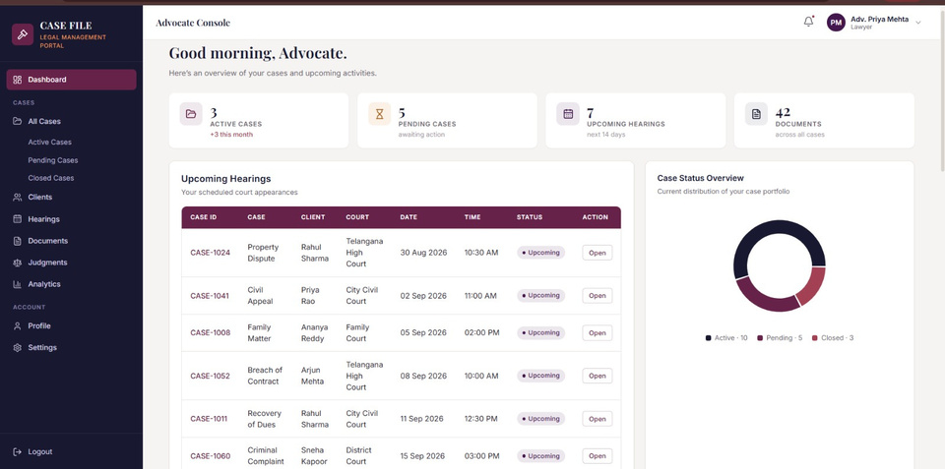
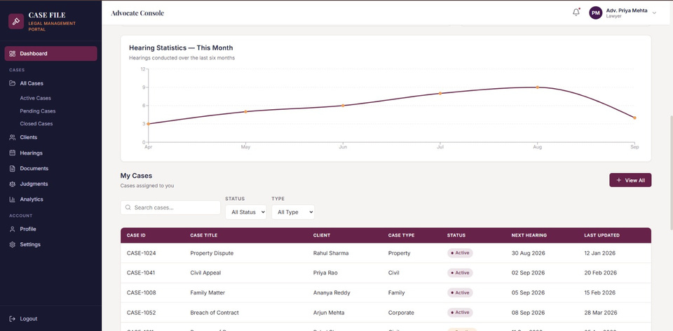
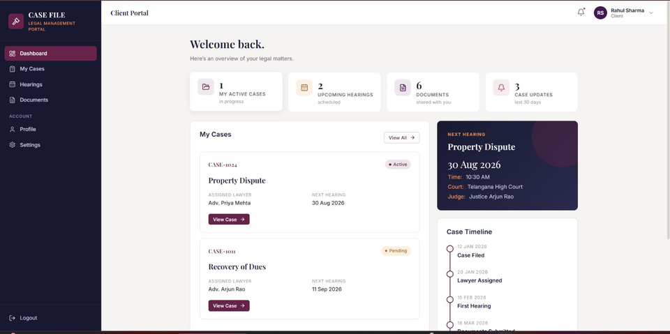
Frontend Implementation

Slide 10




Database Design
user
clients
lawyers
judges
PK user_id • name • email
password • role • phone
UNIQUE: email
PK client_id •FK user_id • name • email password • created_at• phone UNIQUE: email
PK lawyer_id • FK user_id
bar_number • specialization
experience_years • UNIQUE bar no
PK judge_id • name
court • specialization
contact details
Hearings
Documents
judgements
PK case_id • UNIQUE case_number
title • case_type • description
filing_date • status • court
FK client_id → Clients
FK lawyer_id → Lawyers
PK hearing_id
FK case_id • FK judge_id
hearing_date • hearing_time
court_room • purpose • status
PK document_id
FK case_id • FK uploaded_by
document_name • type
upload_date • file_path
PK judgment_id
FK + UNIQUE case_id
judgment_date • decision
summary • remarks
1 Case → max 1 Judgment

Slide 11
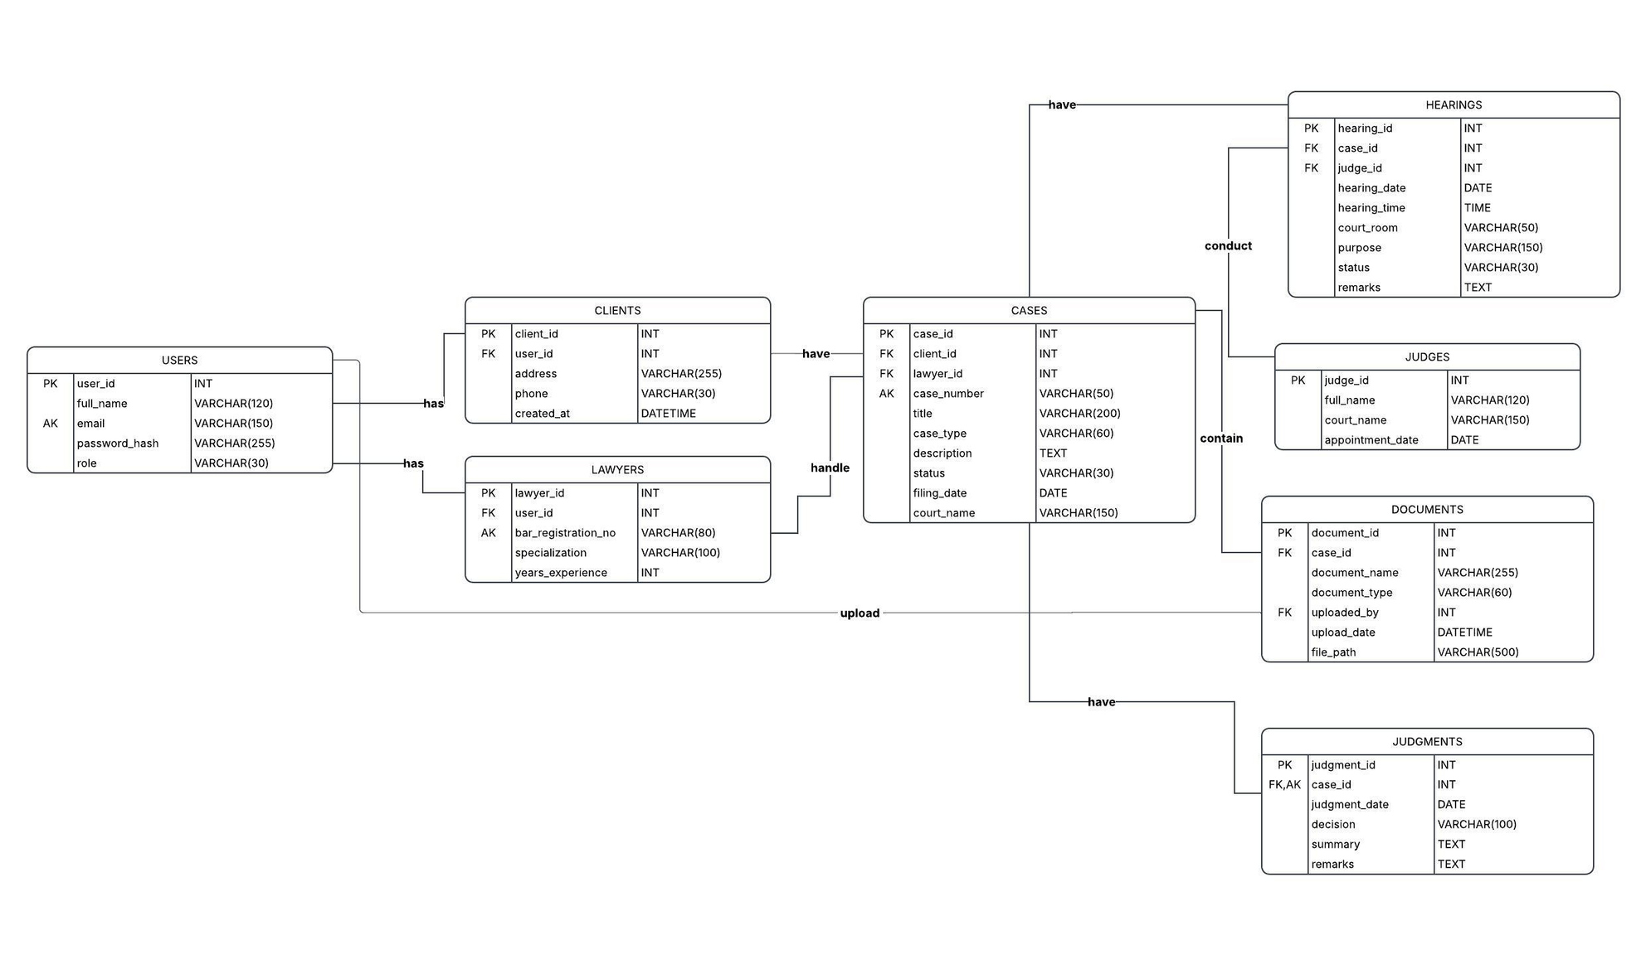
Database ER diagram

Slide 12
1. Software Used
  MongoDB
  MYSQL
  Workbench
  VS Code
  Git + GitHub
  React
  HTML
  CSS
  JavaScript
  Node.js

Slide 13
Chanllenges & Issues Faced
  Designing relationships between multiple legal entities.
  Avoiding duplicate data while storing information about cases, clients, lawyers, and hearings.
  Maintaining consistency between related tables using foreign keys.
  Handling different case statuses such as Active, Pending, and Resolved.
  Writing SQL queries involving multiple tables and joins.
  Generating meaningful analytics using GROUP BY and aggregate functions.
  Ensuring that updating or deleting records does not break relationships.
  Connecting the React frontend with the Node.js backend and MySQL database.
  Managing and retrieving large amounts of case-related information efficiently.

Slide 14
Future Work
  Add user authentication and role-based access for administrators, lawyers, and other authorized users.
  Add automated hearing reminders and notifications.
  Allow secure uploading and downloading of case documents.
  Add advanced dashboard visualizations and reports.
  Implement advanced search and filtering.
  Develop a mobile-friendly version of the portal.

Slide 15
Conclusion
The Case File Management & Analytics Portal provides a centralized and structured solution for managing legal case information. By connecting cases with clients, lawyers, judges, hearings, documents, and judgments, the system makes legal records easier to store, retrieve, update, and track.
The use of MySQL provides a reliable relational database structure with primary keys, foreign keys, constraints, and relationships. SQL-based analytics can provide useful insights into case status, lawyer workload, hearings, document counts, and case duration.
Overall, the proposed system reduces the limitations of manual and scattered record management while demonstrating important Database Management System concepts such as relational schema design, normalization, joins, filtering, grouping, and aggregate queries.

Slide 16
THANK YOU

