Slide 1



KLH University
Employee Attendence
Management
Jalla Geya reddy 2520090123
Kamtam Priyanka 2520090001
Surapuraju Himasree 2520090181
Maroju Ananya 2520080069

Slide 2
01
Problem Statement
02
Solution
Overview
03
Proposed System
04
Module Implementation

Slide 3

Problem Statement
The Background of
My Project
The Problem That Keeps
Us Thinking
Organizations often depend on manual attendance systems, which can cause inaccurate records, missed check-ins, and difficulties in managing employee shifts and working hours.
Identifying unusual attendance patterns, such as repeated late arrivals, early departures, and irregular working hours, is difficult manually. An automated system with AI-based anomaly detection can help HR teams monitor attendance and improve workforce management.

Slide 4

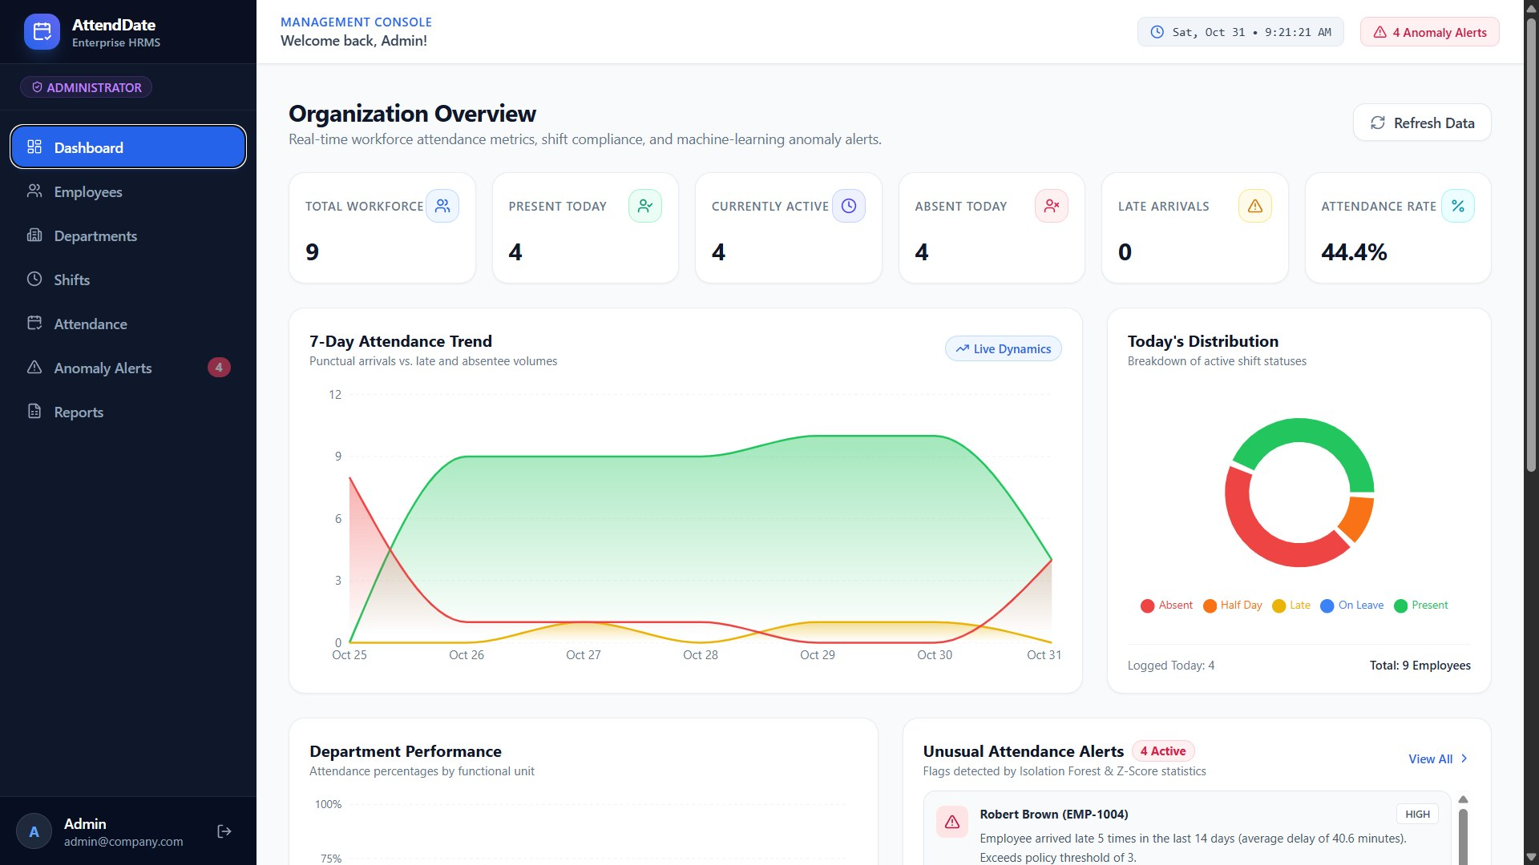
Proposed Solution
The proposed system is a web-based Employee Attendance Management Platform that automates employee check-in/check-out, shift allocation, and department management. It provides centralized attendance records and generates daily, weekly, and monthly reports. A Python-based machine learning model detects unusual attendance patterns, such as frequent late arrivals, early departures, and irregular working hours, helping HR administrators improve attendance monitoring and workforce management.

Slide 5
Module Implementation
Problem Understanding & Database Design
Database Implementation & Operations
Co-1
Identify system requirements and design an ER diagram with tables for Employees, Departments, Shifts, and Attendance.
Co-2
Implement the database using MySQL and perform CRUD operations to manage employee details, shifts, and attendance records.
Backend & REST API Development
Distributed Backend & Integration
Co-3
Develop backend services and REST APIs for employee registration, attendance tracking, shift management, and report retrieval.
Co-4
Integrate the frontend, backend, database, and Python-based anomaly detection module for smooth data exchange and processing.

Slide 6
Module Implementation
mplementation, Demonstration & Industry Evaluation
Problem Solving, Innovation & Optimization
Co-5
Co-6
Deploy and demonstrate the complete application with employee check-in/check-out, shift management, attendance reports, and anomaly detection results.
mplement machine learning using Python to identify unusual attendance patterns, optimize attendance monitoring, and reduce manual effort.

Slide 7
Borcelle University
Thank You
Written by Samira hadid
Student ID: 1234567890

