Slide 1
The Technology Value Stream
By: Matthew Trinh

Slide 2
Technology Value Stream
A series of steps required to transform a business need/idea into a working piece of technology
Key Aspects
Activities: The processes involved requirements gathering, design, development, testing, deployment and maintenance
Flow of work: How work progresses through the system from start to finish
Having an efficient flow is the key to reducing lead time and increasing productivity
Lead Time: Total time it takes from when request is made
Processing Time: Time actually spent actively working on the task

Slide 3
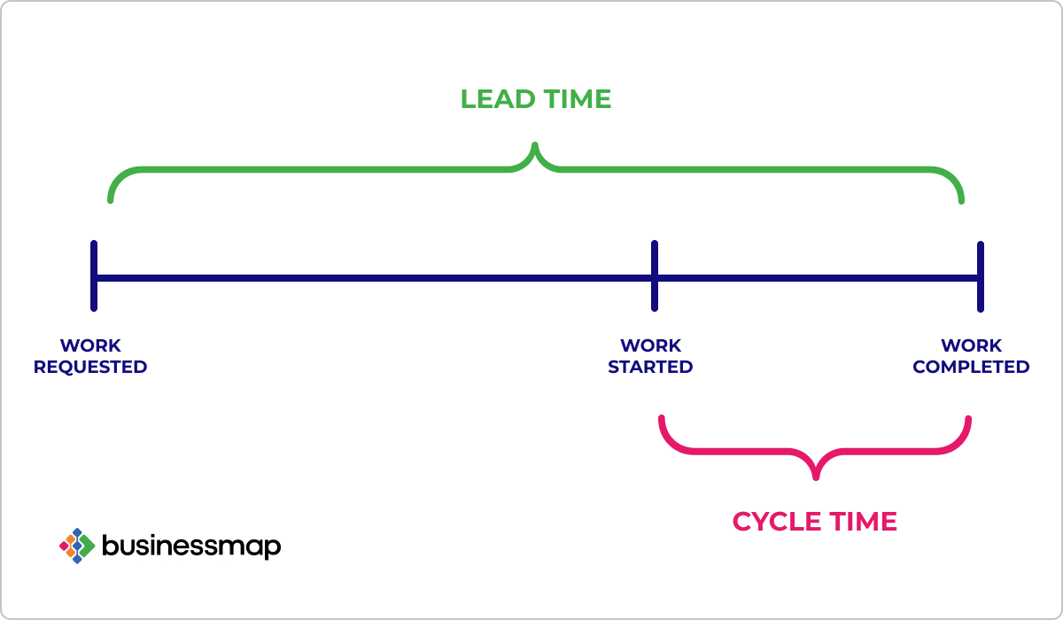
Lead Time vs Processing time
Lead Time: How much time it takes from the initial request to the delivery of the product
Processing Time: The time spend working on a task

Slide 4
The Common Scenario: Long Deployment Times
There are numbers of reasons that can lead to long deployment times.
Having multiple teams (development, testing, operations) that usually work in isolation. All teams are working towards the same goal but are really only in charge of their own tasks.
This could also lead to miscommunications between teams, which can result in longer times
Because of this, there may be periods where we are waiting for each team to complete their work before moving onto the next stages of development
Not to mention if things are not automated, tracking down issues and bugs within the product would just add to the nature of how long deployment times could be

Slide 5
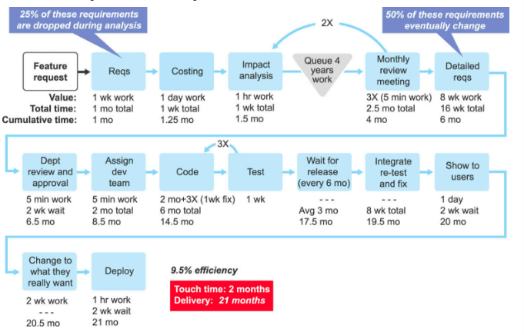
As we see in the image there are numerous steps that need to occur in order to be able to push out a product. However, these times are generally estimations where a small setback between teams can add to a much longer deployment time.

Slide 6
DevOps Ideal
As developers, being able to receive constant feedback on their work, enables them to work efficiently and be able to implement, integrate and validate their code and have it deployed into the production environment
Easily achieved with a modular architecture because it will all ow for small teams to work automatously and if there were to be any mistakes or failures in the code, they would be isolated and easier to tackle.

Slide 7
DevOps Ideal
Autonomy is a huge advantage in the assistance of lowering development times.
Combining both ideas of a well structured architecture and autonomy, we are able to have multiple teams work on their corresponding tasks
With autonomy being introduced, everything would be well documented, who made a change where
Where bugs are introduced and whether or not it has been tackled
Pretty much a log of everything would be maintained and if an issue were to arise, it could be immediately tackled.

