Slide 1
Barriers to Implementing a Just Culture
By: Matthew Trinh

Slide 2
Introduction
A 'Just Culture' balances accountability and learning from mistakes. It fosters trust and fairness but faces barriers that can impede its adoption. This presentation explores these challenges and offers strategies for overcoming them.

Slide 3
Key Barriers
1. Fear of Punishment: Employees hesitate to report mistakes due to retribution fears.
2. Lack of Leadership Support: Without leadership buy-in, efforts may fail.

Slide 4
Organizational Challenges
Organizations with traditional top-down management structures may struggle to adopt a just culture
Resistance to change: Cultural inertia can make employees and leaders skeptical of new approaches

Slide 5
Legal and Compliance Barriers
Fear of litigation discourages open reporting. An environment where the employee is not encouraged to make mistakes creates fear.
Existing punitive policies conflict with Just Culture principles.

Slide 6
Psychological Barriers
A culture entrenched in assigning fault may make transition to a just culture difficult.
Lack of trust: Employees may doubt that reporting mistakes will lead to improvement instead of punishment

Slide 7
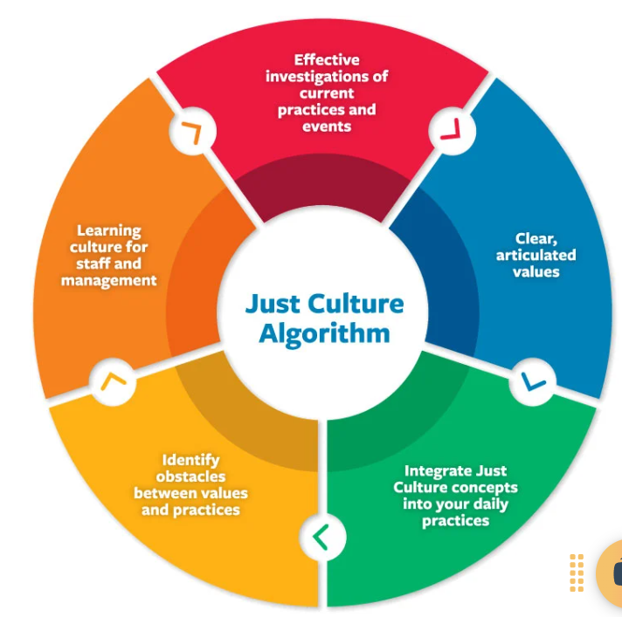
Graphic: Barriers to a Just Culture

Slide 8
Mitigation Strategies
Leadership Training: Foster trust and fairness.
Policy Revisions: Align policies with Just Culture principles.
Building Trust: Encourage open communication and reward learning.

Slide 9
Conclusion
Barriers to implementing a Just Culture include organizational, legal, and psychological challenges. By addressing these issues through leadership support, policy revisions, and trust-building, organizations can foster accountability and improvement.

