Slide 1
Reproducing GraphNorm and Testing Two Graph-Specific Extensions
Paper: GraphNorm - A Principled Approach to Accelerating Graph Neural Network Training
Dataset: PROTEINS | Backbone: GIN | Compared norms: BN, GN, GSGN, DWGN
Project goals
Reproduce the GraphNorm idea
Propose and test graph-specific extensions
Main result
DWGN gave the best final test accuracy
GSGN gave the best peak test accuracy
Practical message
DWGN is best for fixed long training
GSGN is best when early stopping is allowed
These slides are designed to be directly speakable in a TA presentation.

Slide 2
Why this paper matters
What problem GraphNorm tries to solve
GNN training is often unstable and slower than expected.
BatchNorm uses batch-level statistics, but graph batches are highly heterogeneous.
InstanceNorm, when adapted graph-wise, trains faster because it normalizes inside each graph.
But subtracting the full graph mean can remove useful structural information.
GraphNorm keeps graph-wise normalization and learns how much mean information should be preserved.
What to say
The paper's key insight is that graph-level statistics are more meaningful than batch-level statistics for GNNs.
GraphNorm improves InstanceNorm by making the mean subtraction learnable rather than fixed.
Takeaway: GraphNorm = graph-wise normalization + a learnable mean-preservation term.

Slide 3
Mathematics behind GraphNorm
How the paper motivates the method
GraphNorm formula
For each feature dimension j, the graph mean μ_j is computed over the nodes of one graph.
The learnable coefficient α_j decides how much of that mean is removed.
γ_j and β_j are standard affine parameters.
The paper's two mathematical claims
1) Graph-wise centering acts like a preconditioner and can improve optimization.
2) Plain InstanceNorm may hurt expressive power because it always removes the full graph mean.
3) GraphNorm fixes that by learning α_j instead of hard-coding α_j = 1.
Takeaway: The learnable shift is not cosmetic: it is the paper's fix for the expressiveness problem of plain graph-wise InstanceNorm.

Slide 4
Our two proposed modifications
Both keep the GraphNorm structure but change how graph statistics are used
GSGN: Graph-Size-Aware GraphNorm
Idea: the ideal amount of preserved mean information may depend on graph size.
Implementation: use a sigmoid gate driven by log(1 + number of nodes).
Expectation: better adaptation across small and large graphs.
DWGN: Degree-Weighted GraphNorm
Idea: not all nodes should contribute equally to the graph summary.
Implementation: compute the mean and variance with degree-based weights.
Expectation: structurally central nodes influence the normalization more.
Takeaway: GSGN changes how much mean is preserved; DWGN changes how the graph mean itself is computed.

Slide 5
Experimental setup
What was actually run in the reproduction
Data and model
Dataset: PROTEINS
Backbone: GIN
Folds used: 0, 1, 2
Epochs: 300
Graph pooling: sum
Hyperparameters
Batch size: 128
Hidden dimension: 64
Dropout: 0.5
Learning rate: 0.01
Weight decay: 0.05
Important caveat
This is a reduced reproduction, not the full paper protocol.
One dataset and three folds were used.
So the conclusions are project-scale and not full benchmark claims.
Takeaway: The comparison is fair because all four norms were run under the same GIN setup.

Slide 6
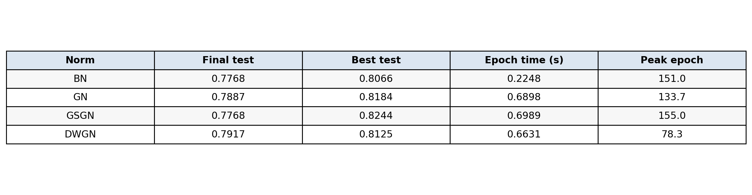
Main quantitative results
What the numbers say at a glance
Most important outcomes
DWGN has the best final test accuracy: 0.7917
GSGN has the best peak test accuracy: 0.8244
Efficiency
BN is far faster per epoch: 0.2248 s
All graph-specific methods cost about 0.66-0.70 s
Stability hint
DWGN has lower spread than GN on final test accuracy
GN is strong but more variable
Takeaway: If I must choose one method for fixed 300-epoch training, I would choose DWGN.

Slide 7
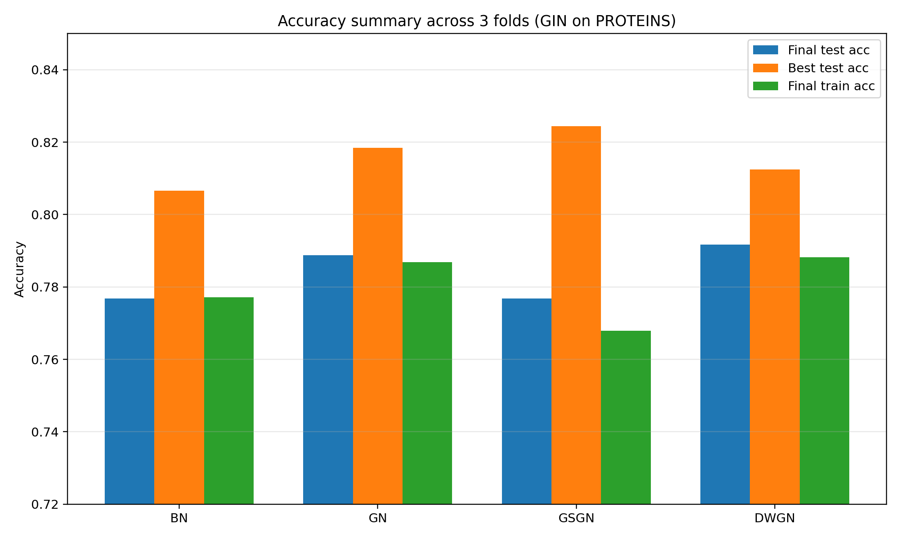
Accuracy comparison
Final accuracy versus best accuracy reached during training
How to explain this slide
BN is fast, but it is not the top accuracy method.
GN is a strong baseline and stays competitive.
GSGN has the highest peak, which means it finds very good transient solutions.
DWGN has the best final test accuracy, which suggests better end-of-training stability.
Takeaway: Peak accuracy and final accuracy tell different stories; that distinction is central to the interpretation.

Slide 8
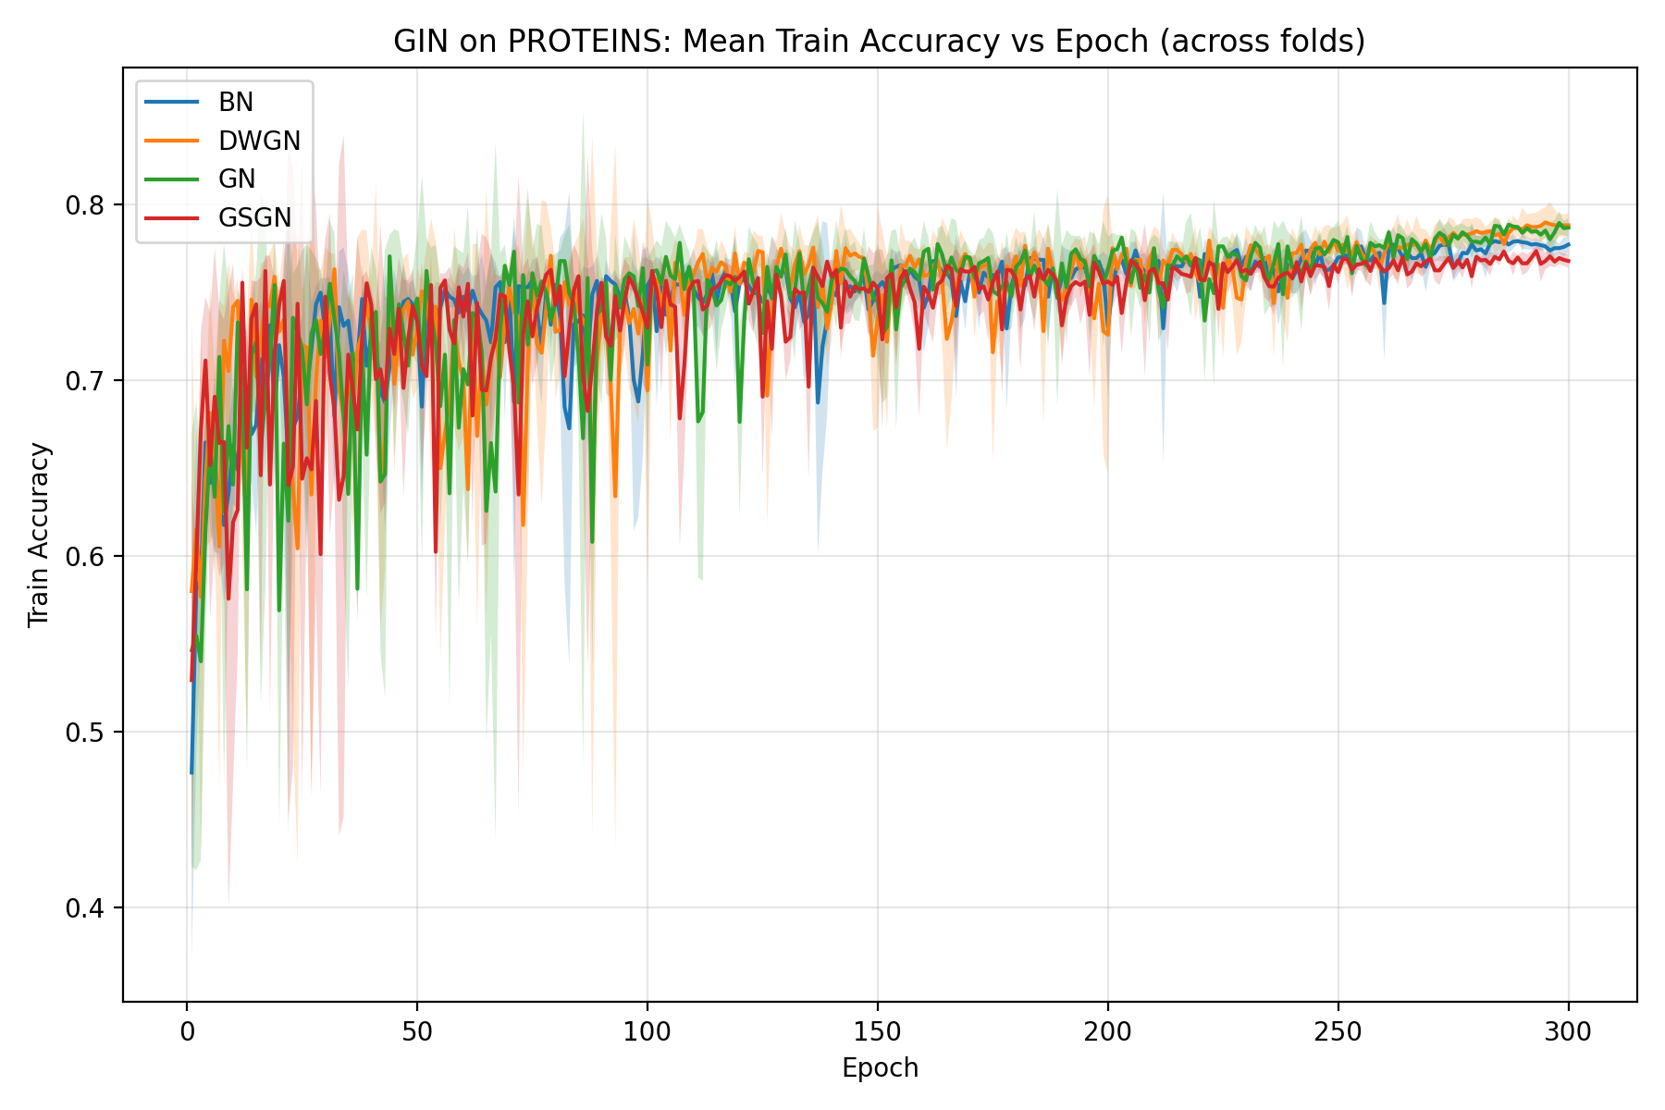
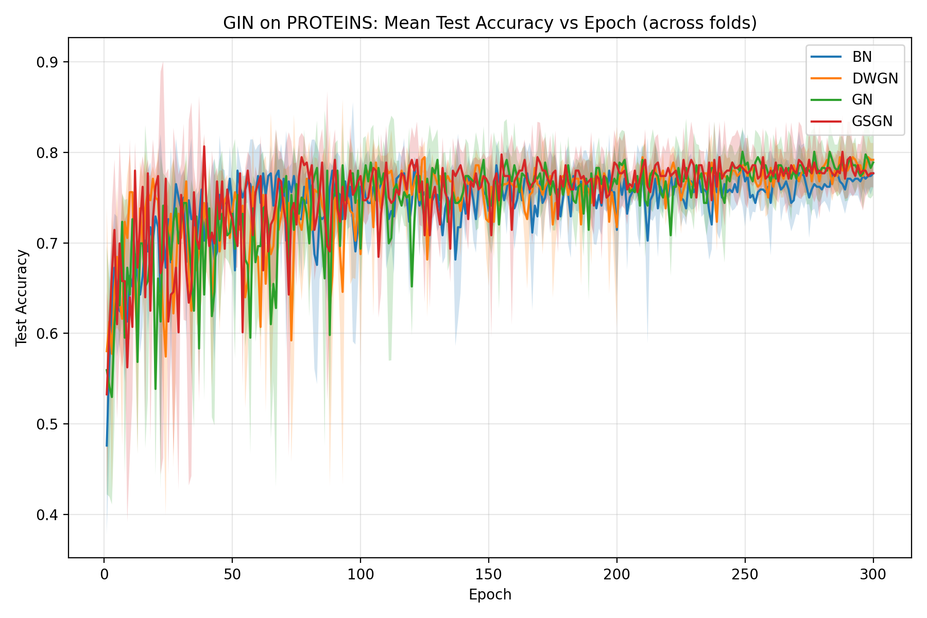
Mean training and test curves
Why the behavior of GSGN and DWGN looks different
Interpretation
GSGN reaches strong peaks but loses some advantage by the end; DWGN rises to a slightly better final plateau.
Takeaway: A good one-line explanation: GSGN looks best with early stopping, while DWGN looks best without it.

Slide 9
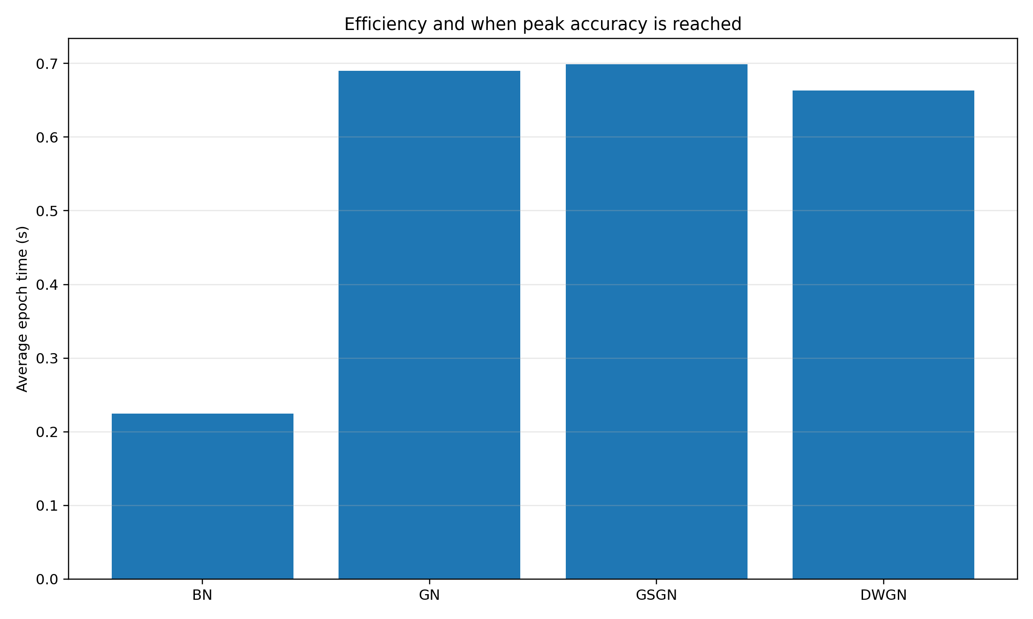
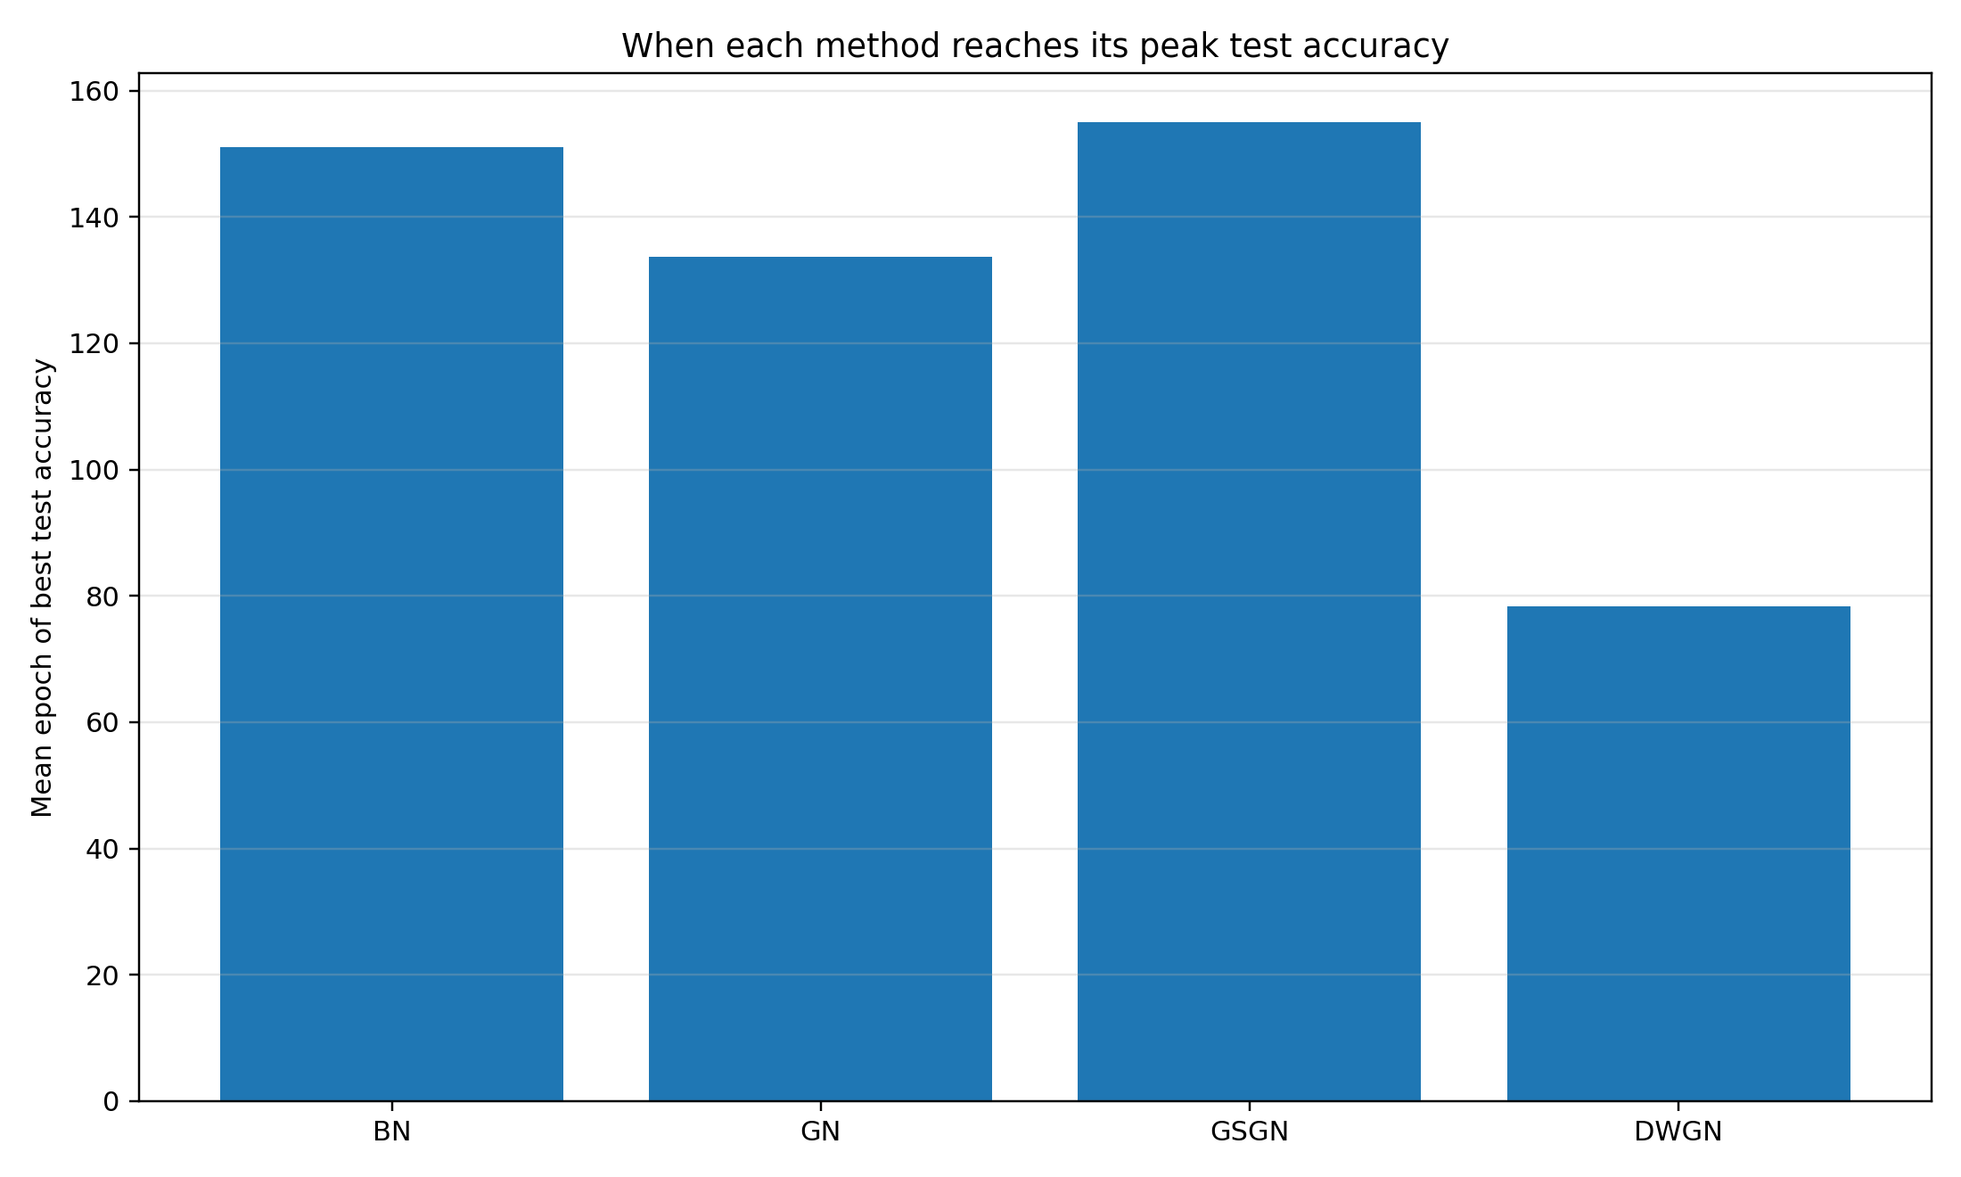
Efficiency and when each method peaks
These plots help explain the practical trade-offs
What this means in practice
BN is the cheap option. DWGN reaches its best accuracy much earlier than GN and GSGN, so it may be easier to train efficiently.
Takeaway: DWGN is attractive not only because it finishes best, but also because it peaks earlier.

Slide 10
Final conclusions and discussion points
Suggested closing slide for the presentation
GraphNorm's core idea is validated: graph-wise normalization is a strong baseline for GNNs.
The learnable mean-preservation term is important because graph means can carry structural information.
GSGN was a useful idea, but its strength appeared more in peak accuracy than final accuracy.
DWGN was the most successful extension in this project: best final test accuracy, earlier peak, and good stability.
The fairest conclusion is not that one method wins universally, but that different graph-aware statistics change the trade-off between speed, peak accuracy, and stability.
If the TA asks 'which method would you recommend?'
For fixed long training: DWGN.
If the TA asks 'which method seems most promising?'
For early stopping: GSGN.
Takeaway: Best short answer: DWGN is the best final model here, while GSGN is the best early-stopping candidate.

Slide 11
Limitations and next steps
Useful if you get follow-up questions
This was a reduced reproduction on one dataset rather than the full benchmark suite from the paper.
Only three folds were used, so the results should be treated as indicative rather than definitive.
The modifications were tested only on GIN; other backbones such as GCN could behave differently.
A natural next step would be to add early stopping explicitly and test whether GSGN then becomes the best overall method.
Another next step would be to evaluate DWGN on datasets where node degree is known to be especially informative.
Takeaway: The project still succeeds because it reproduces the paper's main idea and turns it into testable, graph-specific extensions.

