Slide 1

DataBall : BasketBall Team Management System
Aakashnag, Himavanth, Sethumadhava, Sowmya

Slide 2
Overview
The Basketball Team Management System is a comprehensive web-based application designed to streamline the scheduling and management of sports facilities, practice sessions, and game events. Developed using the Python Django framework back ended by OracleSQL, this system caters to sports organizations and universities enabling efficient utilization of resources and organized data management.

Slide 3
Objectives
Streamline Management Processes: Facilitate efficient scheduling and management of sports facilities, practices, and game events.
Enhance Accessibility: Provide easy access to game schedules, practice sessions, and team data for coaches, managers, and players.
Improve Resource Utilization: Ensure optimal use of sports facilities through advanced scheduling capabilities and capacity management.
Enhance Communication and Planning: Enable better planning and communication among team members and staff through centralized data access and updates.

Slide 4
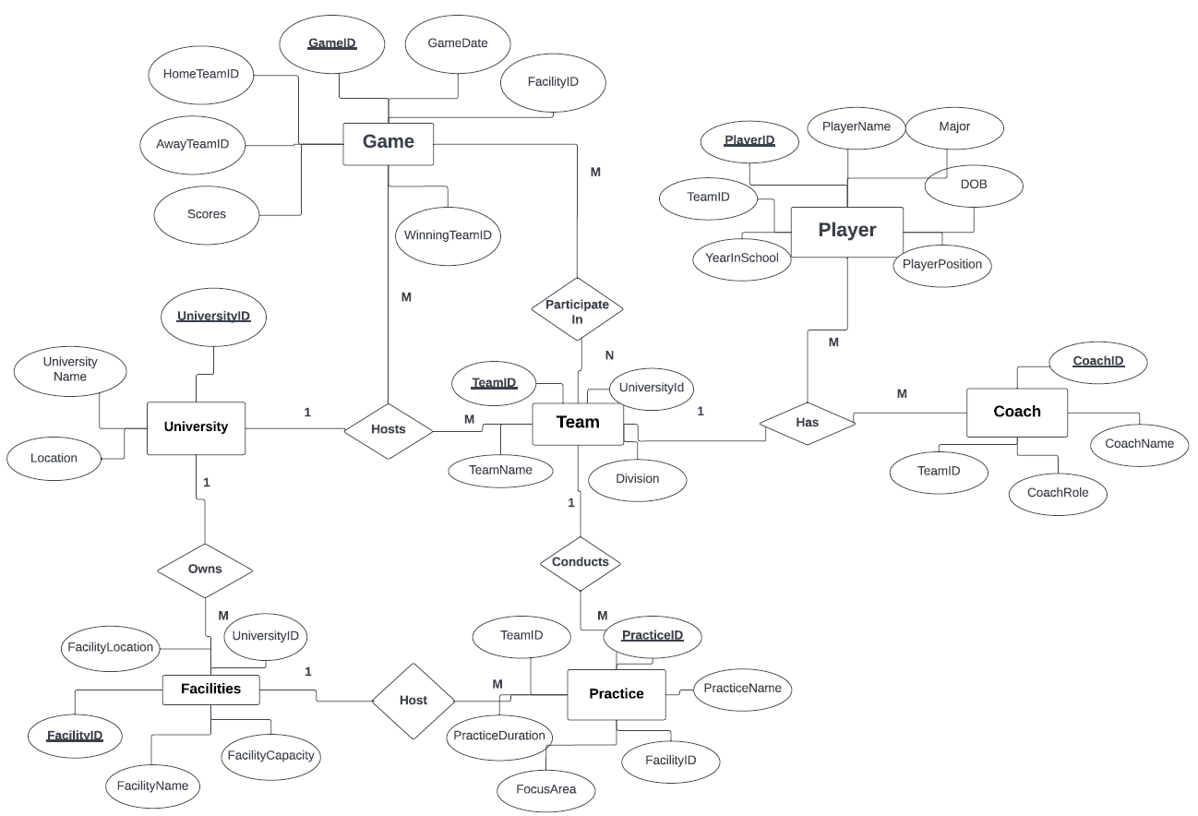
ER Diagram

Slide 5
Schema Diagram

Slide 6
Relationship Schema Diagram

Slide 7
User Stories
As a sports facility manager, I want to schedule games between teams at a facility. So, it prevents scheduling conflicts and ensures different home and away teams.
As a coach, I want to schedule practices for my team so that we can prepare for upcoming games.
As a sports admin, I want to update game details once the game is completed.
As a parent of a player, I want to access the game schedule and results to keep track of my child's team performance and attend games.
As a player, I want to view my practice and game schedules so that I know when and where I need to be for my team activities.
As a university sports administrator, I want to view all teams associated with my university so that I can manage team activities and resources effectively.
As a facilities manager at the university, I want to view all events scheduled in each facility so that I can manage space allocation and maintenance schedules.
As a sports analyst, I want to retrieve data on games, including teams and scores, so that I can analyze team performance and trends over time.
As a student, I want to find information about my university's sports teams, including rosters and schedules, so that I can follow and support them.
As a health and fitness coach, I want to access players' practice and game records to evaluate their physical condition and performance and plan fitness programs accordingly.

Slide 8
Technologies Used
This project leverages a combination of technologies and tools that are suited for robust web application development and efficient data handling:
Backend Framework: Django (Python) - Used for constructing the web application, handling logic, and rendering views.
Database: OracleDB is Utilized for storing and managing all data related to the project. OracleDB's advanced features support complex queries and stored procedures critical for the project's operational requirements.
Procedures and Data Management: OracleDB procedures are heavily used to perform backend tasks like updating records, scheduling, and capacity management directly within the database, enhancing performance and data integrity.
Frontend: Django templates - While the project does not use JavaScript, it relies on Django's powerful templating engine to manage web application features.

Slide 9
Data Dictionary
Player Table
PlayerID (VARCHAR2, PK): Unique identifier for a player.
PlayerName (VARCHAR2): Full name of the player.
Major (VARCHAR2): Academic major of the player.
DOB (DATE): Date of birth.
YearInSchool (NUMBER): Current academic year of the player.
TeamID (VARCHAR2, FK): Reference to the player’s team.
PlayerPosition (VARCHAR2): Athletic position or role on the team.
Game Table
GameID (VARCHAR2, PK): Unique identifier for a game.
GameDate (TIMESTAMP): Date and time when the game is scheduled.
FacilityID (VARCHAR2, FK): Facility where the game is held.
HomeTeamID (VARCHAR2, FK): Home team participating in the game.
AwayTeamID (VARCHAR2, FK): Visiting team participating in the game.
Scores (VARCHAR2): Recorded scores, formatted as "Home-Away".
WinningTeamID (VARCHAR2, FK): Team that won the game.
Practices Table
PracticeID (VARCHAR2, PK): Unique identifier for a practice session.
PracticeDate (TIMESTAMP): Date and time when the practice is scheduled.
TeamID (VARCHAR2, FK): Team conducting the practice.
PracticeDuration (NUMBER): Duration of the practice session in hours.
FocusArea (VARCHAR2): Main focus or theme of the practice session.
FacilityID (VARCHAR2, FK): Facility where the practice is held.
University Table
UniversityID (VARCHAR2, PK): Unique identifier for a university.
UniversityName (VARCHAR2): Name of the university.
Location (VARCHAR2): Geographical location of the university.
Facilities Table
FacilityID (VARCHAR2, PK): Unique identifier for a facility.
FacilityName (VARCHAR2): Name of the facility.
FacilityLocation (VARCHAR2): Physical location of the facility.
FacilityCapacity (NUMBER): Maximum capacity of people the facility can accommodate.
UniversityID (VARCHAR2, FK): Reference to owning university.
Team Table
TeamID (VARCHAR2, PK): Unique identifier for a team.
TeamName (VARCHAR2): Official name of the team.
Division (VARCHAR2): Division or league in which the team competes.
UniversityID (VARCHAR2, FK): Reference to affiliated university.
Coach Table
CoachID (VARCHAR2, PK): Unique identifier for a coach.
CoachName (VARCHAR2): Full name of the coach.
CoachRole (VARCHAR2): Role or position of the coach within the team.
TeamID (VARCHAR2, FK): Reference to the coach’s team.
Notes:
Facility Location is not the actual geographic location but actual location referring as On/Off Campus

Slide 10
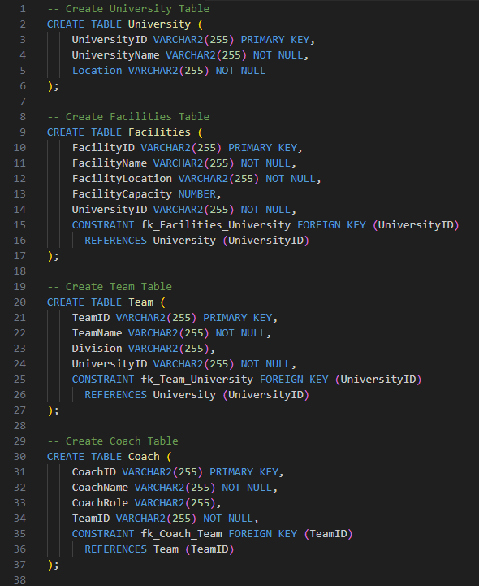
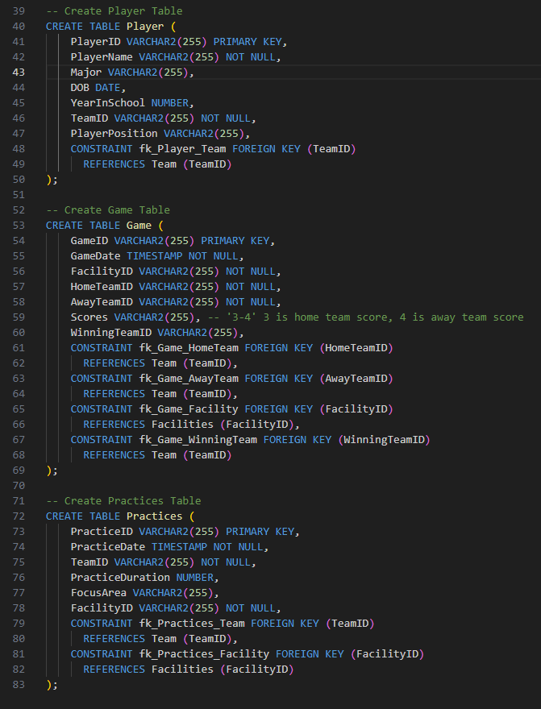

Slide 11
Views
GameData View
Description: Consolidates detailed game information including dates, locations, teams, and scores.
Use Case: Useful for quick access to comprehensive game overviews for management and analysis.
PlayerGameSchedule View
Description: Shows game schedules for each player, detailing game dates and locations.
Use Case: Helps players and coaches track upcoming game commitments.
PlayerPracticeSchedule View
Description: Details practice sessions for players, including dates, locations, and focuses.
Use Case: Assists in managing regular training schedules and preparation.
UniversityTeams View
Description: Lists teams with their corresponding universities to easily associate team affiliations.
Use Case: Supports administrative tasks and enhances external communications about team structures.

Slide 12
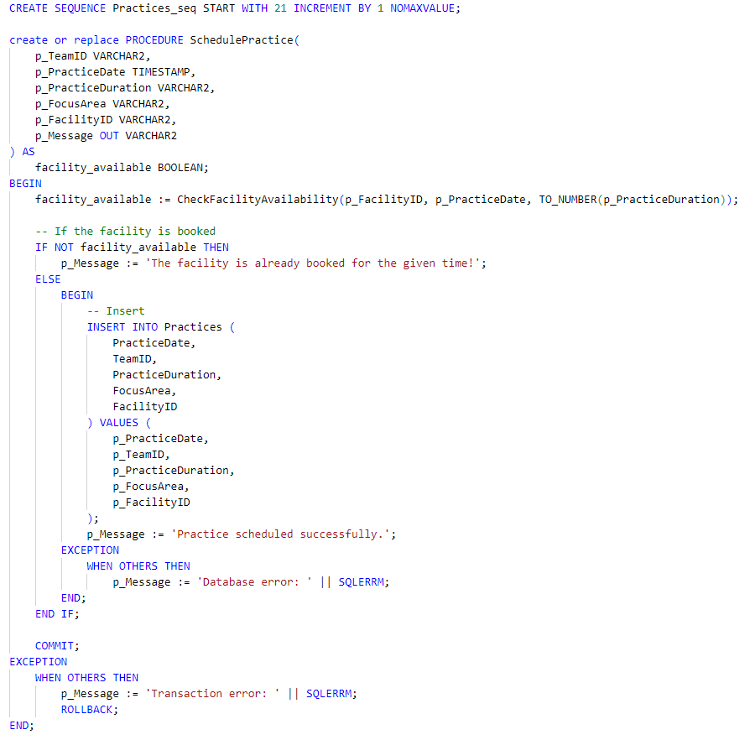
Procedures
Functionality: Schedules new practice sessions by checking the availability of a facility at a specified time and duration, and inserts the practice details into the database if the facility is available.
Steps:
Check Availability: Uses CheckFacilityAvailability function to determine if the specified facility is available at the desired time.
Condition Handling:
If Available: Inserts the new practice details into the Practices table and sets a success message.
If Not Available: Sets an error message indicating the facility is already booked.
Error Handling: Catches and reports database errors during insertion and transaction errors.
Practices_seq Sequence
Purpose: Generates unique identifiers for practice sessions, starting from 21 and incrementing by 1 for each new entry.
Usage: Ensures each practice session has a distinct ID, supporting systematic record keeping and retrieval.
Notes:
Make sure to introduce p_Message is a variable used to carry message to frontend. Will be discussed on UI part.

Slide 13
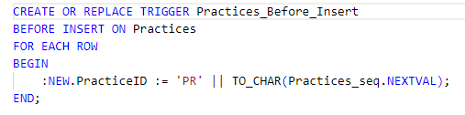
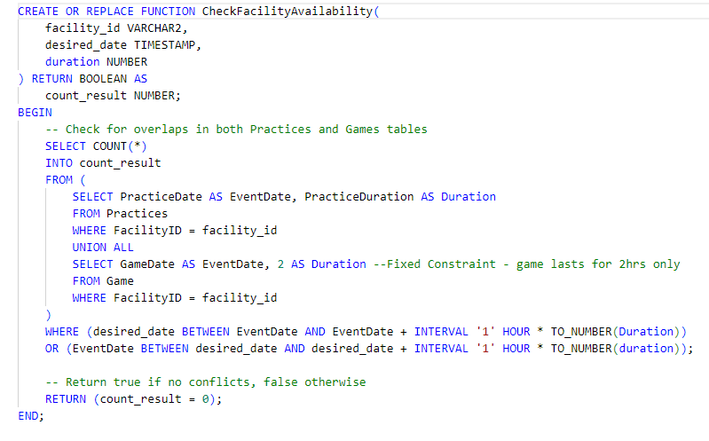
Function and Trigger
CheckFacilityAvailability
Purpose: Determines if a facility is available for a new event by checking for scheduling conflicts with existing practices and games.
Operation: Compares the desired time and duration against existing events in the Practices and Game tables. Returns TRUE if no conflicts are found (facility available), otherwise FALSE.
Practice_Before_Insert
Purpose: Automatically generates and assigns a unique identifier to each new practice session before it is inserted into the database.
Operation: Concatenates 'PR' with the next value from the Practices_seq sequence to form a new PracticeID for each practice record being inserted.
Notes:
Make sure to link from above slide (these are used in the above procedure)

Slide 14
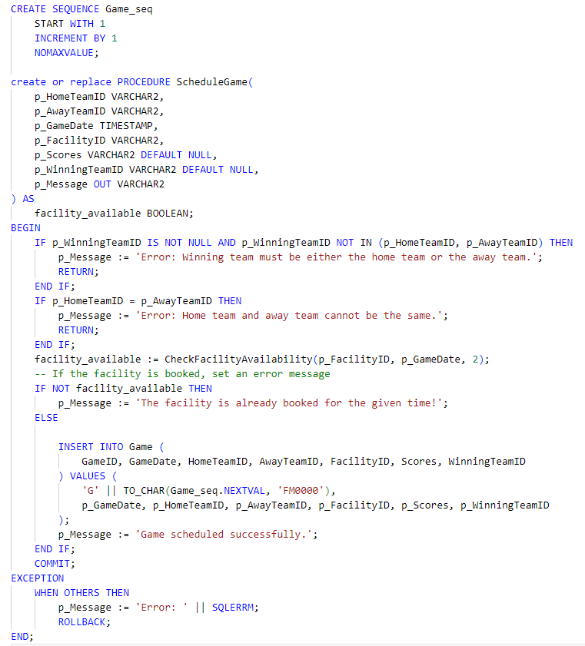
Procedures-continued
Functionality: Team Validation: Checks that the home team and away team are not the same, and if a winning team is specified, it must be one of the participating teams.
Purpose: Schedules a new game while ensuring the selected facility is available, and the game parameters (teams and winning team) are logically consistent.
Facility Availability: Utilizes the previously discussed CheckFacilityAvailability function to verify that the facility is available for the scheduled game date and duration (constrained to be 2 hours).
Game Insertion: If all conditions are met (teams are distinct, the winning team is valid, and the facility is available), inserts a new game record into the Game table using the Game_seq for generating a unique GameID.
Game_seq Sequence
Purpose: Creates a sequential identifier for each new game, starting from 1 and incrementing without a set maximum value.
Usage: Ensures each game entry in the database has a unique identifier.

Slide 15
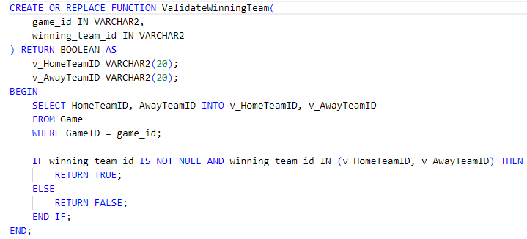
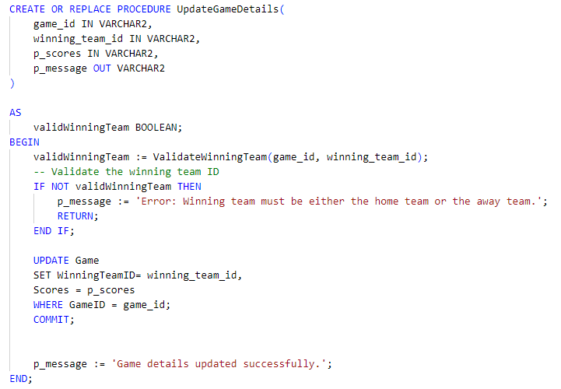
Procedures - continued
ValidateWinningTeam
Purpose: Checks if a specified winning team ID is one of the participating teams in a given game, ensuring the integrity of game results.
Functionality:
Fetches the home and away team IDs from the Game table for the specified game. Determines if the proposed winning team ID matches either the home or away team ID. Returns TRUE if the winning team ID is valid (i.e., matches either the home or away team), otherwise returns FALSE.
Purpose: Updates the details of an existing game, specifically the winning team and the game's scores.
Functionality: Uses the ValidateWinningTeam function to ensure that the specified winning team is one of the participants in the game (either the home team or the away team).
Record Update: If the winning team is valid, the procedure updates the WinningTeamID and Scores for the specified GameID in the Game table.
If the update is successful, sets the output message to confirm the successful update of game details.
Notes:
This boolean output is crucial for validating updates to game records to ensure accuracy and consistency in game results.

Slide 16
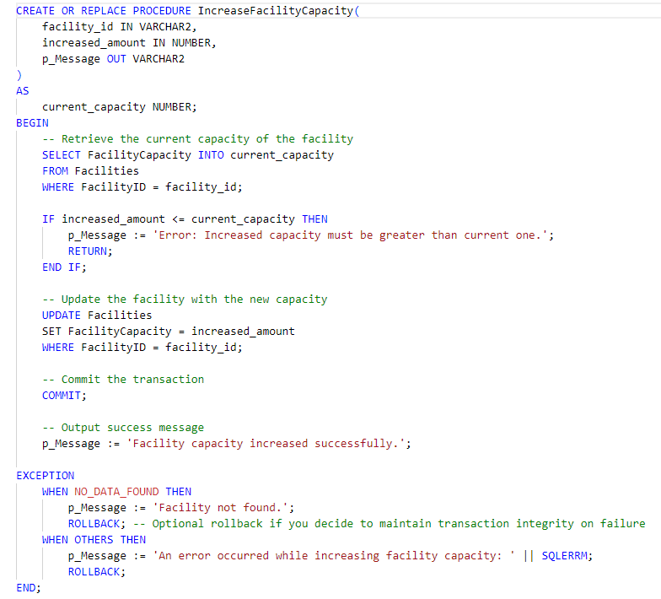
Procedures-continued
Purpose: Adjusts the capacity of a specified facility to a new higher value, ensuring the facility can accommodate more occupants or resources.
Functionality:
Capacity Check: Retrieves the current capacity of the facility and checks if the proposed increased amount is greater than the existing capacity.
Capacity Update: If the new capacity is greater, updates the facility's capacity in the Facilities table to the new specified amount.

Slide 17
UI – Django Python Framework
Django is a high-level Python web framework that encourages rapid development and clean, pragmatic design. It is built to handle much of the hassle of web development, allowing us to focus on writing app without needing to reinvent the wheel.
Django structure is based on three vital things:
Models
Django models are Python classes that define the structure of your database. Each model represents a database table and each attribute of the model represents a field in the table.
Views
Django views are Python functions or classes that handle the logic of processing a user's request and returning the appropriate response. Views access the data through models and delegate formatting the response to the templates.
URLs
Django URLs are the web addresses that route users to the correct view based on the request URL.
This project with Django framework streamlines workflows essential for sports management, enabling quick access to common tasks like game scheduling and player updates, reducing administrative overhead and enhancing user experience.
Notes:
Django is also renowned for its robustness, scalability, and security, making it a popular choice for building complex web applications efficiently.

Slide 18
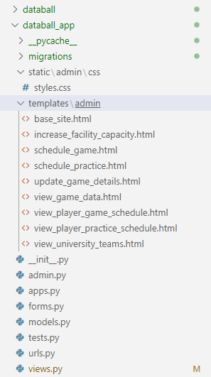
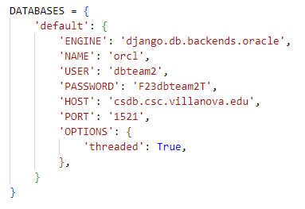
UI – DB Connection & Project Structure

Slide 19
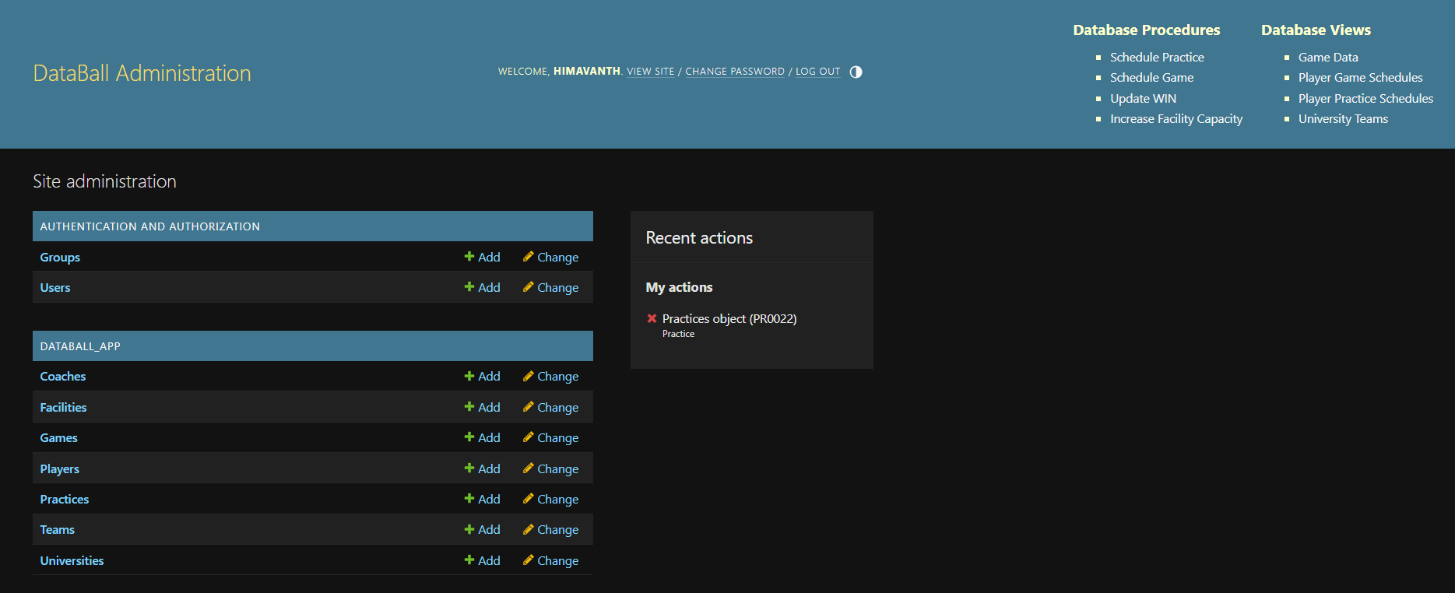
User Interface - HomePage

Slide 20
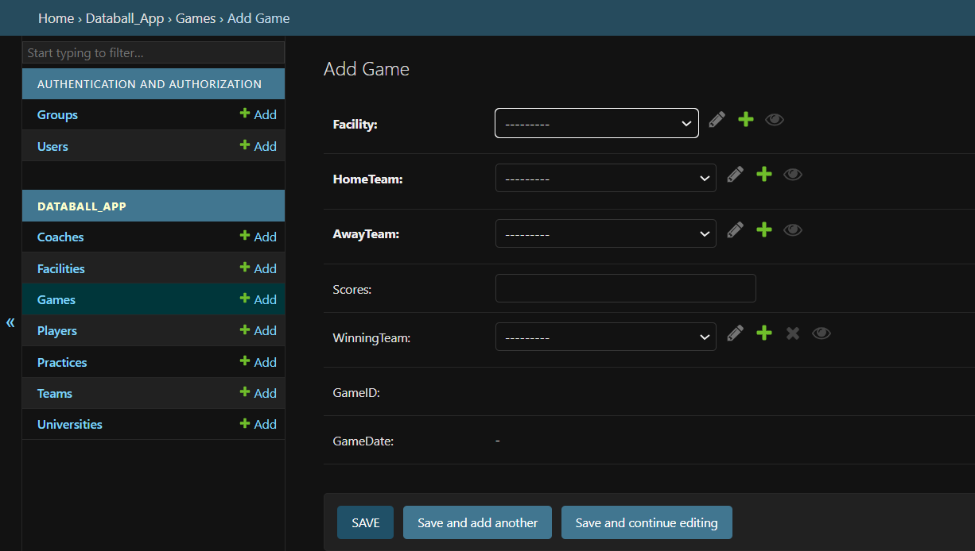
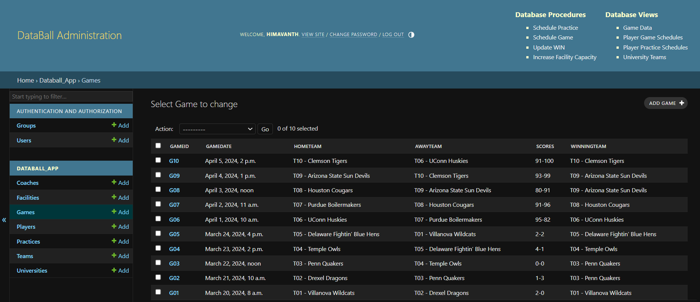
UI – View/Insert into Tables

Slide 21
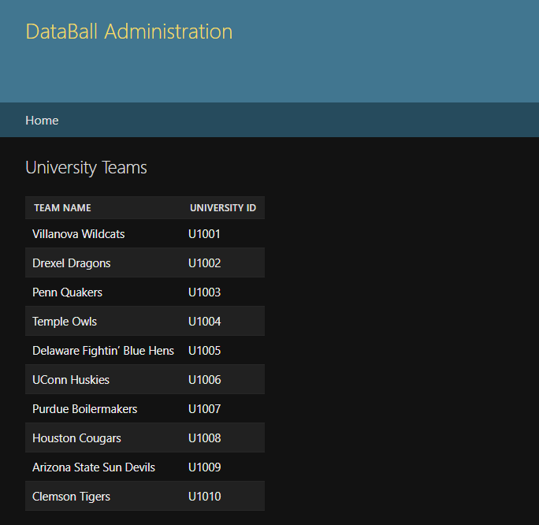
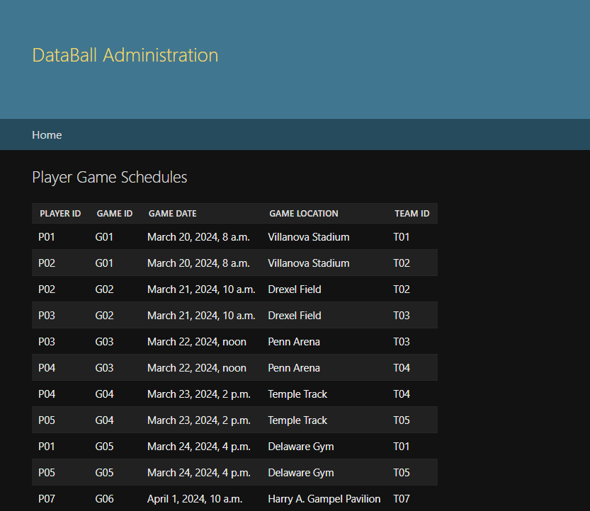
UI - Views

Slide 22
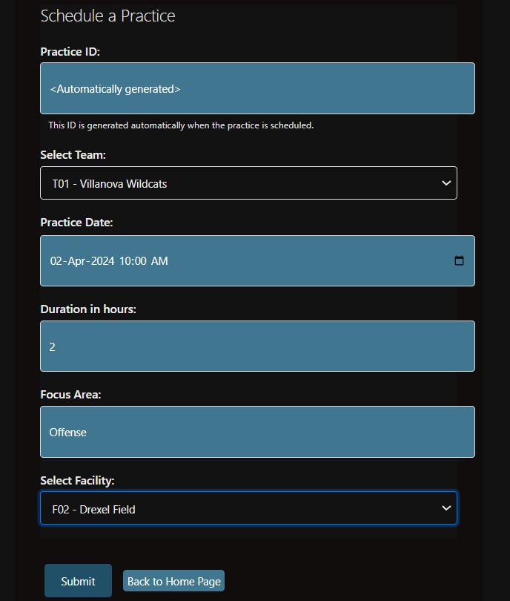
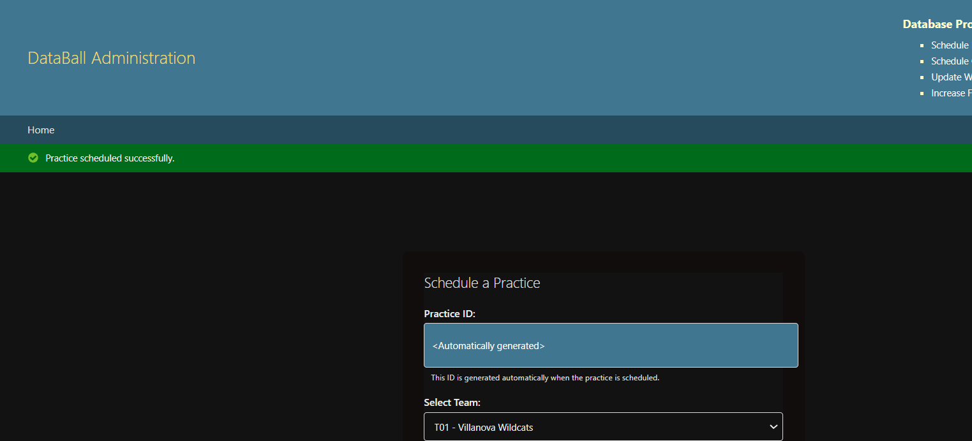
UI – Procedure Calls

Slide 23
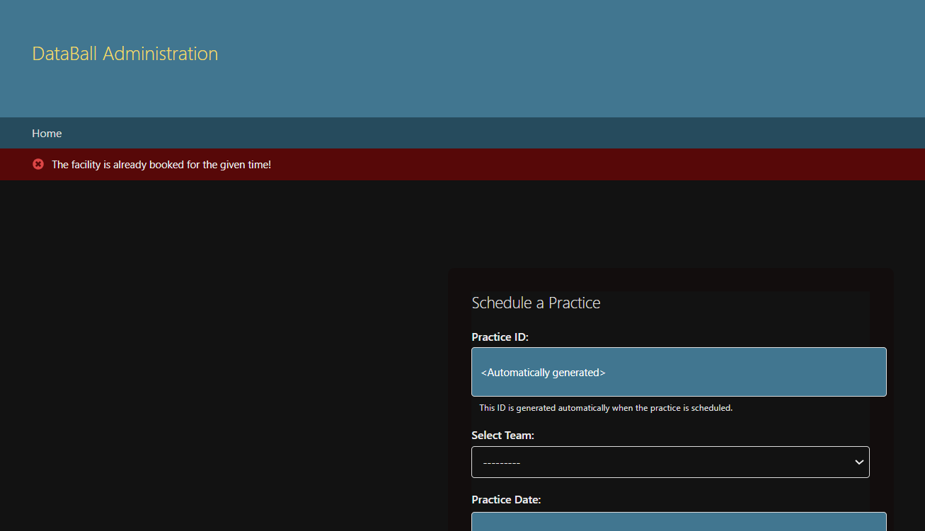
UI – Procedure Calls - Continued
<TBD>

Slide 24
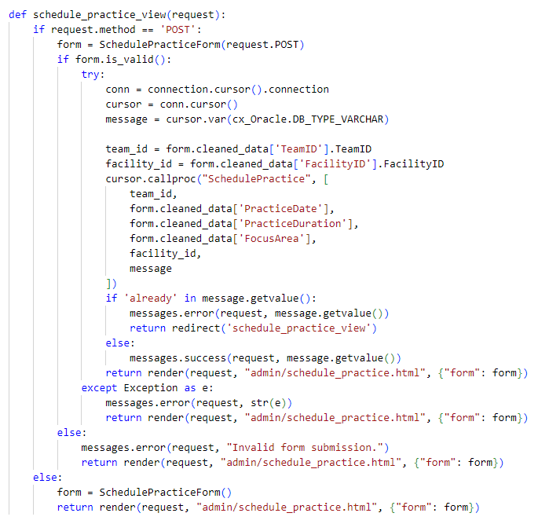
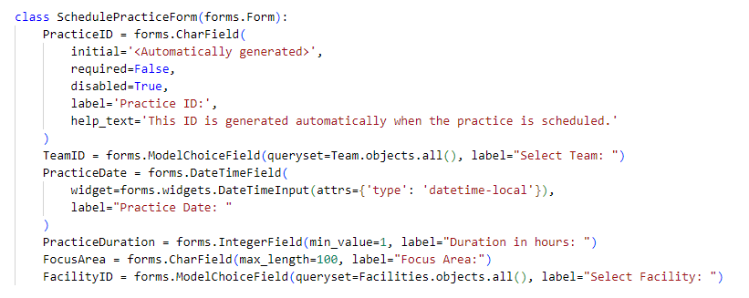
Django Code

Slide 25
GitHub Repository
https://github.com/Himavanth2211/Databall
Notes:
Public Repository

Slide 26

THANK YOU

