Slide 1

Blood Group Detection using Fingerprint
Team members:
VENKATA HIMAVARSHA 21BD1A12D0
YEERAKAR SNEHA 22BD5A1212
KARLA KEERTHI 21BD1A1292
CHILUMULA MANASA 21BD1A1279

Slide 2
INDEX
ABSTRACT
INTRODUCTION
TOOLS AND TECHNOLOGIES
WORK FLOW
METHODOLOGY
IMPLEMENTATION
RESULTS
ADVANTAGES
DISADVANTAGES
APPLICATIONS
CONCLUSION

Slide 3
ABSTRACT
Blood group detection is crucial in medical diagnostics, but traditional methods are invasive and require lab infrastructure. This study presents an innovative, non-invasive approach using fingerprint image processing to detect blood groups. By analyzing unique ridge patterns in fingerprints and correlating them with blood group types, a Convolutional Neural Network (CNN) is employed for accurate and rapid classification.
The system, trained on a dataset of labeled fingerprint images, demonstrates promising results in terms of accuracy. This method offers a portable, cost-effective solution for blood group detection, especially in resource-limited settings, with potential applications in medical diagnostics and transfusion services.

Slide 4
INTRODUCTION
Blood group detection is vital for medical diagnostics but traditionally requires invasive methods and lab infrastructure.
This project introduces a non-invasive, cost-effective approach using fingerprint image processing for blood group classification.
A Convolutional Neural Network (CNN) is used to analyze fingerprint ridge patterns and accurately classify blood groups.
The system is trained on a dataset of labeled fingerprint images, providing a portable and rapid solution.
The approach is ideal for resource-limited settings, with potential applications in medical diagnostics and transfusion services.

Slide 5
TOOLS AND TECHNOLOGIES
1.Kaggle
Used for accessing the dataset and running the project in a cloud-based environment with integrated tools.
2.TensorFlow
Framework for building, training, and evaluating the CNN model.
3.Keras
High-level API for model creation and training, built on top of TensorFlow.
4.Python
Main programming language for implementation, utilizing libraries like NumPy and Matplotlib.
5.OpenCV
For image processing tasks like resizing and enhancing fingerprint images.
6.ImageDataGenerator
Augments the dataset in real-time to improve model generalization.

Slide 6
7.Scikit-learn
Provides functions for dataset splitting and model evaluation (e.g., confusion matrix, accuracy).
8.Matplotlib / Seaborn
Visualization libraries used for plotting accuracy, loss, and confusion matrices.
9.HDF5
Used to save and load the trained model in an efficient file format.
10.HTML, CSS, JavaScript
Used to create the front-end interface of the web application.
11.Flask
Python web framework used for creating the back-end of the application and handling requests.

Slide 7
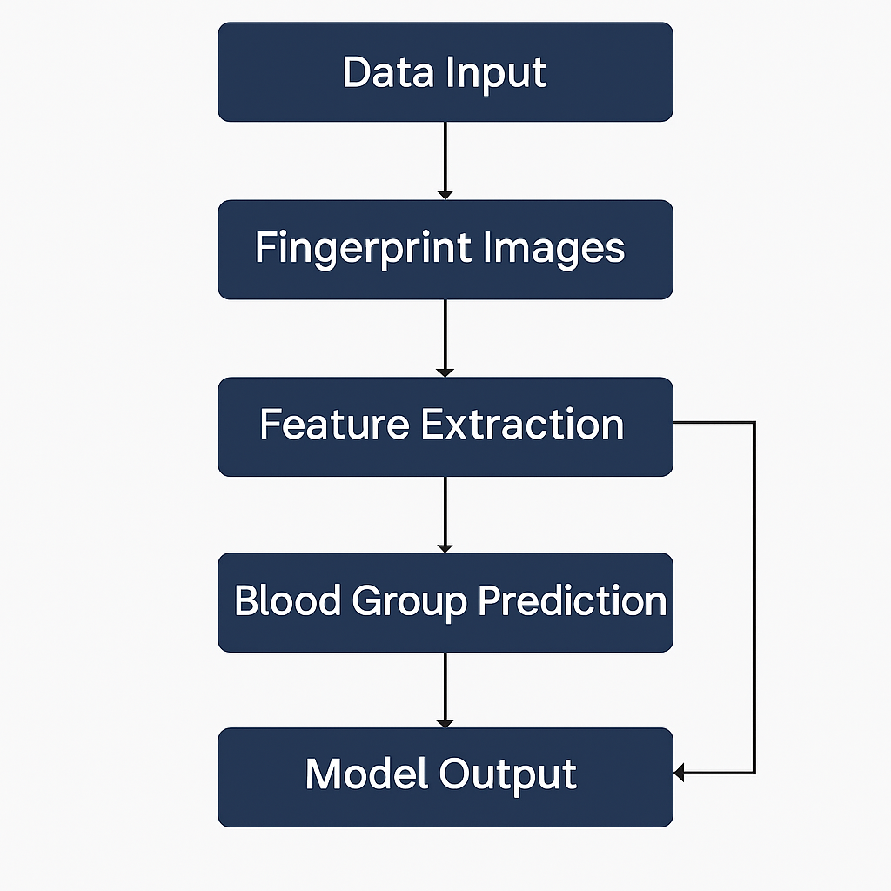
WORKFLOW

Slide 8
METHODOLOGY
Preprocessing: Resized images to 64x64 pixels.
Dataset Collection: Collected fingerprint images labeled with blood groups.
Dataset Balancing: Used oversampling to balance the dataset.
Model Training: Trained a CNN model on the balanced dataset.
Evaluation & Testing: Evaluated the model’s accuracy on the test set.
Model Saving: Saved the trained model for future us

Slide 9
IMPLEMENTATION
1.Dataset Collection and Preprocessing: Dataset sourced from Kaggle, with image resizing, normalization, and augmentation.
2. Batching and Unbatching: Dataset is batched for training and unbatched for class distribution analysis and dataset splitting.
3.Data Augmentation and Balancing: Real-time augmentation using ImageDataGenerator and oversampling for class balancing.
4.Oversampling: Applied to underrepresented classes using custom logic to repeat samples and match the maximum class count.
5.Model Architecture: CNN with Conv2D, MaxPooling2D, Dropout, and a final Dense layer with Softmax activation.
6.Model Training: Using Sparse Categorical Crossentropy loss, Adam optimizer, and accuracy metrics with EarlyStopping and ReduceLROnPlateau callbacks.
7.Model Evaluation: Model performance evaluated with training/validation accuracy and a confusion matrix.
8.Model Saving and Deployment: Trained model saved as HDF5 and ready for deployment with Flask for real-time predictions.

Slide 10
RESULTS
Accuracy
Classification
Confusion matrix

Slide 11
ADVANTAGES
1.Non-Invasive
No need for blood samples; reduces discomfort and risk of infection.
2.Cost-Effective
Eliminates the need for expensive lab equipment and reagents.
3.Portable and Fast
Suitable for real-time use in remote or emergency settings with minimal infrastructure.
4.Automated and Scalable
Deep learning allows automation, reducing human error and enabling large-scale screening.
5.User-Friendly Deployment
Deployed via Flask web app, making it accessible through a simple interface for users and healthcare workers.

Slide 12
DRAWBACKS
1.Limited Dataset Availability
Fingerprint datasets labeled with blood groups are scarce, affecting model generalization.
2. Accuracy Constraints
85.72% accuracy may not be reliable enough for critical medical decisions without confirmation.
3.Model Bias Risk
Imbalanced or biased data may lead to inaccurate predictions for certain blood groups.
4.Requires Digital Infrastructure
Needs a camera or fingerprint scanner, computing device, and internet ,which may be a limitation in some areas.

Slide 13
APPLICATIONS
Emergency medical services
Rural and remote healthcare
Blood donation camps
Military and Disaster operations
Biometric health records integration

Slide 14
CONCLUSION
This project demonstrates the potential of using fingerprint images and deep learning for non-invasive blood group detection. With an accuracy of 85.72%, the system offers a portable, cost-effective, and user-friendly alternative to traditional methods. While still in the early stages, it paves the way for faster, scalable, and accessible medical diagnostics.With further improvements in data quality and model design, the system can become a reliable tool in real-world healthcare.It also opens new avenues for integrating biometrics with personalized health monitoring systems.

Slide 15


