Slide 1
WE2 Image Gen User Guide
2023.03
Notes:
1

Slide 2
Outline
Generate Key & Burn Key Step
Generate output.img SOP
Image Generation Tool Feature
Flash Image Overview
Use Case1: One Core Secure Only
Use Case2: One Core Trustzone / Non-Trustzone
Use Case3: Dual Core Secure Only
Use Case4: Dual Core Trustzone / Non-Trustzone
Flash layout
Image Gen Configure file
How to use Image gen
Output log
Troubleshooting

Slide 3
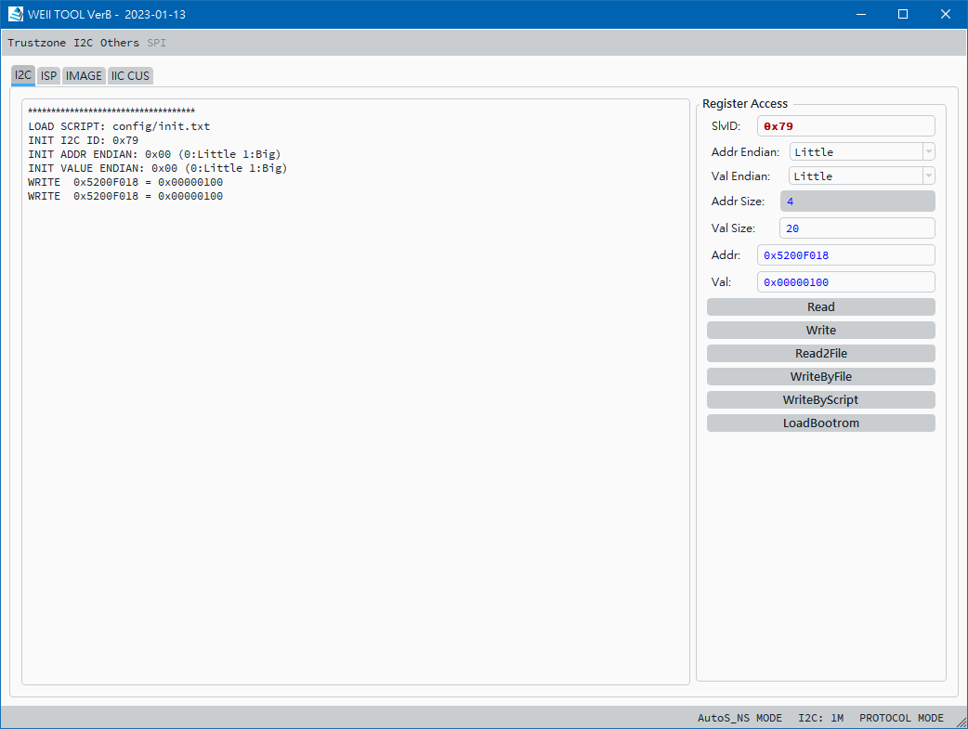
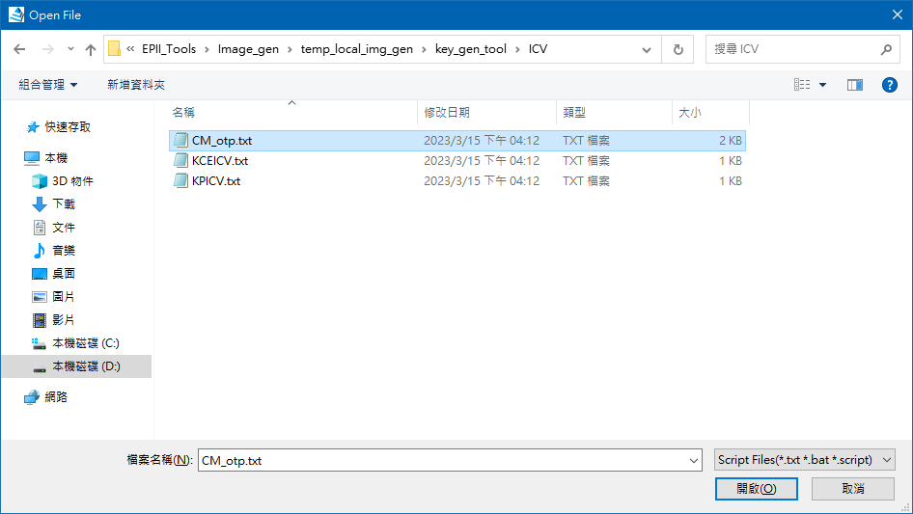
Generate Key & Burn Key Step
Generate Key :
Click bat or script
Windows : run_key_gen_cm_2048.bat
Linux : $ ./run_key_gen_cm_2048.sh
File path : we2_image_gen_local/key_gen_tool
Burn Key :
1. Open WE2 ISP Tool
2. select write by script : we2_image_gen_local/key_gen_tool/ICV/CM_otp.txt

Slide 4
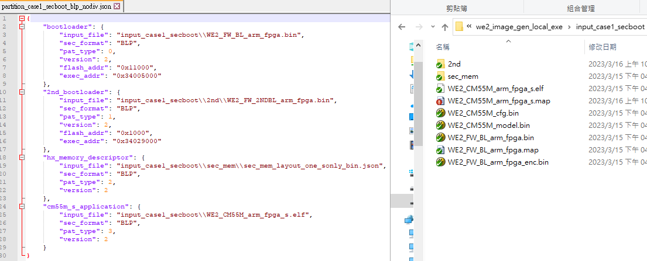
Generate output.img SOP
Step 1. Put the input_file path of your application file based on partition.json file to the corresponding location.

Slide 5
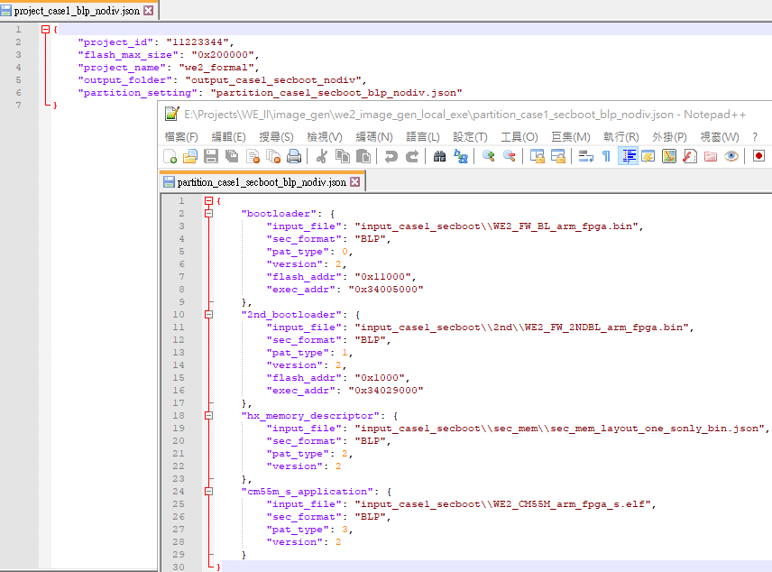
Generate output.img SOP count.
Step 2. Confirm your project.json & partition.json setting.

Slide 6
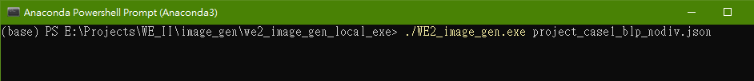
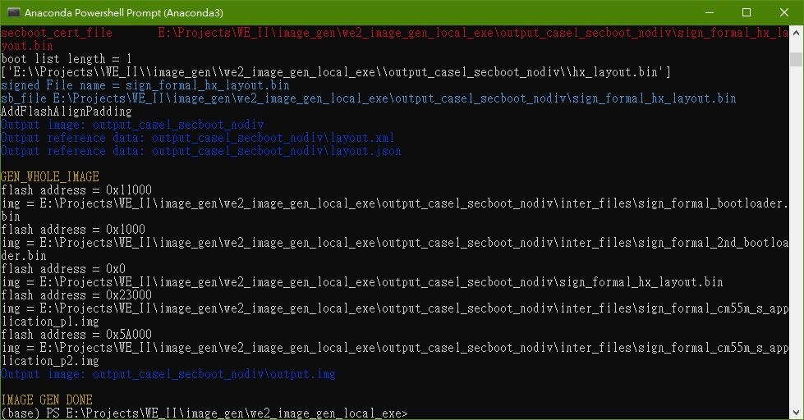
Generate output.img SOP count.
Step 3. Once all setting is correct we use “project.json” as we2_image_gen tool’s input.
Step 4. When the image build completes without errors and displays the following:

Slide 7
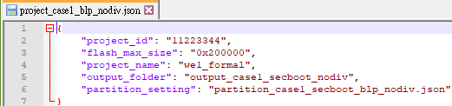
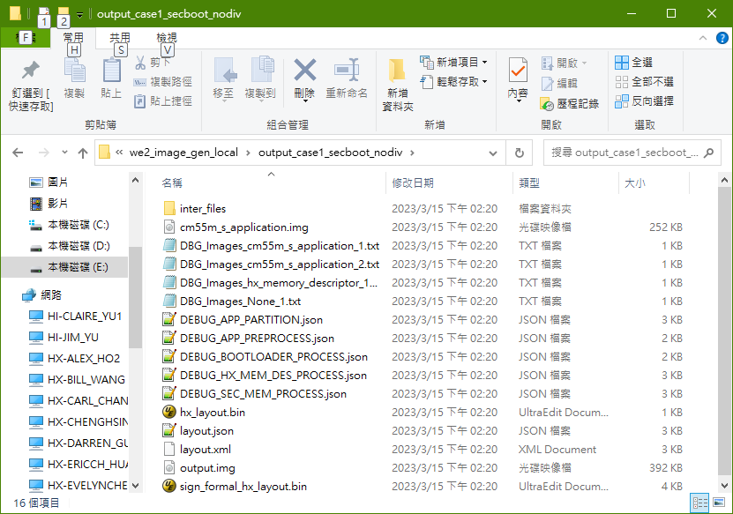
Generate output.img SOP count.
Step 5. Check the output image file based on the “output_folder” path setting of the project.json file.

Slide 8
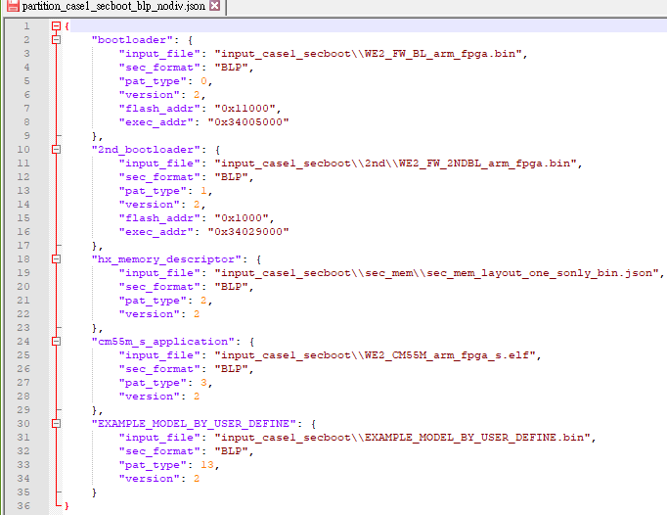
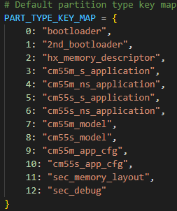
Generate output.img SOP count.
Supplementary Note. If user needs to set a custom module
※ pat_type must start from 13(DEC)
and cannot be repeated

Slide 9
Image Generation Tool Feature
Partition key item :
Bootloader, 2nd loader, memory descriptor, secure application big core, secure application little core, non-secure application big core, non-secure application lttile core, models, CFGs.
Each key can be divided into multiple partitions.
Partition :
A partition is a block of image which is signed by RSA signature.
Each partition can be divided into multiple sections.
Section :
Section attribute : .CODE, .DATA, .RODATA
Multiple sections store in single partition can achieve better performance in signature verification stage.
Support Format:
RAW(CRC only), BLP(CRC+ Signature), BLW(CRC + Signature + Encrypt), BLW_REENC(CRC + Signature + Re-Encrypt)
Support Use Case
Use Case1: One Core Secure Only
Use Case2: One Core Trustzone / Non-Trustzone
Use Case3: Dual Core Secure Only
Use Case4: Dual Core Trustzone / Non-Trustzone

Slide 10
Flash Image Overview
Dual core S/NS
Single core Secure only
Single core S/NS
Dual core Secure only
0x00000
2ND BootLoader
0x10000
1st BootLoader
2ND BootLoader
2ND BootLoader
2ND BootLoader
0x20000
Memory
descriptor
1st BootLoader
1st BootLoader
1st BootLoader
Dynamic
Memory
descriptor
CM55 Master
Trustzone
App
Memory
descriptor
Memory
descriptor
CM55 Master
Trustzone
App
CM55 Master
Trustzone
App
CM55 Master
Trustzone
App
Dynamic
CM55 Master
Non-Trustzone
App
CM55 Master
Model
CM55 Master
Non-Trustzone
App
Dynamic
CM55 Slave
Trustzone
App
CM55 Slave
Trustzone
App
CM55 Master
APP CFG
CM55 Master
Model
CM55 Master
Model
Dynamic
CM55 Slave
Non-Trustzone
App
CM55 Master
APP CFG
CM55 Slave
Model
Dynamic
CM55 Master
Model
CM55 Master
APP CFG
Dynamic
CM55 Slave
Model
CM55 Slave
APP CFG
Dynamic
option
CM55 Master
APP CFG
Dynamic
CM55 Slave
APP CFG

Slide 11
Flash layout
Secure cert
0x00000000
4K
HIMAX Memory descriptor
Fixed address and size
0x00001000
Secure cert
2nd bootloader
0x00011000
Secure cert
1st bootloader
Secure cert
HIMAX APP Big Core
Secure cert
Secure
HIMAX APP Little Core
Secure cert
ODM Memory descriptor
Non Secure
Secure cert
ODM APP Big Core
Secure cert
ODM APP Little Core

Slide 12
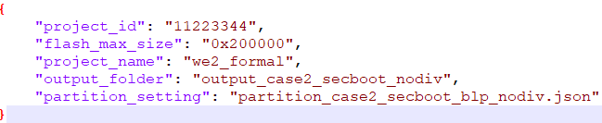
Image Gen configure file: project.json
<project_id> must be 4 bytes value
<partition_setting> partition setting file path

Slide 13
Image Gen configure file: partition settings
Partition key name :
"bootloader", "2nd_bootloader", "hx_memory_descriptor", "cm55m_s_application","cm55m_ns_application", "cm55s_s_application", "cm55s_ns_application", "cm55m_model", "cm55s_model","cm55m_app_cfg", "cm55s_app_cfg", "sec_debug"
Must check format:
<,> to separate different element
Last element without <,>
Must be key words:
"input_file", "sec_format", "version", "flash_addr“ : these types support in all partition key itmes
"exec_addr“ : support in bootloader, 2nd_bootloader.
"load_verify“ : support in "cm55m_model", "cm55s_model","cm55m_app_cfg", "cm55s_app_cfg"
“\\” instead of “\”
Partition setting example

Slide 14
Image Gen configure file
Scenario | Description | Double CLICK left mouse to open
Case 1 | One Core Secure Only
Case 2 | One Core Trustzone / Non-Trustzone
Case 3 | Dual Core Secure Only
Case 4 | Dual Core Trustzone / Non-Trustzone

Slide 15
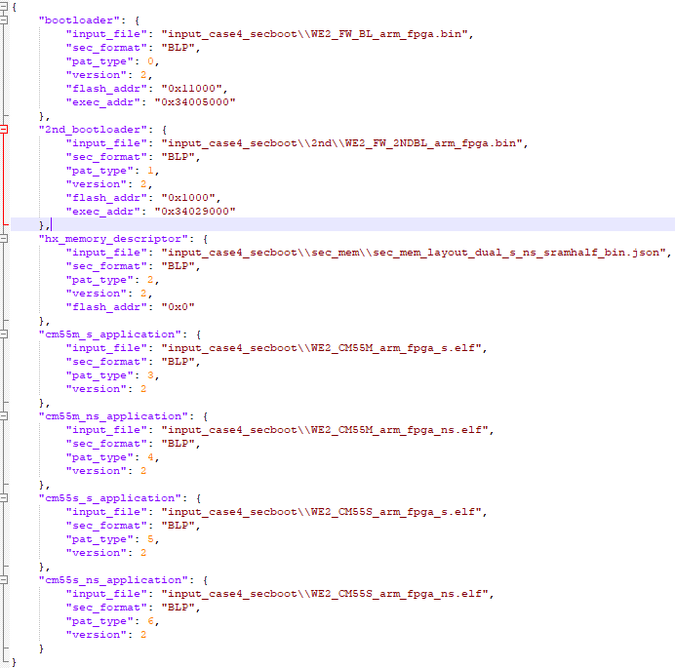
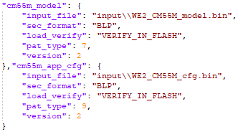
Image configure file

Slide 16

Image Gen configure Glossary
input_file: input file path and name
division_size : application division size (hex), only application can be division
version: header version
option function:
exec_addr (application, hx_memory_descriptor not support): execution address (hex)
flash_addr: file put in flash address (hex)
default :
bootloader flash addr: 0x11000
2nd_bootloader flash addr: 0x1000
memory_descriptor flash addr: 0x00000

Slide 17
How to use Image gen
$ ./we2_image_gen.exe <project json file name>.json
Ex : $ ./we2_image_gen.exe project_case1_blp_nodiv.json
Output file :
Path : we2_image_gen/output_case<n>_secboot_nodiv/output.img

Slide 18
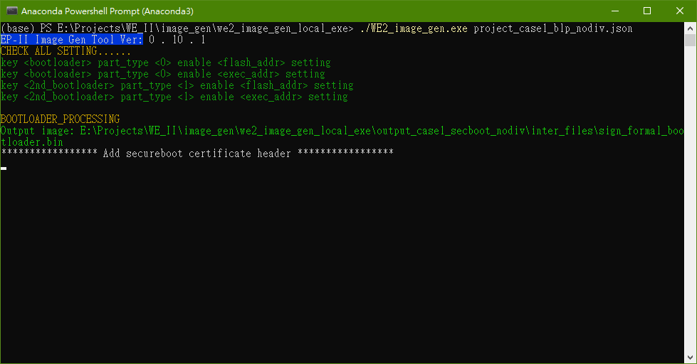
Output log
Check flash_addr and exec_addr enable
Show output intermediate files

Slide 19
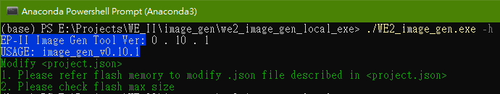
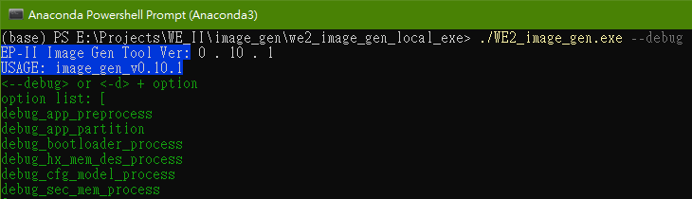
Output log
Show usage
Show enable debug message

Slide 20
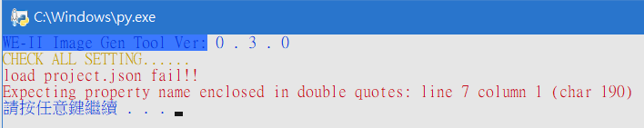
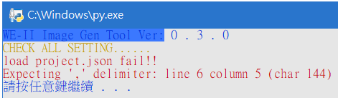
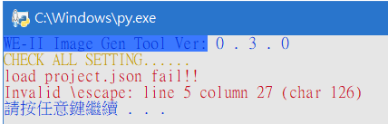
Troubleshooting
JSON file format error:
last element with ‘,’
element without ‘,’
use “\”

Slide 21
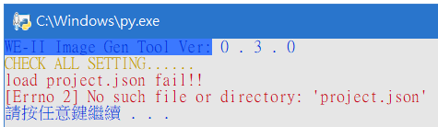
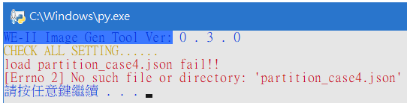
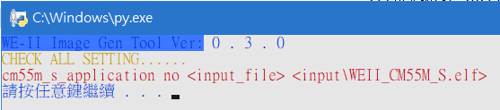
Troubleshooting
Load file error:

Slide 22

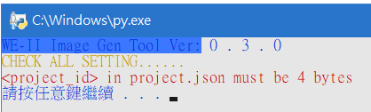
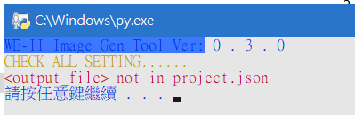
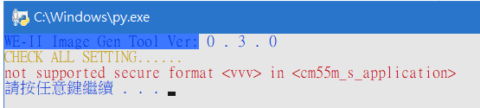
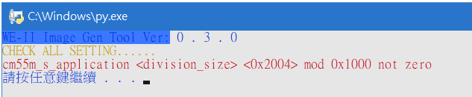
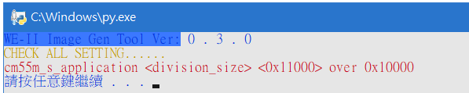
Troubleshooting
Setting error:

