Slide 1
Bangla Sentiment Analysis
Himel Mazumder (011 161 045)
Kazi Faria Oishee (011 153 060)

Slide 2
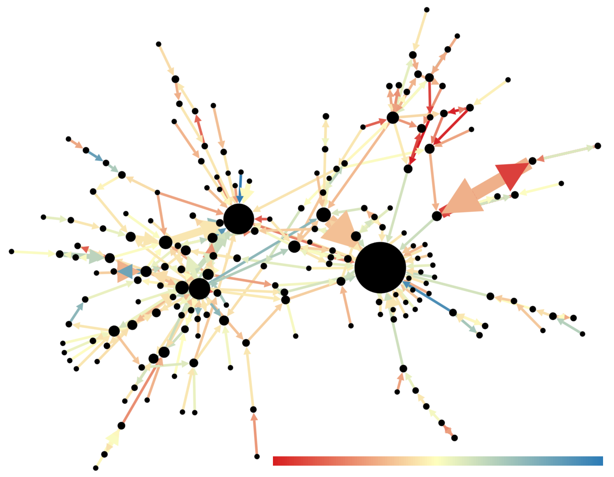
Introduction
Natural Language Processing (NLP)
Text Classification
Sentiment Analysis

Slide 3
Methodologies
Data
Acquisition
Feature Engineering
Model Implementation
Result Analysis
Data Preprocessing

Slide 4
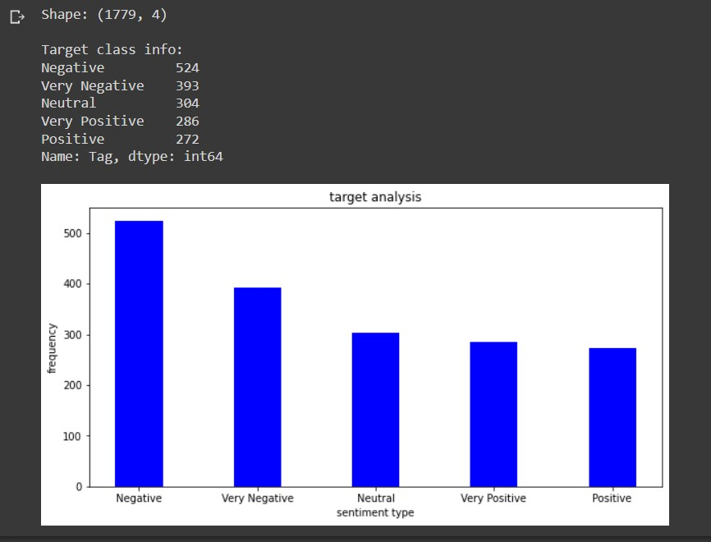
Data Acquisition
News comment dataset
5 types of sentiment:

Slide 5
Data Preprocessing
Normalization for Bangla words
Data cleaning
Converting emojis to text
Removing URL
Removing Bangla special characters and numbers
Removing stop words for both Bangla and English

Slide 6
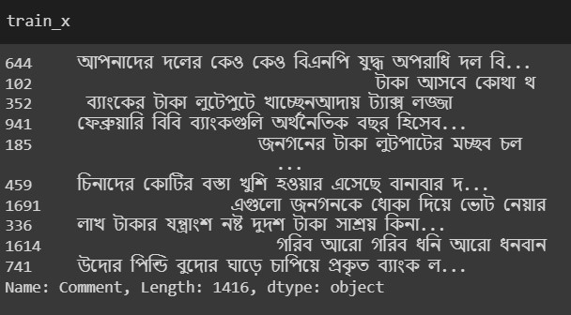

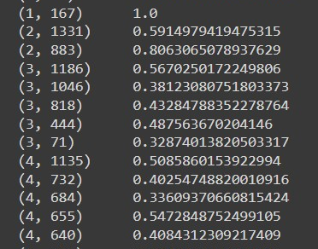
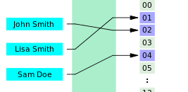
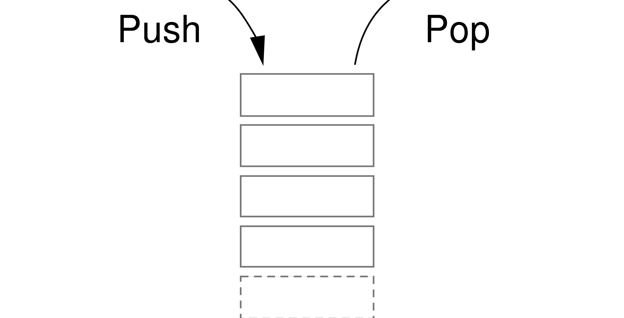
Feature Engineering
TF-IDF vectorization
converting words in to number vectors
Feature engineering for deep learning

Slide 7
Model Implementation
Machine Learning
Naïve Bayes
Naïve Bayes with K-Fold Cross Validation
Logistic regression
Logistic regression with Grid Search
Deep Learning
Long Short-Term Memory LSTM

Slide 8
Result Analysis
Result Analysis:
Naïve Bayes (NB): 0.276
Naïve Bayes with K-Fold (NB_KFold): 0.279
Logistic Regression (LR): 0.313
Logistic Regression with Grid Search (LR_GR): 0.281
LSTM: 0.237

Slide 9

Conclusion
accuracy is very low
>> dataset with low amount of instances

