Slide 1

SDG 3 · GOOD HEALTH | Aotearoa AI Hackathon Festival 2026
ClearChart
Consent forms patients sign — turned into consent forms patients understand.
An AI tool that rewrites hospital discharge summaries and consent forms into plain language at a reading level patients can act on — with a clinician approving every word before it reaches the patient.
University of Waikato
Notes:
CONNECT (0:30). Open with who you are and what you care about. 'We are [names]. We care that in New Zealand, more than half of adults sign hospital forms they cannot fully understand — and then get sent home to act on them.' Set the working name ClearChart (rename freely).

Slide 2




0:30 · CONNECT
Who we are, and what we care about
People with low health literacy
The moment we keep coming back to
Over half of NZ adults — across every community
A patient signs a consent form, nods, and goes home — then can't remember which pill changed, what danger sign means call someone now, or when the follow-up is. That gap isn't the patient failing. It's the paperwork failing them.
Clinicians
Who want patients to actually understand, not just sign
Whānau who don't read clinical English
Te reo Māori and Pacific-language speakers most of all
Notes:
Keep this to ~20 seconds. Make it human before you hit data. Name the three groups you're building for so the judges know exactly who benefits.

Slide 3
1:00 · PROBLEM
Care a patient can't act on isn't really care
56%
~90%
16.1%
of NZ adults — over 1.6 million people — can't obtain and understand basic health information well enough to make informed decisions.
of Pacific people aged 15+ have low health literacy. Māori and Pacific rates sit below non-Māori.
of acute medical admissions in over-65s are readmitted within 30 days — higher for Māori, Pacific, and deprived areas.
Killer data point: an LLM-rewritten discharge summary moved understandability from 13% to 81% — the same study also introduced errors, which is exactly why our design puts a clinician in the middle.
Notes:
1 minute. Lead with one human sentence, then hit the three numbers hard, then the 13%->81% study. The last clause seeds your safety story before the judges can raise it.

Slide 4


THE REFRAME
This isn't a nice-to-have. It's a legal right.
Why that changes the pitch
Right 5 — Code of Health & Disability Services Consumers' Rights
From helpful to required
Judges can verify the obligation exists — it's law, not opinion.
Every consumer has the right to effective communication “in a form, language, and manner that enables the consumer to understand.” A consent form the patient didn't understand is arguably not compliant. Right 6 adds the right to be fully informed.
A defensible reason to exist
We're closing a compliance gap, not adding a chatbot.
Local and specific
This is the NZ Code — overseas products aren't built around it.
Notes:
This slide is your edge. Health chatbots are the most crowded category — leading with Right 5 makes the judges hear 'required', not 'another chatbot'. Say the word 'compliance gap' out loud.

Slide 5
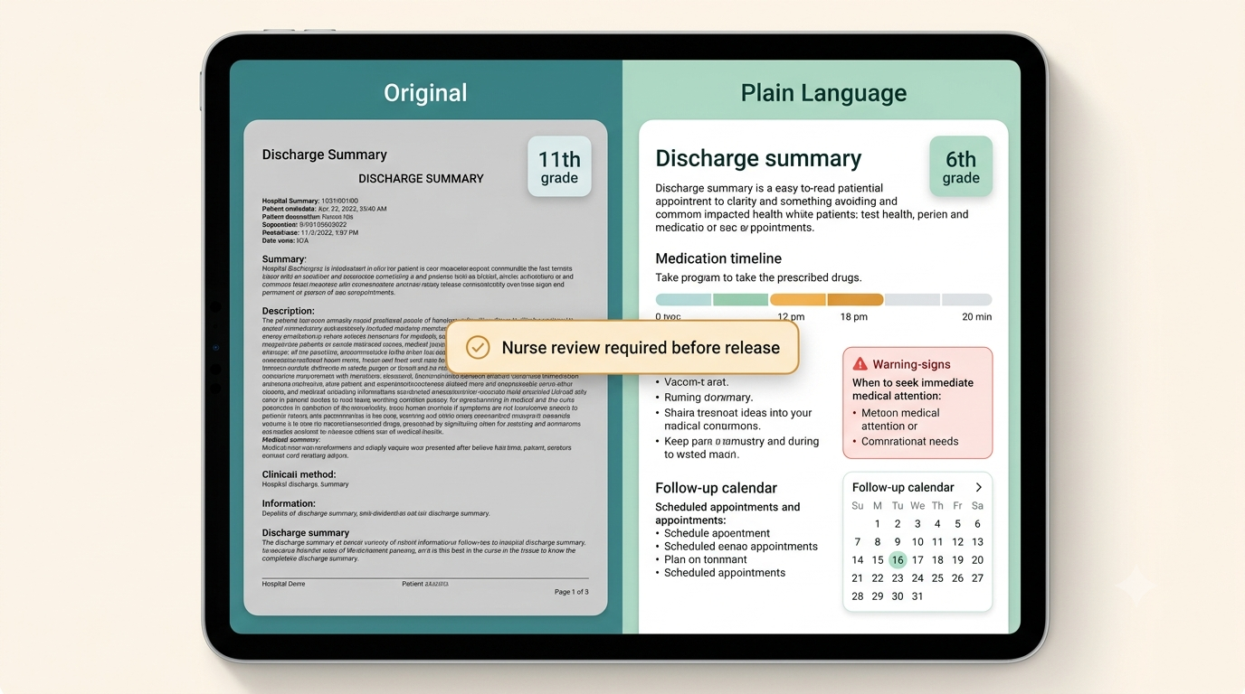


2:00 · YOUR BIG IDEA — THE PROTOTYPE
Same record. Two readings. One safety gate.
Before → after
An 11th-grade clinical summary becomes a 6th-grade one, side by side.
Clinician gate
“Nurse review required before release” — a human approves every rewrite.
Structure over prose
Medication timeline, red-flag warning card, follow-up calendar.
Concept mockup — the live build is a working web app (see next slide).
Notes:
This is the heart of the pitch (part of the 2-minute Big Idea). Put the mockup on screen and narrate it left to right: dense original, plain-language version, and the amber gate in the middle. Be honest it's a concept mockup; the working demo is the next slide.

Slide 6
HOW IT WORKS · BUILDABLE IN A DAY
Four steps. No training, no hospital integration.
1
2
3
4
Ingest & structure
Rewrite + clinician gate
Visual breakdown
Language & format
Pull the parts a patient acts on from a PDF: meds & changes, warning signs, follow-ups, who to call.
Generate a plain-language version at a target reading level. A nurse approves or edits before release.
Medication timeline, a red-flag 'call now' card, and a follow-up calendar. Structure does the work.
Te reo Māori, Pacific languages, large print, audio — with human verification. Where Right 5 is met.
Why 48 hours works: PDF extraction + one structured-extraction call + one rewrite call + a review screen. The review UI is ordinary CRUD. Nothing to train, nothing to integrate.
Notes:
Still inside the 2-minute Big Idea. This is your Technology score. Emphasise the clinician gate (step 2, amber) is the safety design, and that the whole thing is genuinely buildable in the time given.

Slide 7
DIFFERENTIATION
“Why not just use ChatGPT — or Epic?”
Epic's Emmie exists — but
NZ public hospitals don't run on Epic
It summarises lab & procedure results inside MyChart. It has no shipped feature that rewrites the full inpatient discharge summary or the consent form.
So none of that reaches a patient at Waikato Hospital. The gap is real and local.
No overseas product does te reo Māori or Pacific languages
The clinician gate is the difference
That output — the part where Right 5 is actually met for NZ — is ours to own.
A generic chatbot ships its guess straight to the patient. We put a human in the middle by design.
Notes:
Judges almost always ask 'why not just Google it / use ChatGPT'. Answer it before they ask. The honest line: overseas tools exist, but none rewrite the full discharge summary, none reach NZ hospitals, and none do te reo or Pacific languages with a clinician gate.

Slide 8


1:30 · IMPACT · WHAT WE NEED · FUTURE
What changes if this ships
13% → 81%
What we need
The future
Clinical partner to validate rewrites
Every discharge form leaves the ward in a form the patient understands — in their language, checked by a clinician, turning a legal right into a daily reality.
measured jump in how well patients understand their own discharge summary, in the study we build on.
Verified te reo & Pacific translations
A pilot ward to test comprehension
Synthetic sample docs only — never real records
IMPACT
Technical roadmap: Next: MedGemma 4B for structured medicine/date extraction (targets the 6/52 misparse). De-identification and simplification fine-tuning are post-hackathon future work. Since prototype: mobile patient view, QR save-to-phone, on-device TTS — all single-file/offline. Delivery roadmap: push approved rewrites into ManageMyHealth (NZ's largest patient portal).
Notes:
1.5 minutes. Be compelling on impact (13->81%), be concrete on the ask (what you need to go further), then end on the future line — a legal right becoming daily reality. This closes the official template.

Slide 9
WHY THIS WINS ON THE SCORECARD
Every criterion, covered
Inspiration
Technology
Design & Innovation
Presentation
A defined problem with a legal spine and a human face.
Real AI, buildable in a day, with a clinician safety gate.
Shipped safety UI, QR patient handoff, on-device TTS; te reo & Pacific output no rival ships.
One sentence any judge grasps: forms patients can actually understand.
SDG mapping: Indicator 3.8.1 (coverage of essential health services) + SDG 10.2 (inclusion — low literacy tracks with ethnicity & deprivation).
The ask: help us put a plain-language, clinician-approved consent form in front of the next patient who signs one.
Notes:
Closing slide. Explicitly map to the four equally-weighted criteria and the two SDG indicators so the judges can tick their sheet. End on the one-line ask.

