Slide 1
Student Alcohol Consumption Project
2021.12.2
Xingyue Claire Zhu
Notes:
Data collect from

Slide 2
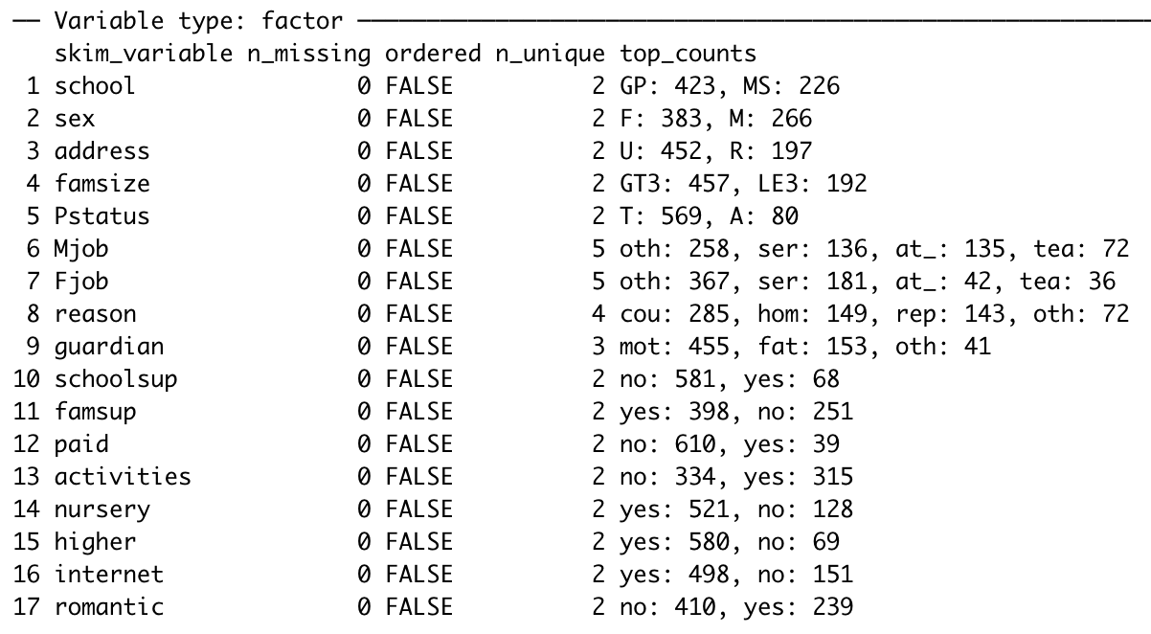
Brief summary for categorical variables

Slide 3
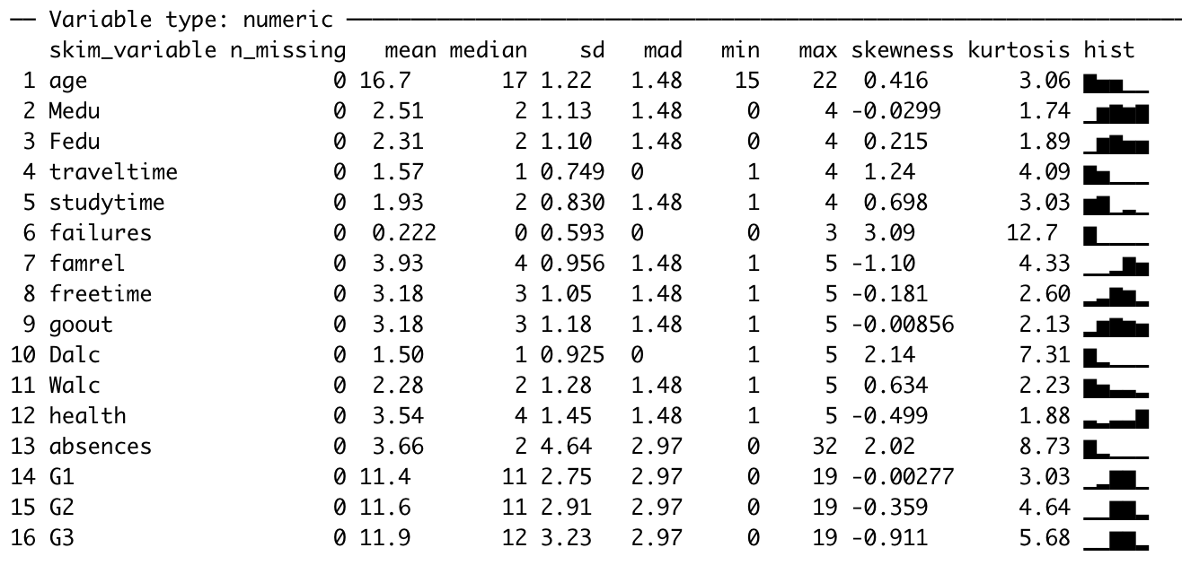
Brief summary for numeric variables

Slide 4
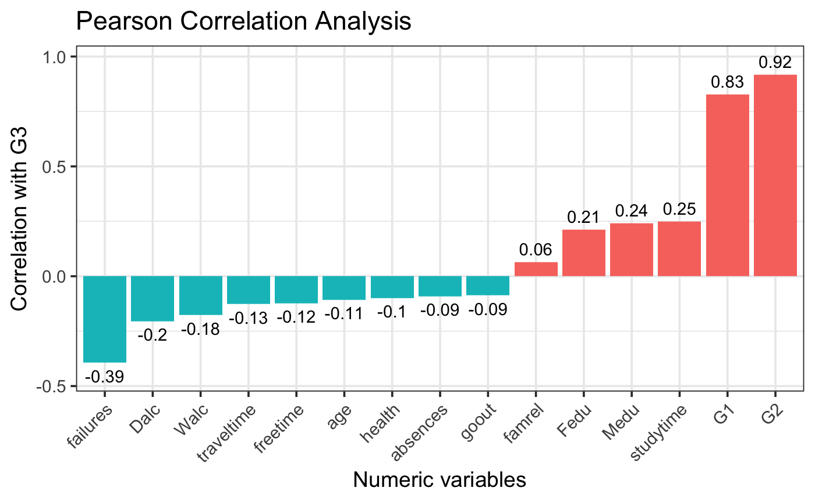
Bi-variate correlation analysis between G3 and all numeric variables
A positive number means this variable has positive correlation with G3. The larger the number is, the more linear related.

Slide 5
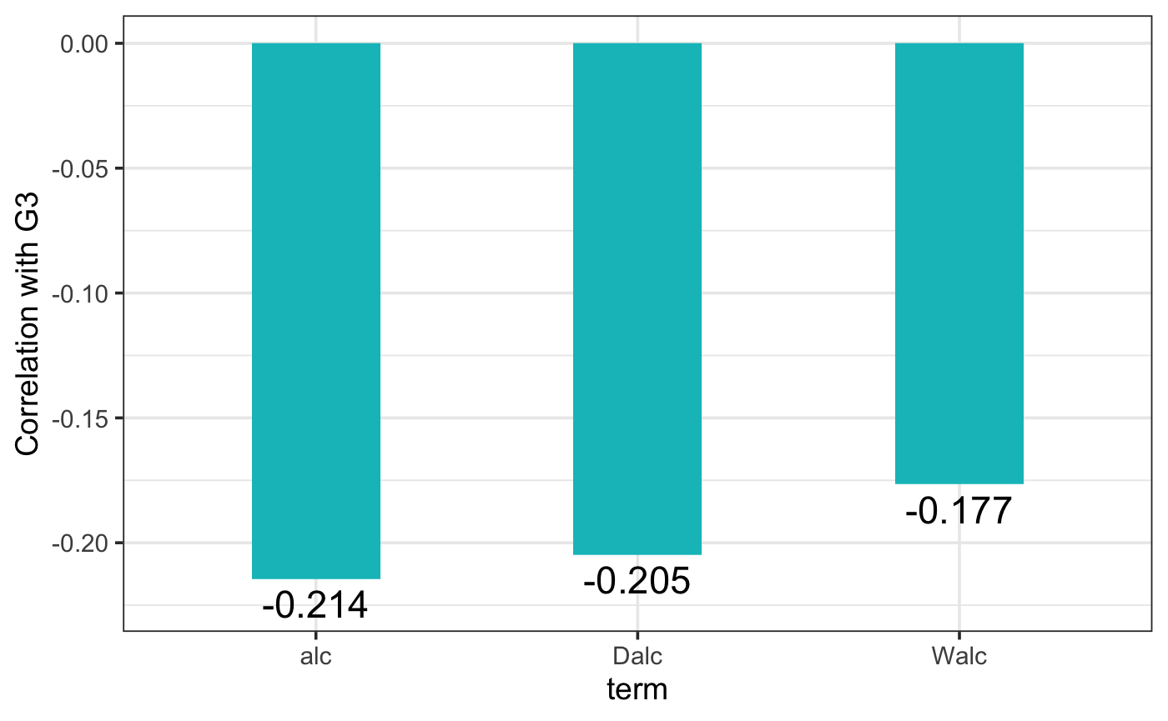
Create a new feature “alc”

Slide 6
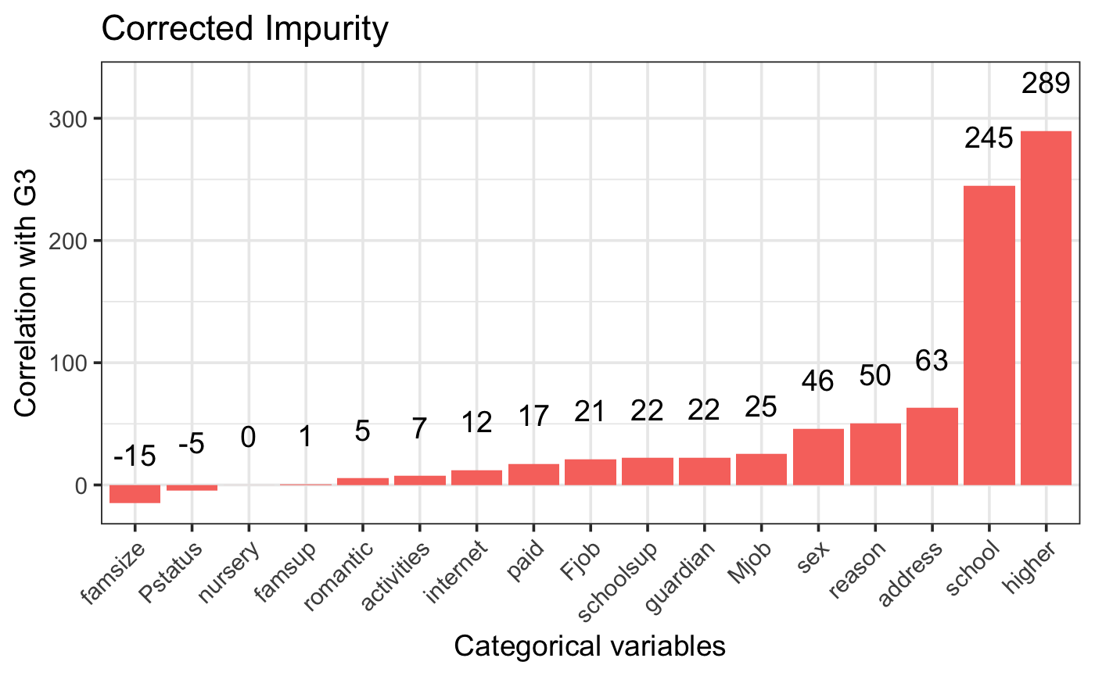
Bi-variate importance analysis between G3 and all categorical variables
The higher the importance score means the feature provides more help to the regression. A negative importance value means that feature makes the loss go up, which indicates that your model is not getting good use of this feature.

Slide 7
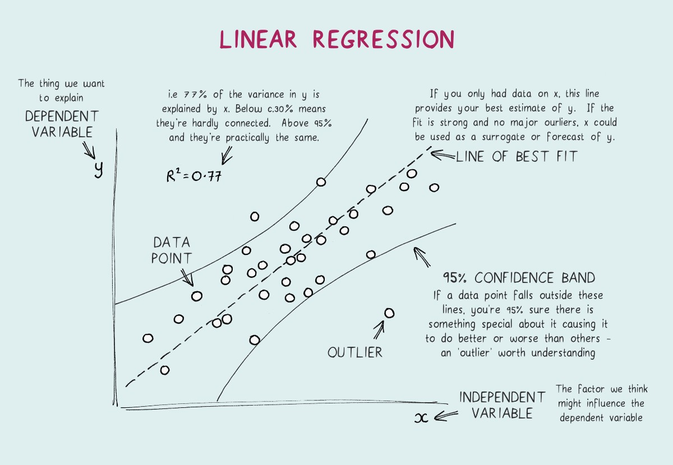
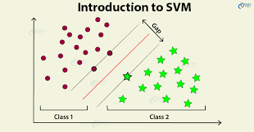

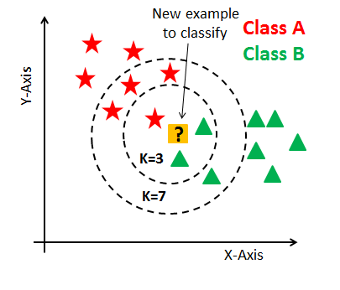
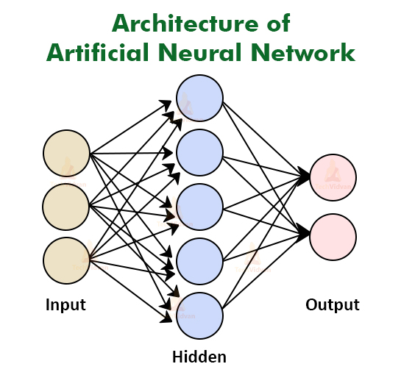
Candidate Models
Linear regression
Support vector machine
Random forest
K-nearest neighbors
Artificial neural network
https://towardsdatascience.com/linear-regression-explained-1b36f97b7572
https://data-flair.training/blogs/svm-support-vector-machine-tutorial/
https://www.teamcassracing.top/products.aspx?cname=random+forest+deep+learning&cid=23
https://www.datacamp.com/community/tutorials/k-nearest-neighbor-classification-scikit-learn
https://techvidvan.com/tutorials/artificial-neural-network/

Slide 8
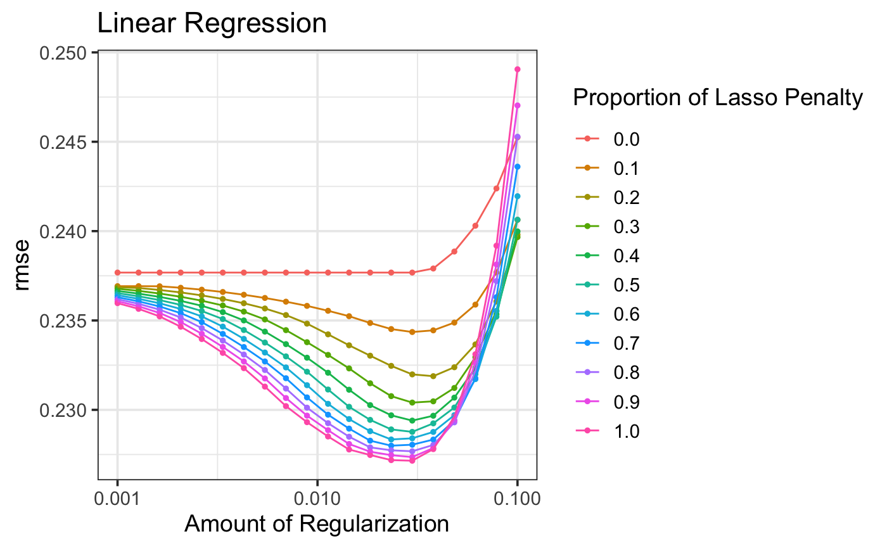
Best parameters for linear regression
The penalty of lasso regression is 1, and the penalty of ridge regression is 0, the penalty of elastic network is between 0 and 1.
Best hyper parameters:
Regularization = 0.0298
Mixture = 1

Slide 9
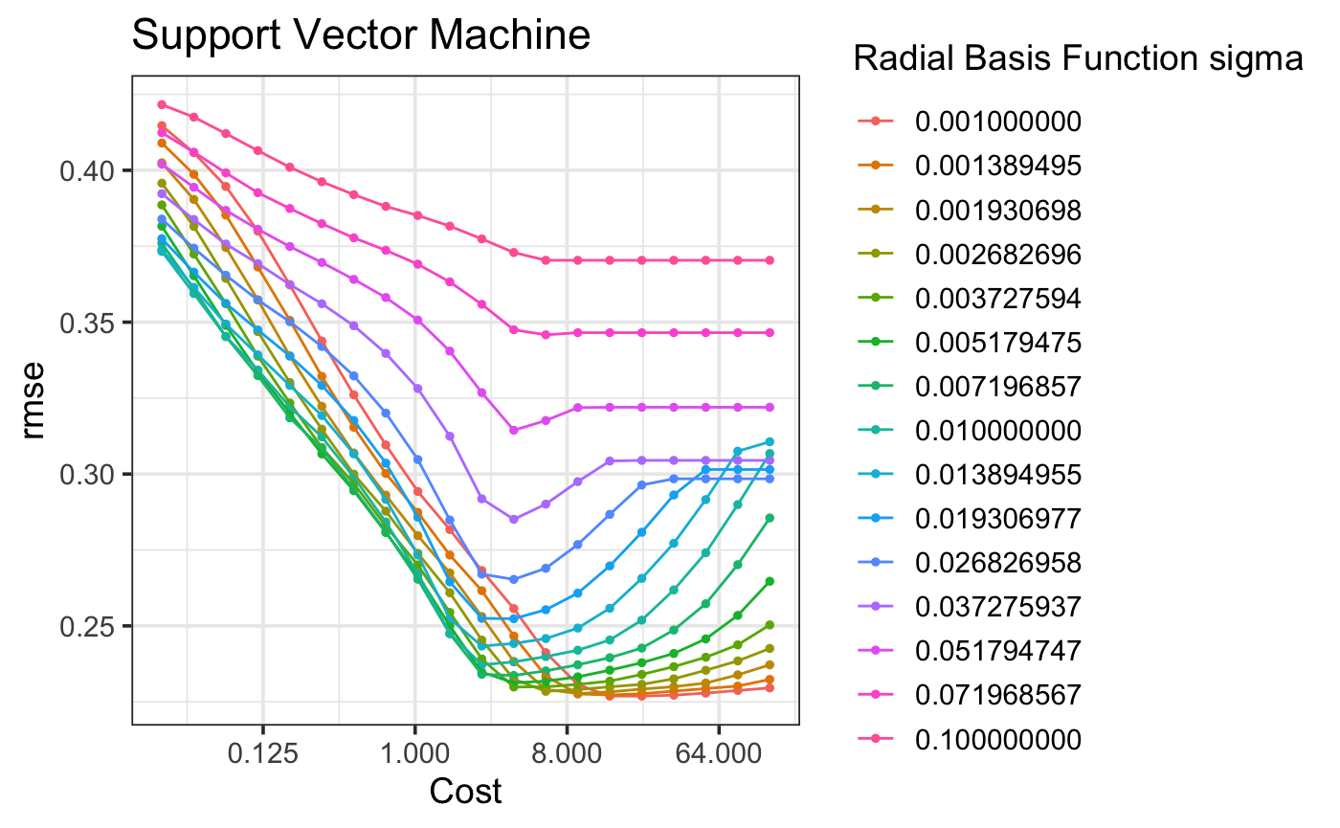
Best parameters for support vector machine
The cost parameter decides how much an SVM should be allowed to “bend” with the data. For a low cost, you aim for a smooth decision surface and for a higher cost, you aim to classify more points correctly. It is also simply referred to as the cost of misclassification.
The RBF sigma decides how far reach every instance will have. A high values of sigma typically produce highly flexed decision boundaries, and low values of gamma often results in a decision boundary that is more linear.
Best hyper parameters:
Cost = 22.2
Sigma = 0.001

Slide 10
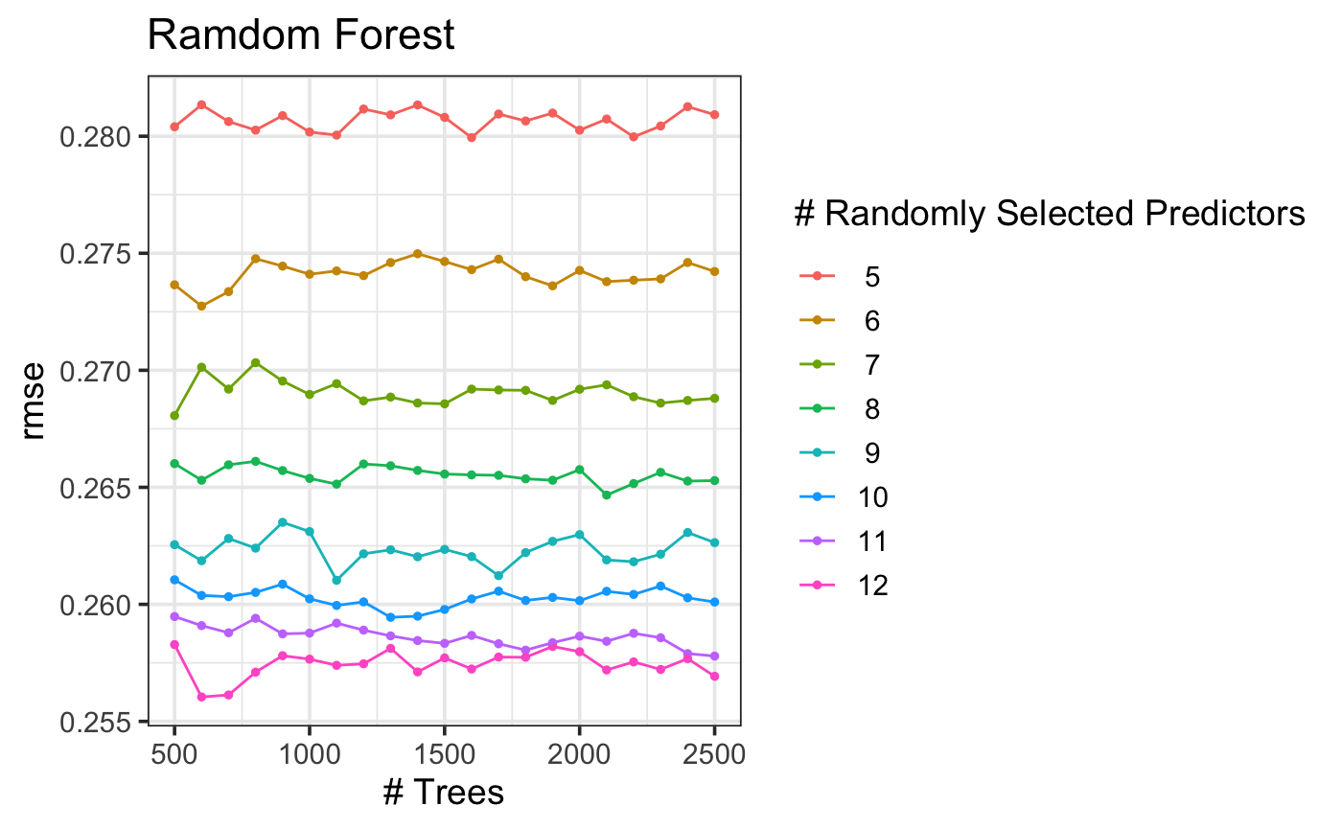
Best parameters for random forest
The randomly selected predictors, also refer to mtry in a random forest means the number of variables available for splitting at each tree node.
Best hyper parameters:
mtry = 12
trees = 600

Slide 11
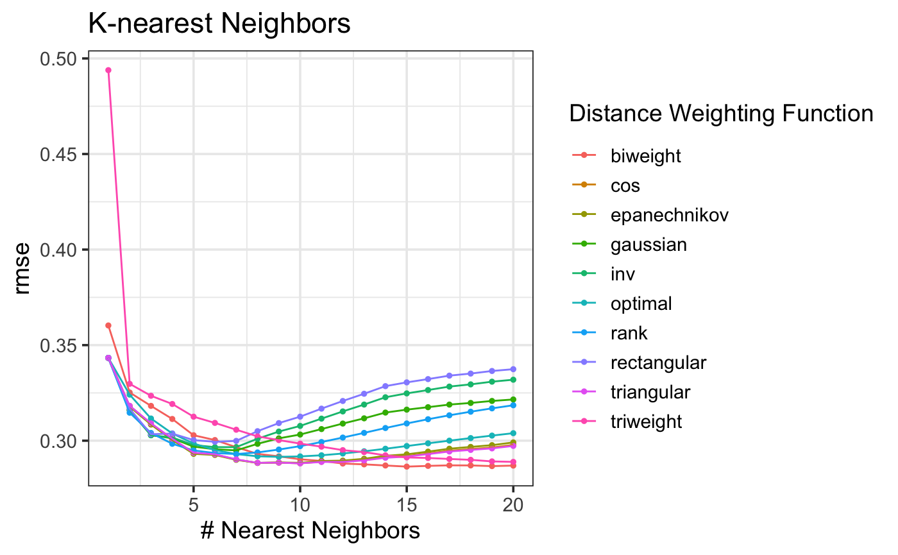
Best parameters for k-nearest neighbors
Best hyper parameters:
k = 15
Weighting function = biweight

Slide 12
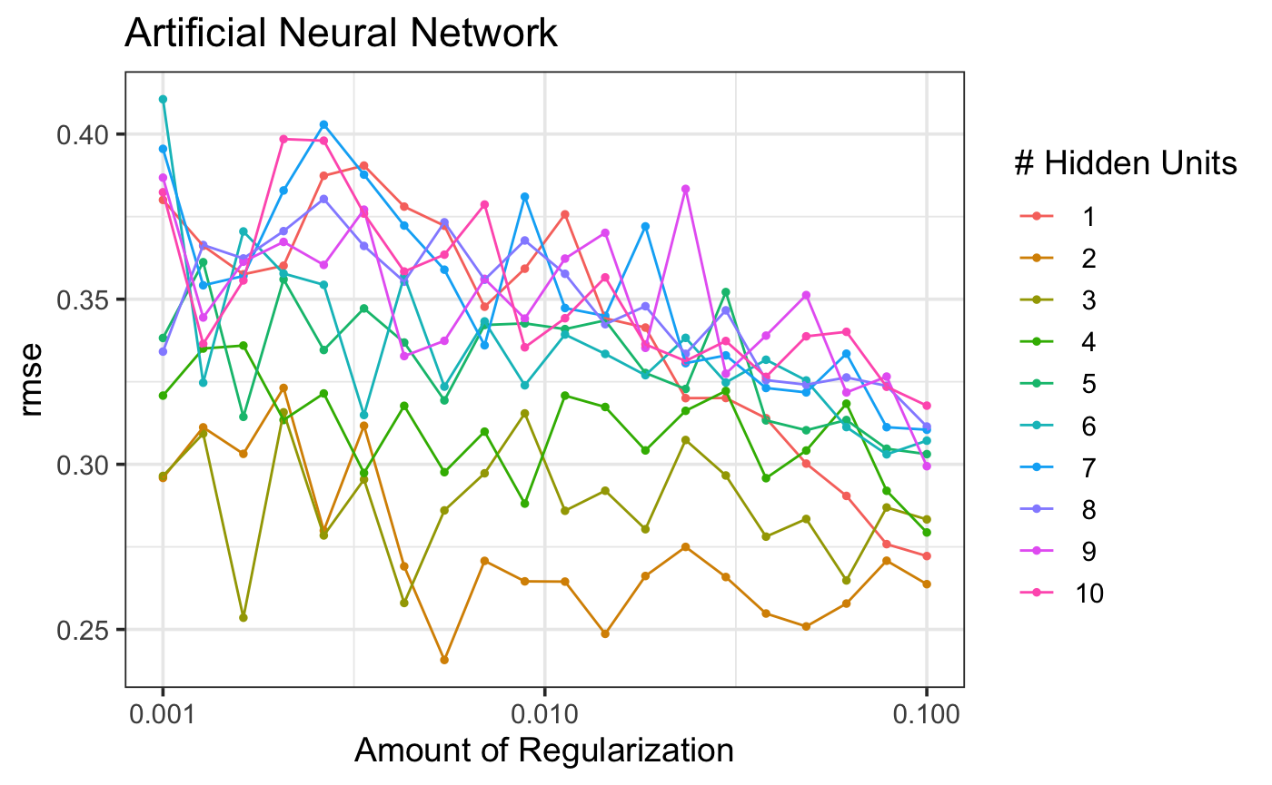
Best parameters for artificial neural network
The hidden units means how many nodes will the hidden layer have.
The regularization here is similar to the regularization in the linear regression.
Best hyper parameters:
Regularization = 0.0055
Hidden units =2

Slide 13
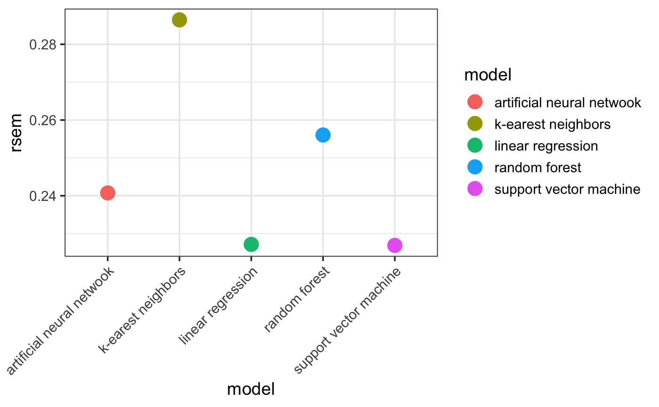
Prediction performance in cross validation

Slide 14
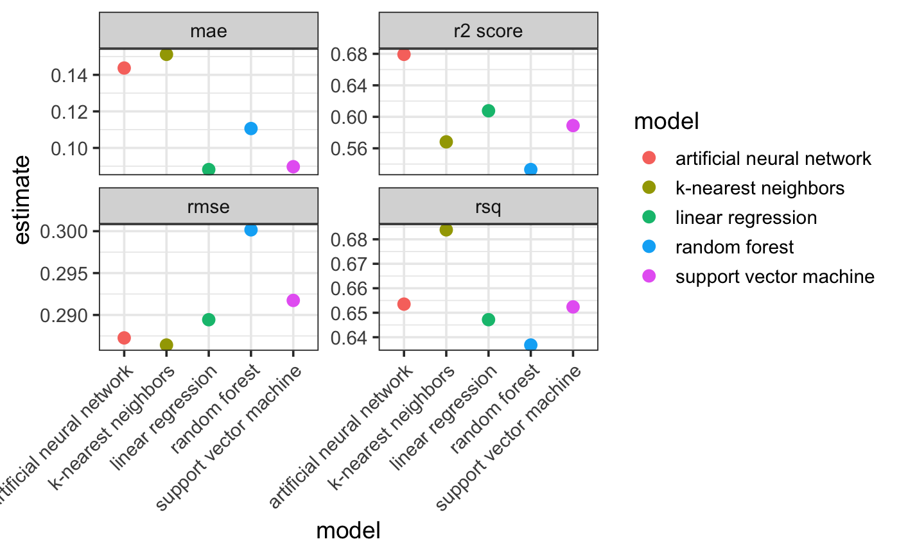
Prediction performance in test set
Overall, artificial neural network is the best model.

Slide 15
Thank you for watching!

