Slide 1


Exploring Countermovement Jump (CMJ) Scan Movement Signatures in Men’s Collegiate Lacrosse Athletes
EPID 600: Data Science for Biomedical Informatics
Final Project, Due: 12/1/20
Bernadette D’Alonzo
Dr. Doug Wiebe, Dr. Abby Bretzin, Dr. Jeremy Weeks, Dr. Brian Sennett

Slide 2
Overview
“Force Plate Analysis in Collegiate Athletes: An Epidemiologic and Injury Prevention Study”
Evaluate Sparta Science at Penn (5 years):
Can force plate measurements predict injuries, and performance outcomes, and (how) do these measurements vary across sports and sex?
Goal: Inform customized strength and conditioning injury prevention programs
(How) do these measurements vary between athletes from the same sport compared to within one athlete over time?
Penn Varsity Men’s lacrosse players
Notes:
Penn Athletics, Penn Sports Medicine, Penn Injury Science Center (PISC)

Slide 3
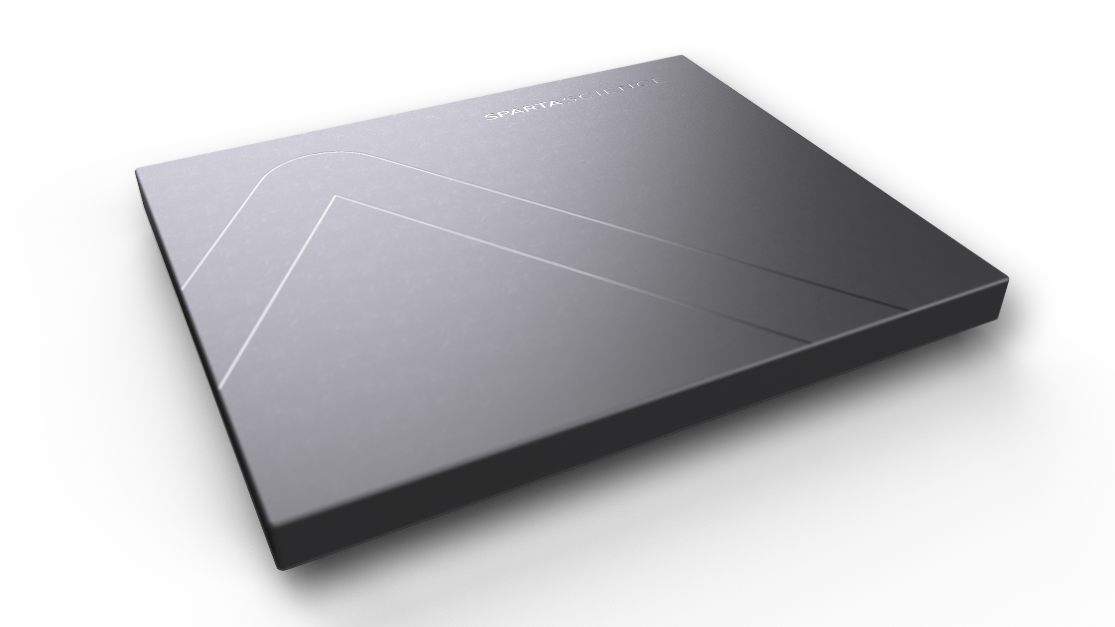
Introduction: Sparta Science¹
Founded in 2009 by Dr. Phil Wagner
Reduce injury risk and improve movement efficiency
“Force plate machine learning”
Force plate technology + Sparta database:
Measure Ground Reaction Forces (GRF) generated as individual stands or moves across plate
Database containing 1,500,000+ assessments
Balance scan, Jump scan, Plank scan
¹ https://spartascience.com/about

Slide 4
Movement SignatureTM + Injury Risk Score
Measures phases of movement – “how an individual moves”²
Load: how much and how quickly force is created, measured during downward phase of jump
Explode: how much and how efficiently force is transferred, measured through transitional phase of jump
Drive: how much and how long force is applied, measured during upward phase of jump
Expressed as t-score
https://gfycat.com/discover
Injury Risk Score: range 0(low risk) – 5(high risk)
² https://success.spartascience.com/hc/en-us/articles/360044860713-Load-Explode-and-Drive

Slide 5
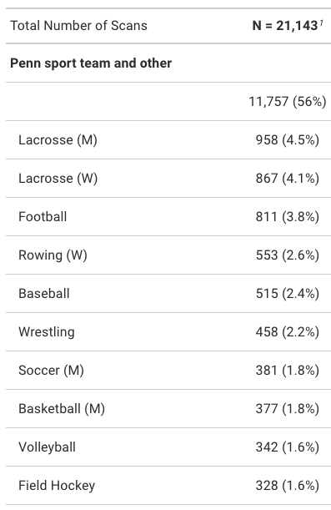
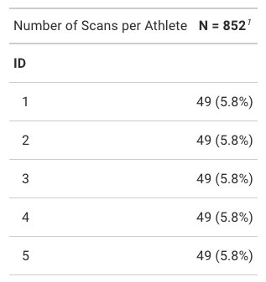

Men’s Varsity Lacrosse
CMJ scan only-35 athletes
Notes:
I aimed to focus on a single sport for this project, and so I first examined the total number of scans that we have access to in the Sparta dataset.
There are 21,143 scans total, roughly half (54%) are scans of Penn Varsity athletes with complete data.
I confirmed that among Penn teams, Men’s Varsity Lacrosse has the most number of scans (Note, we suspected this following conversations with the Strength & Conditioning group due to this team’s frequent utilization of Sparta and buy-in from coaches, etc.).

Slide 6
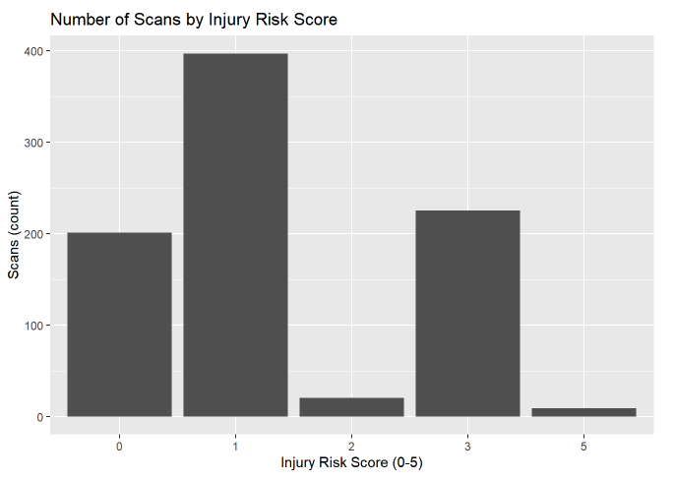
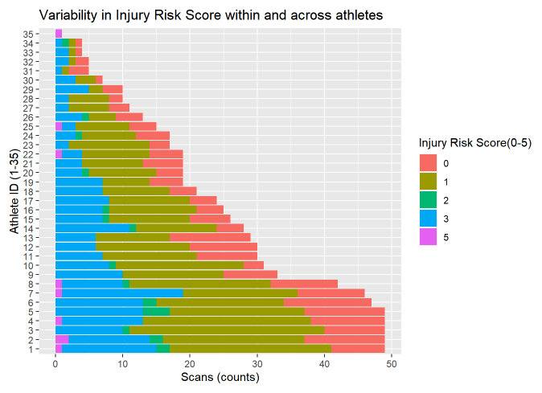
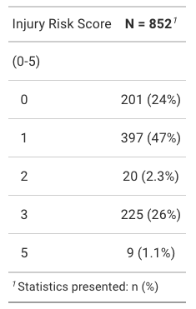
Injury Risk Score
Notes:
I explored “Injury Risk Score” first, which ranges from 0-low to 5-high risk of injury.
We see that for the majority of scans (47%; almost half) Injury Risk Score was reported to be 1, followed by 3, then 0.
We can further observe that Injury Risk Score varies greatly both across the 35 lacrosse athletes and within a given athlete here.
Almost all athletes experienced each Injury Risk Score at one point in time.
A next step in the larger study will be to explore whether an increase (or change) in Injury Risk Score for a given athlete coincides with an actual injury occurring by combining this dataset with medical/athletic training records containing injuries.

Slide 7
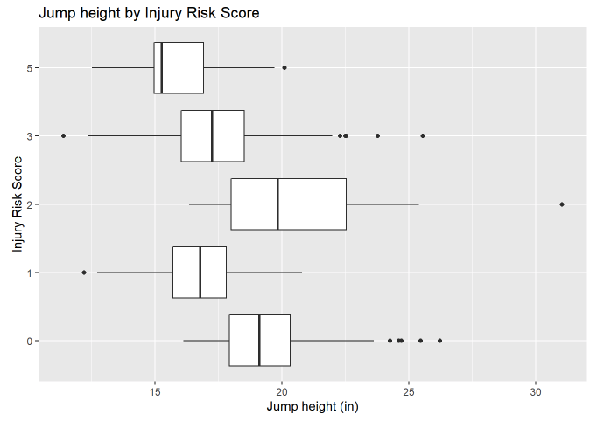
Jump Height, Injury Risk Score
Notes:
To explore another facet of the Counter Movement Jump (CMJ), I looked at Injury Risk Score and Jump Height below.
We see that in general, higher jumps seem to coincide with lower Injury Risk Scores; 0 and 2.
We may have expected to see some sort of dose response relationship, however, Jump Height seems to be fairly consistent across all Injury Risk Scores.

Slide 8
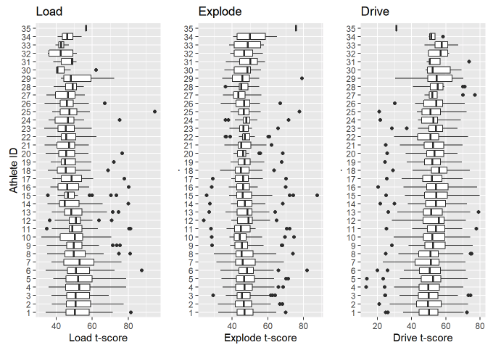
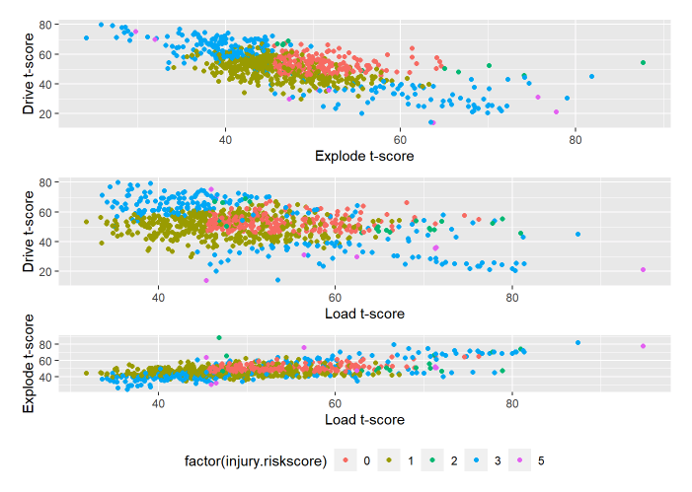
LOAD, EXPLODE, DRIVE
Notes:
After Injury Risk Score, I explored the 3 variables that make up the Sparta Movement Signature; LOAD, EXPLODE, and DRIVE (expressed as tscores).
Looking across all 35 athletes, we see that most athletes’ median scores in all 3 measures center around 50, however, we see consistent variability within a given athlete’s scores.
This is additional motivation for future studies to determine what factors may be contributing to a change in score over time.
I then examined the relationship between LOAD, EXPLODE, DRIVE scores and Injury Risk Score.
We see below that low Injury Risk Score (0,1) seems to coincide with tscores primarily between 45-60, while higher Injury Risk Scores are clustered at tscores below 45 and above 60, resembling a U-shape relationship.

Slide 9
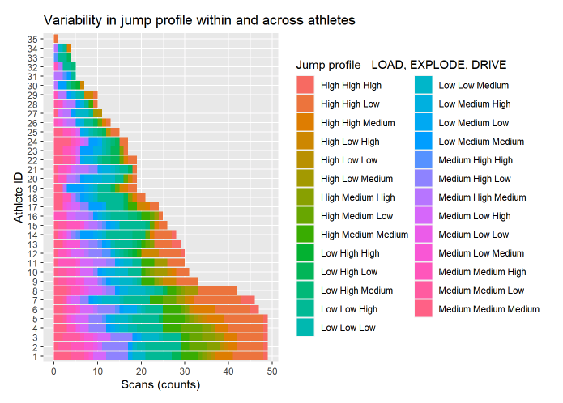
Jump profiles
LOAD, EXPLODE, DRIVE tertiles
“High” | “Medium” | “Low” on each measure
Notes:
Despite being 3 distinct measures, as discussed above, LOAD, EXPLODE, DRIVE can really be thought of together as one overall summary measure. So, in order to better conceptualize LOAD, EXPLODE, and DRIVE scores as one measure, I generated a variable similar to Sparta Science’s Movement Signature.
I split each variable LOAD, EXPLODE, and DRIVE into tertiles and classified each scan according to “High,” “Medium,” “Low” on each measure. I then concatenated them, creating a “Jump Profile” for each jump scan.
Putting these pieces together, I then looked at jump profile within an athlete and across our 35 Men’s Lacrosse players, and saw a lot of variability here as well.

Slide 10
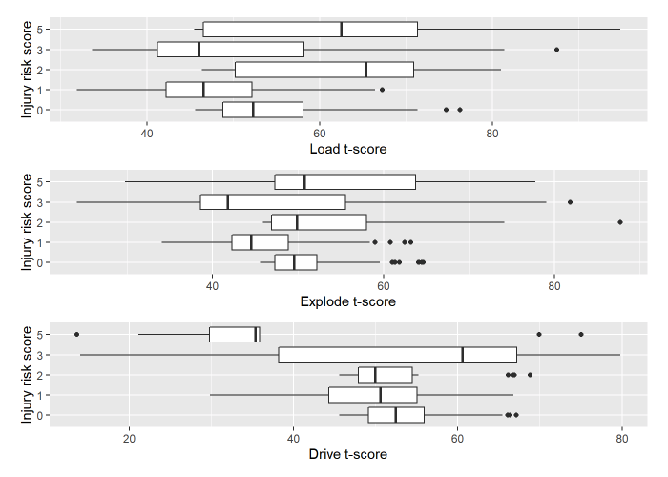
LOAD|EXPLODE|DRIVE -> Injury Risk Score?
Bivariate analysis, linear(OLS) regression
Load t-score -> Injury Risk Score
Explode t-score -> Injury Risk Score
Drive t-score -> Injury Risk Score
Multivariate linear regression
Load, Explode, Drive -> Injury Risk Score
Conclusion: neither LOAD, EXPLODE, nor DRIVE correspond to Injury Risk Score in a linear fashion.
Notes:
Bivariate analysis, linear(OLS) regression to look at the pairwise relationships between:

Slide 11
Conclusions & Next Steps
? Examine appropriate cut-points, split Injury Risk Score into levels as an ordinal variable, repeat the analysis as a logistic regression
However, field needs to explore variability that we see in these measures within an athlete
Best next step: examine variability as it relates to actual injury occurrence over time

Slide 12
References
Load, Explode, and Drive. (Updated April 2020). Retrieved November 27, 2020, from https://success.spartascience.com/hc/en-us/articles/360044860713-Load-Explode-and-Drive
Sparta Science: About. (Updated 2020). Retrieved November 27, 2020 from https://spartascience.com/about

