Slide 1
Identification and Classification of Retinal Bipolar Single Cells
Nico Dana
12/5/17

Slide 2
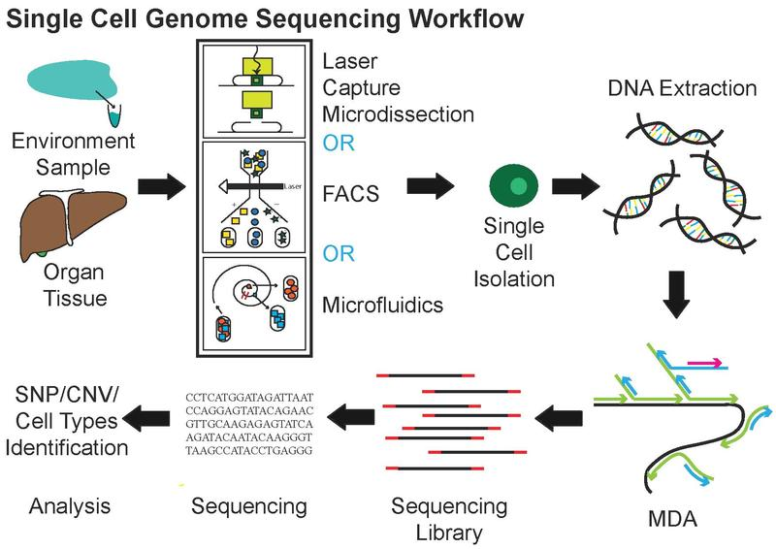
Single Cell Sequencing
Examines the sequence information from individual cells
Provides a higher resolution of cellular differences
Grants understanding of individual cell functions
Due to this increased resolution, with respect to tissue sequencing:
Cell type identification plays a critical part in data interpretation
Gene markers for cell types must be identified
Notes:
For this project I considered the data from several single cell sequencing runs of mouse retinal cells.
Compared to traditional tissue sequencing, where you would compare multiple disease states to non-diseased tissue, single cell sequencing offers higher resolution understanding of a cell population while also presenting additional problems.
The greatest of these problems being the identification of the cell types within the population.

Slide 3
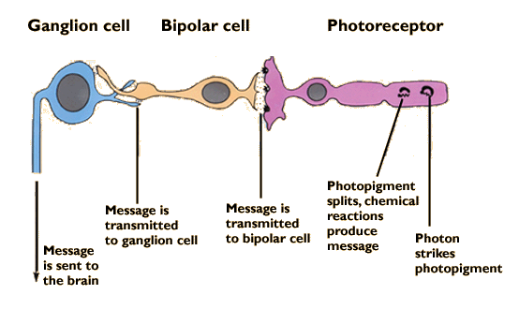
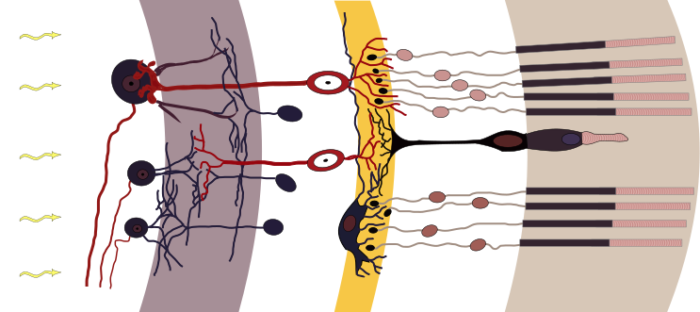
Retinal Bipolar Cells
Bipolar cells transfer information from the photoreceptors (both rods and cones) to ganglion cells
Currently there are 10 known cone bipolar cells (further divided into ON-cone and OFF-cone types) and 1 rod bipolar cell
Notes:
The cells considered for this project were bipolar cells, which lie between the photoreceptor and ganglion cells within the eye.
There are a total of 11 known bipolar cell types, 1 rod and 10 cone types, of which the cones can be further divided into on and off cone types.

Slide 4
Project Goals
To identify the 11 known bipolar cells types within the data using known biological markers.
To potentially identify unique traits for bipolar cell types.
To accomplish all of the above using the R package “Seurat”
Notes:
With that short background, the goal of this project was to identify the 11 known bipolar cell types using known biological markers, which I will go over a bit later.
In addition, I also hoped to identify unique traits for the identified cell types.
And finally to accomplish this using Seurat, which is an R package specialized to analyze single cell data.

Slide 5
Data Used
~25,000 mouse retinal bipolar cells
Shekhar et al. August 2017.
https://portals.broadinstitute.org/single_cell/study/retinal-bipolar-neuron-drop-seq
Gene expression matrix
Medium normalized, log transformed
~13,000 gene expression values per cell
Notes:
I used the data from a paper published earlier this year in August, which sequenced about 25,000 mouse bipolar cells.
The data came in the form of a gene expression matrix, where each element would correspond to a single cell and a gene

Slide 6
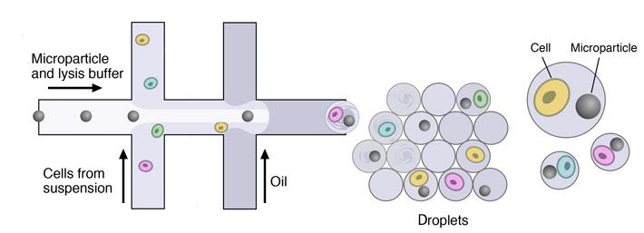
Cell Doublets
Occur when two cells are captured with a single barcode.
Introduces noise into the data
Notes:
When you’re working with single cell data you have to keep in mind how the cells are isolated.
Typically, the goal is to isolate a single cell with a single barcode, but occasionally you will have multiple cells isolated with a barcode or a barcode isolated with some other noise in the solution.
Ideally we want to filter out any noise introduced by the isolation method used to prepare cells for sequencing.

Slide 7
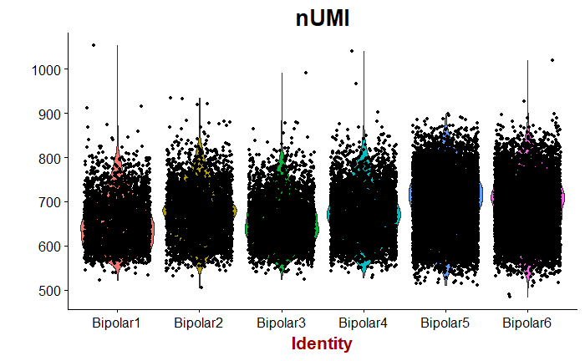
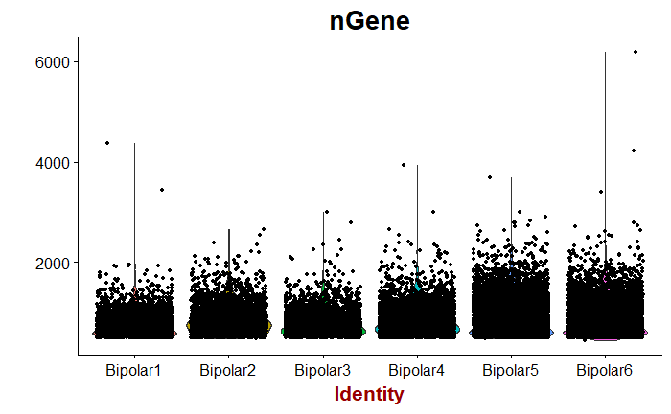
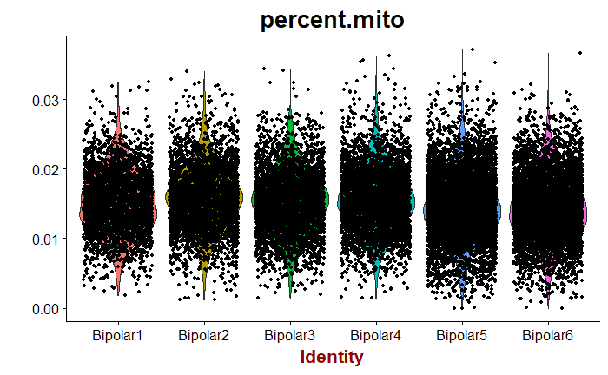
Quality Control
Notes:
So to find any cell doubles, I looked at three variables, the first being the number of genes expressed in an individual cell, second being the number of unique molecular identifiers per cell, and third being the percentage of mitochondrial content.
These graphics show a violin plot in the background with a type of Manhattan plot shown over it, where each point represents a cell in the data.
The number of genes is pretty straightforward. The unique molecular identifiers are introduced during sequencing as barcodes, so the number of unique molecular identifiers essentially shows how fragmented a cell’s rna was during the sequencing process.
The mitochondrial percentage is another metric worth looking at as for every copy of the nuclear genome a cell can have 10s to 1000s of copies of the mitochondrial genome.
So what that looks like in the data is: you will have, in this case, 20 genes express a high percentage of the total cellular expression, but in this data it was very low.

Slide 8
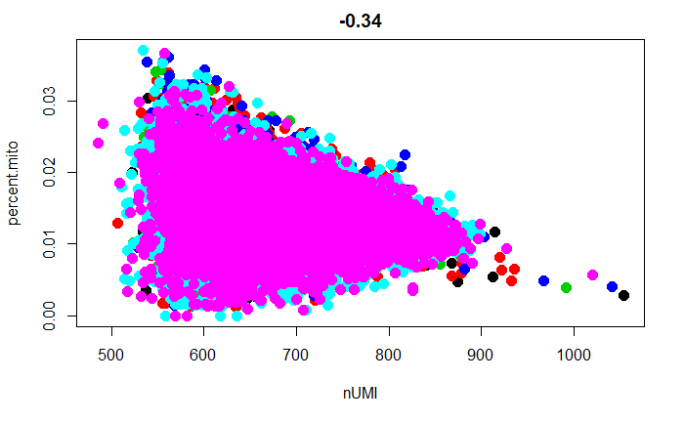
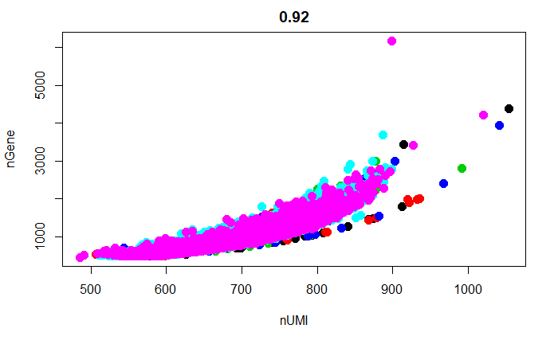
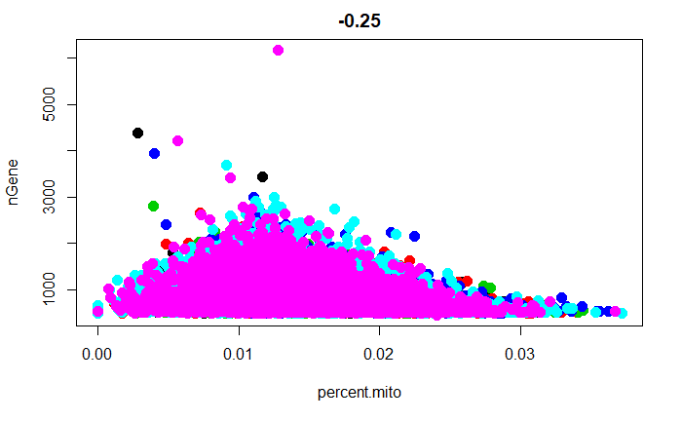
Quality Control
Notes:
Another way to visualize this information is to plot the variables against each other, the goal of this to remove any obvious outlier cells that we may suspect to be cell doubles.
There aren’t that many outliers in this cell population, but I ended up filtering out cells based on the number of genes and unique molecular identifiers.

Slide 9
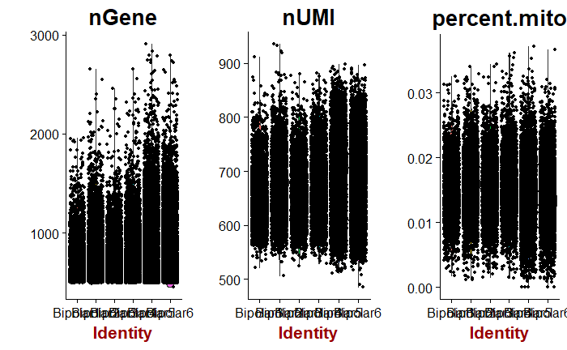
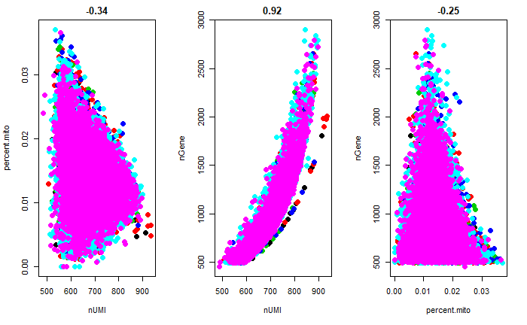
Filtered Data
Notes:
To give you an idea on how the data appears after it has been cleaned, I’m showing the same plots for the now filtered data. There no longer appears to be any outliers and we can move on to a PCA analysis.

Slide 10
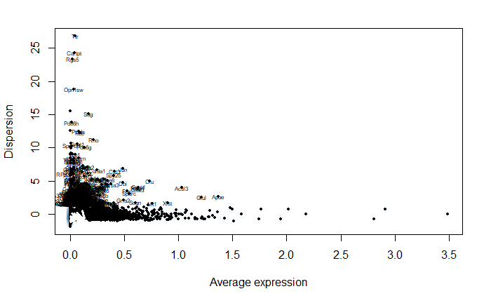
Principle Component Analysis
Performed on all cells for highly variable genes
Outliers on the mean-variability plot
347 variable genes identified
30 PCs computed
Each PC calculated will effectively represent an extra dimension of data for a set of correlated genes from the variable genes list
Notes:
To save computational time the PCA was run only on the most variable genes, instead of all 13,000.
These genes are identified as outliers on the mean-variability plot shown, in total there were 350 variable genes.
The idea behind this is, a gene that shows a constant expression value across all cells is less interesting than a gene that shows a large amount of variability across the cells.
For those 350 genes, 30 principle components were calculated.

Slide 11
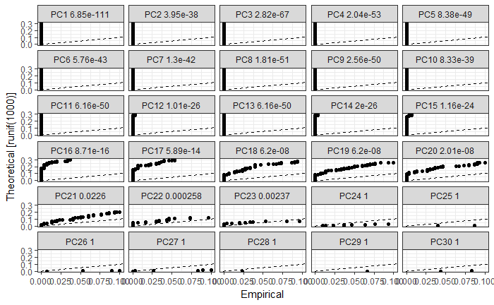
PC Selection
Heatmaps and Jack Straw plots (left) were used to determine true dimensionality of the data
21 Dimensions were selected
Notes:
To determine the actual dimensionality of the data, I looked to plot the PCs against each other, plot the top genes for each PC, plot heatmaps, and a couple other methods, but I found them to be somewhat uninformative.
The most definitive method for the PCA seems to be a jackstraw plot, which compare the p-values for each PC to a uniform distribution, shown as the dashed line.
Significant PCs will display a curve above the uniform distribution.
Using this 21 PCs were selected.

Slide 12
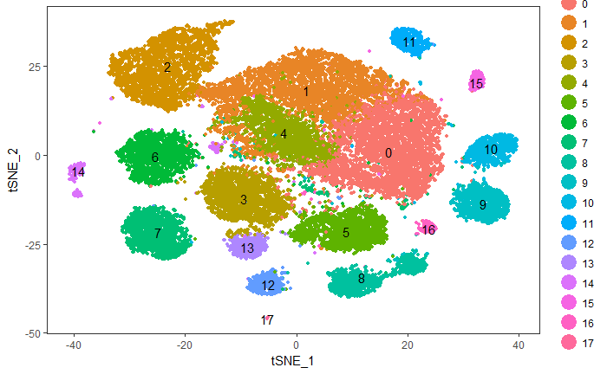
Dimensionality Reduction
Shared Nearest Neighbor (SNN)
18 total cell clusters
T-distributed Stochastic Neighbor Embedding (tSNE)
Notes:
Now that we know which PCs are significant we can begin to cluster the cells.
To do this, Seurat uses a shared nearest neighbor algorithm which clusters cells within the 21 dimensional data; it does this by determining core points in the data and then building clusters around those points.
Using the significant PCs, a total of 18 clusters were found.
To visualize the clusters, tSNE was used to reduce the 21 dimensions down to 2.
This is actually a machine learning algorithm which embeds high dimensional data into two or three dimensions, so that it can be visualized.

Slide 13
Cell Identification
4 key known retinal bipolar cell markers
Prkca – Rod Bipolar Cells
Scgn – Cone Bipolar Cells
Isl1 and Grm6 – On Cone Bipolar Cells
Notes:
To identify the clusters 4 known bipolar cell markers were considered.
1 corresponding to rod cells, 1 for general cone cells, and 2 for ON cone cells; where off cone cells can be inferred from the general and on cone cell markers.

Slide 14
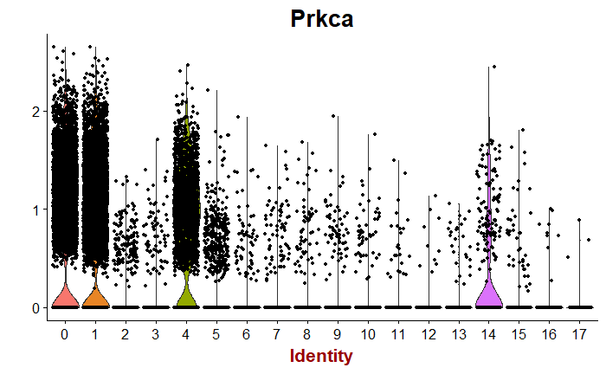
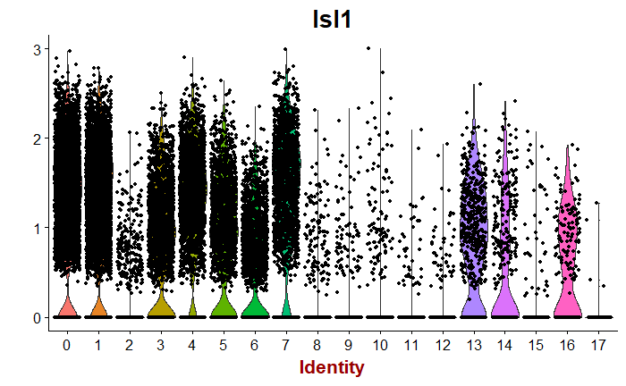
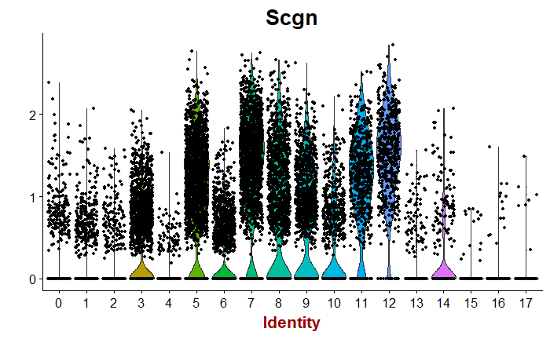
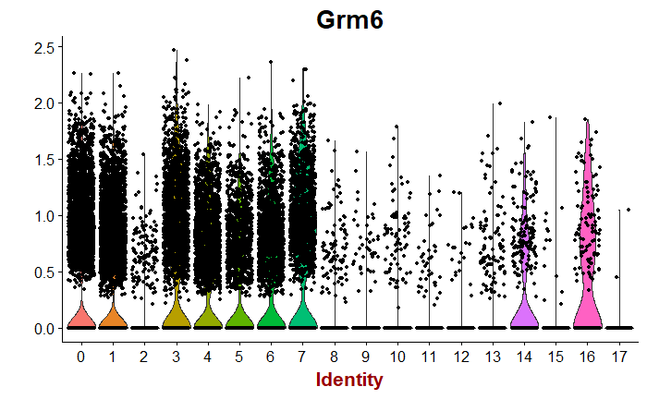
Cell Identification
Rod BCs
ON Cone BCs
Cone BCs
ON Cone BCs
Notes:
Here I'm plotting the cells of each cluster along the x axis, against the gene expression for each cell on the y axis, where each point represents a cell and its expression value for the gene examined.
The ON-Cone markers showed overlap within Rod type clusters, so an overlap of significant general Cone and ON-Cone marker expression were used to determined ON-Cone BCs.

Slide 15
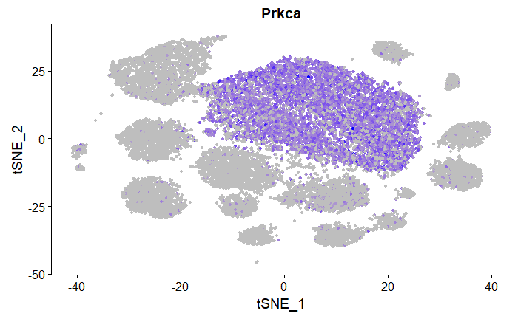
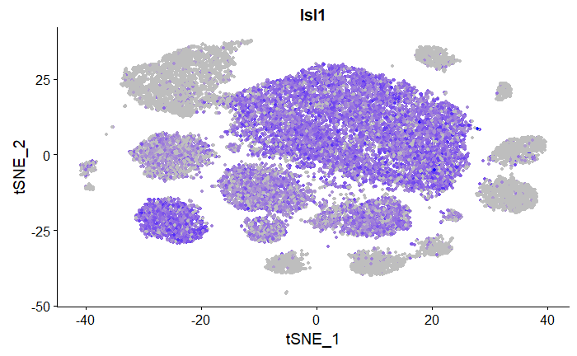
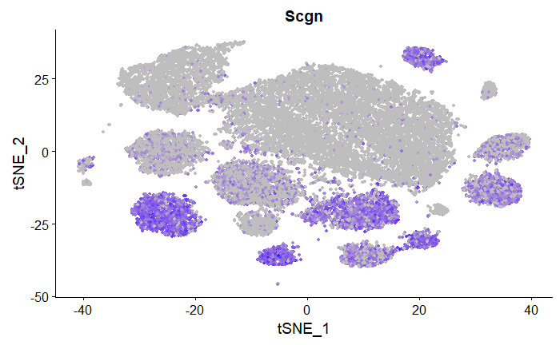
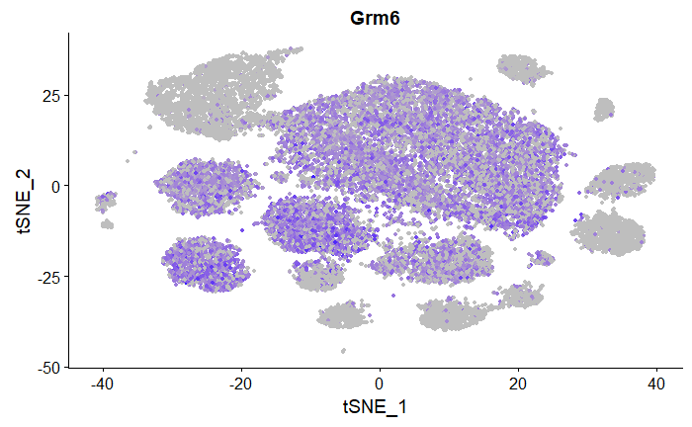
Cell Identification
Rod BCs
ON Cone BCs
Cone BCs
ON Cone BCs
Notes:
This information can also be displayed by applying a gradient to cells on the tSNE plot corresponding to the expression of the marker genes.
Again the overlap of Rod and ON-Cone type marker expression is clearly seen.

Slide 16
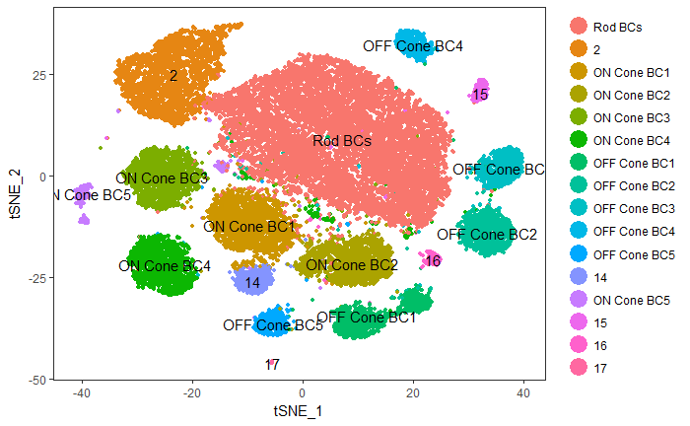
Cluster Identification
14 clusters identified
11 potentially unique cell types
1 rod cell type
5 ON-Cone types
5 OFF-Cone types
5 Unidentified Clusters
Noise?
Unknown BC type?
Non-BC cell?
Notes:
Finally, we can use this information to map cell types to the cluster identities.
There were 5 unidentified clusters which may be due to noise in the data, a so far unknown bipolar cell type, or some contaminant cell populations.
But the cells that were successfully identified appears to include what I believe to be the 11 known bipolar cell types, with 1 rod type, 5 ON–cone types, and 5 OFF-cone types.
As of now I did not have enough time to search each cell type for unique traits.

