Slide 1
Determining the Causal Factors Behind High Sodium Intake
Michal Schapira
12/11/2018

Slide 2
Background and Motivation
Biggest killers worldwide: ischemic heart disease and stroke
Dietary sodium has been shown to play a causal role in BOTH of these
So what can we do about it?

Slide 3
Background and Motivation
A popular intervention is to encourage people to eat at home instead of at restaurants, but what is really going on when people eat at restaurants? Is it the food, or are there confounding variables?
Meal location: he psychological experience of eating at home vs away from home – maybe eating away from home is more of a “special occasion” that warrants a “cheat day”?
Day type: People tend to eat more frequently at restaurants on the weekend – definitely a common “cheat day”

Slide 4
Methods
Dataset: NHANES 2015-2016, dietary component
Dietary data from 2 non-consecutive days for each participant
Variables used:
Whether or not they ate it at home
Where they obtained it (defining “premade” as from a convenience store or restaurant, “not premade” as from a grocery store)
Whether it was a weekend or a weekday
Which meal it was (breakfast, lunch, dinner, snack)
Count premade foods from the grocery store (frozen pizza, frozen chicken nuggets) as premade

Slide 5
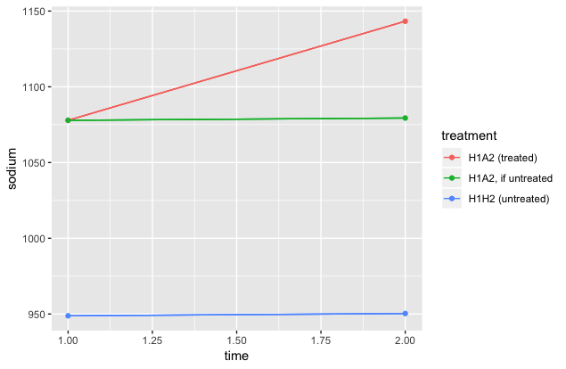
Strategy: Differences-in-Differences

Slide 6
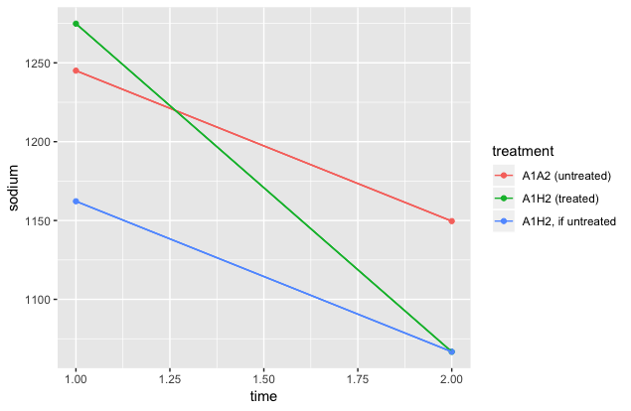
Strategy: Differences-in-Differences

Slide 7
Results: Sodium_{AWAY} - Sodium_{HOME}
Premade?
Premade
Either
Not premade
Weekday
Either
Weekend
Weekday
Either
Weekend
Weekday
Either
Weekend
-318.7 .
-644.1.
+104.5
+20.7
-52.9
+169.2***
+97.8**
-61.8
-132.6
**
p < 0.001: ***, p < 0.01: **, p < 0.05: *, p < 0.1: .

Slide 8
Discussion
Q: Is sodium higher in food eaten away from home?
A: On weekdays definitely yes (p < 0.001), on weekends probably the opposite (p < 0.1).
Q: What about when premade status is accounted for?
A: The results are unfortunately inconclusive. However, non-premade foods on the weekends probably (p < 0.1) have more sodium when they are eaten at home. Perhaps public health campaigns should target long Sunday brunches as well as quick fast-food weekday dinners.

Slide 9
Next Steps
Separate out more interaction effects: BMI, income, education level, etc (all included in NHANES)
Pool with results from other years of NHANES
Conduct sensitivity analyses to test whether results hold up if quantities of food consumed were actually higher than reported

Slide 10
Acknowledgements
Dr. Marilyn Schapira (Internal Medicine) for her review of the NHANES questionnaire and suggestion for sensitivity analysis
Dr. Konrad Kording (Bioengineering) for his course (BE568) on causal techniques including differences-in-differences
The USDA and CDC, for jointly sponsoring the dietary portion of NHANES, otherwise known as WWEIA (What We Eat in America)

