Slide 1



Carbon Emission Prediction
~Himesh Sharma
STU681a42dcab6171746551516
https://github.com/Himesh-1/Carbon-Emission-Prediction

Slide 2

Learning Objectives
Execute a complete data science workflow, from data preparation to model building.
Clean and prepare data for analysis, including handling missing values.
Analyze and visualize data to uncover key insights and relationships.
Build and train a Random Forest model to predict CO2 emissions.
Apply data science techniques to a real-world environmental problem.
GOAL
Source :
www.freepik.com/

Slide 3
Tools and Technology used
Programming Language: Python
The core language used for all data processing, analysis, and modeling tasks.
Core Python Libraries:
Pandas: For loading the data into DataFrames, cleaning it, and performing data manipulation.
Scikit-learn (sklearn): For building the machine learning model (Random Forest), splitting the data into training and testing sets, and evaluating the model's performance.
Matplotlib & Seaborn: For creating the data visualizations, such as the bar charts and correlation heatmaps, to explore the data.
Development Environment:
Jupyter Notebook: The interactive environment used to write and execute the code, visualize the results, and document the entire process step-by-step.

Slide 4
Methodology
Data Preparation: Clean and organize raw data, handling missing values and preparing it for analysis.
Data Exploration: Analyze cleaned data to understand characteristics, identify patterns (e.g., CO₂ trends, variable relationships), and detect outliers.
Model Building: Apply the Random Forest algorithm for predictive analysis, leveraging insights from data exploration regarding nonlinear relationships and country-specific clusters.

Slide 5
Problem Statement:
The core problem addresses the critical need to predict CO₂ emissions accurately. This involves leveraging country-specific data to understand historical patterns and influencing factors, with the ultimate goal of developing a robust predictive model. Such a model can provide valuable insights for environmental policy-making, sustainable development planning, and assessing the impact of various economic and social activities on global carbon output.

Slide 6
Solution:
Comprehensive Data Processing:
Data Preparation: This initial stage ensures the raw country-specific data is cleaned, preprocessed, and transformed into a usable format, addressing issues like missing values and inconsistencies. This step is crucial for the reliability of subsequent analyses.
Data Exploration: Following preparation, thorough exploration of the data is conducted. This involves visualizing trends, identifying relationships between variables (e.g., energy use, population, economic indicators, and CO₂ emissions), and pinpointing country-specific patterns or anomalies. Insights gained here are vital for informing the modeling approach.
Advanced Predictive Modeling:
Model Selection and Implementation: The core of the solution involves applying a suitable machine learning algorithm. Given the potentially nonlinear relationships and diverse country-specific trends observed during data exploration, the Random Forest machine learning algorithm is employed. This algorithm is well-suited for handling complex, non-linear data patterns and provides robust predictive capabilities.
Prediction and Analysis: The trained Random Forest model is then used to predict CO₂ emissions based on new or future country-specific data. The output of this model provides actionable forecasts and a deeper understanding of the factors driving emission changes, which can then be used to support environmental policies and strategic planning for emission reduction.

Slide 7
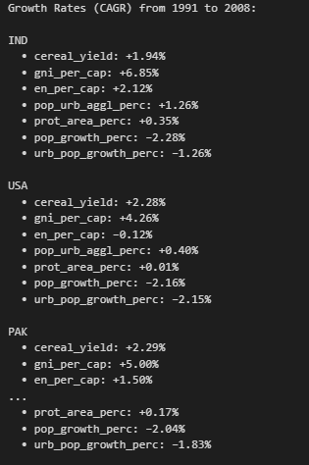
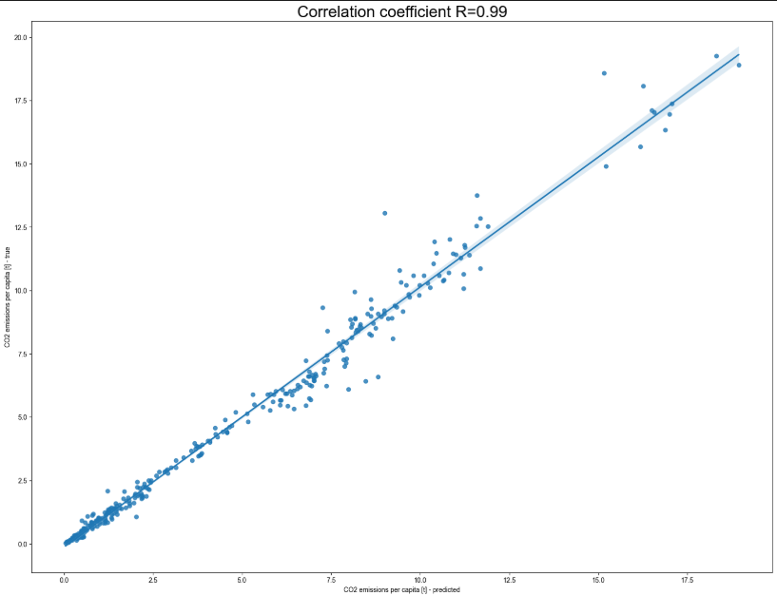
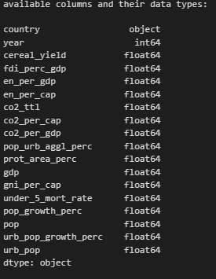
Screenshot of Output:

Slide 8
Conclusion:
This project demonstrates a robust methodology for predictive data analysis of CO₂ emissions, culminating in the successful application of the Random Forest machine learning algorithm. Through meticulous data preparation and in-depth data exploration, the complexities of country-specific emission trends and influencing factors were understood. The chosen Random Forest model proved effective in handling the nonlinear relationships and diverse patterns observed within the data, providing a reliable tool for forecasting.
Ultimately, the insights derived from this predictive model can significantly contribute to:
Informed Environmental Policy-Making: Offering data-driven forecasts to guide strategies for emission reduction.
Sustainable Development Planning: Supporting initiatives aimed at balancing economic growth with environmental responsibility.
Global Climate Understanding: Enhancing the comprehension of factors that drive CO₂ output worldwide.
The project highlights the power of machine learning in addressing critical environmental challenges, providing a foundational framework for future efforts in climate prediction and mitigation.

