Slide 1
PROJECT X · PERSISTENT MEMORY FOR TEAMS
Smaran.ai
A project memory layer for decisions, reasoning, and trust.
Himesh Jadhav · Ankit Bhuria · Nabeel Ali · Abuzar Ansari

Slide 2
THE PROBLEM
Every project forgets why
01
Decisions live inside old chat threads.
02
Months later, teams reopen the same debate.
03
Most chatbots start every session from zero.
“What did your team decide last week — and why?”

Slide 3



THE PRODUCT
Smaran.ai remembers reasoning, not noise
Inspectable
See what was recalled and why.
A project-level memory layer that carries decisions, assumptions, constraints, and outcomes into every new session.
Correctable
Conflicts wait for a human decision.
Temporary
Constraints can expire on purpose.

Slide 4
THE MEMORY LOOP
One message. Five memory moves.
01
02
03
04
05
Embed the message.
Recall active, relevant project memories.
Reply with context while extracting new commitments.
Reconcile: new, duplicate, conflict, or invalidation.
Write the change and show the evidence.
Reply and extraction run in parallel to keep the loop fast.

Slide 5


THE “AHA” MOMENT
Memory changes the answer
Same project. New session. Different answer.
1
2
Session 1
Session 2
“We’re using MongoDB because menus and orders are flexible.”
“Let’s use Postgres for orders.”
Smaran.ai pushes back
Earlier decision. Date. Reason. A visible “used in this reply” trail.

Slide 6
CONFLICT HANDLING
Conflicts become decisions — not silent contradictions
When a new proposal conflicts with an active memory, it waits as pending until someone chooses Override or Keep.
Pending
Override
Keep
New proposal conflicts with an active memory.
The new decision becomes active.
The proposal is removed from retrieval.
Timeline: MongoDB → Postgres stays explainable.

Slide 7

Alice's View
Bob's View
Decision posted with author attribution
Conflicting proposal appears to Alice for review
TEAM MODE
One live project memory. Two accountable windows.
Shared reasoning. Clear accountability.

Slide 8





TRUST BY DESIGN
Trust is designed into every memory
Score breakdown
Source quote
Secret guard
Similarity × confidence.
The exact words behind the memory.
Passwords and keys are never stored.
TTL expiry
Delete means delete
Temporary constraints expire, with a retrieval backstop.
Permanent deletion is separate from historical superseding.

Slide 9
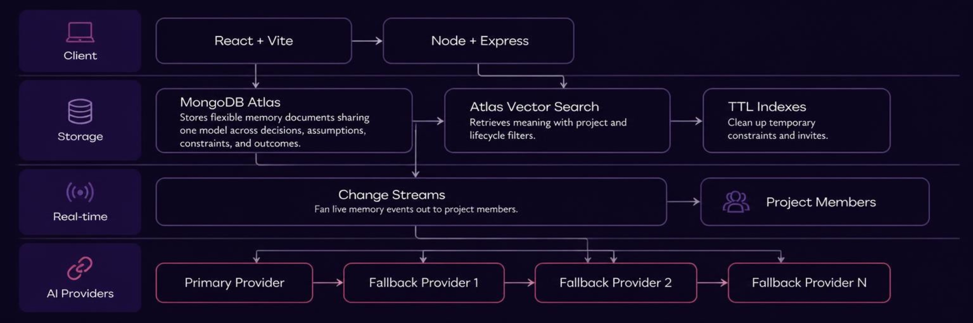
THE ARCHITECTURE
MongoDB is doing the right jobs
React + Vite · Node + Express · MongoDB Atlas · provider fallback chain

Slide 10


LIVE DEMO · FOUR MINUTES
Four minutes to prove it
01
02
03
04
05
Create a decision, assumption, and temporary constraint.
Start a new session and ask for the opposite database.
Let the judge choose: Override or Keep?
Open the memory panel, timeline, and Atlas document.
Toggle memory off, repeat the question, then turn it on again.
Interactive close: “Which memory should the team trust?”

