Slide 1
Exploring Public-Private Key Encryption and Bitcoin Wallets

Slide 2
What is Cryptography?
Cryptography is the practice and study of techniques for secure communication in the presence of adversaries. In simpler terms, it's about protecting information and communications through the use of codes.
Cryptography uses a combination of mathematical concepts and algorithms to transform messages into a form that is difficult to decipher without the proper key. There are two main types of cryptography:
  Symmetric cryptography: This uses a single secret key to both encrypt and decrypt the message. This is like having one key that can both lock and unlock a door.
  Asymmetric cryptography: This uses a pair of keys: a public key and a private key. The public key can be used to encrypt a message, but only the corresponding private key can decrypt it, and vice-versa. This is like having a mailbox with two locks: one for putting mail in (public key or private key) and another for taking mail out (private key or public key).

Slide 3
  Symmetric Cryptography
Symmetric cryptography, also known as secret-key cryptography, is a type of encryption where the same key is used to both encrypt and decrypt data. It's like having a single key that can both lock and unlock a door.
Here's how it works:
Shared Secret Key: The sender and receiver must first agree on a secret key. This key is typically a random string of bits and must be kept confidential.
Encryption: The sender uses the secret key and an encryption algorithm to transform the plain text message into cipher text. This cipher text is unreadable to anyone who doesn't have the key.
Transmission: The cipher text is then sent to the receiver through an insecure channel.
Decryption: The receiver uses the same secret key and the corresponding decryption algorithm to transform the ciphertext back into the original plaintext message.

Slide 4
  Symmetric Cryptography
Advantages of Symmetric Cryptography:
Speed and Efficiency: Symmetric encryption is generally faster and more efficient than asymmetric encryption, making it suitable for encrypting large amounts of data.
Simplicity: The algorithms used in symmetric cryptography are typically simpler to implement than those used in asymmetric cryptography.
Disadvantages of Symmetric Cryptography:
Key Distribution Problem: The biggest challenge with symmetric cryptography is securely sharing the secret key between the sender and receiver. If the key is intercepted by an attacker, they can easily decrypt the messages.
Limited Functionality: Symmetric cryptography is primarily used for confidentiality, but it cannot provide
other security features like authentication and non-repudiation.

Slide 5
  Asymmetric Cryptography
Asymmetric cryptography, also known as public-key cryptography, is a type of encryption that uses a pair of keys: a public key and a private key. These keys are mathematically linked, but it is computationally infeasible to derive the private key from the public key.
Here's how it works:
    Key Generation: A user generates a key pair consisting of a public and private key.
    Public Key Distribution: The public key is shared freely with anyone who wants to send encrypted messages to the user.
    Encryption: The sender uses the recipient's public key and an encryption algorithm to transform the plaintext message into ciphertext. This ciphertext can only be decrypted with the corresponding private key.
    Transmission: The ciphertext is then sent to the recipient through an insecure channel.
    Decryption: The recipient uses their private key and the corresponding decryption algorithm to transform the ciphertext back into the original plaintext message.

Slide 6
  Asymmetric Cryptography
Advantages of Asymmetric Cryptography:
Solves Key Distribution Problem: Unlike symmetric cryptography, there's no need to securely share a secret key. Anyone can encrypt a message using the public key, but only the holder of the private key can decrypt it.
Provides Authentication and Non-Repudiation: Asymmetric cryptography can be used for digital signatures, which allows the recipient to verify the sender's identity and ensure that the message hasn't been tampered with.
Disadvantages of Asymmetric Cryptography:
Slower and Less Efficient: Asymmetric encryption is generally slower and less efficient than symmetric encryption, making it less suitable for encrypting large amounts of data.
Complexity: The algorithms used in asymmetric cryptography are typically more complex to implement than those used in symmetric cryptography.

Slide 7
Hybrid Cryptography
Hybrid cryptography combines the strengths of both symmetric and asymmetric cryptography to provide a more efficient and secure solution for data protection. It addresses the limitations of each individual method by using them in tandem.
Here's how hybrid cryptography works:
Generating a Symmetric Key: A random symmetric key (also called a session key) is generated for each communication session. This key will be used to encrypt the actual data.
Encrypting the Data: The symmetric key is used to encrypt the plaintext data using a symmetric encryption algorithm (e.g., AES). This is much faster than using asymmetric encryption directly on large amounts of data.
Encrypting the Symmetric Key: The symmetric key itself is then encrypted using the recipient's public key and an asymmetric encryption algorithm (e.g., RSA). This ensures that only the intended recipient, who possesses the corresponding private key, can decrypt the symmetric key.
Transmission: Both the encrypted data and the encrypted symmetric key are sent to the recipient.
Decryption: The recipient first uses their private key to decrypt the symmetric key. Then, they use the decrypted symmetric key to decrypt the actual data using the corresponding symmetric decryption algorithm.

Slide 8
Hybrid Cryptography
Benefits of Hybrid Cryptography:
  Efficiency: By using symmetric encryption for the bulk data and asymmetric encryption only for the smaller symmetric key, hybrid cryptography achieves better performance than using solely asymmetric encryption.
  Security: It benefits from the strong security guarantees of asymmetric encryption for key exchange, while leveraging the speed and efficiency of symmetric encryption for data encryption.
  Versatility: Hybrid cryptography can be used for various purposes, including secure communication, data storage, and key wrapping.
Examples of Hybrid Cryptosystems:
TLS/SSL: The protocol that secures HTTPS connections uses a hybrid approach.
PGP (Pretty Good Privacy): A popular email encryption software that uses hybrid cryptography.
SSH (Secure Shell): Used for secure remote access to servers, also employs a hybrid approach.
Hybrid cryptography offers a practical and robust solution for protecting data in the digital world. By combining the strengths of both symmetric and asymmetric cryptography, it achieves a balance between efficiency and security.

Slide 9

Generating Keys
To generate an AES key you can use openssl.
Open a terminal window and enter the following command for 256bit key.

Slide 10


Generating Keys
For A Public And Private key pair.

Slide 11
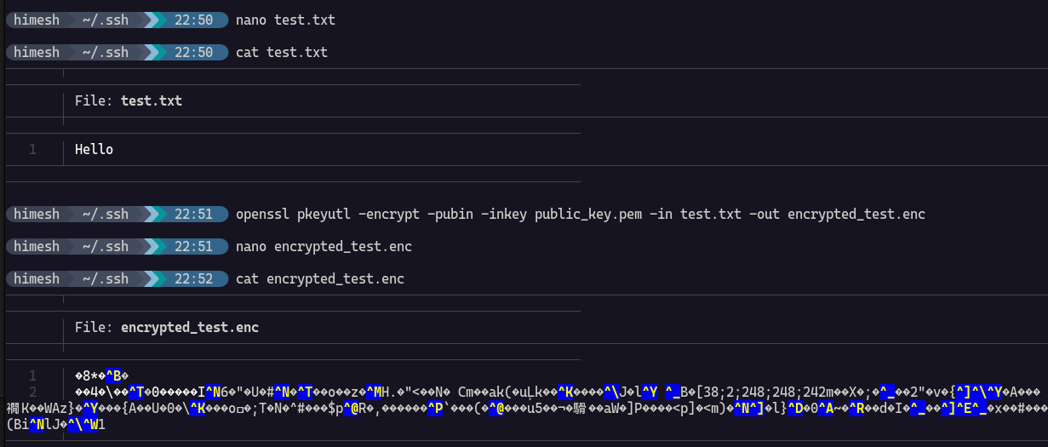
Encrypting Data

Slide 12
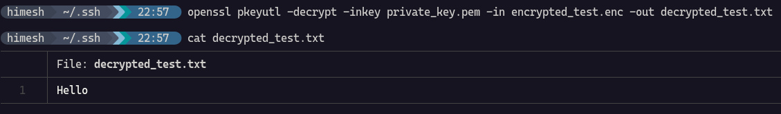
Decrypting Data

Slide 13
RSA (Rivest-Shamir-Adleman)
Let's explain the RSA algorithm using a simple example where we encrypt the letter 'H' with a 2-character public-private key pair. Please note that in practice, RSA uses much larger key sizes for security reasons (commonly 1024, 2048, or 4096 bits).
Key Generation: Let's assume our public key (e, n) is (5, 35) and our private key (d, n) is (29, 35). Here, n is the modulus, and both the public and private keys share the same modulus for simplicity.
To encrypt the letter 'H' (ASCII value 72), we convert it into a numerical representation. In RSA, encryption is done using the public key (e, n) with the formula:
C=(72)^e * mod(n).
So, the encrypted value for 'H' using RSA is 12.
To decrypt the cipher text '12', we use the private key (d, n) with the formula:
M=(12)^d * mod (n).
So, the decrypterd value for '␌'(form feed) using RSA is 72.

Slide 14
RSA (Rivest-Shamir-Adleman)
The values e, d, n in RSA encryption are generated as part of the key generation process. Here's how each of these values is typically generated:
n (Modulus):
Select two large prime numbers, typically denoted as p and q.
Compute n=p×q.
ϕ(n) (Euler's Totient Function):
Compute ϕ(n)=(p−1)×(q−1)
e (Public Exponent):
Choose a public exponent e that is relatively prime to ϕ(n), meaning that e and ϕ(n) have no common factors other than 1. Common choices for e include 3, 17, and 65537 (2^16 + 1) due to their properties.
Verify that e and ϕ(n) are co-prime, i.e., gcd(e, ϕ(n)) = 1.
d (Private Exponent):
Compute the modular multiplicative inverse of e modulo ϕ(n). This means finding a number d such that e×d≡1 * mod ϕ(n).
The extended Euclidean algorithm is commonly used to compute dd.
Once you have these values computed, you have your RSA key pair:
Public key: (e,n)
Private key: (d,n)

Slide 15
Signatures
Digital signatures are cryptographic techniques used to ensure the authenticity, integrity, and non-repudiation of digital messages or documents. They provide a way for a sender to prove that a message or document was indeed created by them and has not been altered since it was signed.
Signing Process:
When the sender wants to sign a message, they follow these steps:
Compute a hash value (message digest) of the message using a cryptographic hash function such as SHA-256. Let's denote this hash value as (M).
Encrypt (M) using the sender's private key. Result (S).
Verification Process:
When the receiver receives the signed message (M) along with the digital signature (S), they perform the following steps to verify the signature:
Decrypt the digital signature (S) using the sender's public key.
Compute a hash value of the received message (M′) using the same cryptographic hash function: SHA-256
Compare the computed hash value (M′) with the hash value extracted from the decrypted signature (M). If they match, the signature is valid; otherwise, it is invalid.
Signature Properties:
Authenticity: The digital signature proves that the message was signed by the holder of the private key.
Integrity: Any modification to the message (M) would result in a different hash value (M′), causing the signature verification to fail.
Non-repudiation: The sender cannot deny having signed the message since the signature can be verified using their public key.

Slide 16
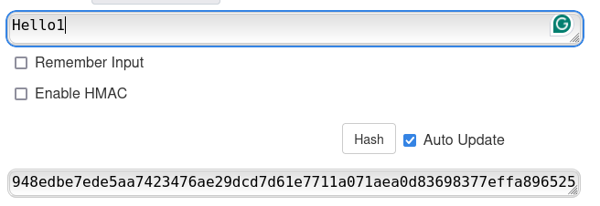
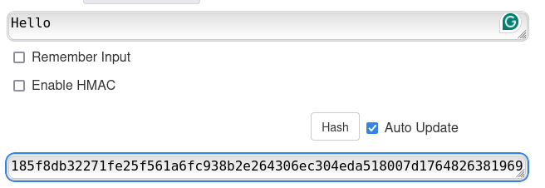
SHA-256
Here you can see an example of the this Algorithm.

Slide 17
Bitcoin And Wallets
Bitcoin is a decentralized digital currency that operates on a peer-to-peer network known as the blockchain. It was invented in 2008 by an anonymous person or group using the pseudonym Satoshi Nakamoto and released as open-source software in 2009. Bitcoin is often referred to as a cryptocurrency because it uses cryptographic techniques to secure transactions and control the creation of new units.
Bitcoin wallets are software applications or physical devices used to store, manage, and interact with Bitcoin (BTC) and other cryptocurrencies. These wallets facilitate the sending and receiving of digital currencies, provide security features for protecting private keys, and enable users to monitor their cryptocurrency balances.

Slide 18
Bitcoin Wallets
Bitcoin wallets store and manage cryptographic keys, specifically public keys and private keys, which are essential for interacting with the Bitcoin blockchain.
Private keys are typically 256 bits long and are randomly generated using secure algorithms. They should be kept confidential and securely backed up to prevent unauthorized access or loss of funds.
The public key is derived from the private key using elliptic curve cryptography (ECC), specifically the secp256k1 curve(y² = x³ + 7 (mod p)), which is a widely used curve in Bitcoin.
The public key is used to generate a Bitcoin address, which serves as a destination for receiving Bitcoin payments. This process involves hashing the public key multiple times using cryptographic hash functions like SHA-256 and RIPEMD-160.
When someone sends Bitcoin to a user's Bitcoin address, the sender specifies the recipient's address and signs the transaction using their own private key.
Nodes on the network verify the digital signature using the corresponding public key. If the signature is valid and matches the public key associated with the sending address, the transaction is considered authorized and legitimate.
Public-private key encryption ensures that only the rightful owner of a Bitcoin address (possessing the corresponding private key) can authorize transactions associated with that address.

Slide 19

Hot Wallets
Definition: Hot wallets are cryptocurrency wallets that are connected to the internet and accessible for frequent transactions and day-to-day use.
Examples:
Mobile wallets: Trust Wallet, Coinbase Wallet, Breadwallet (BRD).
Desktop wallets: Electrum, Exodus, Jaxx.
Web wallets: Blockchain.com, Coinbase, Binance.

Slide 20
Hot Wallets
Advantages:
Convenience: Hot wallets are convenient for frequent transactions and quick access to funds, making them suitable for everyday use.
Ease of Use: They often have user-friendly interfaces and support multiple cryptocurrencies, providing a seamless experience for users.
Integration with Exchanges: Many hot wallets are integrated with cryptocurrency exchanges, allowing users to easily buy, sell, and trade assets within the wallet interface.
Disadvantages:
Security Risks: Hot wallets are connected to the internet, making them more susceptible to hacking attacks, phishing attempts, malware, and other cybersecurity risks.
Risk of Loss: If a hot wallet is compromised or if the device is lost, stolen, or damaged, there is a risk of losing access to funds. It's crucial to implement strong security measures and backups.
Less Secure Storage: Hot wallets are less secure than cold wallets for long-term storage of large amounts of cryptocurrency due to their online nature.

Slide 21
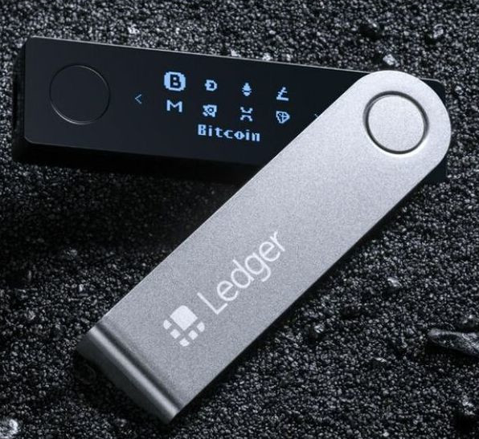
Cold Wallets
Definition: Cold wallets are cryptocurrency wallets that are offline or disconnected from the internet, providing enhanced security and protection against online threats.
Examples:
Hardware wallets: Ledger Nano S, Ledger Nano X, Trezor One, Trezor Model T.
Paper wallets: Generating a private key and Bitcoin address offline and storing them on physical paper.

Slide 22
Cold Wallets
Advantages:
High Security: Cold wallets offer a higher level of security since they are not connected to the internet, reducing the risk of hacking, malware, and cyber-attacks.
Offline Storage: They are ideal for long-term storage of large amounts of cryptocurrency, protecting funds from online threats and vulnerabilities.
Control over Private Keys: Users have full control over their private keys, enhancing security and reducing reliance on third-party services.
Protection against Exchange Risks: Cold wallets can protect funds from risks associated with cryptocurrency exchanges, such as hacks, insolvency, and regulatory issues.
Disadvantages:
Less Convenient: Cold wallets are less convenient for frequent transactions and require manual steps to transfer funds between cold and hot wallets.
Setup Complexity: Hardware wallets may have a learning curve for setup and usage, requiring users to follow instructions carefully and keep backups of recovery phrases.
Risk of Physical Damage or Loss: Physical hardware wallets or paper wallets can be lost, damaged, or stolen, leading to potential loss of access to funds if not properly secured and backed up.

Slide 23
Securing Wallets and keys
Securing cryptocurrency wallets and backing up keys are critical steps to protect your funds against loss, theft, and unauthorized access. Additionally, enabling multi-factor authentication (MFA) adds an extra layer of security to your accounts. Here are best practices for securing wallets, backing up keys, and using multi-factor authentication:
  Choose Reputable Wallets: Use trusted and reputable cryptocurrency wallets from reputable providers. Research the security features and reputation of the wallet provider before using their services.
  Use Strong Passwords: Create strong, unique passwords for your wallet accounts. Avoid using easily guessable passwords and consider using a password manager to generate and store complex passwords securely.
  Enable Two-Factor Authentication (2FA): Whenever possible, enable two-factor authentication (2FA) for your wallet accounts. This adds an extra layer of security by requiring a second form of verification in addition to your password.
  Enable Biometric Authentication: If your wallet supports biometric authentication (such as fingerprint or facial recognition), consider enabling this feature for additional security.
  Use Hardware Wallets: Consider using hardware wallets for storing large amounts of cryptocurrency securely. Hardware wallets store private keys offline, reducing the risk of online threats.
  Backup Recovery Phrases: For software wallets, such as mobile or desktop wallets, backup the recovery phrase (also known as seed phrase or mnemonic phrase) securely. This recovery phrase is used to restore access to your wallet if you lose access to your device or forget your password.

Slide 24
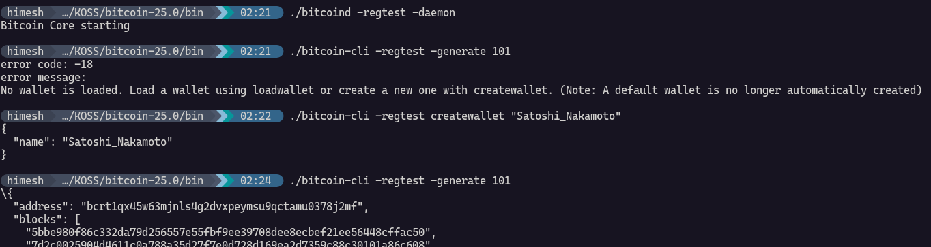
Bitcoin-cli
Lets make a testnet and visualise this.
Install Bitcoin core from bitcoin.org
Now extract then go to bin then chmod executable all the files (chmod +X *).

Slide 25
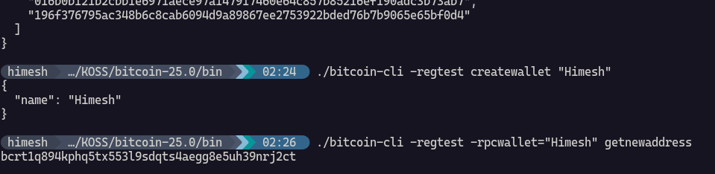
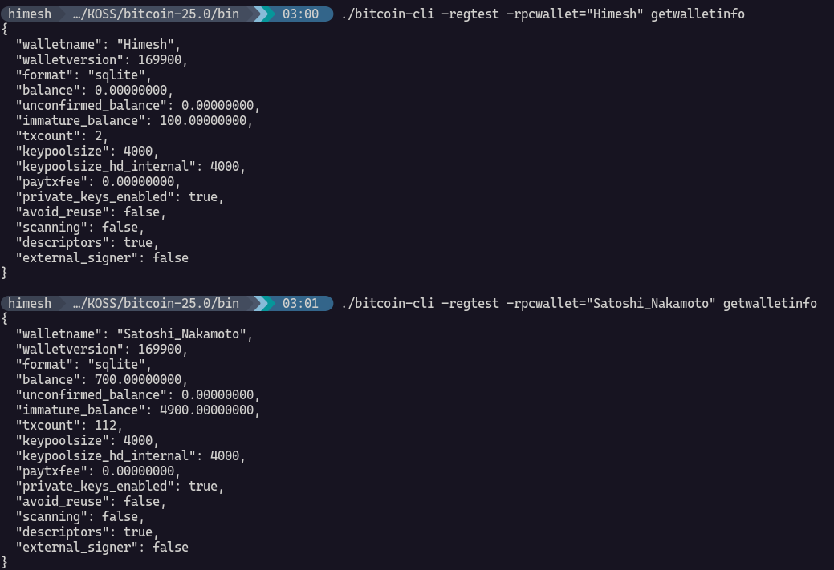

Slide 26
Sorry
Running into some Errors while making transactions related to fallbackfee.
Not been able to either enable or disable it and will through an error if I use it as an argument.
Will commit the changes once fixed.

Slide 27
Thank You!

