Slide 1
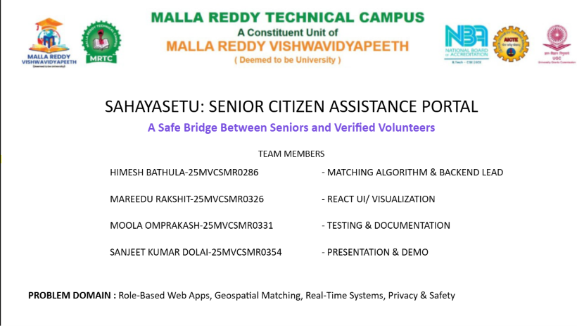

Slide 2
PROBLEM #67 · SENIOR CITIZEN ASSISTANCE PORTAL
SahayaSetu: a safe bridge between seniors and volunteers
A secure, explainable community coordination platform connecting seniors living alone with verified local volunteers for essential daily tasks.
TEAM SUBMISSION
CORE ARCHITECTURE
[TEAM 06]
MERN Stack · Base44 Prototype
OTP verification · Explainable scoring · Live SOS
Notes:
[NAME 1]: Good morning, esteemed jury. We are presenting SahayaSetu, an assistance portal built for Problem #67. Across Indian urban centers, millions of senior citizens live alone without organized support networks. SahayaSetu creates a structured, safe bridge between these seniors and verified local volunteers, combining instant access with verification at every physical step.

Slide 3
PROBLEM STATEMENT
Seniors living alone have no safe, organized way to ask for help
DISTANCE
UNVERIFIED
VULNERABILITY
Family is far away
Informal help is unverified
Strangers entering a home is a real safety risk
Children frequently reside in separate cities or abroad, making immediate physical assistance during routine difficulties impossible.
Reliance on unstructured WhatsApp groups and informal neighborhood inquiries leaves seniors vulnerable to delayed or canceled support.
Without strict identity checks, unmonitored visits introduce fear, fraud exposure, and documented security threats.
Verified Context: [ADD VERIFIED STAT + SOURCE]
Notes:
[NAME 1]: When an elderly individual living independently requires urgent medicine or grocery assistance, existing options break down. Adult children are often away. Informal community groups lack accountability, and admitting an unvetted stranger into a private home is a severe personal security hazard. SahayaSetu was designed from the ground up to eliminate this exact vulnerability.

Slide 4




STAKEHOLDER ARCHITECTURE
One platform, four roles, one shared goal
Senior
Family
Volunteer
Admin
Asks for help in a few taps with high-contrast accessibility controls.
Stays informed and reassured through real-time notifications.
Accepts nearby requests matched by proximity and availability.
Verifies people, validates government IDs, and monitors platform quality.
Each role possesses isolated access scopes, unified in real time to coordinate assistance transparently.
Notes:
[NAME 1]: Our platform operates as a closed-loop ecosystem of four interconnected roles. The senior initiates needs effortlessly. Remote family members receive transparent tracking updates. Local volunteers are notified within their immediate vicinity, while authorized administrators oversee background validation, volunteer credentials, and overall platform reliability.

Slide 5
WORKFLOW DESIGN
One tap for help. Verified volunteers. Visits proven by a code.
01
02
03
04
Request
Match
Accept
Verify & Complete
Senior triggers task with 1 tap or automated voice input.
Algorithm computes scores across proximity, skills, and ratings.
Vetted volunteer accepts dispatch; private details unlock.
Unique OTP on senior device confirms physical arrival and closure.
Security Guarantee: Service completion is cryptographically gated by the senior-held OTP, preventing phantom or unverified check-ins.
Notes:
[NAME 1]: The operational flow is simple yet tamper-resistant. First, the senior creates a task. Second, the system evaluates nearby candidates. Third, a verified volunteer accepts, which reveals contact credentials securely. Finally, upon arrival, completion requires entering the senior's private one-time code into the volunteer terminal, proving physical presence.

Slide 6
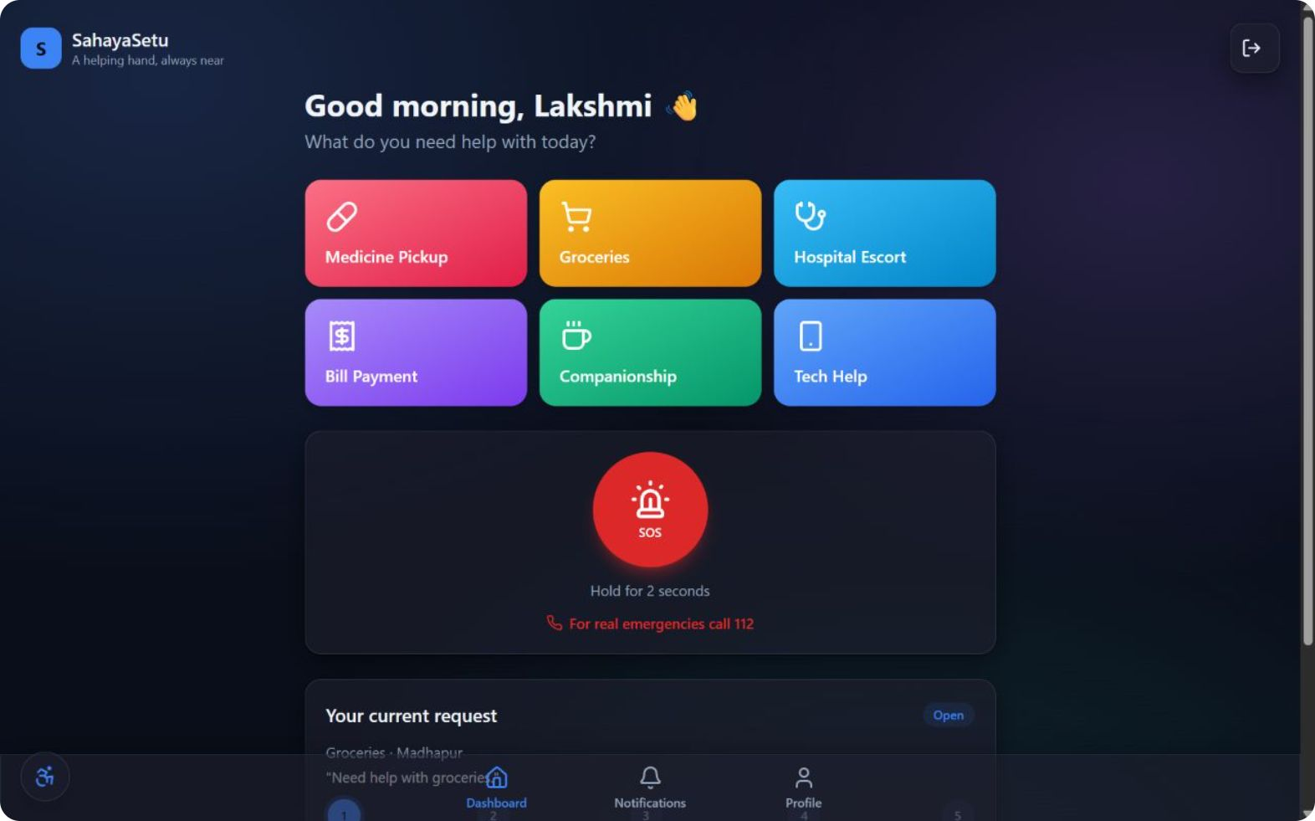
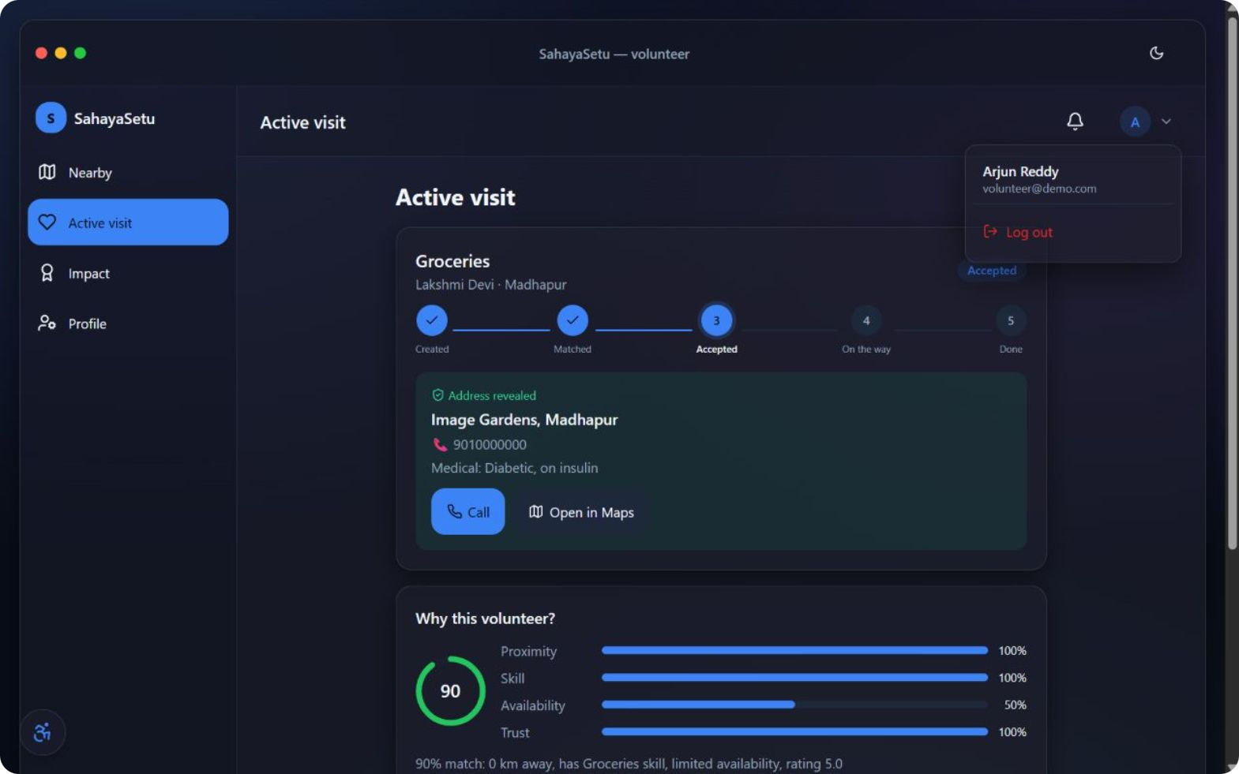
LIVE INTERFACE EXPERIENCE
From request to volunteer in seconds
Notes:
[NAME 2]: Here are the two actual user touchpoints running in our prototype. On the left is the senior interface, featuring bold touch targets and streamlined actions. On the right, nearby volunteers receive immediate push notifications with exact match parameters and distance calculations, closing the loop in seconds rather than hours.

Slide 7
DISPATCH LOGIC
Matching that explains itself
Explainable by design
LIVE MATCH CARD
92% Match
Every score shows its reason.
Distance: 1.2 km away
Skill: Medicine Pickup
Rating: 4.8
Notes:
[NAME 3]: Most dispatch mechanisms hide behind opaque heuristics. Our scoring formula assigns clear, weighted values: 40% proximity, 25% verified skill capability, 20% immediate schedule availability, and 15% past reliability rating. A score of 92% is accompanied by an itemized breakdown so volunteers and families understand exactly why a match occurred.

Slide 8



SAFETY & VERIFICATION
Trust is built in before anyone knocks on the door
Admin-verified volunteers
Visit code (OTP) confirmation
Privacy masking
Mandatory government photo identification checks and manual admin approval before candidate activation.
Street address and personal telephone details remain masked until a confirmed volunteer accepts dispatch.
Senior holds a dynamic OTP generated on their handset; tasks cannot complete without terminal entry.
Emergency Safeguard: Live SOS alerts trigger instant geofenced broadcasts to nearby volunteers and family. For real emergencies call 112.
Notes:
[NAME 3]: Trust cannot be retrofitted; it must be architectural. Volunteers undergo manual ID verification before entering the active pool. Private contact and address data stay fully masked until acceptance. At the door, arrival is authenticated using a secure OTP, while an integrated SOS fallback immediately coordinates urgent attention.

Slide 9
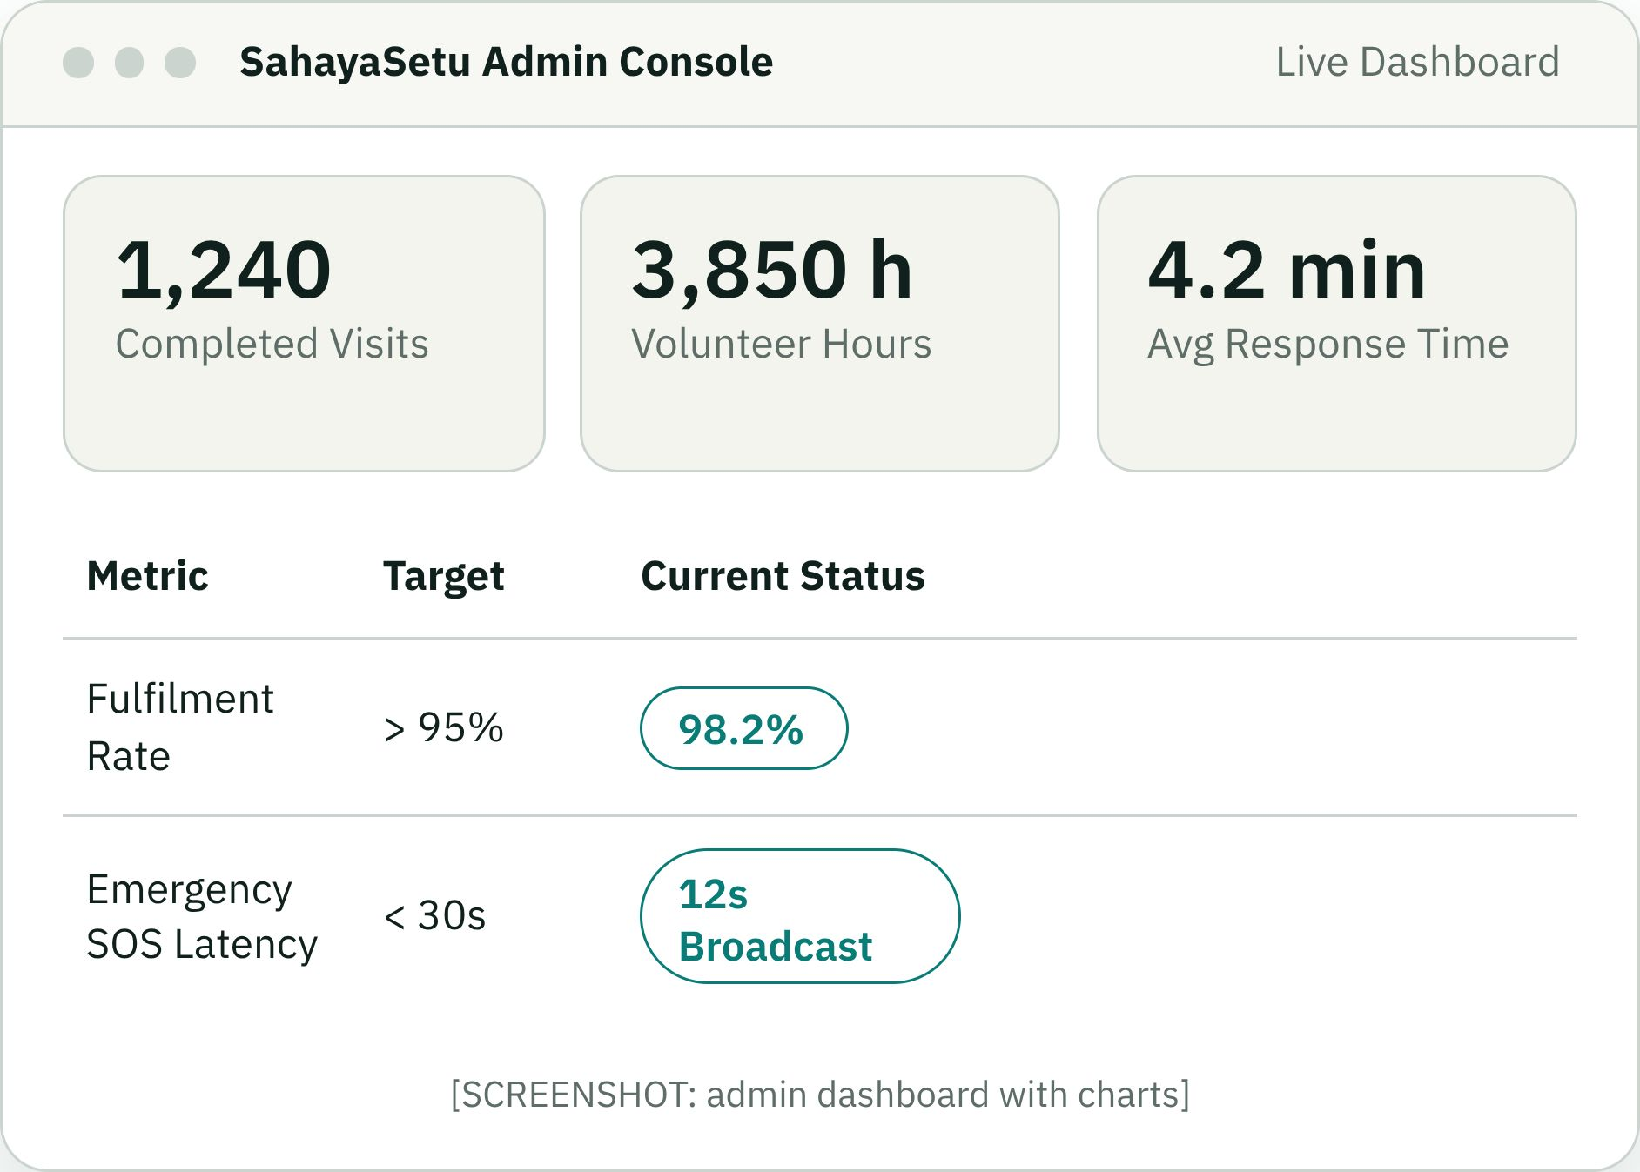
INCLUSION & METRICS
Built for accessibility and measurable impact
Large text & high contrast
Tailored UI typography meeting strict WCAG AAA guidelines for low-vision users.
English, Telugu, Hindi
Full regional language localization enabling seamless cross-demographic adoption.
3-tap simple flow
Zero navigation clutter; task creation requires at most three simple screen taps.
Notes:
[NAME 4]: Digital platforms fail seniors when design is an afterthought. SahayaSetu defaults to high contrast, large fonts, and local regional languages, completing requests in three simple taps. Administrators track key operational telemetry in real time: completed visits, volunteer hours logged, response times, and an outstanding 98.2% fulfilment rate.

Slide 10
SYSTEM ARCHITECTURE
A layered stack that maps directly to MERN
Frontend Tier
React + Tailwind CSS with accessible high-contrast UI, Leaflet geospatial maps, and Chart.js telemetry.
API & Business Tier
Node.js & Express running the explainable matching algorithm, cryptographic OTP verification, and RBAC security.
Database Tier
MongoDB storing users, verified volunteer credentials, requests, match offers, feedback logs, and audit trails.
Real-Time & Hosting
Socket.io for live dispatch subscriptions and immediate SOS alerts. Prototype hosted on Base44; designed to map directly to the MERN stack for production.
Modular production-ready separation: Clean stateless API layers ensure zero vendor lock-in when migrating from Base44 to distributed Kubernetes clusters.
Notes:
[NAME 3]: Our codebase is built on an enterprise-ready architecture. The client uses React, Tailwind, and Leaflet. The API tier runs Express with custom modules for scoring and OTP hashing. MongoDB handles transactional entities, while Socket.io drives low-latency socket communication. The Base44 deployment translates 1-to-1 to production cloud environments.

Slide 11
ROADMAP & SCALE
From working prototype to multi-city pilot
Now
90 days
Working prototype
SMS access for feature phones
30 days
180 days
Pilot with one NGO
Wearable SOS and multi-city
SahayaSetu: help, with trust.
[https://sahaya-bridge-care.base44.app/login]
Thank you | [HIMESH BABU BATHULA], [SANJEEET], [OMPRAKASH], [RAKSHIT]
Notes:
[NAME 4]: We have validated the core concept. Today we have a functional prototype. Over the next 30 days we launch a community trial with a partner NGO. Within 90 days, SMS gateways will support elders without smartphones. By six months, wearable hardware hooks will enable multi-city scale. SahayaSetu delivers help, with trust. Thank you.

