Slide 1

GLOBALMART // SUPPLY CHAIN ANALYTICS
Data-Driven Insights for
Operational Excellence
GlobalMart Superstore Dataset · Power Query Cleaning · Power BI Analysis · Executive Summary
Prepared by Adeniyi Aishat Himisioluwa| Data Analytics Stack |Piety Coders

Slide 2
01 — CONTEXT
Business Problem Overview
Rising customer complaints tied to delayed deliveries across multiple regions
Simultaneous overstocking and stockouts across product categories, pointing to a demand-forecasting gap
Profit margins holding flat around 27.8% despite steady revenue — growth without efficiency gains
Fragmented, static reporting is limiting real-time, data-driven decision-making
GLOBALMART SUPPLY CHAIN ANALYTICS
2

Slide 3
02 — APPROACH
Methodology
Excel
Power Query
Power BI
Insights
→
→
→
Raw dataset
2,090 records
Cleaning &
transformation
Dashboards &
DAX measures
Strategic
recommendations
Data Cleaning Summary
Removed 32 exact duplicate rows and 80 duplicate Order IDs
Standardized 7+ inconsistent categorical fields (casing, spacing, abbreviations, spelling variants)
Corrected mixed date formats and physically invalid negative values (Quantity, Unit Cost, Days to Ship)
Recomputed missing financial fields (Total Sales, Total Cost, Profit) from related columns rather than leaving blanks
Result: 2,090 raw records → 2,010 validated, analysis-ready records
GLOBALMART SUPPLY CHAIN ANALYTICS
3

Slide 4
03 — DATASET
Data Overview & Structure
2,010
5
13
10
VALIDATED ORDERS
REGIONS
SUPPLIERS
PRODUCT CATEGORIES
Fields Captured
Order & Ship Dates, Delivery Status, Days to Ship
Region, Country, Warehouse, Shipping Mode
Product Category, Product Name, Supplier
Quantity Ordered, Unit Cost, Unit Price
Total Sales, Total Cost, Profit
Stock Level, Damaged Goods
Data Quality After Cleaning: 0 missing values · 0 duplicate Order IDs · all types validated
GLOBALMART SUPPLY CHAIN ANALYTICS
4

Slide 5
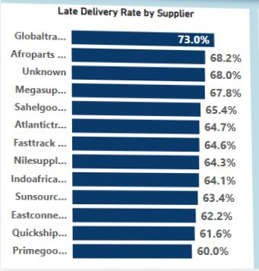
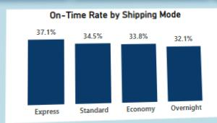
04 — OPERATIONS
Delivery Performance Insights
ON-TIME RATE
LATE RATE
AVG SHIP TIME
MOST URGENT ISSUE
34.4%
65.1%
10.2 days
65% of orders arrive late — no shipping mode currently solves it.
of all orders
1,309 orders delayed
order to delivery
Late Delivery Rate by Supplier (%)
On-Time Rate by Shipping Mode (%)
Globaltrade Ng has the worst late rate which is 73.0% — 13 points above the best performer, Primegoods Africa which is 60.0% . Even Express, the most reliable mode, is only on-time 37.1% of the time.
GLOBALMART SUPPLY CHAIN ANALYTICS
5

Slide 6
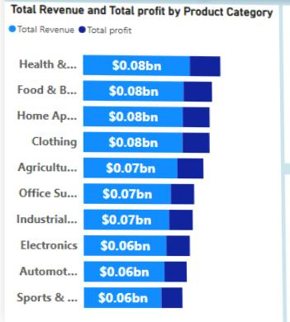
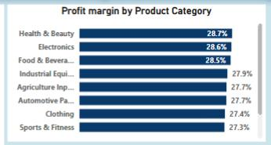
05 — PROFITABILITY
Profitability Analysis Insights
TOTAL REVENUE
TOTAL PROFIT
AVG ORDER VALUE
TOP SUPPLIER
$703.5M
$195.5M
$349.9K
Quickship Co
across 2,010 orders
27.8% margin
per order
$18.7M profit contributed
Revenue vs Profit by Category ($M)
Profit Margin by Category (%)
GLOBALMART SUPPLY CHAIN ANALYTICS
6

Slide 7
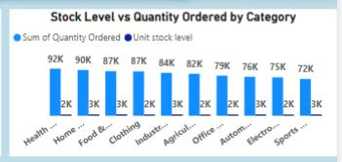
06 — INVENTORY
Inventory Optimization Insights
Average Stock Level vs Total Quantity Ordered by Category
Health & Beauty has the highest order volume (92,443 units) relative to its stock level — a tighter turnover risk than other categories.
Health & Beauty also has the highest damaged goods count (2.68% rate) — flags a handling/packaging issue, not just a stocking one.
GLOBALMART SUPPLY CHAIN ANALYTICS
7

Slide 8
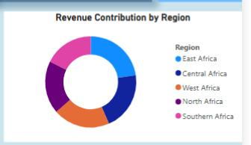
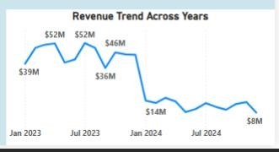
07 — TRENDS
Business Trends & Patterns
Revenue Contribution by Region ($M)
Monthly Revenue Trend ($M)
East Africa leads revenue at $157.9M, followed by Central Africa ($144.9M); Southern Africa trails at $122.8M. Revenue is fairly evenly distributed across categories.
GLOBALMART SUPPLY CHAIN ANALYTICS
8

Slide 9
08 — RECOMMENDATIONS
Strategic Recommendations
Review Globaltrade Ng 73% late rate is a clear outlier — worth a supplier performance review or renegotiation
Reassess Express Shipping If it's not meaningfully more reliable than other modes, its added cost may not be justified
Tighten QC for Health & Beauty Highest damaged-goods rate in the dataset signals a handling or packaging issue despite having the highest profit and revenue.
Rebalance Inventory Align stock levels with category-level demand rather than a flat average across categories
Standardize Data Capture Most cleaning issues stemmed from inconsistent manual entry, fix at the source by having a standardized format for data collection or entry.
GLOBALMART SUPPLY CHAIN ANALYTICS
9

Slide 10
09 — CLOSING
Conclusion & Next Steps
Delivery reliability, not profitability, is GlobalMart's most urgent issue. Margins are healthy and stable at 27.8%, but nearly 2 in 3 orders arrive late.
Next Steps
Automate this dashboard's refresh cycle so leadership can monitor delivery KPIs in real time
Extend the analysis to customer satisfaction data, if available, to link delivery delays to churn risk
Pilot inventory rebalancing in Health & Beauty, the category with the widest demand-supply gap
Thank you.
GLOBALMART SUPPLY CHAIN ANALYTICS
10

