Slide 1

A PERSONAL REFLECTION
Givers Never Lack
Adeniyi Aishat Himisioluwa
Data Analytics Track
1

Slide 2
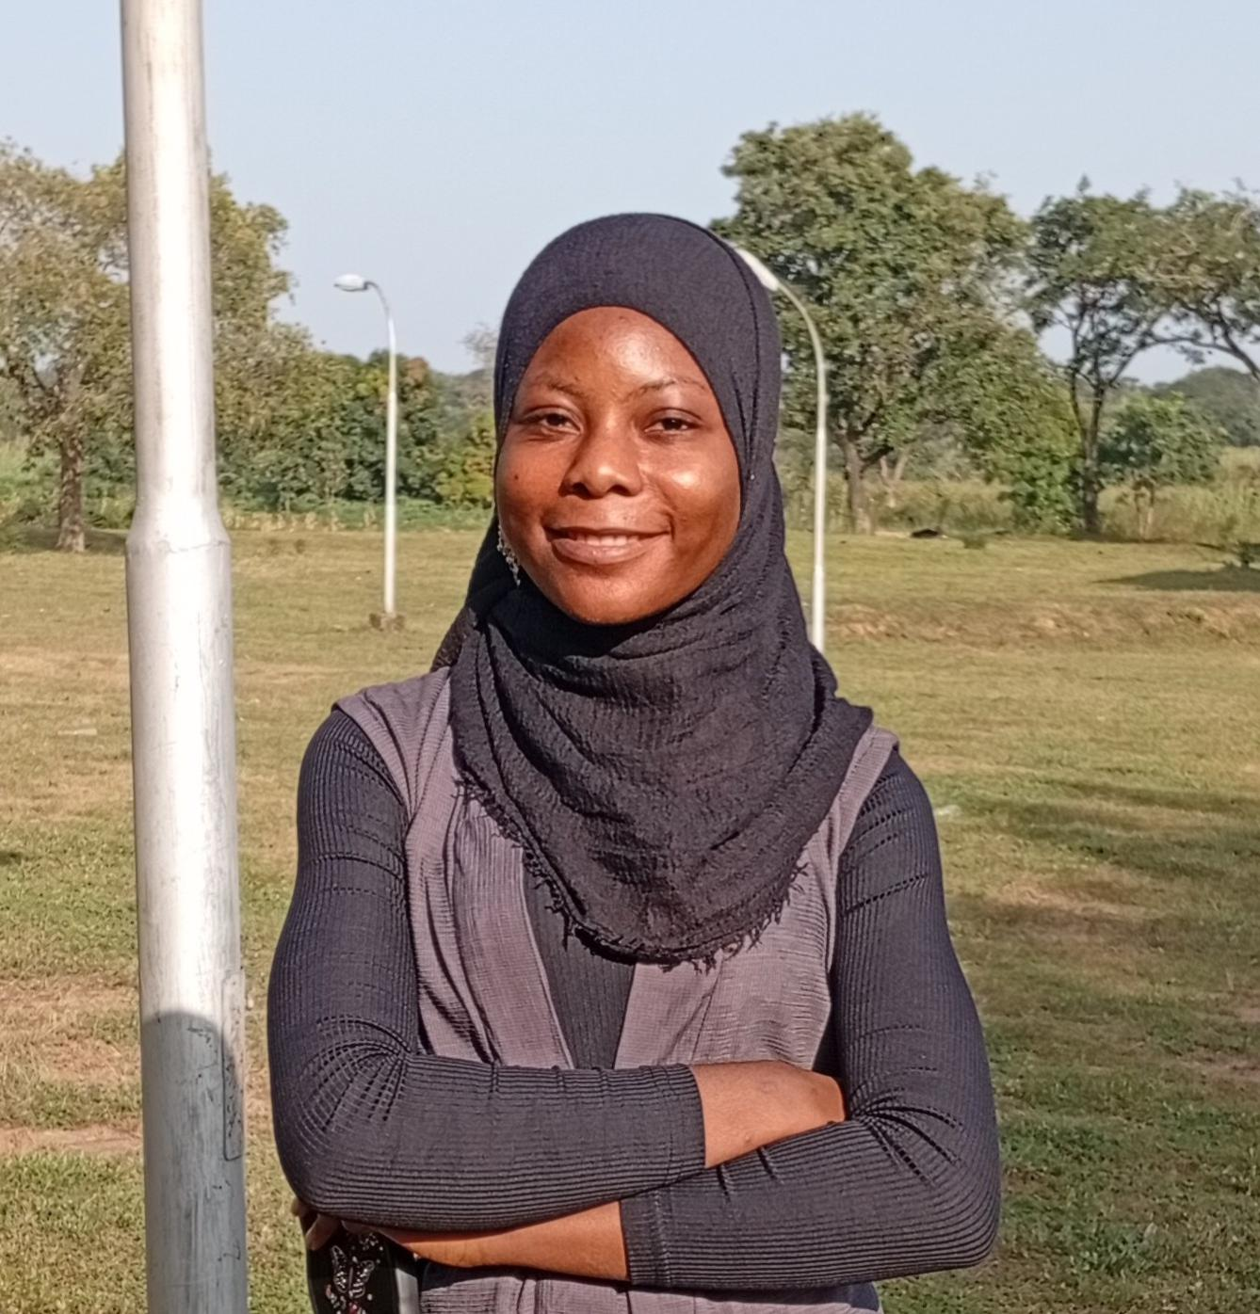
ABOUT ME
Adeniyi Aishat Himisioluwa
Data Analytics Track
I am medical student passionate about bridging the gap between health and technology, using data to make informed, data-driven decisions and applying technology to solve real health problems.
Healthcare
Data Analytics
Health-Tech Innovation
2

Slide 3
01
Watching the video made me reflect on several things that I know I ought to incorporate into my daily life but have not been doing consistently. As a result, it has affected my growth and productivity.
Introduction
Reflecting on the video and on habits I know I should build.
It feels like identifying your problem but not being ready to solve it.
3

Slide 4
The Phrase "Givers Never Lack"
The phrase “Givers Never Lack “ is one statement that resonated with me deeply, even though it wasn’t stated exactly like that in the video. Rather it is a phrase I coined from the following key take away:
1
2
3
Help Others Make Money
Be Ready to Serve
Perception and Visibility Matter
Another lesson was to give, give, give, and keep giving. The more value you give to people, the more you learn, the greater impact you make, and the more people trust, appreciate, and recommend you.
“Make money for your friend so you won’t have to worry about money in life.” In other words, the more value you create for others and the more opportunities you help them access, the more opportunities come back to you.
You can know and still remain unknown because people are unaware of what you can do. If you consistently serve people and make your skills visible, you become someone others naturally recommend. Branding never sleeps, even Coca-Cola keeps advertising to stay visible. No matter how talented you are, if people do not know you, your opportunities become limited.
4

Slide 5
How It Resonates With Me
How this message resonate with me and how it perfectly aligns with what I am currently learning at IOTBTech and the stage of life I am in.
Firstly, I am a medical student with a strong passion for technology, particularly in finding ways technology can improve healthcare. That is one of the reasons I chose the Data Analytics track at IOTB Tech, and I have never regretted that decision despite the challenges, time constraints, and demands of school, assignment deadlines and the likes I am proud of who I am becoming and keep hoping for the best.
Secondly, this also resonated with me in the sense that one can achieve anything if they have a clear vision and are willing to work towards it, regardless of their background. Sometimes, I used to think that because I came from a humble background, I was limited in some ways or not privileged. Yes, I might not be privileged in some aspects, but I am not limited in how far I can go in life. Sometimes, I use being a medical student as an excuse, but in reality, many of my peers are doing well despite being medical students. I want to challenge myself to step out of my comfort zone, make a meaningful impact, and stop placing unnecessary limitations on myself while still maintaining my great academic integrity. The saddest part is when the future you rely on becomes blurry and seems uncertain due to the current situation surrounding the profession. So, why should I limit myself from doing extraordinary things when I have the opportunity to do so?
HEALTHCARE + TECHNOLOGY
5

Slide 6
Reflecting on the video helped me identify some reasons:
Where I Fall Short And Need Improvement
I rarely share what I know with others because I believe I don’t know enough.
I do not connect with like-minded people.
1
2
I often try to do everything alone instead of collaborating or seeking guidance.
I do not make my skills and capabilities visible.
3
4
I like exploring many different fields without having a clear focus or purpose.
I spend more time learning new things rather than implementing the ones I know or giving back by teaching or sharing my knowledge with who may need it.
5
6
6

Slide 7
Lessons That Hit Me Personally
Every lesson from the video resonated, but a few stood out the most:
1
2
3
Doing Things Well
Don't Limit Yourself
Hard work, Discipline & Deferred Gratification
This reminded of the sentence that says “whatever is worth doing is worth doing well”. Whatever you choose to do should not be done merely for the sake of doing it. Instead, do it wholeheartedly, with intention, and with a clear understanding of the value or reward you hope to gain. Just as some of us join classes simply for the sake of joining, we should instead participate with purpose and strive to get the best out of every opportunity.
Our brains keep adapting and growing as we keep challenging ourselves and learning, which explained the concept neuroplasticity emphasized in the video.
Great achievements rarely happen overnight or by luck , they require consistency, sacrifice, and patience.
4
Time Management
Effective time management is not about having more time; it is about making better use of the time I already have. This occur in scenario when we tend to leave classes or not doing assignments in the name of I don’t have time but we tend to spend time in some unnecessary things.
7

Slide 8
Key Takeaways I Would like to Incorporate Into My Daily Life
From today onward, I want to intentionally practice the following:
1
2
3
Serve people wholeheartedly
Under-promise and over-deliver
Make my work and skills visible
4
5
6
Invest in myself and in others
Keep giving value consistently
Build a name and reputation people can trust
8

Slide 9
"
Another Key Takeaways
When preparation meets luck, it becomes opportunity.
When preparation meet luck, it becomes opportunity i.e opportunity favors those who are prepared. So the question is “Am I prepared to meet a luck” Honest I can’t say.
No matter what
- There is still so much value to create, so much impact to make, and so much of the world that still needs to be built.
9

Slide 10
Appreciation to IOTB Tech
I have explored different areas in the tech space, but my experience at IOTB Tech has been incomparable. The knowledge, mentorship, community, and opportunities provided here are truly invaluable, money can't buy them. IOTBTech continuously empowers people with world-class professional skills, creates opportunities, and genuinely invests in the success of others.
The statement, “Help your friend make money so you won’t have to worry about money in life,” truly reflects what IOTBTech stands for. The organization continuously empowers people with world-class professional skills, creates opportunities, and genuinely invests in the success of others.
May Almighty Allah continue to reward the founders, the leadership, the mentors, and every contributor to IOTB Tech. May your efforts continue to transform lives and open doors for many more people.
Jazakumullahu khayran.
10

