Slide 1
CFD Fundamentals
Aerodynamics 2
James Slaughter

Slide 2
Overview and Goals:
Goals of Simulation:
Accurately predict mean aerodynamic forces on supplied aerofoil profile
Validate model and compare against experimental methods
Learning Goals:
Conduct an turbulent, external, high-Reynolds Number CFD simulation on an aerofoil
Continue to learn the basics of numerical simulation techniques and their practical use cases and industrial best practice
Learn the basics of how to use STAR-CCM+ for such simulations
Learn how to extract salient information from a CFD model and how to present and discuss that information in a relevant manner.

Slide 3
Domain

Slide 4
Assumptions

Slide 5
Residuals:

Slide 6
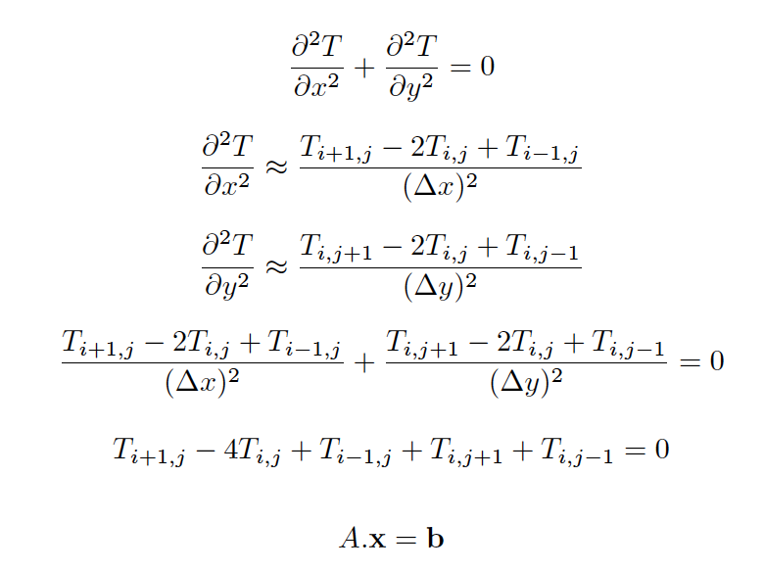
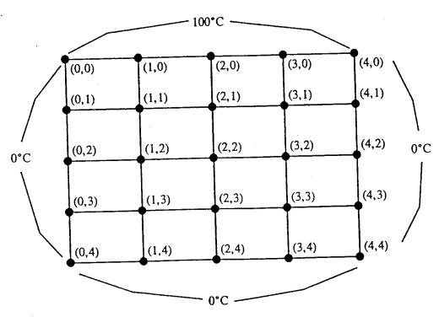
Residuals:

Slide 7
Residuals:

Slide 8
Residuals:

Slide 9
Residuals:

Slide 10
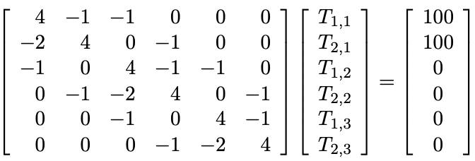
Residuals:

Slide 11
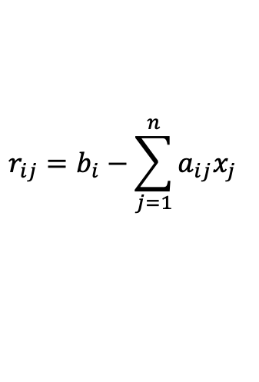
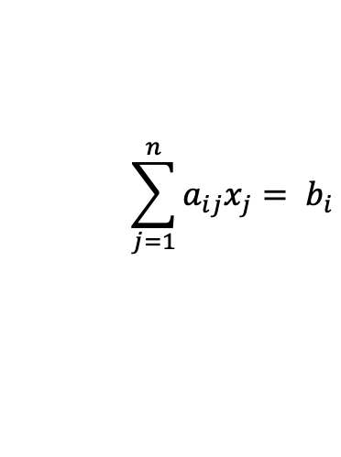
Residuals:
$$\sum_{j=1}^{n}{a_{ij}x_{j}= b_{i}}$$
$$r_{ij}=b_{i}−\sum_{j=1}^{n}{a_{ij}x_{j} }$$

Slide 12
SIMPLE Solver:
RANS Equations non-linear and non-homogenous in nature:
A number of ways to solve them either Coupled or Segregated solvers (using splitting of operators approach)
SIMPLE Solver :
Segregated approach
Cheaper on memory (RAM)
Less time/iteration
Generally more stable
More iterations to reach convergence

Slide 13
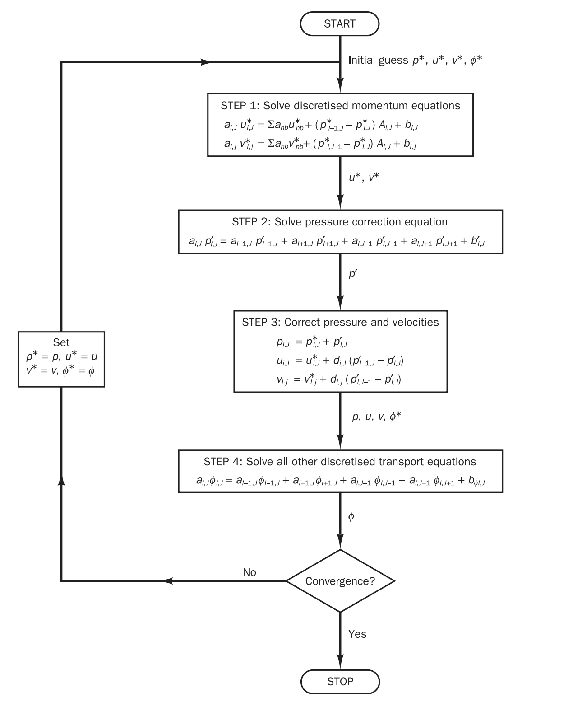
SIMPLE Solver:

Slide 14
Overview and Goals:
Goals of Simulation:
Accurately predict mean aerodynamic forces on supplied aerofoil profile
Validate model and compare against experimental methods
Learning Goals:
Conduct an turbulent, external, high-Reynolds Number CFD simulation on an aerofoil
Continue to learn the basics of numerical simulation techniques and their practical use cases and industrial best practice
Learn the basics of how to use STAR-CCM+ for such simulations
Learn how to extract salient information from a CFD model and how to present and discuss that information in a relevant manner.

Slide 15
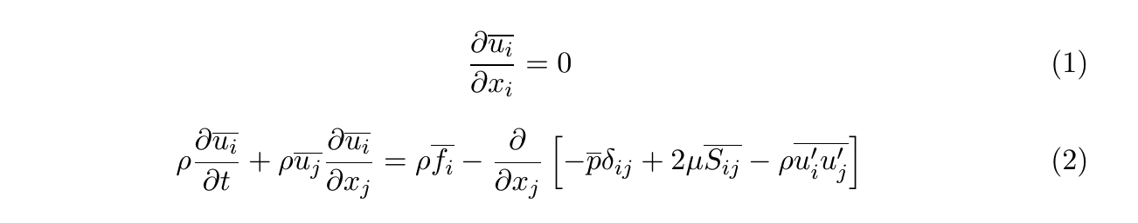
Physics and Governing Equations

Slide 16
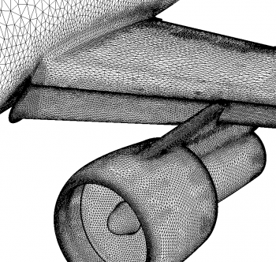
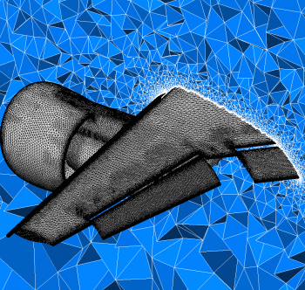
Example Meshes

