Slide 1
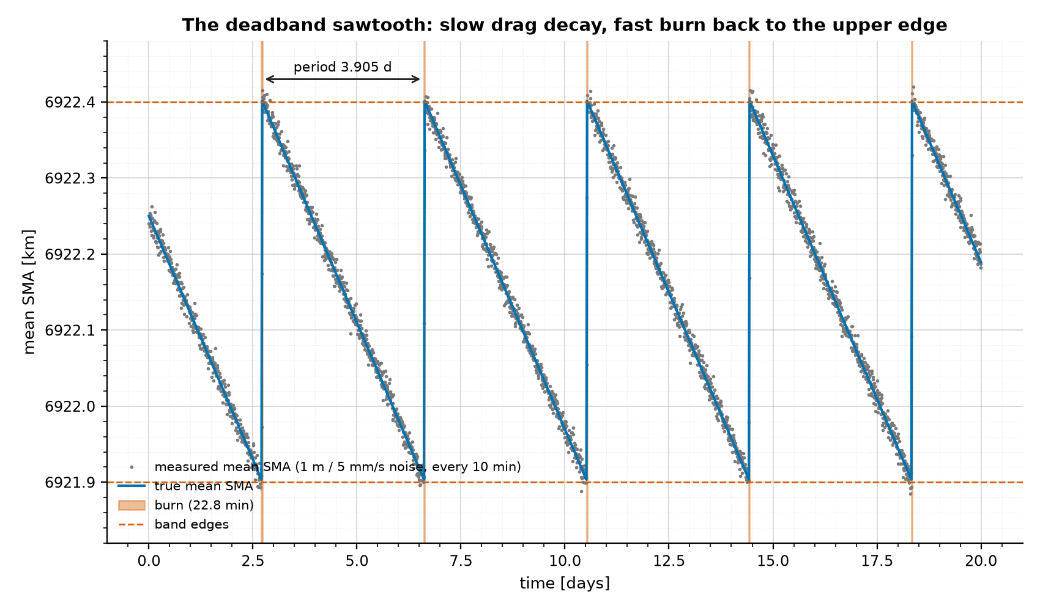
Manoeuvre Pattern-of-Life Prediction for Space Domain Awareness
Learning a station-keeping control law from noisy tracking data:
simulation, burn detection, SINDy / BINDy, Gaussian processes and forecasting
UROP project, Imperial College London
45 min presentation + 15 min questions
The simulated deadband sawtooth: mean SMA vs time (20 days)
Notes:
- Topic: learning a satellite's station-keeping control law from noisy tracking data and forecasting its burns.
- Setting: UK Space Agency challenge brief; UROP project at Imperial College London.
- Approach: a known-truth simulation, then a chain of estimators scored against that truth.
- Talk: 45 minutes in process order (physics, code, detection, learning, forecasting, assessment).
- 15 minutes for questions at the end; backup detail is in the written report.

Slide 2
Roadmap: the analysis chain, in process order
0. Simulate
(physics + deadband
controller, ODE)
1. Natural dynamics
(c_d, J2: FD, energy,
EKF, spectra)
2. Detect burns
(unmodelled accel.,
SG filter, GMM)
3. Learn laws
(SINDy / BINDy,
GP, hysteresis)
4. Forecast
(next burns,
intervals)
Use: space weather, tracking passes, conjunction screening, sensor tasking, fleets, GEO
Part A - Physics and simulation code (slides 3-14)
Part B - Estimating drag and detecting burns: GMM (slides 15-22)
Part C - Learning the thrust, natural and switching laws: GP, SINDy, BINDy (slides 23-26)
Part D - Forecasting, error budget, robustness, all forces, extensions (slides 27-31)
Part E - Ranking, holistic assessment, limitations, conclusions (slides 32-37)
Notes:
- The talk follows the processing chain from left to right.
- Stage 0 builds the truth: a 400-day simulation with a deadband controller.
- Stages 1-3 estimate the natural dynamics, detect burns and learn the laws.
- Stage 4 forecasts burns; extensions test the forecasts in operational settings.
- We close with an error budget, method ranking and best practices.

Slide 3
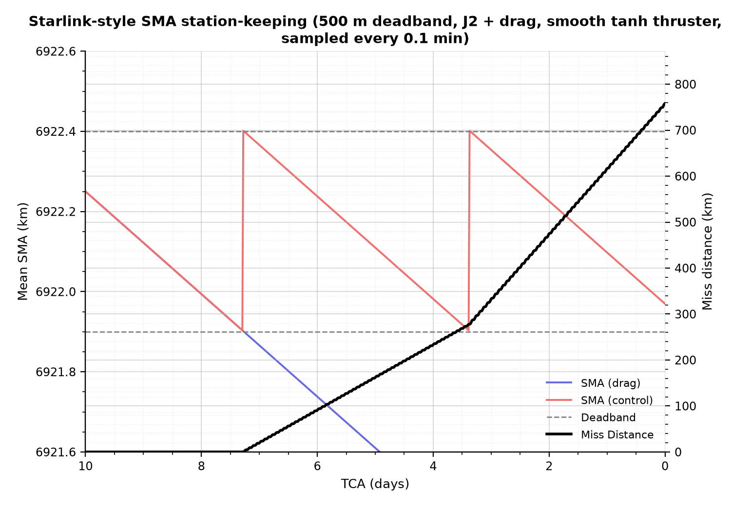
The brief: predict future manoeuvres, not just detect past ones
UK Space Agency challenge: Manoeuvre Pattern of Life Prediction for SDA
Unpredicted burns break three SDA functions:
  conjunction screening (predicted orbits wrong)
  track association (observations not linked)
  sensor scheduling (uncertainty must be re-acquired)
Question: can the control law be learned from noisy data well enough to forecast the next burns?
Method: known-truth simulation + scored chain of estimators
Our reproduction of the brief's Figure 1
Notes:
- Of ~50,000 tracked objects ~15,000 are active and may manoeuvre; mega-constellations will multiply this.
- Unpredicted manoeuvres break conjunction screening, track association and sensor scheduling.
- Brief Figure 1: a 500 m deadband shifts the miss distance by hundreds of km in a week.
- The gap: reconstruct the control law from measurements and use it to forecast.
- Our figure reproduces Figure 1 from our own simulation (controlled vs drag-only twin).

Slide 4
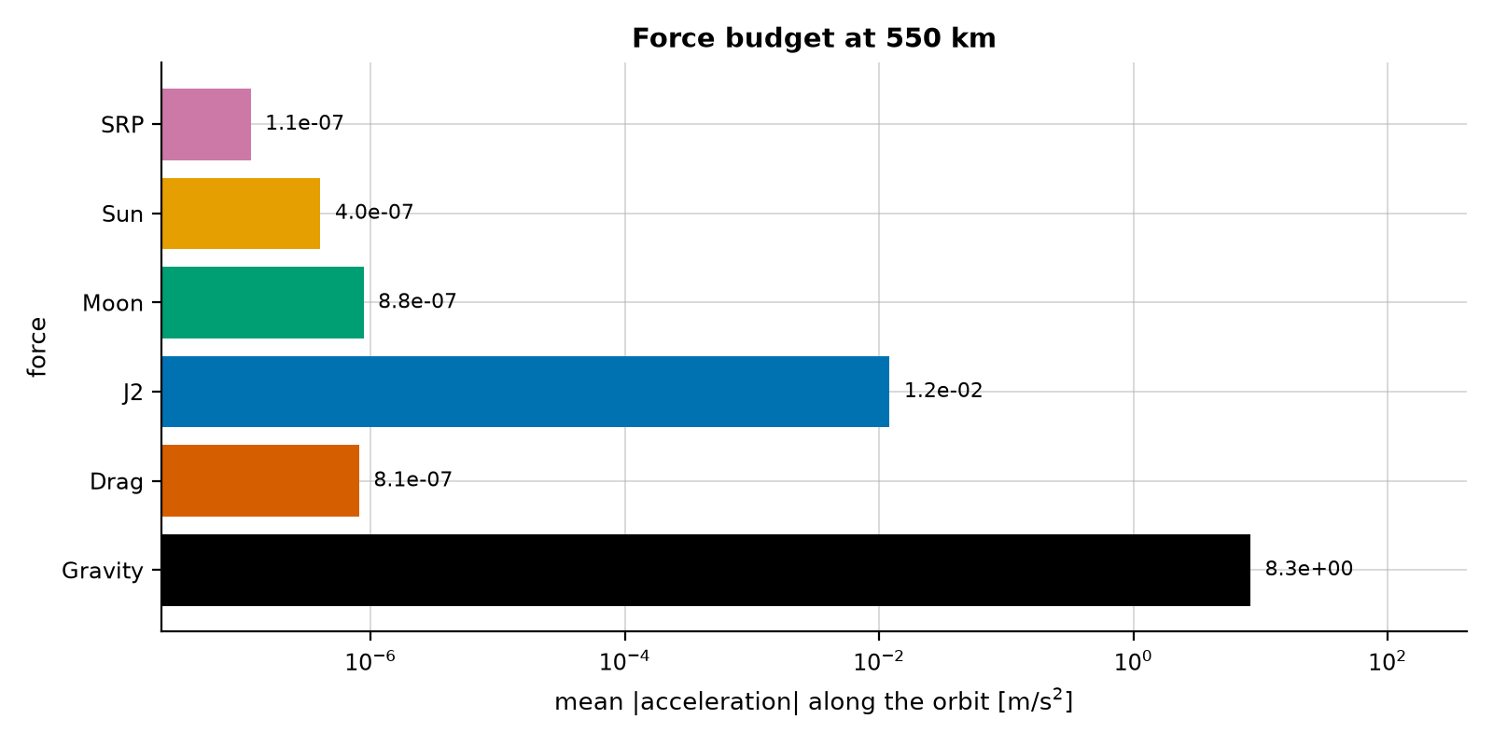
Physics model: forces on a 550 km Starlink-like orbit
dr/dt = v
dv/dt = -mu r / r^3 + a_J2 + a_drag + a_Moon + a_Sun + a_SRP + a_thrust
a_drag = -c_d |v| v ; a_J2 = -grad U_J2, U_J2 = (mu J2 Re^2 / 2r^3)(3 sin^2(lat) - 1)
Third bodies: tidal form mu_b [ (r_b - r)/|r_b - r|^3 - r_b/|r_b|^3 ]
Units: DU = 6371 km, TU = 13,713.44 s (non-dimensional state ~ 1)
Thrust (2e-4 m/s^2) is 250x drag but 60x below J2
Mean acceleration of each force (log scale)
Notes:
- State x = (r, v) in non-dimensional units: DU = 6371 km, TU = 1/omega_Earth = 13,713.44 s, mu = 289.873.
- Forces: two-body gravity, J2 (equatorial radius 6378.137 km), quadratic drag, Moon, Sun, SRP, thrust.
- Mean accelerations: gravity 8.3, J2 1.2e-2, Moon 8.8e-7, drag 8.1e-7, Sun 4.0e-7, SRP 1.1e-7 m/s^2.
- Thrust 2e-4 m/s^2 sits between J2 and drag: detectable once J2 is removed.
- Drag tuned to 5.3 m/h of SMA decay (realistic order for 550 km); constant density in the core run.

Slide 5
Code: the force model (deadband/physics.py)
def gravity_accel(r):
"""Two-body gravity."""
return -MU * r / np.linalg.norm(r) ** 3
def drag_accel(v, cd):
"""Quadratic drag opposing the velocity: -cd * |v| * v."""
return -cd * np.linalg.norm(v) * v
def j2_accel(r, j2=J2):
"""Acceleration from Earth's oblateness (J2)."""
radius = np.linalg.norm(r)
x, y, z = r
earth_radius = EARTH_EQUATORIAL_RADIUS_KM / DU # J2 reference radius
factor = 1.5 * j2 * MU * earth_radius**2 / radius**4
z_ratio_sq = (z / radius) ** 2
return factor * np.array([
x / radius * (5 * z_ratio_sq - 1),
y / radius * (5 * z_ratio_sq - 1),
z / radius * (5 * z_ratio_sq - 3),
])
Pure functions: easy to test and to vectorise
Non-dimensional state keeps all components ~1 (good for solvers and least squares)
J2 reference radius = equatorial 6378.137 km
Verified: a_J2 = -grad U_J2 (unit test)
Moon, Sun, SRP: same pattern in perturbations.py
Notes:
- Each force is a small pure function of the state; the right-hand side just sums them.
- Everything is non-dimensional; J2 uses the EQUATORIAL radius (a bug found and fixed: 0.22% too weak before).
- Drag is -c_d |v| v with a lumped ballistic coefficient c_d.
- Vectorised versions of the same functions are reused by the classifier (known_accel).
- Unit test: a_J2 equals minus the gradient of the J2 potential.

Slide 6
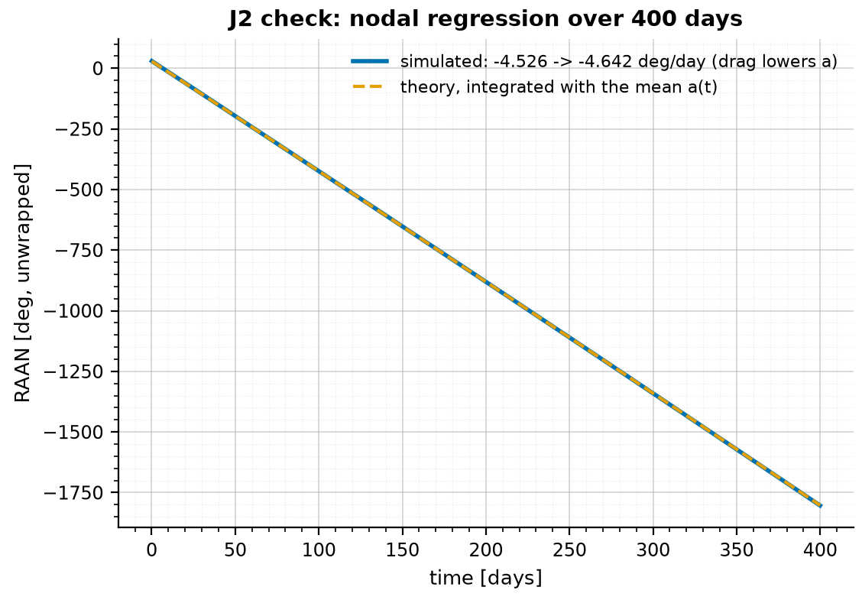
Verifying J2: nodal regression against the analytical rate
Simulated node: Omega = atan2(h_x, -h_y), h = r x v
Theory (secular J2):
  dOmega/dt = -(3/2) n J2 (Re / p)^2 cos i
  Omega_th(t) = Omega(0) + integral of dOmega/dt along the run
  n = sqrt(mu / a^3), one-orbit means of a and i, p ~ a (e ~ 1e-4)
Agreement after 400 days: 0.04%
Rate -4.526 → -4.642 deg/day as drag lowers the free orbit by 51 km
Simulated RAAN vs integrated J2 theory, 400 days
Notes:
- Simulated node from the angular momentum h = r x v: Omega = atan2(h_x, -h_y), cos i = h_z/|h|.
- Theory: dOmega/dt = -3/2 n J2 (Re/p)^2 cos i, with one-orbit means of a and i, p = a(1-e^2) ~ a.
- The rate is integrated along the run (cumulative sum, 1-min steps) because drag lowers the orbit 51 km.
- Agreement after 400 days: 0.04% (rate -4.526 deg/day at start, -4.642 deg/day at end).
- This check exposed the mean-radius bug (J2 was 0.22% too weak) before any learning was done.

Slide 7
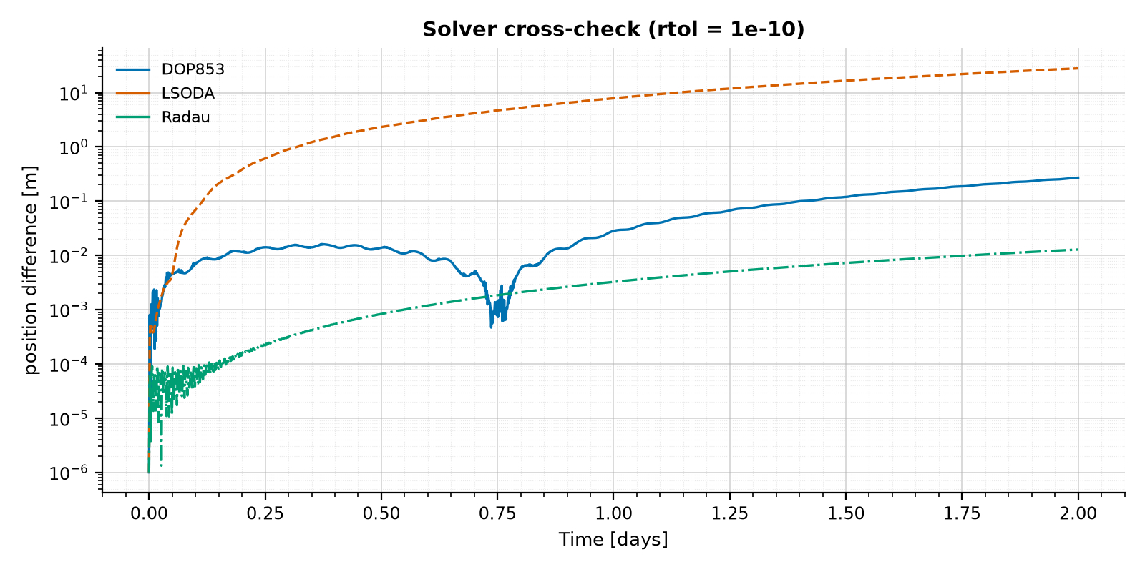
ODE solvers: DOP853 for free flight, LSODA for the controller
# free flight (perturbations.py): explicit Runge-Kutta 8(5,3)
solution = solve_ivp(full_rhs(cd, forces), [t_eval[0], t_eval[-1]], state0,
t_eval=t_eval, method="DOP853",
rtol=tolerance, atol=tolerance) # 1e-10
# controlled run (smooth_controller.py): stiff / non-stiff switching
result = solve_ivp(rhs, [0.0, t_end], state0, method="LSODA",
rtol=tolerance, atol=tolerance, # 1e-11
dense_output=True)
DOP853: high order, efficient for smooth free flight
LSODA: Adams (non-stiff) <-> BDF (stiff) chosen automatically
Stiffness: 60 s switch time and 5 m switch width at each burn edge
Cross-check (2 days, vs 1e-13 reference): 0.27 m / 28 m / 0.013 m
10-day Week 5 run: 55,138 steps, 157,404 RHS calls
Solver cross-check
Notes:
- Free runs: DOP853, explicit 8th-order Runge-Kutta, rtol = atol = 1e-10 (non-dimensional).
- Controlled runs: LSODA, which switches automatically between non-stiff Adams and stiff BDF methods.
- The tanh switches make the controlled ODE stiff for seconds at each burn edge; LSODA shrinks its steps there.
- Cross-check over 2 days vs a 1e-13 DOP853 reference: DOP853 0.27 m, LSODA 28 m, Radau 0.013 m.
- States are read from the solver's dense output every 6 s; 10-day chunks keep memory low.

Slide 8
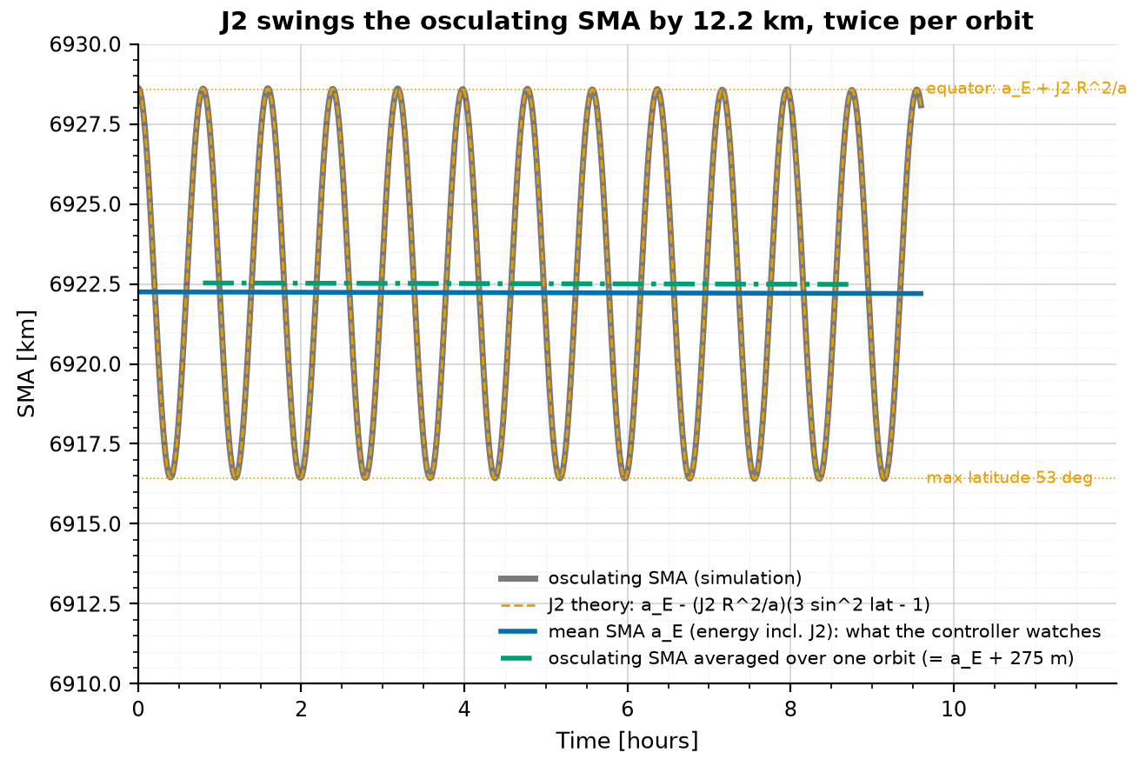
Why the controller watches the J2 mean SMA
def j2_potential(r, j2=J2):
"""Potential energy per unit mass from J2 (its gradient is physics.j2_accel)."""
radius = np.linalg.norm(r)
earth_radius = EARTH_EQUATORIAL_RADIUS_KM / DU # J2 reference radius
return MU * j2 * earth_radius**2 / (2 * radius**3) * (3 * (r[2] / radius) ** 2 - 1)
def mean_sma(r, v, j2=J2):
"""SMA from the total energy (kinetic + point-mass + J2 potential). Constant under J2."""
energy = np.dot(v, v) / 2 - MU / np.linalg.norm(r) + j2_potential(r, j2)
return -MU / (2 * energy)
a_osc = -mu / (2 eps), eps = v^2/2 - mu/r: swings 12.2 km per orbit
a_mean = -mu / (2 eps_J2), eps_J2 = eps + U_J2: flat between burns
Theory check: 12.17 vs 12.22 km (0.4%)
Osculating vs mean SMA
Notes:
- Osculating SMA from two-body energy swings 12.2 km per orbit under J2: 25x the 500 m band.
- A controller on the osculating SMA fires every orbit and climbs out of the band.
- Adding the J2 potential to the energy gives a quantity that is constant under J2.
- It then changes only through drag and thrust: exactly what the deadband must see.
- Check: first-order swing 3 J2 Re^2 sin^2 i / a = 12.17 km vs 12.22 km simulated (0.4%).

Slide 9
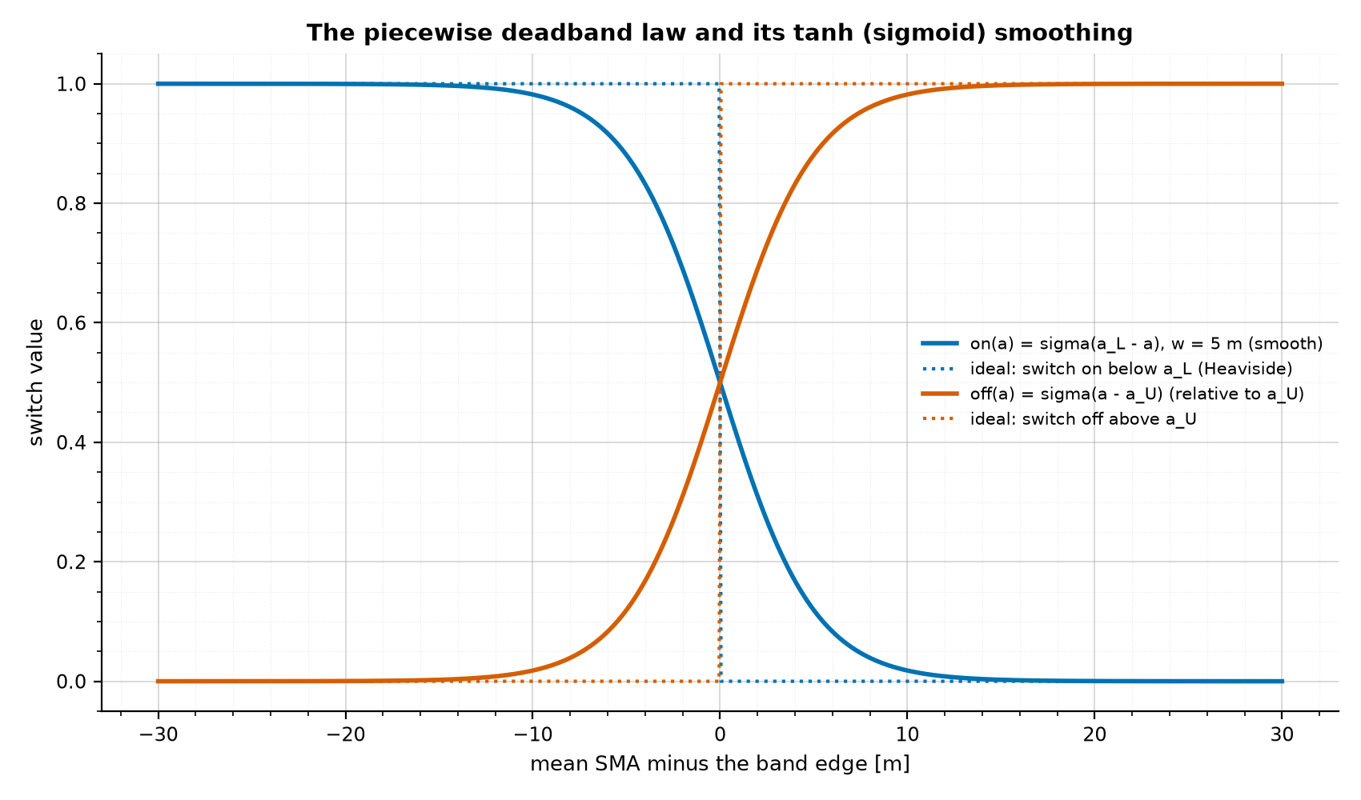
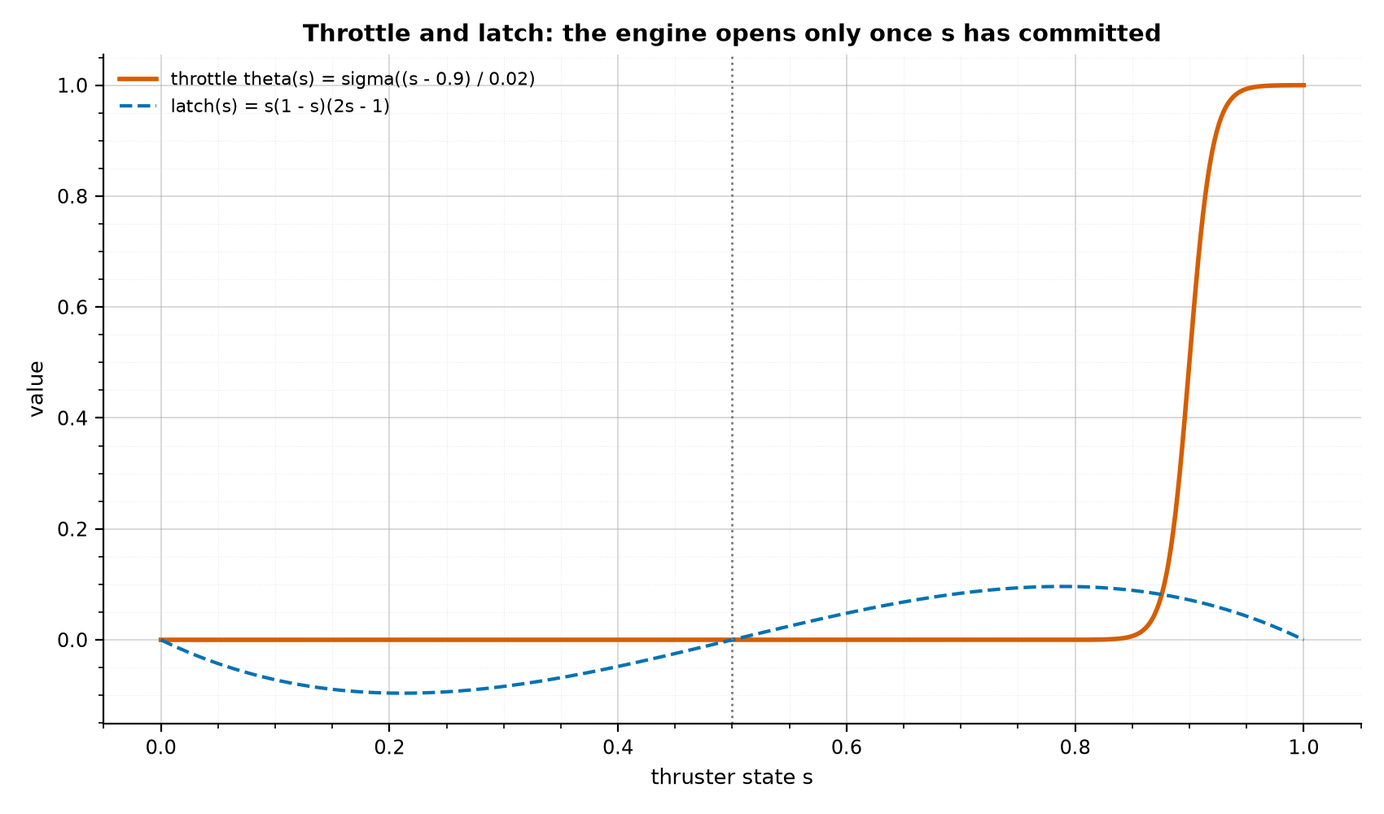
The deadband law: a piecewise switch made smooth with sigmoids
Ideal: s+ = 1 if a <= a_L; 0 if a >= a_U; s- otherwise
Smooth: tau ds/dt = sigma(a_L - a)(1 - s) - sigma(a - a_U) s + lambda s(1 - s)(2s - 1)
a_thrust = T theta(s) v_hat, theta(s) = sigma((s - 0.9) / 0.02)
a_L = 6921.9 km, a_U = 6922.4 km, w = 5 m, tau = 60 s, lambda = 1, T = 2e-4 m/s^2
Ideal (dotted) vs tanh switches
Throttle and latch
Notes:
- Ideal law: s = 1 when a <= a_L, s = 0 when a >= a_U, otherwise keep s (memory).
- Heaviside steps are discontinuous: a solver needs events and thrust would jump instantly.
- Replace each step with sigma(x) = (1 + tanh(x/w))/2, w = 5 m; s gets its own ODE with time constant 60 s.
- Latch term s(1-s)(2s-1) makes s = 0 and s = 1 the stable states: the memory (hysteresis).
- Throttle opens only past s = 0.9 so the burn cannot stall half-way.

Slide 10
Code: the deadband logic inside the ODE (smooth_controller.py)
def rising_switch(x, width):
"""Smooth step: ~0 for x << -width, 1/2 at x = 0, ~1 for x >> width."""
return 0.5 * (1 + np.tanh(x / width))
def throttle(s):
"""How open the thruster is (0..1): opens steeply as s passes THROTTLE_OPENS_AT."""
return rising_switch(s - THROTTLE_OPENS_AT, THROTTLE_WIDTH)
def a_thrust(v, s, thrust_accel=THRUST_ACCEL):
"""Thrust acceleration: along the velocity, magnitude THRUST_ACCEL * throttle(s)."""
return thrust_accel * throttle(s) * v / np.linalg.norm(v)
def thruster_state_rate(sma, s, sma_width=SWITCH_SMA_WIDTH, switch_time=SWITCH_TIME,
a_lower=SMOOTH_A_LOWER, a_upper=SMOOTH_A_UPPER):
"""ds/dt for the thruster on/off state s."""
turn_on = rising_switch(a_lower - sma, sma_width) # 1 once the SMA is below the lower edge
turn_off = rising_switch(sma - a_upper, sma_width) # 1 once the SMA is above the upper edge
latch = LATCH_GAIN * s * (1 - s) * (2 * s - 1) # holds s at 0 or 1 inside the band
return (turn_on * (1 - s) - turn_off * s + latch) / switch_time
Three sigmoids replace three 'if' statements
turn_on / turn_off: 5 m wide
latch: zeros at s = 0, 1/2, 1
throttle: opens over s = 0.88-0.92 (~30 s ramp)
THROTTLE_OPENS_AT = 0.9, THROTTLE_WIDTH = 0.02
Notes:
- rising_switch is the tanh sigmoid; it replaces every 'if' of the ideal law.
- thruster_state_rate is ds/dt: switch on below the lower edge, off above the upper edge, latch in between.
- throttle maps the state s to how open the engine is; a_thrust points along the velocity.
- The controller reads the J2 mean SMA, so it ignores the 12 km osculating swing.
- No events, no discontinuities: one smooth 7-state ODE [r, v, s].

Slide 11
Code: the 7-state right-hand side f(t, [r, v, s])
def rhs(t, state):
r, v, s = state[0:3], state[3:6], state[6]
accel = gravity_accel(r) + drag_accel(v, cd) + j2_accel(r, j2)
if extra_forces:
clock = t + t_offset
if "Moon" in extra_forces:
accel = accel + third_body_accel(r, moon_position(clock), MU_MOON)
if "Sun" in extra_forces or "SRP" in extra_forces:
r_sun = sun_position(clock)
if "Sun" in extra_forces:
accel = accel + third_body_accel(r, r_sun, MU_SUN)
if "SRP" in extra_forces:
accel = accel + srp_accel(r, r_sun)
ds_dt = 0.0
if controlled: # a fixed choice of model, not a switch inside the dynamics
accel = accel + a_thrust(v, s)
sma = mean_sma(r, v, j2) if use_mean_sma else osculating_sma(r, v)
ds_dt = thruster_state_rate(sma, s, sma_width, switch_time, a_lower, a_upper)
return np.concatenate([v, accel, [ds_dt]])
State: [x, y, z, vx, vy, vz, s]
Physics block + control block
Third bodies use t + t_offset (10-day chunks keep the true Moon / Sun phase)
The 'if controlled' is a model choice made once, not a discontinuity
Notes:
- One closure returns d/dt of [r, v, s] for solve_ivp.
- Physics part: gravity + drag + J2, plus Moon / Sun / SRP when requested (evaluated at absolute time).
- Control part: thrust from s, and ds/dt from the J2 mean SMA.
- controlled=False gives the drag-only twin; use_mean_sma=False reproduces the osculating failure case.
- Same function drives the J2+drag run and the all-forces run (step 22).

Slide 12
Generating 400 days of data: chunked integration and results
def _controlled(name, extra_forces=()):
def build():
step = SAMPLE_STEP_S * SECONDS
chunk = from_days(CHUNK_DAYS)
state = smooth_initial_state()
times, samples = [], []
for k in range(int(np.ceil(LONG_DAYS / CHUNK_DAYS))):
sim = simulate_smooth_deadband(chunk, state0=state,
extra_forces=extra_forces,
t_offset=k * chunk)
local = np.arange(0, chunk, step)
times.append(local + k * chunk)
samples.append(sim.sample(local)) # dense output
state = sim.states[:, -1]
return dict(t=np.concatenate(times),
states=np.concatenate(samples, axis=1))
data = _cached(name, build) # .cache/*.npz
102 burns, period 3.9051 d, 22.8 min, 0.273 m/s each
Band kept: [6921.904, 6922.402] km
TRAIN days 0-40, TEST days 40-400
Mean-SMA sawtooth, first 20 days
Notes:
- The 400-day run is integrated in 40 chunks of 10 days; each chunk starts from the last state.
- Samples every 6 s come from the LSODA dense output; the result is cached to disk (~370 MB).
- Outcome: 102 burns, one every 3.9051 days, 22.8 min each, 0.273 m/s per burn, 27.8 m/s in total.
- Mean SMA stays inside [6921.904, 6922.402] km for the whole run.
- TRAIN = days 0-40, TEST = days 40-400, horizons 15-360 days throughout the study.

Slide 13
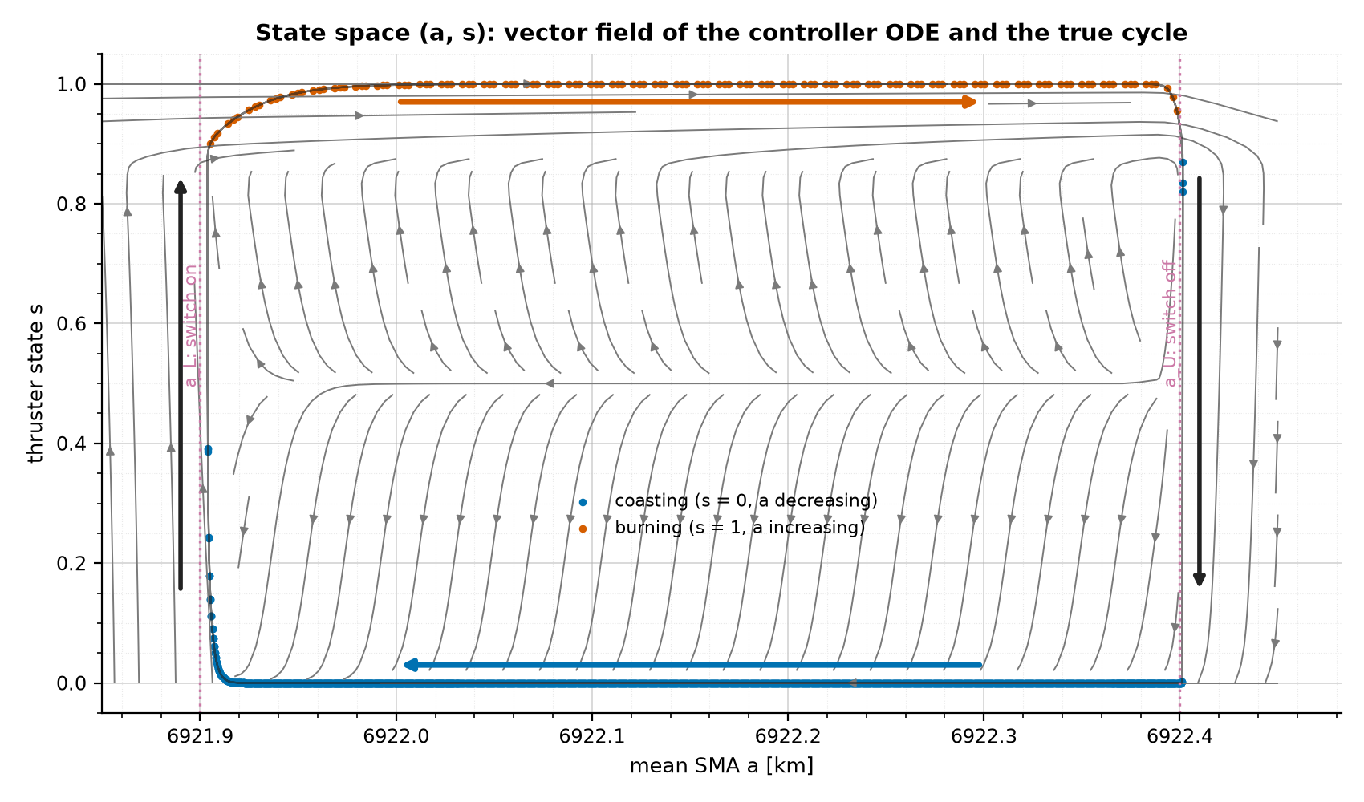
The controller as a two-state system: hysteresis in (a, s)
da/dt = -c_d D(a,v) + T theta(s) B(a,v)
  D = (2a^2/mu)|v|^3, B = (2a^2/mu)|v|
ds/dt = [sigma(a_L - a)(1 - s) - sigma(a - a_U) s + lambda s(1 - s)(2s - 1)] / tau
Two stable branches: coast -5.3 m/h, burn +1311 m/h
Memory-less s = f(a): balanced accuracy 0.50; hysteresis edges: 1.00
Vector field (directions) and one true cycle
Notes:
- Reduced to the slow states x = (a, s): da/dt = -c_d D(a,v) + T theta(s) B(a,v); ds/dt from the switches.
- Inside the band only the latch acts: s = 0 (coast) and s = 1 (burn) are both stable.
- At a_L the coast branch loses stability and s jumps to 1; at a_U the burn branch drops to 0.
- Result: a clockwise hysteresis loop; the same SMA can be coasting or burning.
- So a memory-less law s = f(a) cannot work (balanced accuracy 0.50 vs 1.00 for hysteresis).

Slide 14
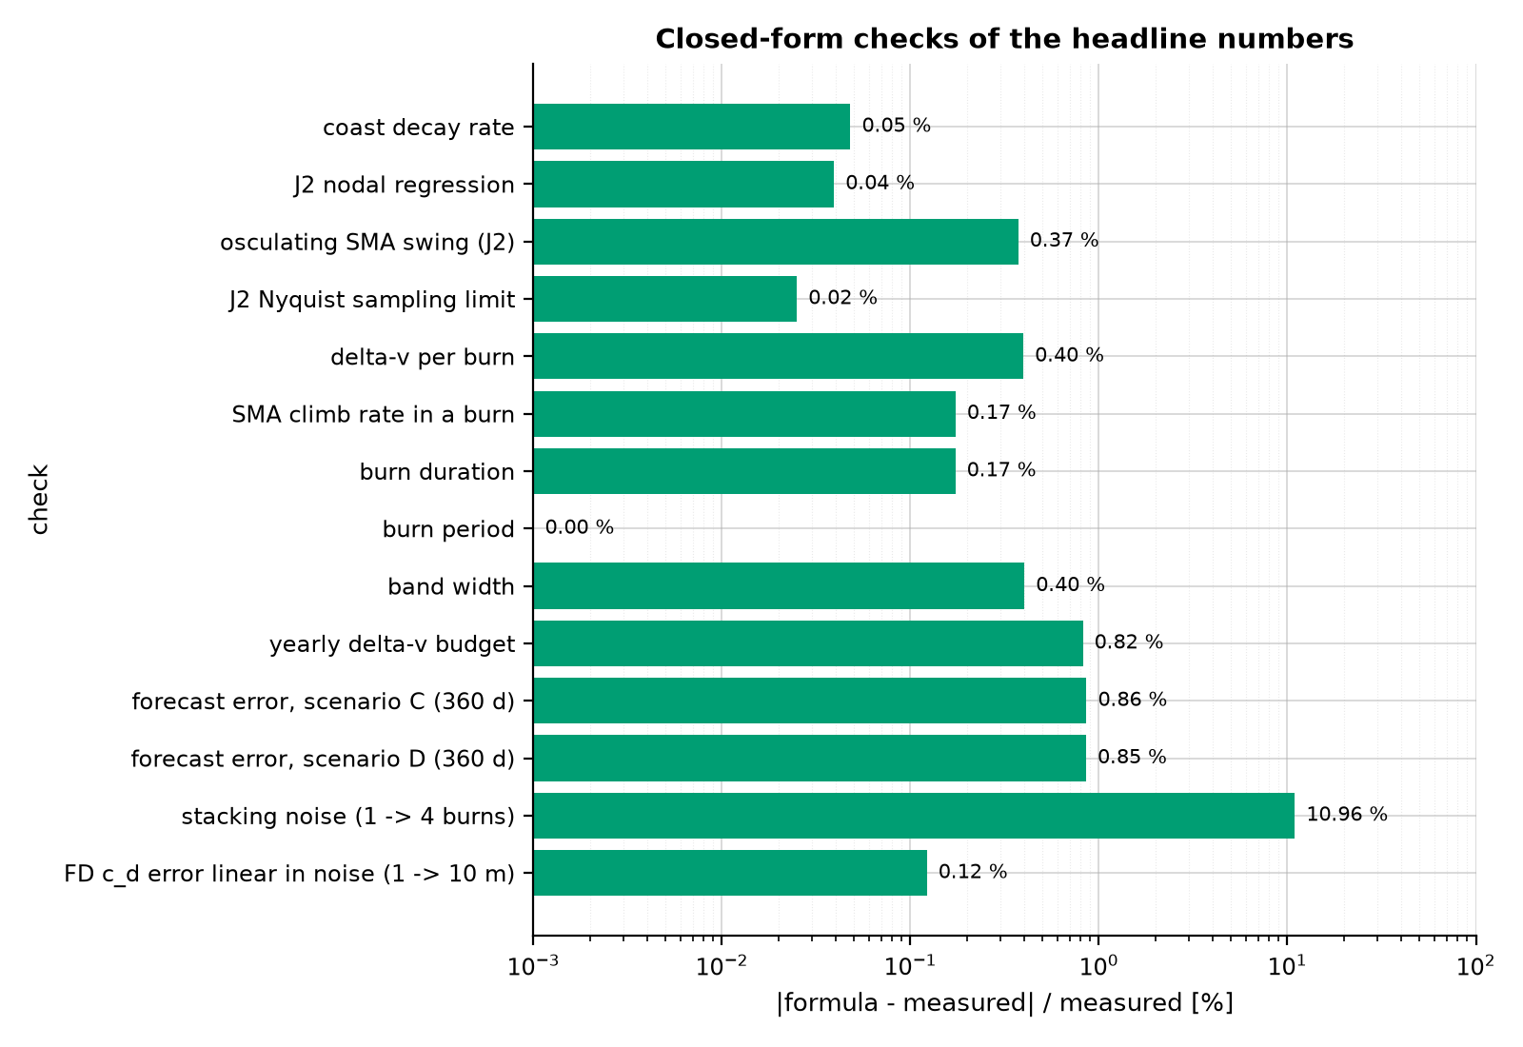
Checking the numbers against closed-form physics
Coast decay: da/dt = -2 c_d sqrt(mu a): 5.333 vs 5.335 m/h
Burn climb: 2aT/v - k: 1308 vs 1311 m/h
Burn: Delta-v / T = 1370 vs 1368 s
Period: w/k + t_b = 3.9051 d (exact)
J2 swing: 3 J2 Re^2 sin^2 i / a = 12.17 vs 12.22 km
Missed burn drift: (3/2) n Delta-a t = 495 km/week (upper bound; simulated 396)
16 / 16 checks pass
Relative difference, formula vs measured
Notes:
- Every headline number is recomputed from a formula (deadband/report_checks.py).
- Examples: decay -2 c_d sqrt(mu a) = 5.333 vs 5.335 m/h; burn 1370 vs 1368 s; period exact.
- Delta-v per burn v Delta-a / 2a = 0.2741 vs 0.2730 m/s; J2 Nyquist T/4 = 23.88 min.
- Forecast error from a period error: (1/2) H |dP/P|, within 0.9% for the SINDy scenarios.
- All 16 checks pass (14 within 1%; stacking noise within 11%; two inequality bounds hold).

Slide 15
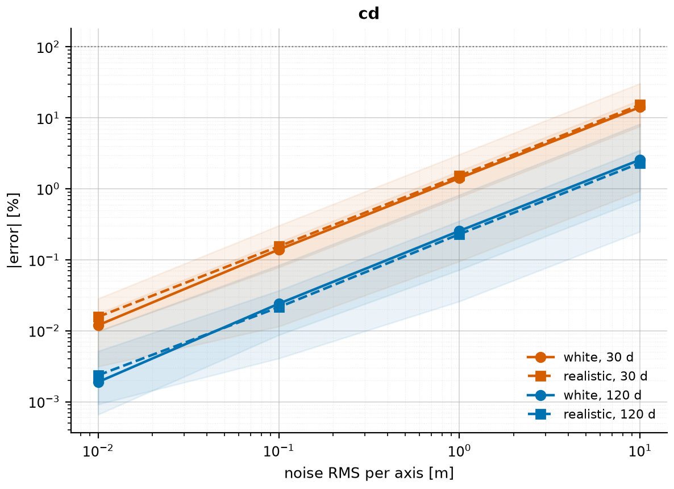
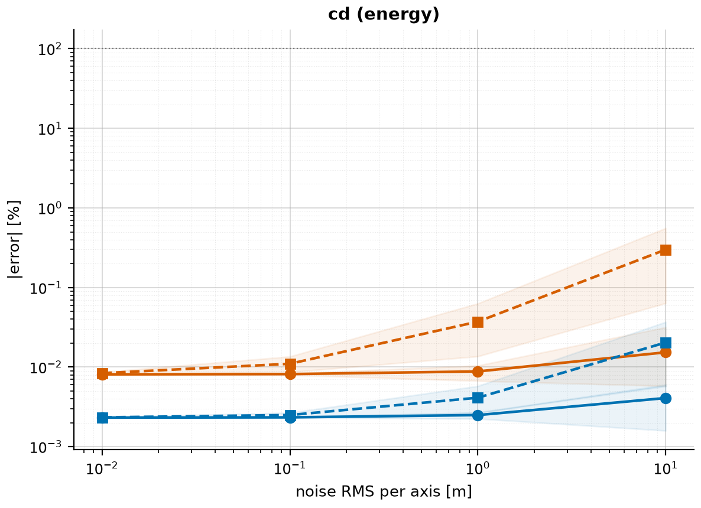
Stage 1: estimating the drag coefficient c_d
FD regression: r'' = mu shapes . coefficients (least squares, unit-scaled columns)
Energy method: da/dt = -(2a^2/mu) c_d |v|^3, fit one slope
Shooting: fit the whole trajectory (Levenberg-Marquardt)
EKF: state (r, v, c_d), STM propagation
c_d error at 10 m noise, 15 d: FD 6.3%, energy 0.035%
EKF (10-min data): 0.04% / 0.01% after 15 / 30 days
FD regression c_d error vs noise
Energy method c_d error vs noise
Notes:
- FD regression: differentiate positions twice and solve least squares; noise amplified as sigma/h^2.
- Energy method: one slope through the mean-SMA history; averages the noise of every sample.
- Shooting (Levenberg-Marquardt) and an EKF with state (r, v, c_d).
- 15 days, 1-min data, 10 m noise: FD 6.3%, energy 0.035%; EKF on 10-min data 0.04% (15 d), 0.01% (30 d).
- Inside the full chain c_d is learned on clean coast arcs to 0.03-0.08% at every sampling step.

Slide 16
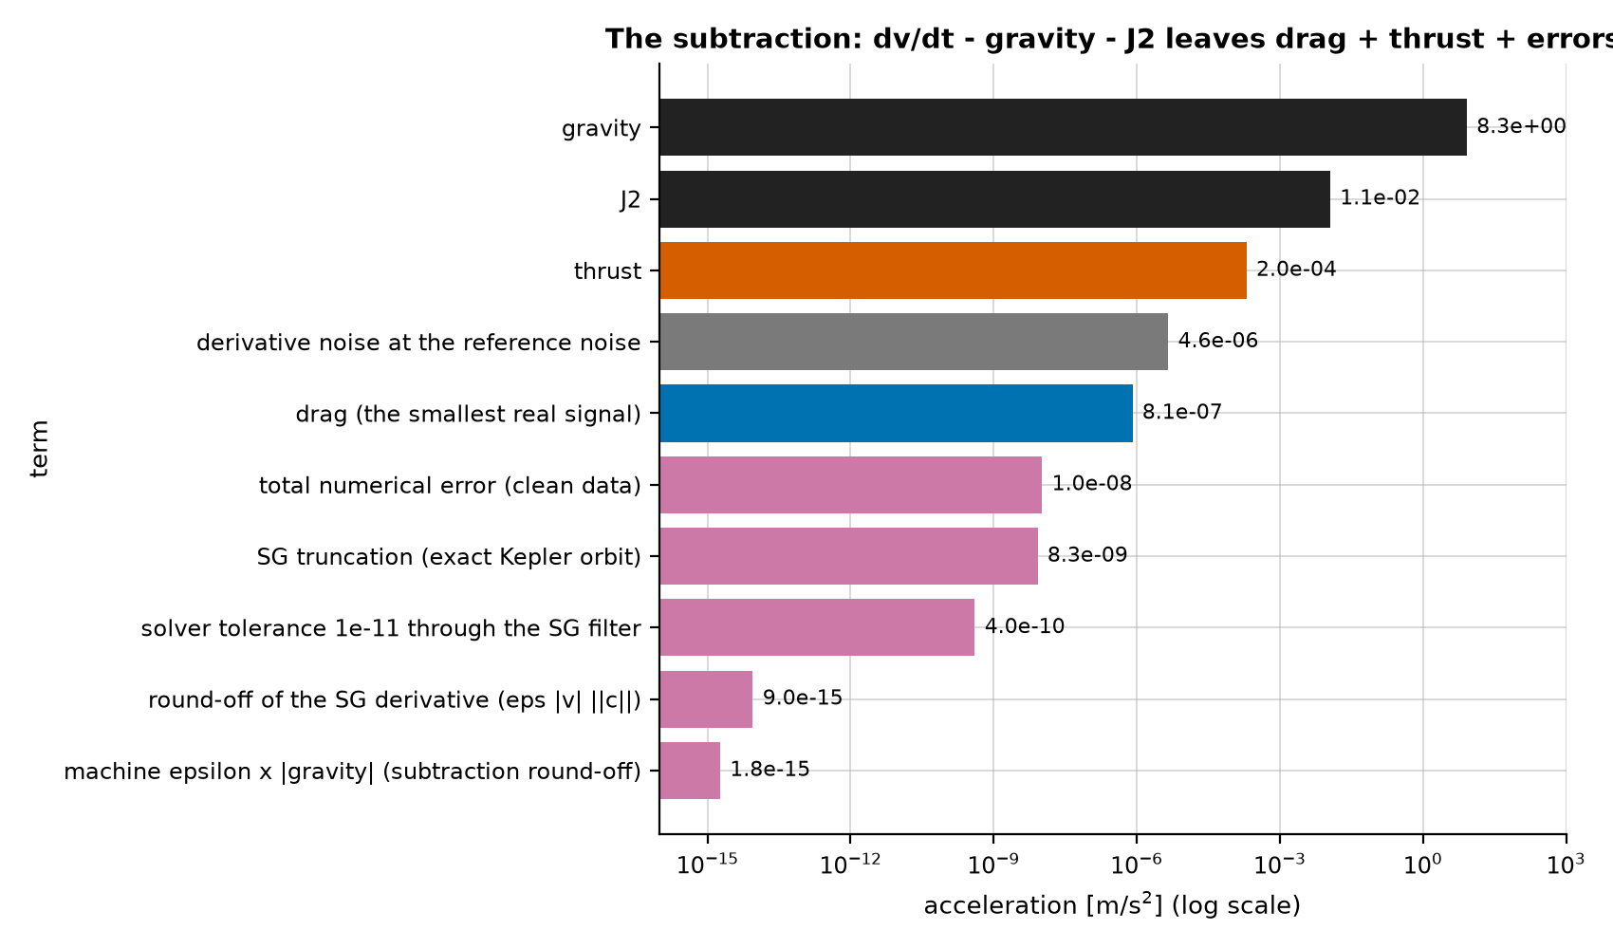
Stage 2: the unmodelled acceleration (subtraction)
def build_features(r, v, step_s, window=None, order=None, method=None):
h = step_s * SECONDS
window, order = window or tuned("sg_window"), order or tuned("sg_order")
r_second_derivative = savgol_filter(r, window, order, deriv=2, delta=h, axis=1)
v_first_derivative = savgol_filter(v, window, order, deriv=1, delta=h, axis=1)
modelled = known_accel(r) # gravity + J2
from_r = (r_second_derivative - modelled) * ACCEL_UNIT_MS2
from_v = (v_first_derivative - modelled) * ACCEL_UNIT_MS2
along = np.sum(from_v * v, axis=0) / np.linalg.norm(v, axis=0)
return Features(accel_from_r=from_r, accel_from_v=from_v, along_track=along)
a_u = dv/dt (measured) - [ -mu r / r^3 + a_J2 ]
a_u ~ drag (8e-7) + thrust (2e-4) + noise (4.6e-6) + numerics (1e-8)
Velocity-based (v') features: r'' of noisy positions is pure noise
Size of every term and error
Notes:
- Measured dv/dt minus modelled gravity and J2 leaves drag + thrust + noise + numerical error.
- This cancels seven decades (8.3 m/s^2 down to 8e-7), so numerical error was checked explicitly.
- Machine epsilon x |g| = 1.8e-15; SG truncation 8.3e-9; total numerical floor 1.0e-8 m/s^2.
- Floor is 80x below drag and 460x below the derivative noise at reference noise.
- So the GMM sees physics + measurement noise, not solver artefacts.

Slide 17
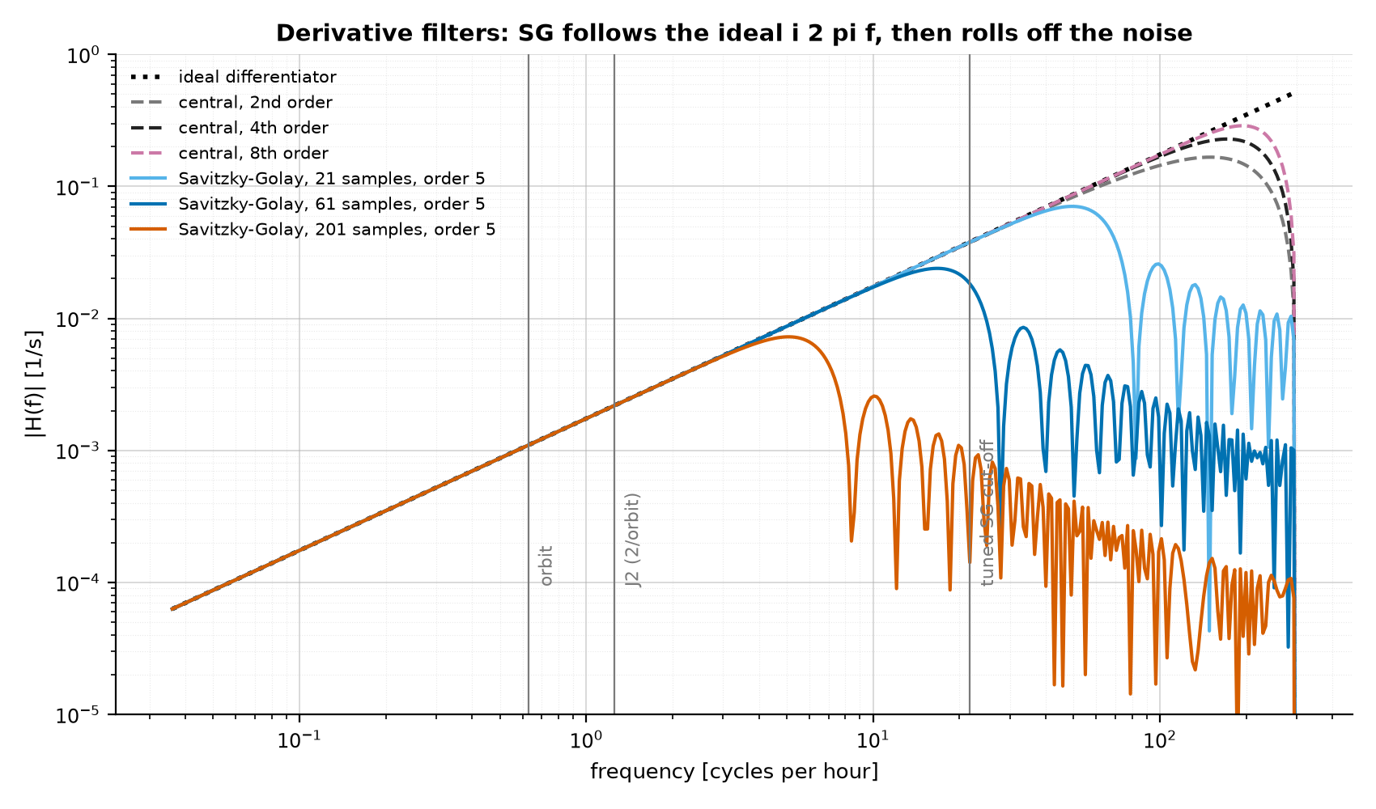
The derivative: Savitzky-Golay filtering
y'_k = sum_j c_j y_(k+j), c = row 1 of (A^T A)^-1 A^T, A_ji = (j h)^i
H(f) = sum_j c_j exp(2 pi i f j h); ideal = 2 pi i f
Exact for polynomials up to order p
Tuned: 61 samples (6 min), order 5 (bias-variance)
Cut-off ~ 2.8 min period; orbit and J2 lines far below it
Central differences keep amplifying noise to Nyquist
Frequency response of derivative filters (6-s data)
Notes:
- SG fits a degree-p polynomial to 2m+1 samples by least squares and differentiates it at the centre.
- Linear in the data, so it is a fixed convolution with known frequency response H(f).
- Exact for polynomials up to order p (no bias on the orbit), low-pass above the cut-off (rejects noise).
- Tuned 61 samples (6 min), order 5: cut-off ~2.8-min period; noise gain falls ~ window^-3/2.
- Cost: fast features (30-s thrust ramps) are smeared to ~60 s.

Slide 18
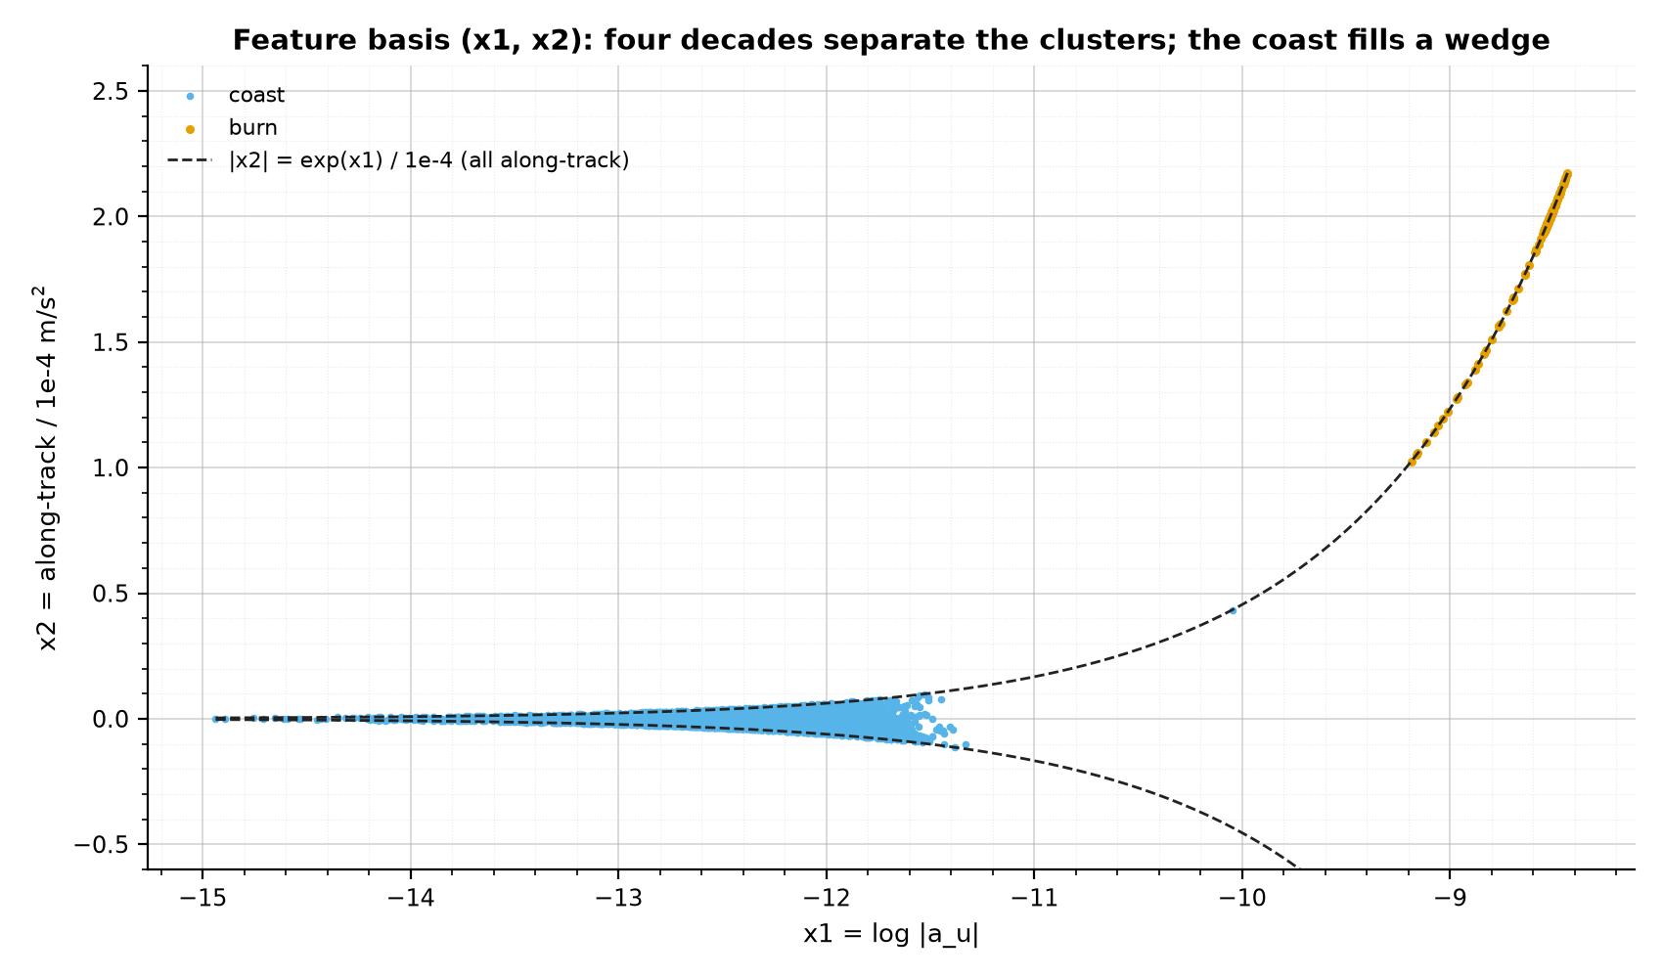
Features: a physics-based change of basis (x1, x2)
x1 = ln |a_u| (how much)
x2 = a_u . v_hat / 1e-4 m/s^2 (which way)
Wedge: |x2| <= exp(x1) / 1e-4
Burns: x2 ~ 2, all along-track
Coast: x2 ~ 0; its mean -0.009e-4 m/s^2 is the drag
Clusters ~4 decades apart in |a|
Samples in the (x1, x2) basis
Notes:
- Raw 3-D acceleration: coast (~1e-6) collapses to a dot next to burns (2e-4).
- x1 = ln|a_u|: compresses four decades so both clusters get comparable widths; frame independent.
- x2 = a_u . v_hat / 1e-4: thrust is along the velocity, noise points anywhere.
- Geometry: |x2| <= e^x1 / 1e-4, so data fill a wedge; burns sit on its upper edge.
- For isotropic noise the along-track share is uniform on [-1, 1] (Archimedes' hat-box theorem).

Slide 19
Code: the Gaussian mixture and the burn rule
def mixture_burn_components(model, n_sigma=3.0):
"""The heaviest component is coast. A component is burn if its mean log|v'|
sits more than n_sigma coast standard deviations above the coast mean."""
coast = int(np.argmax(model.weights_))
coast_sd = np.sqrt(np.atleast_2d(model.covariances_[coast])[0, 0])
return model.means_[:, 0] > model.means_[coast, 0] + n_sigma * coast_sd
def fit_gmm(X_train, n_components=None):
n_components = n_components or tuned("gmm_components") # 4
model = GaussianMixture(n_components=n_components, n_init=3, random_state=0).fit(X_train)
burn = mixture_burn_components(model)
return lambda X: burn[model.predict(X)].astype(int), model
def group_into_events(flags, max_gap=MAX_GAP_SAMPLES, min_samples=MIN_EVENT_SAMPLES):
"""Fill short gaps inside runs, then drop runs shorter than min_samples."""
events = np.asarray(flags, dtype=int).copy()
for first, last in _runs(1 - events): # runs of 0s
is_inside = first > 0 and last < len(events) - 1
if is_inside and last - first + 1 <= max_gap:
events[first:last + 1] = 1
for first, last in _runs(events):
if last - first + 1 < min_samples:
events[first:last + 1] = 0
return events
EM: E-step gamma_ik = pi_k N_k / sum_j pi_j N_j
M-step: pi_k, mu_k, Sigma_k from weighted samples
P(burn | x) = sum of burn responsibilities
K = 4, n_init = 3, 20k TRAIN samples
Events: max gap 2, min length 10 samples
Notes:
- GMM: p(x) = sum_k pi_k N(x; mu_k, Sigma_k), fitted by EM on 20,000 TRAIN samples (3 restarts).
- E-step: responsibilities gamma_ik; M-step: weighted weights, means and covariances.
- Unsupervised: never sees labels. K = 4 chosen by Brier score / event F1 (step 0).
- Burn rule: a component is 'burn' if its mean x1 is > 3 coast standard deviations above the coast mean.
- Flags become events: fill gaps <= 2 samples, drop runs < 10 samples (1 min); score per event (+-60 s).

Slide 20
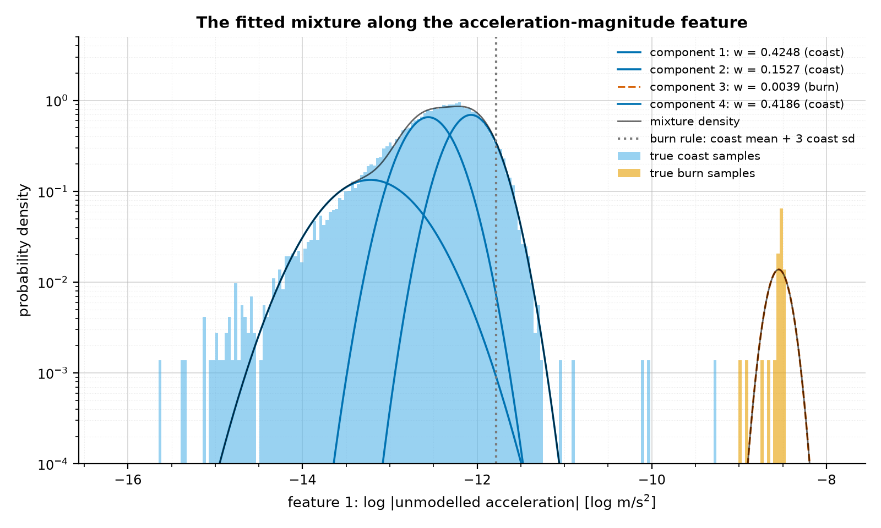
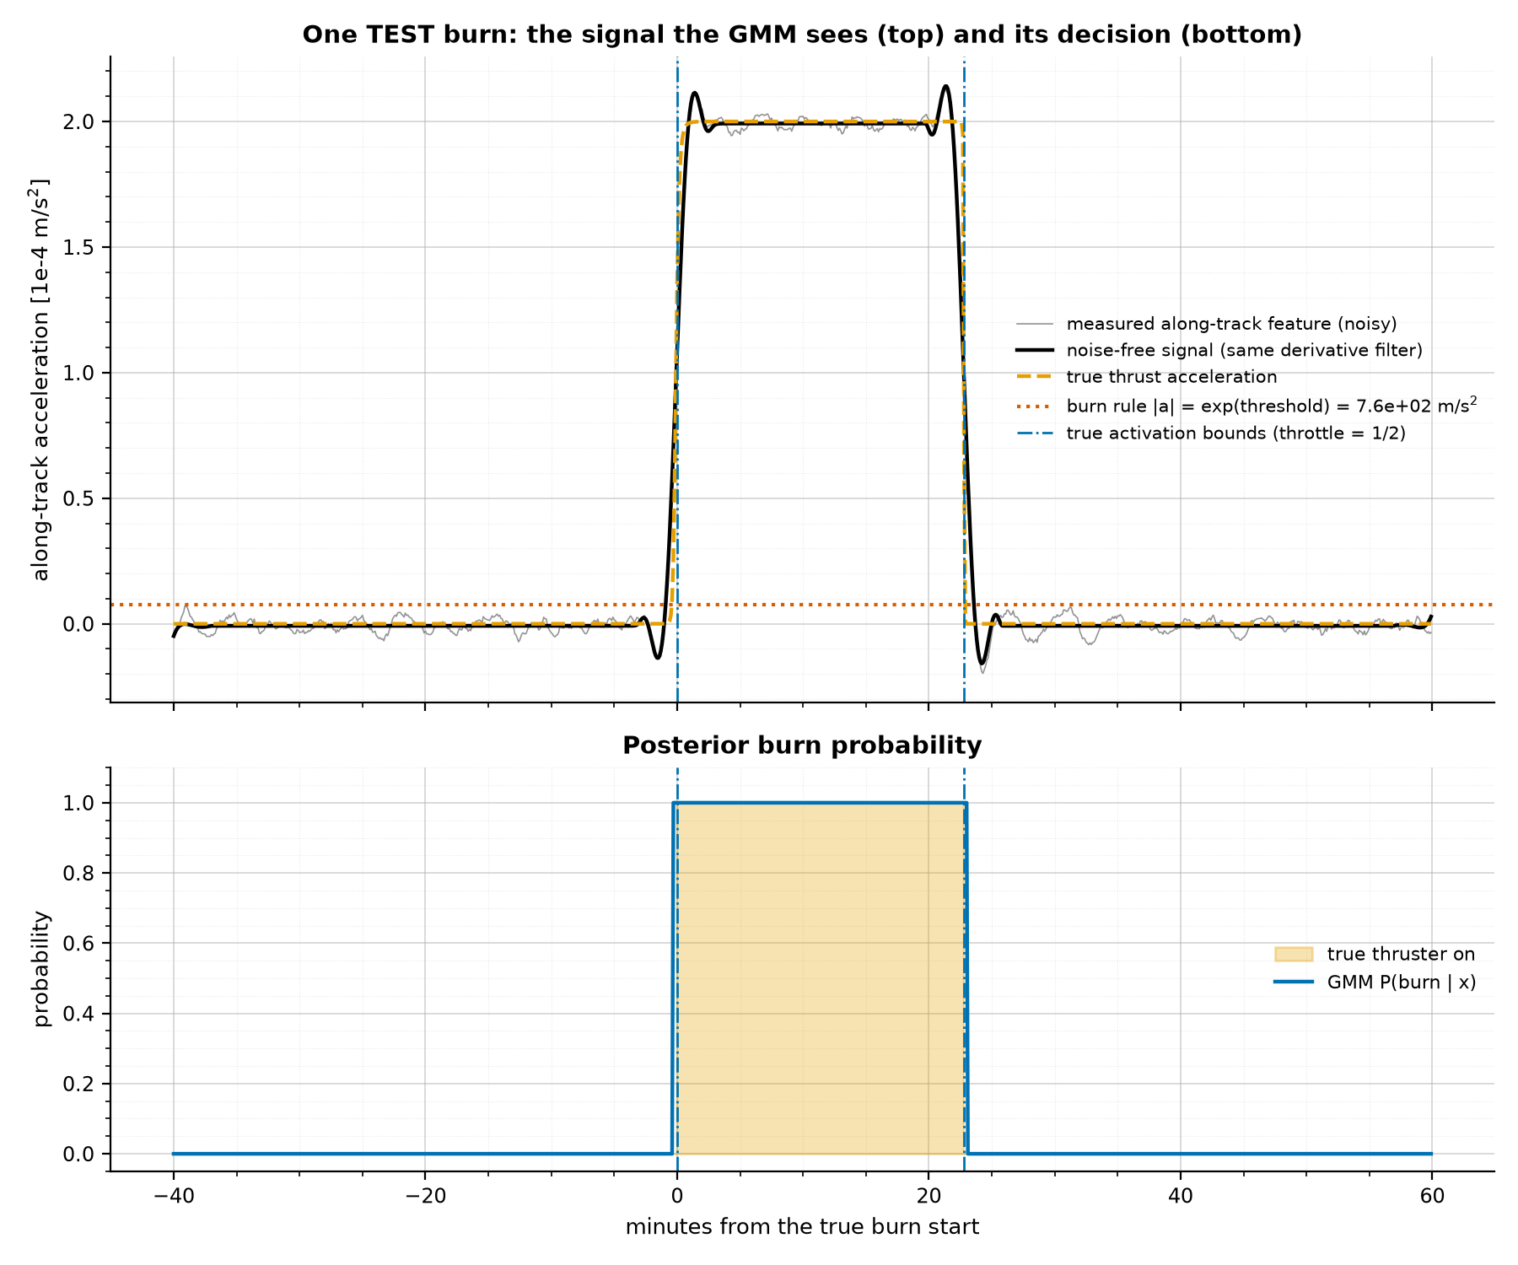
GMM results: four components, perfect event detection
Mixture along x1 (log density)
92/92 burns, 0 false events, F1 = 1.0
Burn weight 0.0039 vs duty cycle 0.0041
k-means: F1 0.001 with noise
One TEST burn: signal (top) and P(burn) (bottom)
Notes:
- Fitted components: three coast components (weights 0.42, 0.15, 0.42) and one burn component (0.0039).
- Check: burn weight should equal the duty cycle 1368 s / 3.905 d = 0.0041.
- 92 / 92 TEST burns, 0 false events, F1 = 1.0; mean start-time error 14 s at reference noise.
- 499 false-positive samples out of 5.18 million, all on thrust ramps; they merge into true events.
- Alternatives: Bayesian GMM and MAD threshold 1.0; Isolation Forest 0.85; k-means 0.001 (136,662 false events).

Slide 21
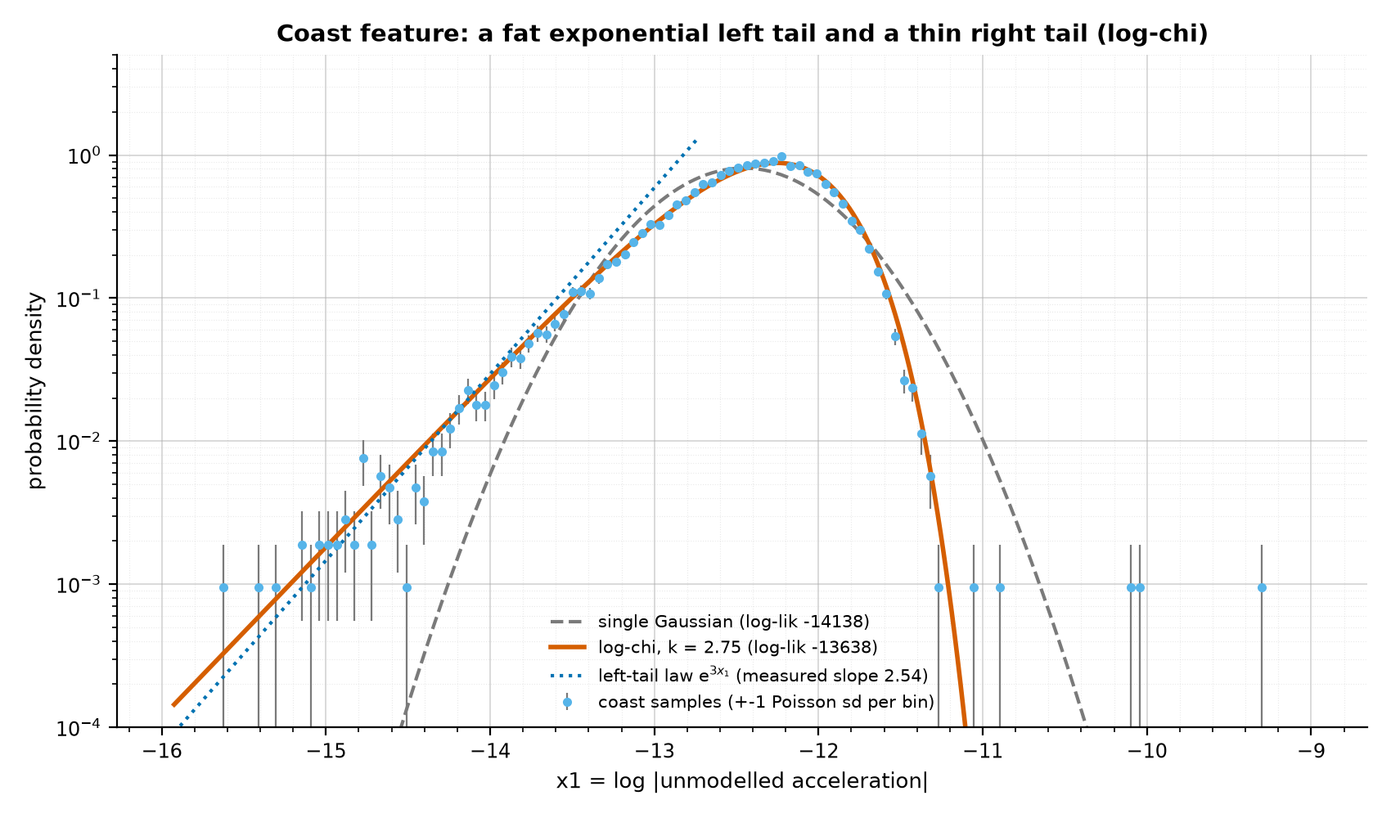
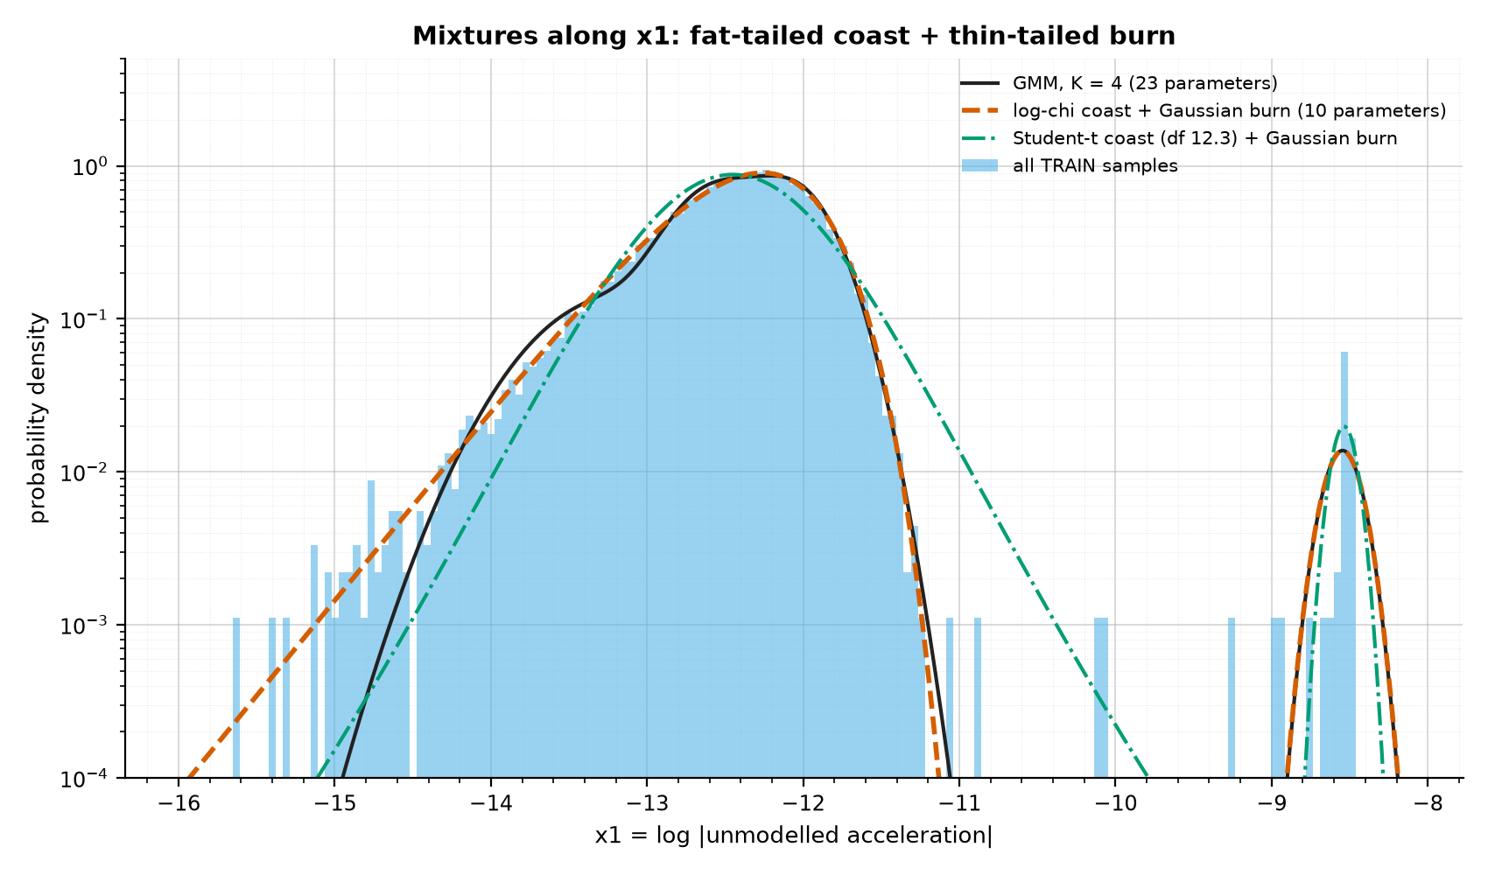
Why the coast cloud is fat-tailed, and better mixtures
Coast x1 with Poisson error bars
GMM vs log-chi vs Student-t mixtures
Model | Params | BIC | Test log-lik / sample | False samples
GMM, K = 4 (used) | 23 | -67,079 | 1.689 | 499
GMM, K = 7 | 41 | -68,454 | 1.728 | 463
log-chi coast + Gaussian burn | 10 | -67,804 | 1.706 | 492
Student-t coast + Gaussian burn | 12 | -60,509 | 1.523 | 0
Notes:
- If coast noise is 3-D Gaussian, |n|/sigma ~ chi_3 and x1 = ln|n| is log-chi distributed.
- Log-chi: left tail ~ exp(k x1) (fat, exponential), right tail ~ exp(-e^(2 x1)) (thinner than Gaussian).
- Data: skewness -0.89, left-tail slope 2.54 (theory 3), fitted k = 2.75; beats a Gaussian by 500 in log-likelihood.
- Physics mixture (log-chi coast + Gaussian burn, 10 parameters) beats the 23-parameter K = 4 GMM on BIC.
- BIC = -2 ln L + p ln n keeps falling with K because extra Gaussians only re-shape the skewed coast.

Slide 22
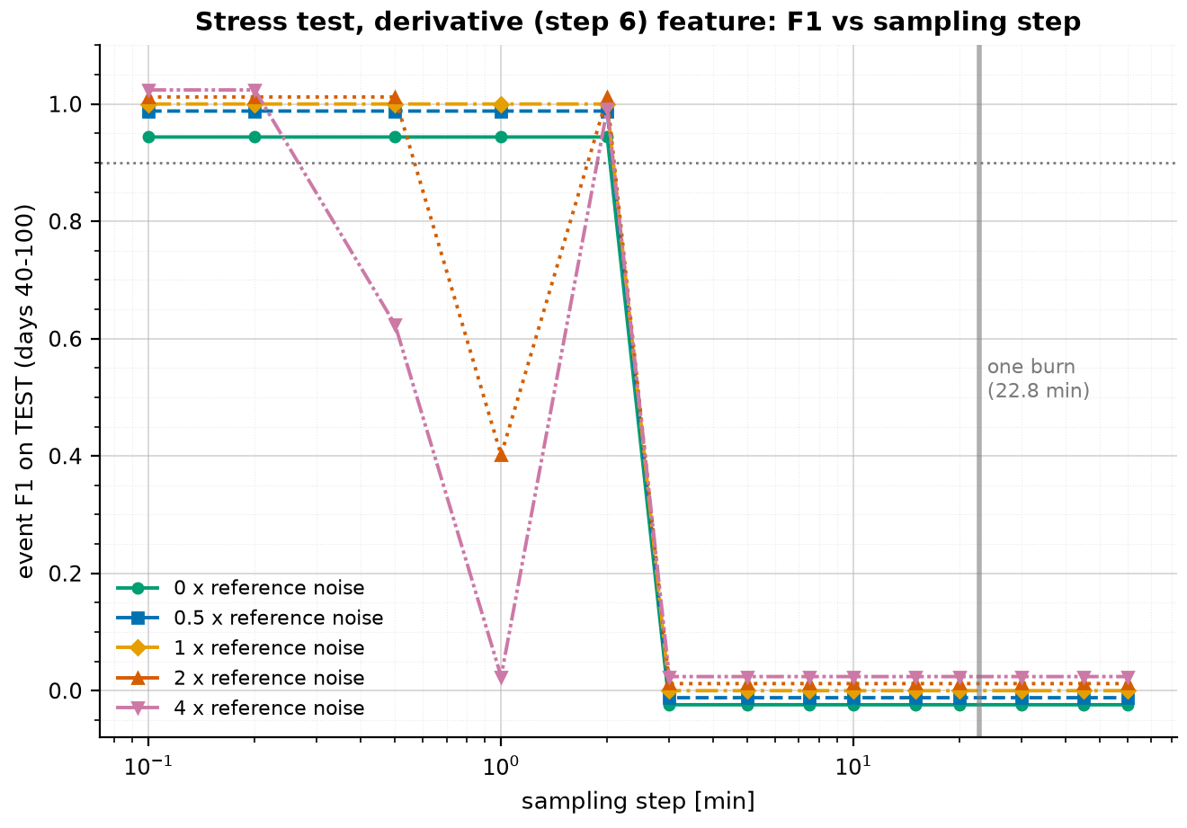
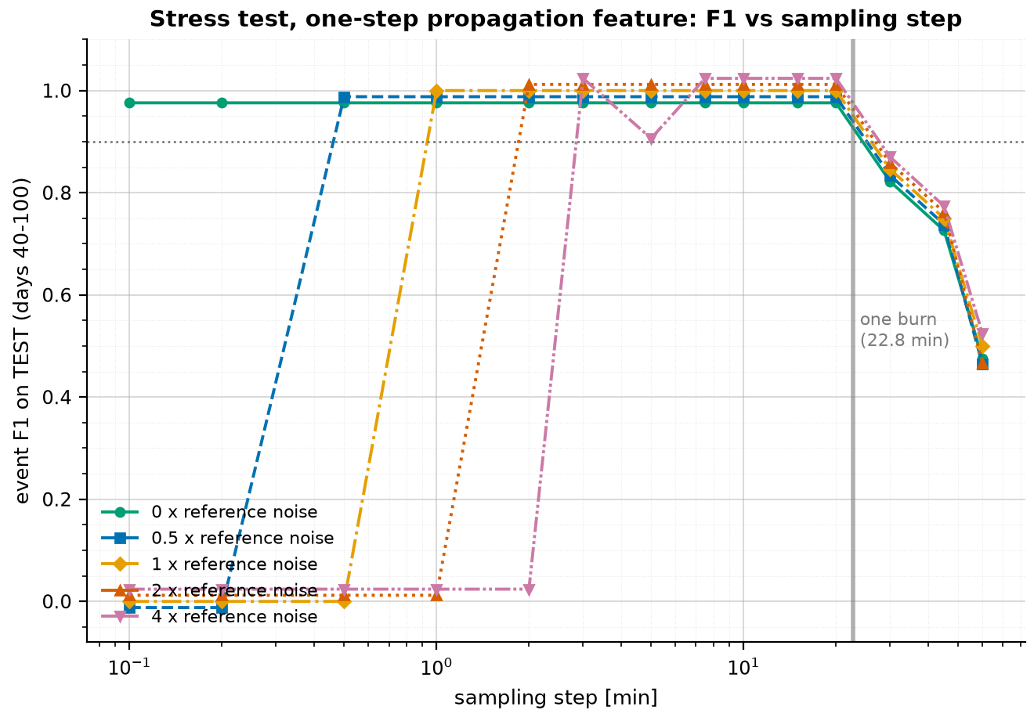
Detection robustness: noise and sampling step
def propagate_rk4(r, v, h, substep):
"""Every column of (r, v) propagated by h under gravity + J2 only."""
n = max(1, int(np.ceil(h / substep)))
dt = h / n
for _ in range(n):
k1r, k1v = v, known_accel(r)
k2r, k2v = v + 0.5 * dt * k1v, known_accel(r + 0.5 * dt * k1r)
k3r, k3v = v + 0.5 * dt * k2v, known_accel(r + 0.5 * dt * k2r)
k4r, k4v = v + dt * k3v, known_accel(r + dt * k3r)
r = r + dt / 6 * (k1r + 2 * k2r + 2 * k3r + k4r)
v = v + dt / 6 * (k1v + 2 * k2v + 2 * k3v + k4v)
return r, v
# feature: a = (v[k+1] - v_propagated[k -> k+1]) / h
SG derivative feature
SG feature: 6 s - 2 min
Propagation feature: ~1 - 20 min
Whole chain: F1 = 1.0 from 6 s to 10 min
One-step propagation feature
Notes:
- GMM keeps F1 = 1.0 from 0.25x to 8x the reference noise (0.1 m, 0.5 mm/s) at 6-s sampling.
- SG derivative feature works up to a 2-min step (curvature truncation dominates beyond).
- One-step propagation feature: propagate each state one step under gravity + J2 (RK4) and compare.
- Its noise scales as 1/h, so it works from ~1 to 20 min; switching at 2 min covers 6 s-20 min up to 2x noise.
- Limit: at 4x noise there is a gap near 1 min; above one burn length (23 min) a burn is diluted.

Slide 23
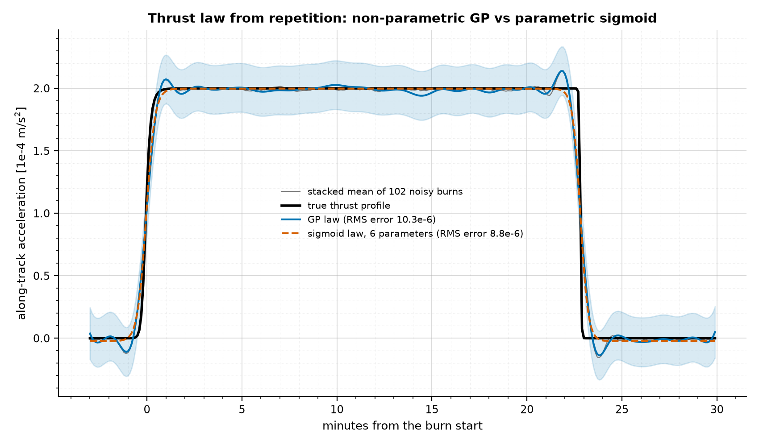
Stage 3a: the thrust law from repetition (GP and sigmoid)
def fit_thrust_law(stack, max_points=GP_MAX_POINTS): # 1500
offsets = np.tile(stack.offsets_s, len(stack.windows))
values = stack.windows.ravel()
pick = np.random.default_rng(0).choice(offsets.size,
size=min(max_points, offsets.size), replace=False)
scale = np.std(values)
kernel = ConstantKernel(1.0) * RBF(length_scale=60.0) \
+ WhiteKernel(noise_level=0.5)
gp = GaussianProcessRegressor(kernel=kernel, normalize_y=True,
random_state=0)
gp.fit(offsets[pick, None], values[pick] / scale)
mean, std = gp.predict(stack.offsets_s[:, None], return_std=True)
Why GP: no assumed shape, uncertainty band, O(n^3) so subsample
Why sigmoid: same form as the simulator law, 6 parameters
RMS vs truth: GP 1.03e-5, sigmoid 0.88e-5 m/s^2
Stacked burns: truth, GP, sigmoid
Notes:
- Autocorrelation of the along-track signal peaks at 3.9051 days, the true period.
- Stack all detected burns on their start time: noise falls as 1/sqrt(N) to a smoothing floor.
- GP (RBF + white kernel, hyper-parameters by marginal likelihood, 1500 random samples): plateau 0.999 of truth, duration exact.
- 6-parameter sigmoid law P sigma((t-t_on)/r) sigma((t_off-t)/f) + b fits 14% better (RMS) and is interpretable.
- Learned rise time 60 s vs true 30 s: the derivative filter, not the thruster.

Slide 24
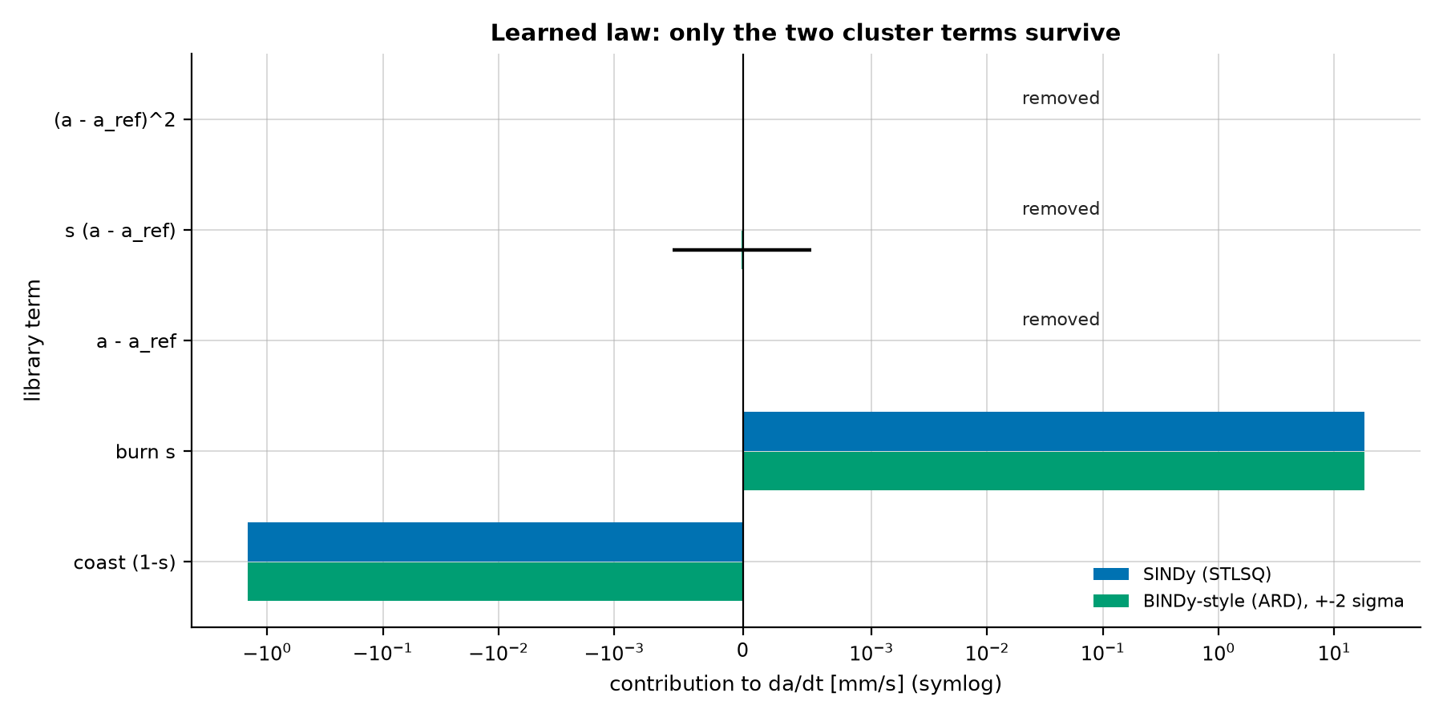
Stage 3b: SINDy and BINDy for the rate laws
def stlsq(theta, target, threshold=None, iterations=10):
"""Sequentially thresholded least squares on unit-scaled columns."""
threshold = threshold if threshold is not None else tuned("stlsq_threshold")
scale = np.linalg.norm(theta, axis=0)
empty = scale == 0
scale = np.where(empty, 1.0, scale)
X = theta / scale
active = ~empty
xi = np.zeros(X.shape[1])
for _ in range(iterations):
xi[:] = 0
xi[active] = np.linalg.lstsq(X[:, active], target, rcond=None)[0]
new_active = np.abs(xi) >= threshold * np.max(np.abs(xi))
if np.array_equal(new_active, active):
break
active = new_active
return xi / scale
def _ard(X, y): # BINDy-style: posterior mean and std of every coefficient
scale = np.sqrt(np.mean(X**2, axis=0))
y_scale = np.std(y) or 1.0
model = ARDRegression(fit_intercept=False).fit(X / scale, y / y_scale)
SINDy / BINDy coefficients
Notes:
- SINDy: da/dt = Theta(a, s) xi, solved by sequentially thresholded least squares on unit-scaled columns.
- Physics library [D, B, 1] is singular over a 500 m band (correlation 0.997): use cluster indicators [1-s, s, ...].
- STLSQ keeps only the coast and burn terms: c_d 1.0005, T 0.9997 of the truth.
- BINDy here = ARD regression: Gaussian priors with learned precisions give posterior standard deviations.
- Threshold 0.05 chosen by test MSE of the predicted rate (step 0).

Slide 25
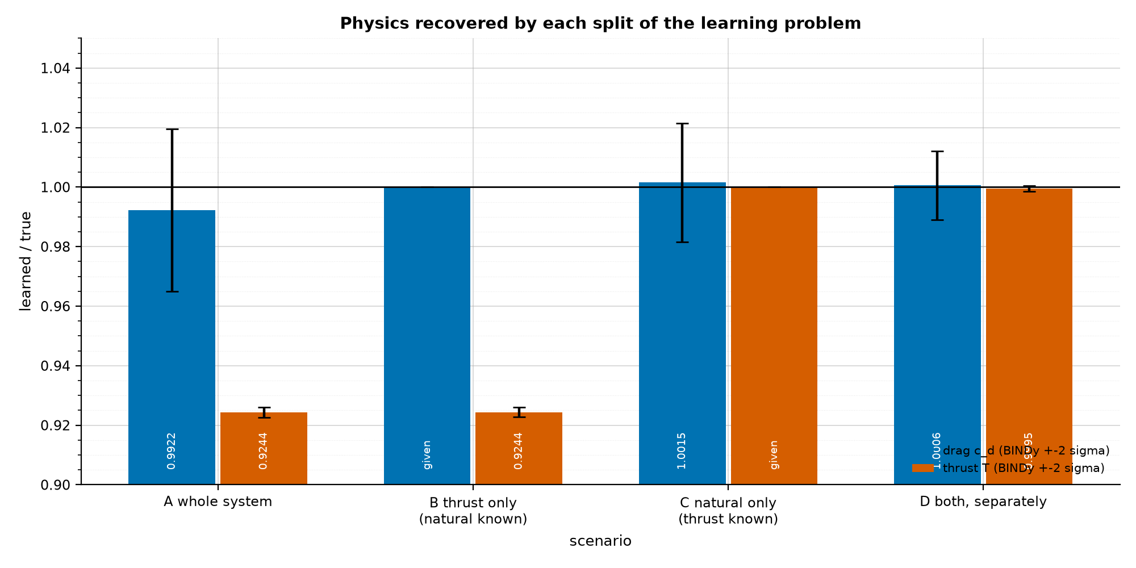
Learning the thrust and natural laws together or apart
Scenario | c_d / true | T / true | Period [d] | Error 15 d | Error 120 d | Error 360 d
A whole system | 0.9922 | 0.924 | 3.9351 | 107 min | 691 min | 1668 min
B natural known | given | 0.924 | 3.9047 | 2.4 min | 9.4 min | 26 min
C thrust known | 1.0015 | given | 3.9005 | 15 min | 103 min | 302 min
D both, separately | 1.0006 | 0.9995 | 3.9011 | 13 min | 89 min | 262 min
Truth | 1 | 1 | 3.9051 | - | - | -
Split learning removes the edge-leakage bias
Knowing c_d matters more than knowing T
The coast is 99.6% of every cycle
c_d and T per scenario (BINDy +-2 sigma)
Notes:
- A: one regression over all samples with detected thruster flags; B: c_d known; C: thrust known; D: both on clean arcs.
- Joint regression A is biased: ramp samples mislabelled, T -7.6%, c_d -0.8%, 1668 min after a year.
- D (split on clean arcs): c_d +0.06%, T -0.05%; 262 min after a year.
- B (natural law known) is best: 26 min, even though its T is 7.6% low.
- Lesson: the coast is 99.6% of each cycle, so the natural (drag) law governs the forecast.

Slide 26
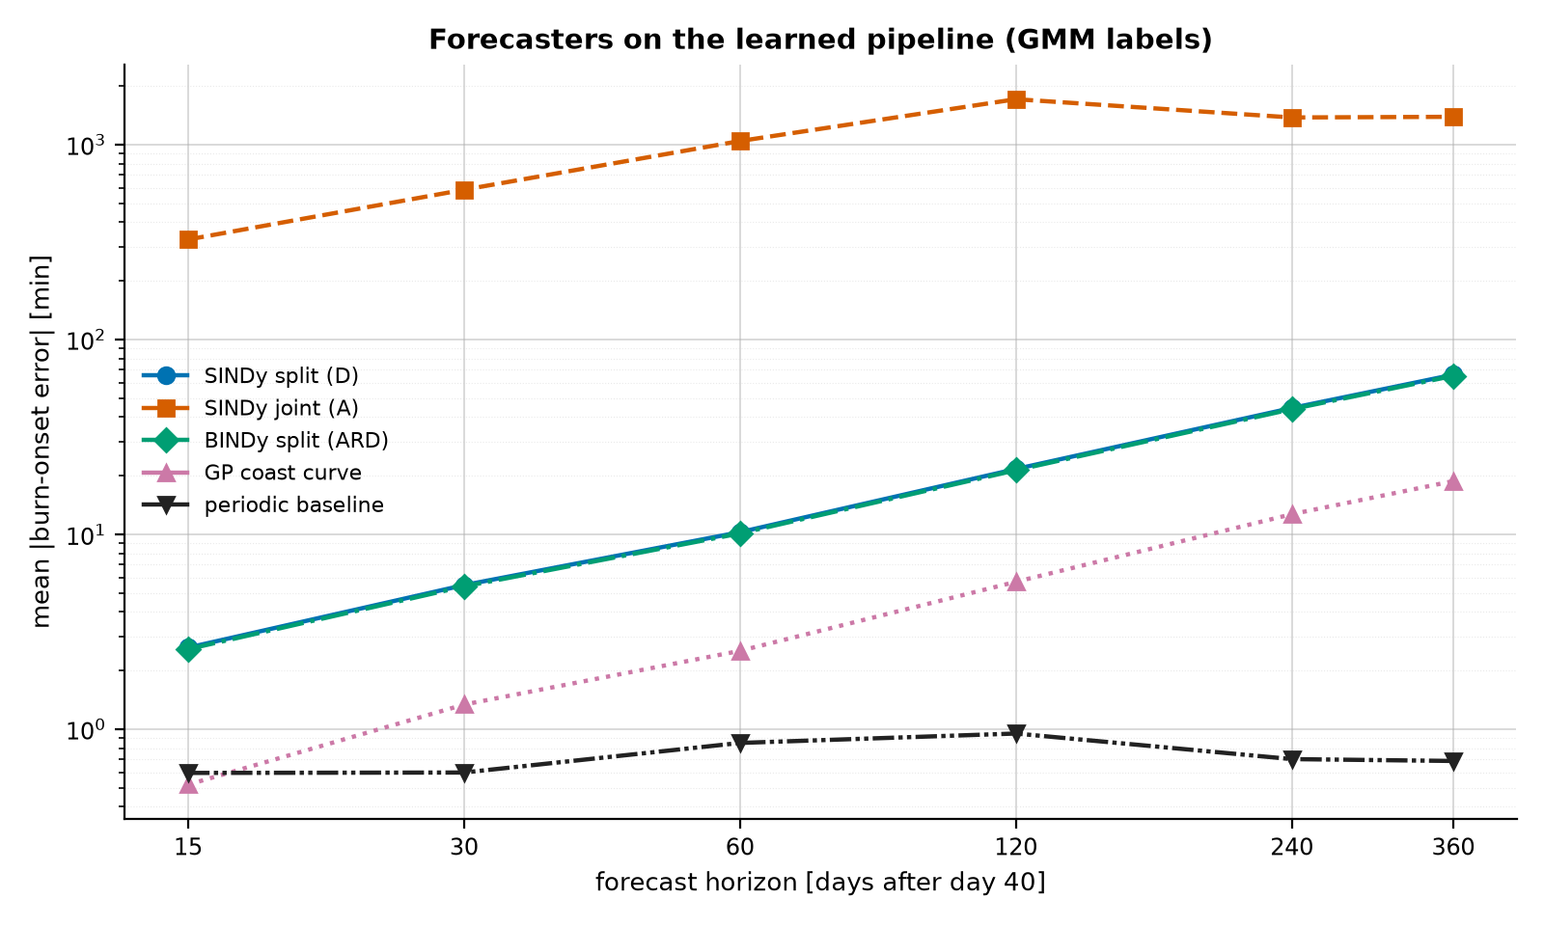
The switching law and the forecast
def hysteresis_states(a, lower, upper, s0=0):
"""The deadband WITH memory: on below lower, off above upper, else keep."""
s = np.zeros(len(a), dtype=int)
state = s0
for i, value in enumerate(a):
if value <= lower:
state = 1
elif value >= upper:
state = 0
s[i] = state
return s
def law_forecast(law, shapes, start_day):
D_bar, B_bar = shapes
width = law.upper_km - law.lower_km
coast_rate = law.cd * D_bar * DU / TU * DAY # km/day
burn_rate = (law.T * B_bar - law.cd * D_bar) * DU / TU * DAY
period = width / coast_rate + width / burn_rate
first = start_day + width / coast_rate
return first + period * np.arange(0, int(400 / period) + 2), period
Forecasters on the fully learned chain
Notes:
- Edges: SMA read a settle time before each detected burn start (lower) and after each end (upper).
- Hysteresis states: on at or below the lower edge, off at or above the upper, otherwise keep the last state.
- Law forecast: coast time = band / coast rate, burn time = band / net burn rate; onsets every period.
- Forecasters compared: split law, joint law, BINDy, GP coast curve, periodic schedule.
- Constant drag: periodic 0.7 min, GP 19 min, split law 66 min, joint law 1391 min at 360 days.

Slide 27
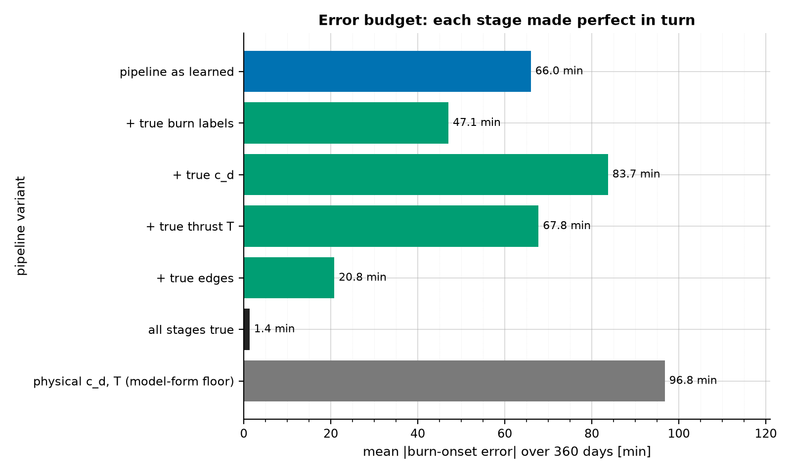
End-to-end error budget: which stage limits the forecast?
Pipeline as learned: 66 min at 360 d
+ true edges: 21 min
+ true labels: 47 min
+ true c_d: 84 min (compensating errors)
All true: 1.4 min (sanity check)
Edges learned to ~2 m (0.4% of the band) = 22 min of coast
Forecast error with each stage made perfect
Notes:
- Run everything learned, then swap the truth into one stage at a time (6-s data, reference noise).
- All stages true: 1.4 min after 360 days (sanity check of the method).
- True edges: 66 -> 21 min; true burn labels: 66 -> 47 min. Edges dominate.
- True c_d alone makes it worse (84 min): the small c_d error was cancelling the edge error.
- Stage accuracies: c_d +0.029%, T -0.005%, edges -2.2 / -2.4 m, F1 1.000.

Slide 28
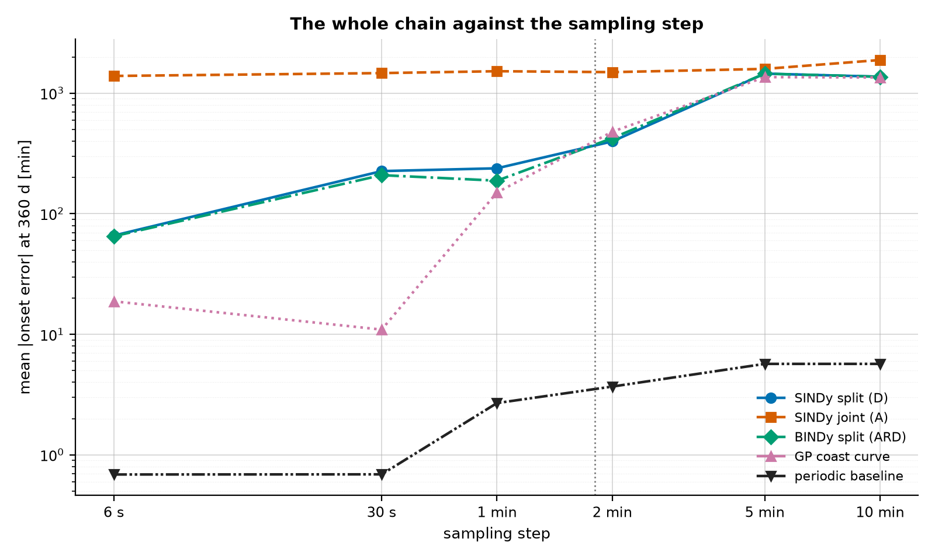
Sampling robustness of the whole chain (6 s to 10 min)
Step | F1 | c_d err | T err | Lower edge | Law 360 d | GP 360 d
6 s | 1.000 | +0.029% | -0.00% | -2.2 m | 66 min | 19 min
30 s | 1.000 | +0.065% | +0.02% | -2.3 m | 226 min | 11 min
1 min | 1.000 | +0.074% | -0.07% | -2.3 m | 238 min | 150 min
2 min | 1.000 | +0.007% | +0.04% | -3.3 m | 398 min | 479 min
5 min | 1.000 | +0.071% | -4.81% | +5.2 m | 1455 min | 1361 min
10 min | 1.000 | +0.077% | -8.65% | +13.9 m | 1371 min | 1352 min
Year-ahead error vs sampling step
Notes:
- Same 400 days re-sampled at 6 s, 30 s, 1, 2, 5, 10 min; SG feature below 2 min, propagation above.
- Detection: F1 = 1.0 at every step.
- c_d within 0.08% at every step: the mean SMA averages the noise of every sample.
- Edges and T degrade from 5 min (few samples per 23-min burn): forecast error grows.
- The periodic schedule stays best here only because drag is constant.

Slide 29
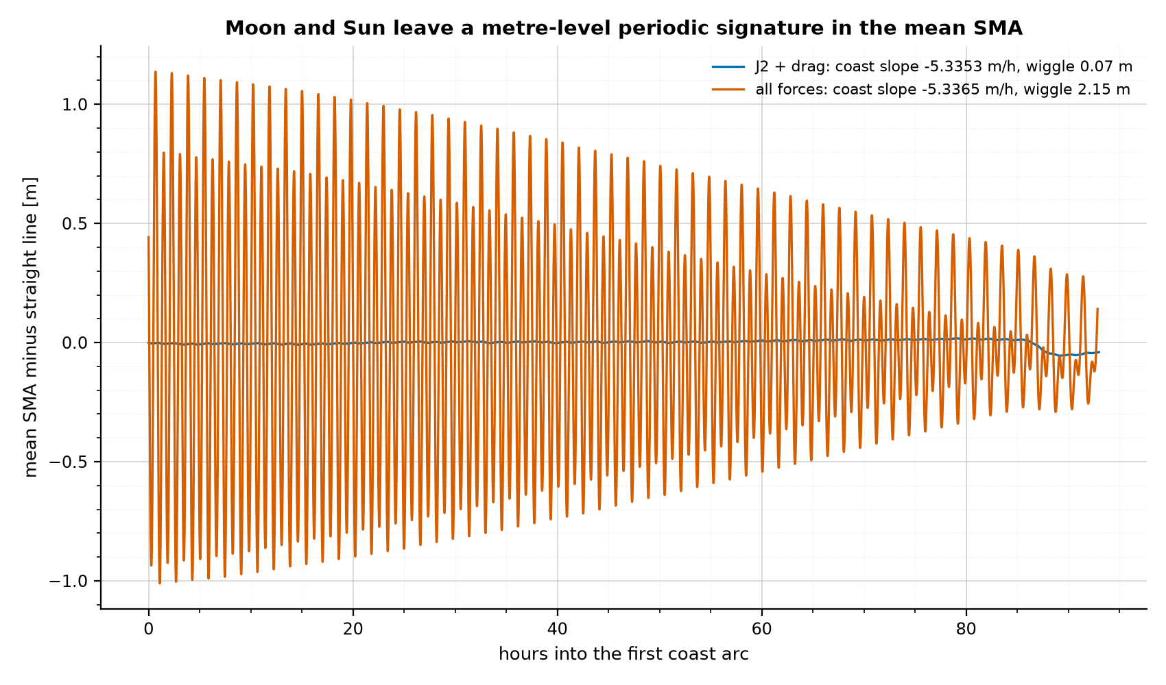
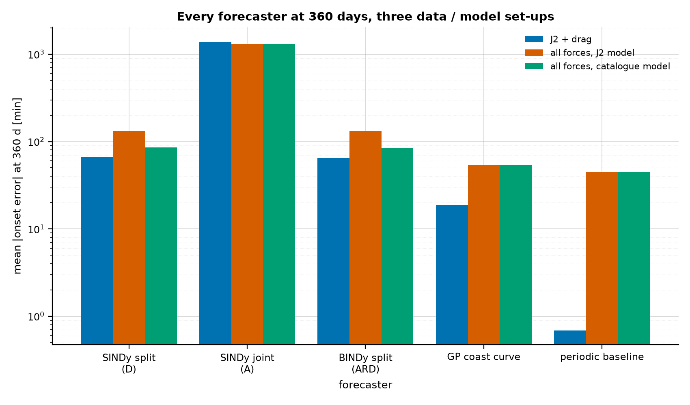
Every force in the loop: Moon, Sun and SRP
Mean SMA minus its trend on a coast arc
Every forecaster at 360 days, three set-ups
360-day onset error | J2 + drag | All forces, J2 model | All forces, catalogue model
Split law (SINDy D) | 66 min | 132 min | 86 min
GP coast curve | 19 min | 54 min | 54 min
Periodic schedule | 0.7 min | 45 min | 45 min
Notes:
- Second 400-day controlled run with J2 + drag + Moon + Sun + SRP (correct absolute time per chunk).
- Moon (9.3e-7), Sun (4.2e-7), SRP (1.1e-7 m/s^2) are drag-sized; they add a 2.1 m wiggle to the mean SMA.
- Detection unchanged (F1 = 1.0); burn period 3.9034 d instead of 3.9051 d.
- Split-law forecast 66 -> 132 min at 360 d; subtracting a catalogue Moon/Sun/SRP model gives 86 min.
- Even the periodic schedule drifts (45 min): a constant-rate law cannot follow periodic modulation.

Slide 30
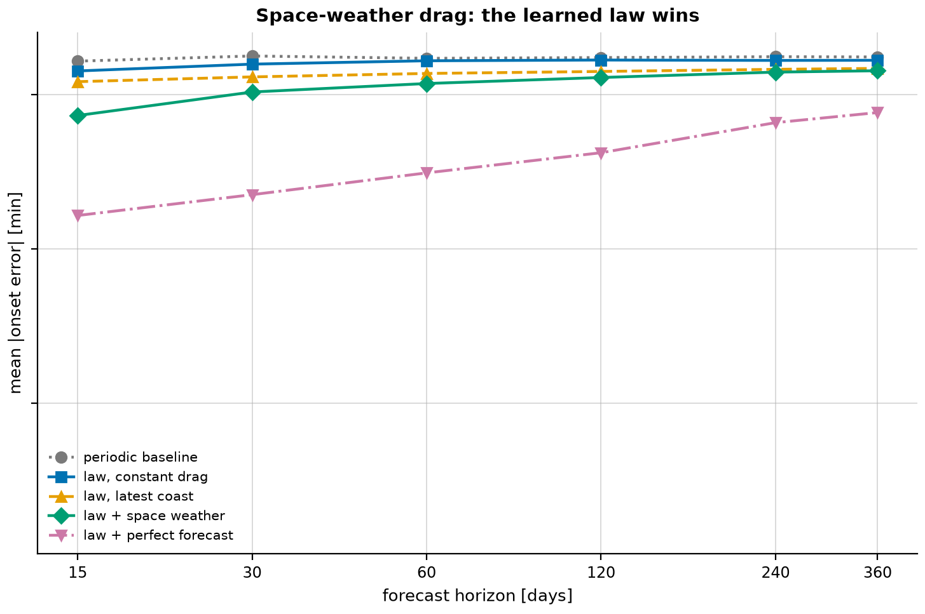
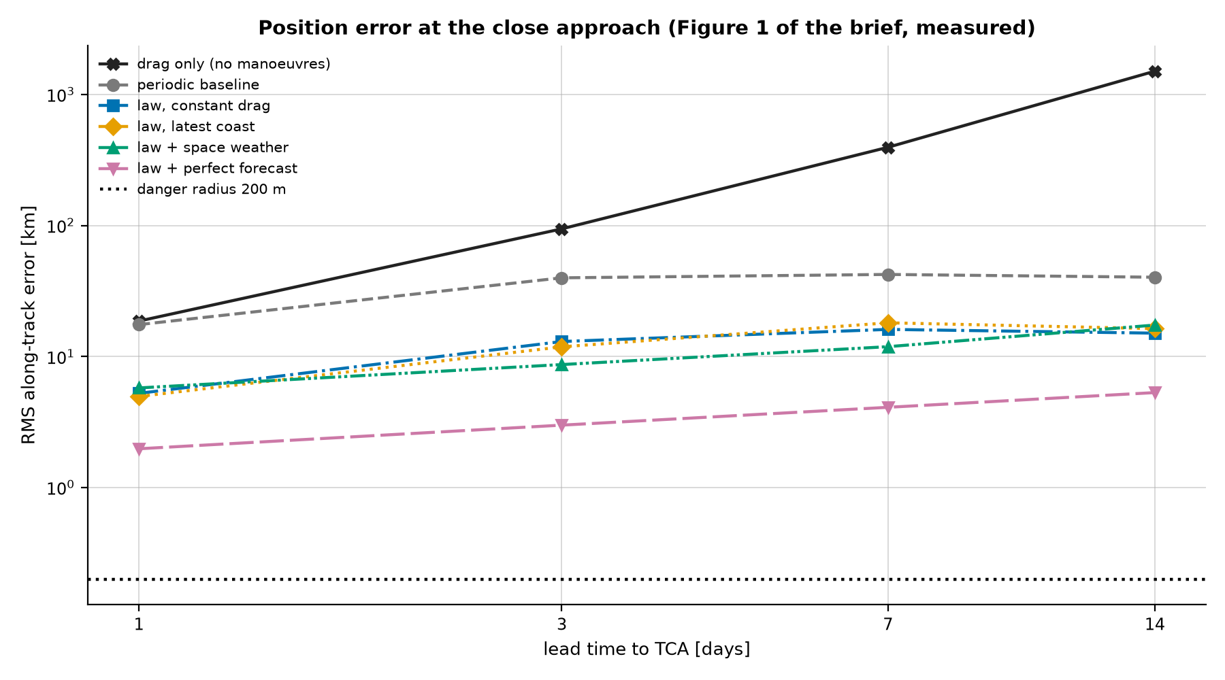
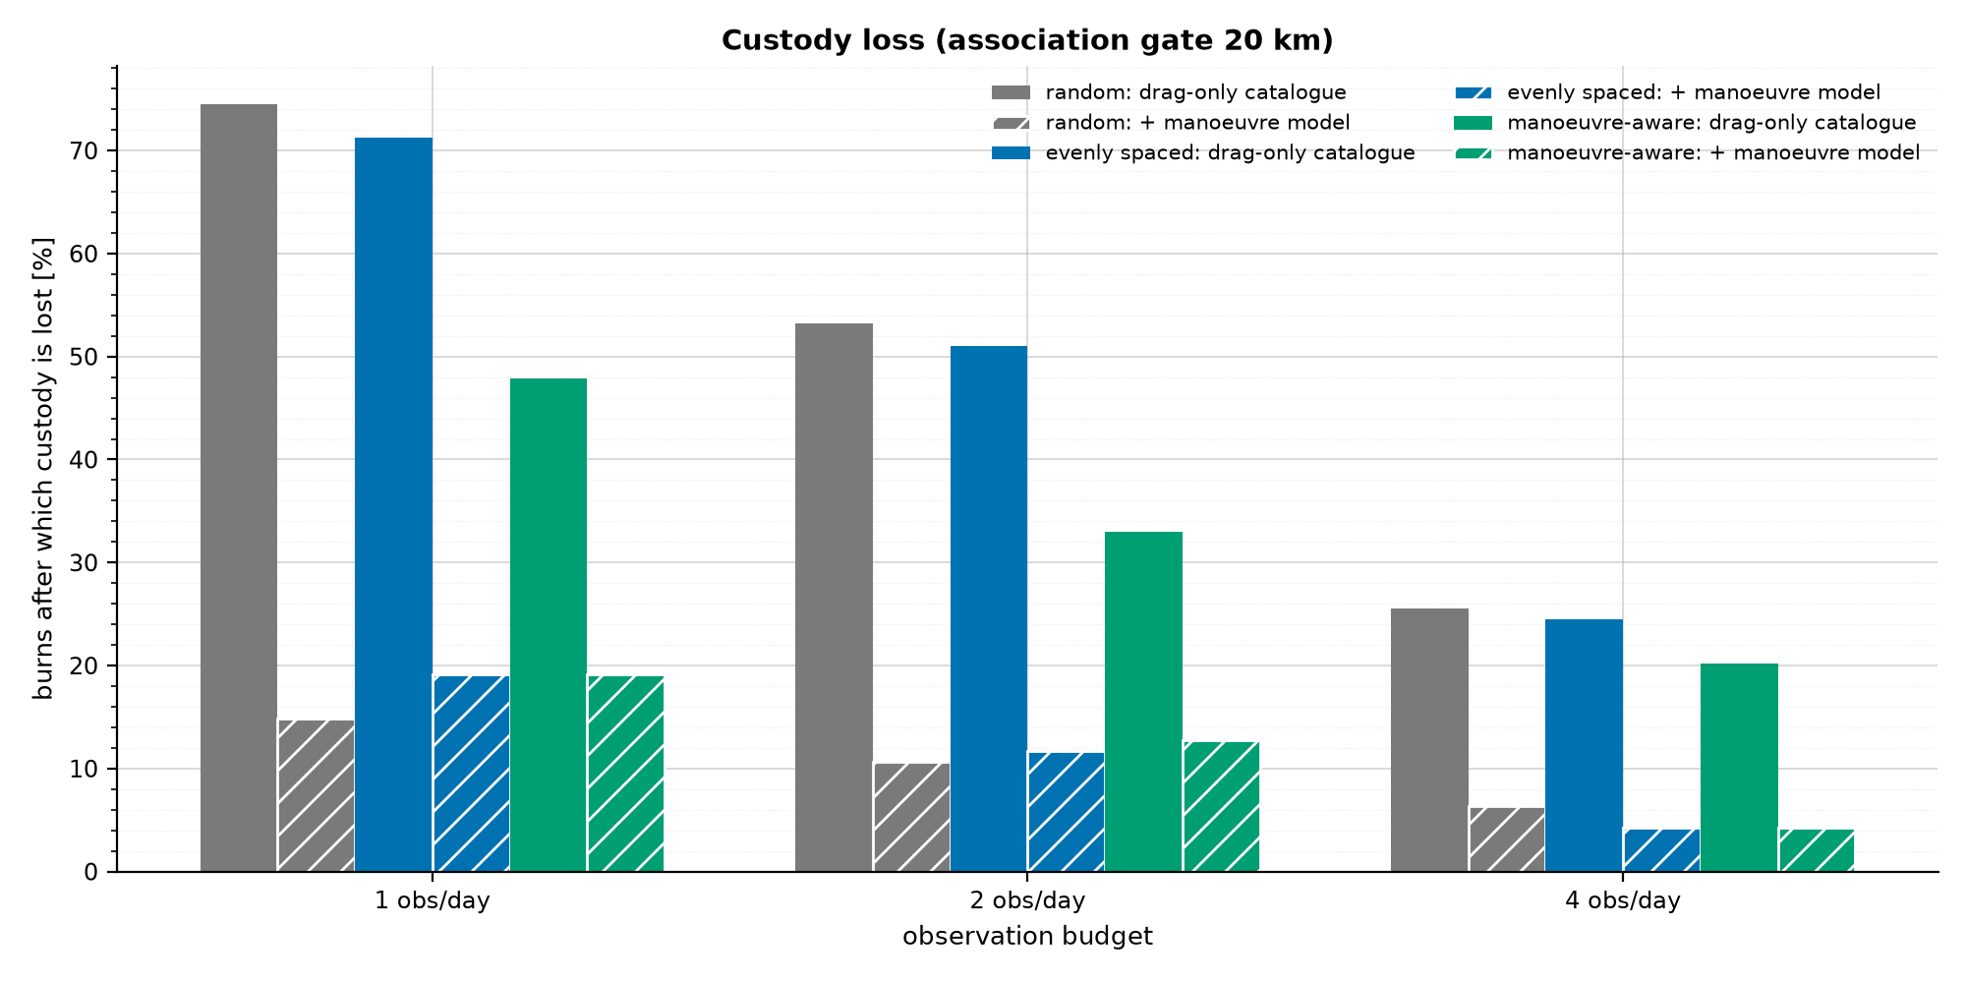
Towards operations: space weather, screening and tasking
Space-weather drag: forecast error
Along-track error vs prediction time
Custody lost after a burn
Variable drag changes the burn interval, not the edges: the learned law wins over a schedule
Missed dangerous conjunctions at 1 day: 68% (drag-only) → 25% (best model)
Also: tracking passes, several control laws, fleet change detection, GEO station keeping
Notes:
- Fast mean-element model calibrated on the full run (period within 0.01%) for hundreds of scenarios.
- Space-weather drag: periodic schedule 1642 min at 15 d; law + drag proxy 730 min; perfect forecast 164 min.
- Screening: along-track error at 7 d drag-only 396 km vs 11.9 km with the learned law + space weather.
- Tasking: custody lost after a burn 74% (1 random obs/day) -> 15-19% with the predicted burn in the catalogue.
- Conformal 90% intervals cover 93-99% of new burns.

Slide 31
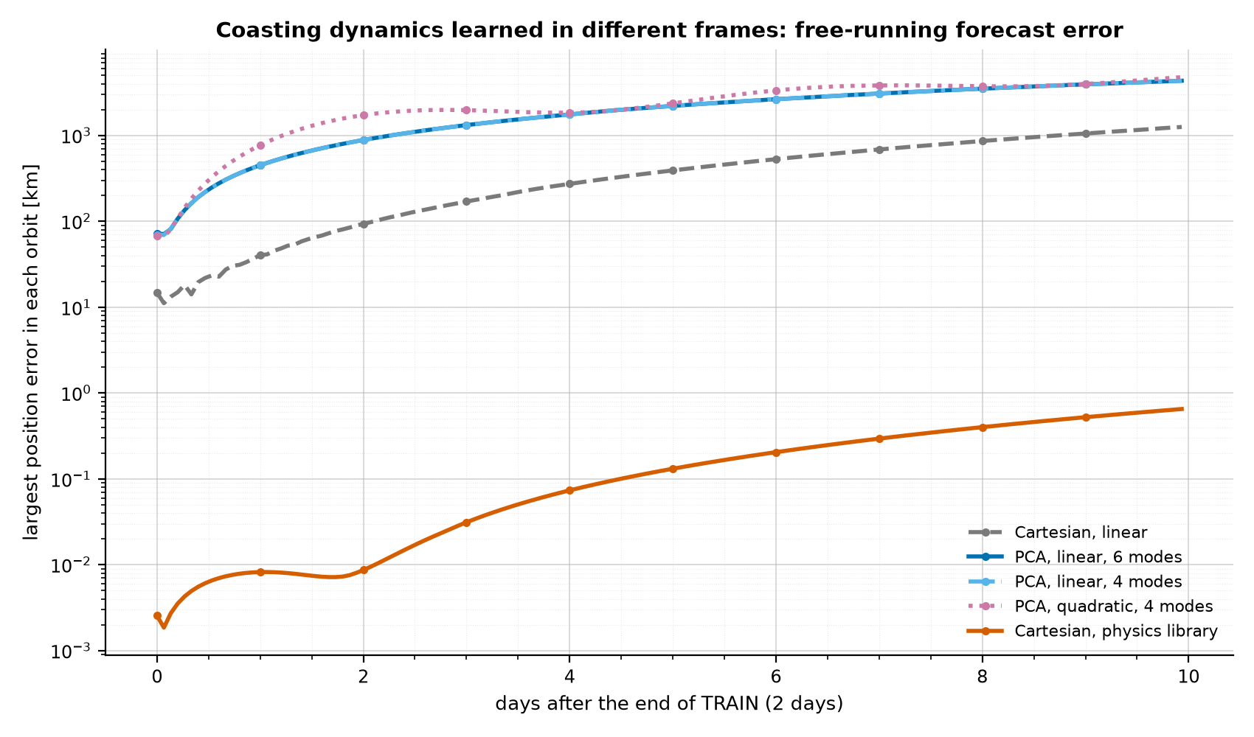
Negative results worth reporting
PCA + SINDy on the coasting state:
  2 modes hold 99.9% of variance (one oscillator pair)
  linear dynamics sparse, eigenvalues = orbital rate
  but a linear change of frame cannot fix nonlinear physics
Physics library: 0.65 km after 10 days
Joint regression biased; k-means fails; memory-less switching fails
Free-running forecasts, not training fit, decide
Coast learned in different frames: position error
Notes:
- PCA frame for the coast: sparse (4 vs 42 terms) but linear models drift tens of km per day.
- Physics library [r/r^3, a_J2, -|v|v]: 0.65 km after 10 days; mu to 2e-8 - the physical frame wins.
- Joint regression: biased by mislabelled ramp samples (T -7.6%).
- k-means: two clusters split the coast cloud under noise (F1 0.001).
- Exponential-density library: physically plausible but wrong here (51 km after a year).

Slide 32
Method ranking by stage of the pipeline
Stage | Best | Also good | Avoid
Drag c_d | EKF (sparse data); energy / mean-SMA coast fit | Shooting; spectroscopy (survey) | FD regression on noisy data
Derivative | Savitzky-Golay (<= 2 min); propagation (2-20 min) | High-order FD on clean data | 2nd-order FD
Burn detection | GMM / Bayesian GMM | MAD threshold; log-chi mixture | k-means; Isolation Forest
Thrust law | Split regression on burn arcs + sigmoid shape | GP through stacked burns | Joint regression
Natural law | Split on coast arcs; physics-shape library | BINDy for uncertainty | Wrong-physics or linear-frame libraries
Switching | Hysteresis edges (accuracy 1.00) | - | Memory-less sigmoid (0.50)
Forecast | Law + space-weather proxy + conformal | GP coast curve (fine data) | Periodic schedule under variable drag
Notes:
- Scores combine accuracy, robustness to noise and sampling, cost and whether uncertainty is reported.
- Drag: EKF on sparse data, energy / mean-SMA coast fit on dense data; avoid FD on noisy data.
- Detection: GMM / Bayesian GMM; derivative SG up to 2 min, propagation feature to 20 min.
- Laws: split learning on clean arcs + hysteresis edges; GP or sigmoid for the thrust shape.
- Forecast: law + space-weather proxy with conformal intervals; a periodic schedule only for constant drag.

Slide 33
Holistic assessment: benefits, improvements, best practices
Benefits
Improvements
Best practices
Physics features: 4 decades separation
Unsupervised detection, F1 = 1
Split learning removes bias
Uncertainty: BINDy, GP, conformal
Interpretable laws (edges, c_d, T)
Learn edges with uncertainty (largest error)
Event-driven forecast with third bodies
Log-chi mixture as default detector
Real ephemerides and passes
Multi-seed confidence intervals
Known-truth simulation + oracle swaps
Score per event, not per sample
Walk-forward / backward testing
Bias-variance tuning per sampling step
Closed-form checks + 53 unit tests
Notes:
- Benefit: physics-based features make an unsupervised clusterer near perfect; splitting removes bias.
- Benefit: uncertainty everywhere it matters (BINDy, GP, conformal intervals).
- Improve: edges dominate the error; event-driven forecasts with modelled third bodies and space weather.
- Improve: real ephemerides, multi-seed confidence intervals, angles-only orbit determination.
- Practice: known-truth tests, oracle swaps, event scoring, walk-forward tests, closed-form checks, unit tests.

Slide 34
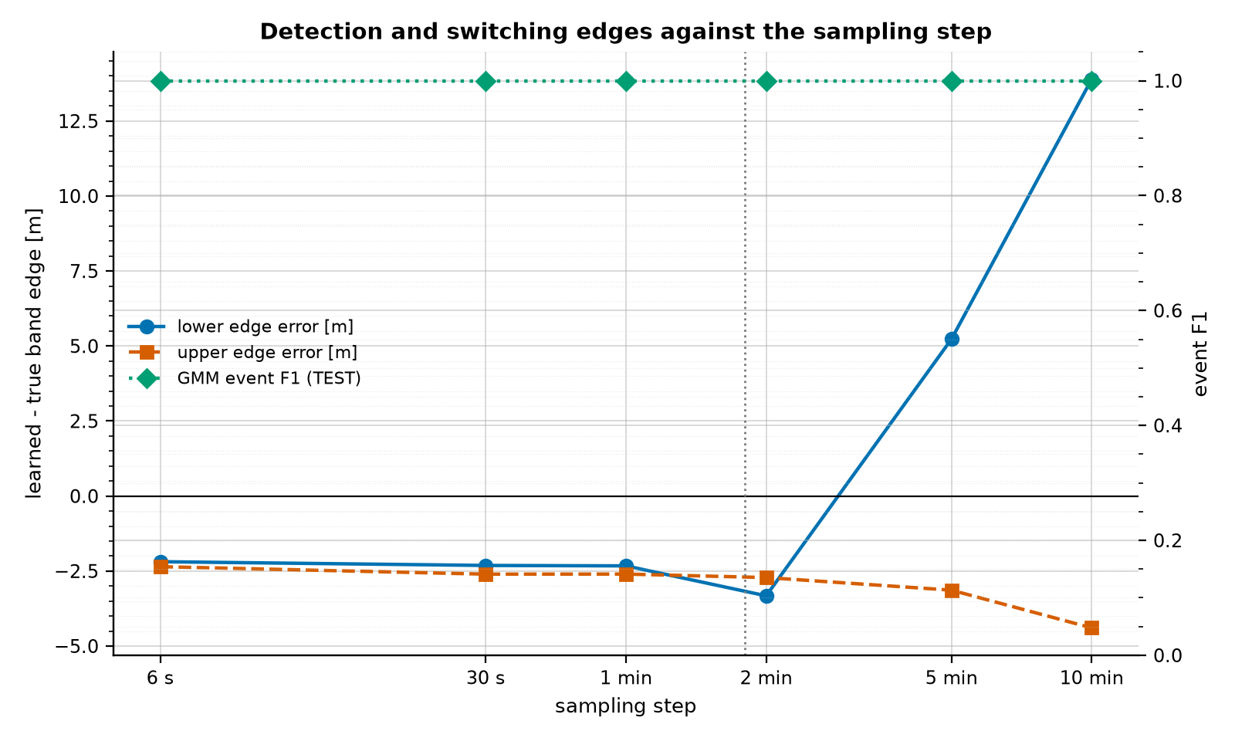
Limitations and future work
Limitations
  Idealised measurements (full state, 6 s, small noise)
  Constant density in the core run
  Mean-element model for steps 10-16
  Single noise seed per pipeline study
  Method ranking is a judgement from the numbers
Future work
  Real ephemerides (CCSDS OEM)
  Event-driven forecast with modelled third bodies and density
  Couple forecasts to screening and sensor tasking
Edges are the weak point at coarse sampling
Notes:
- Inputs are full states at 6 s with 0.1 m / 0.5 mm/s noise: far better than real tracking.
- Core run has constant density; space weather is modelled, not measured.
- Extensions use a calibrated mean-element model rather than full integration.
- No real ephemerides analysed yet (OEM reader exists); no angles-only orbit determination.
- Next: real Starlink OEMs, event-driven forecasts with modelled perturbations, closed loop with screening and tasking.

Slide 35
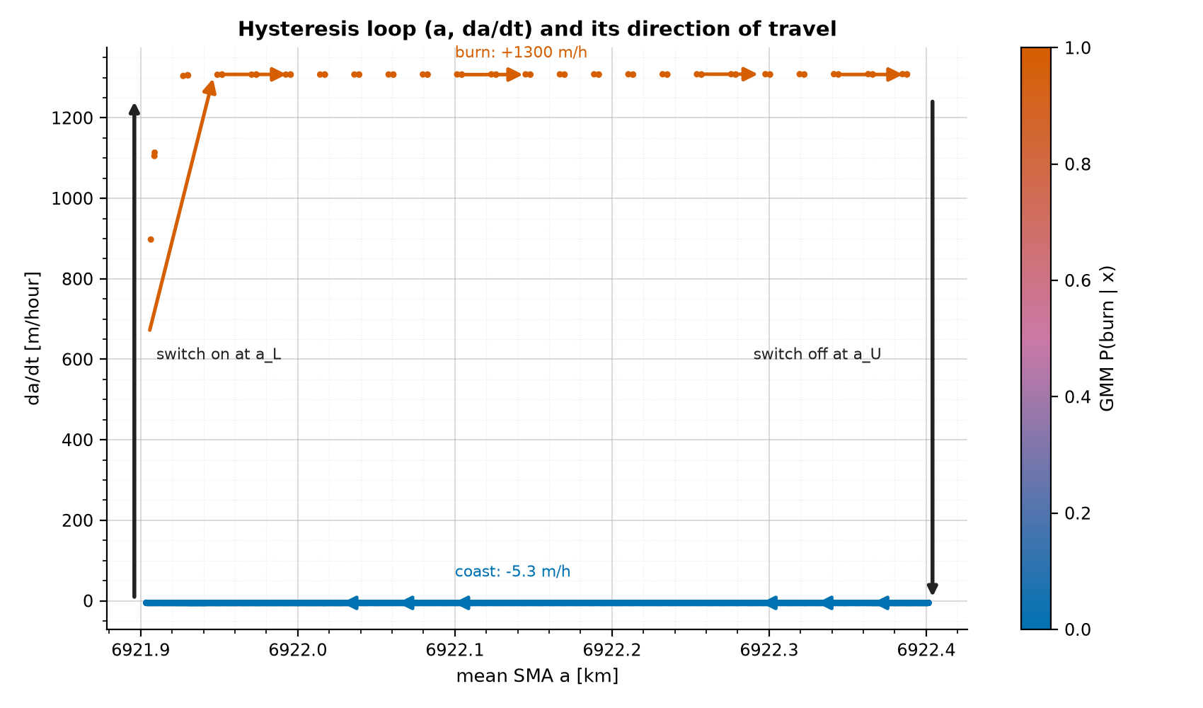
Conclusions
Simulation verified: J2 to 0.04%, 16/16 checks
Detection: F1 = 1.0, 6 s - 10 min, 0.25-8x noise
Laws: c_d +0.03%, T -0.005%, edges ~2 m
Forecast: 66 min after a year (constant drag); edges dominate
Operations: screening misses 68% → 25%; custody lost 74% → 15%
The learned loop, classified by the GMM
Notes:
- A smooth, ODE-friendly deadband controller reproduces the brief's Figure 1 and passes 16 closed-form checks.
- Burns are detected perfectly (92/92, 0 false) from 6-s to 10-min data with a GMM on physics-based features.
- Drag and thrust are learned to < 0.1% when the problem is split onto clean arcs; memory (hysteresis) is essential.
- Year-ahead forecast ~1 hour with constant drag; edges dominate the remaining error.
- With variable drag and third bodies, a learned law with a drag proxy beats a periodic schedule.

Slide 36
Key references
UK Space Agency. Manoeuvre Pattern of Life Prediction for SDA; 2025. Challenge brief.
Vallado DA. Fundamentals of Astrodynamics and Applications, 4th ed.; 2013. Microcosm Press.
Montenbruck O, Gill E. Satellite Orbits; 2000. Springer.
Petzold L. Automatic selection of methods for stiff and nonstiff ODEs; 1983. SIAM J Sci Stat Comput 4(1).
Savitzky A, Golay MJE. Smoothing and differentiation of data; 1964. Analytical Chemistry 36(8).
Dempster AP, Laird NM, Rubin DB. Maximum likelihood via the EM algorithm; 1977. JRSS B 39(1).
Brunton SL, Proctor JL, Kutz JN. Sparse identification of nonlinear dynamics; 2016. PNAS 113(15).
Tipping ME. Sparse Bayesian learning and the relevance vector machine; 2001. JMLR 1.
Fung L, Fasel U, Juniper MP. Rapid Bayesian identification of sparse nonlinear dynamics; 2024. arXiv 2402.15357.
Rasmussen CE, Williams CKI. Gaussian Processes for Machine Learning; 2006. MIT Press.
Notes:
- Brief and SDA context: UKSA challenge, Vallado 2025, Marsillach and Holzinger 2021, Bar-Shalom 2011.
- Dynamics and solvers: Vallado 2013; Montenbruck and Gill 2000; Petzold 1983 (LSODA).
- Signal processing and detection: Savitzky and Golay 1964; Schafer 2011; Dempster et al. 1977 (EM).
- Learning: Brunton et al. 2016 (SINDy); Tipping 2001 (ARD); Fung, Fasel and Juniper 2024 (BINDy); Rasmussen and Williams 2006.
- Full numbered list with URLs is in the written report.

Slide 37
Questions
Code: deadband/ (library) and stages/ (figures); python main.py reruns everything
Report: report/briefing.pdf (methods, checks, all horizons)
Backup topics: solver choice, mean SMA, GMM burn rule, BIC vs Brier, split learning, all-forces run
Force budget (for discussion)
Notes:
- Invite questions; 15 minutes reserved.
- Likely topics: why LSODA, why the mean SMA, how the GMM labels burns without supervision.
- Likely topics: why split learning beats joint regression; why edges dominate the forecast error.
- Likely topics: realism of the noise model and how the method would run on real ephemerides.
- Point to the report sections and the code modules for detail.

