Slide 1
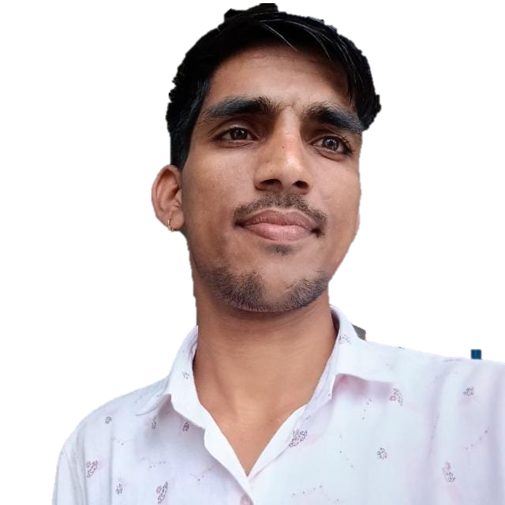
Poonam Singh
about
Hy my name is Poonam Singh
i am a good listener and learner, able to communicate well with a group and on an individual level. I am able to motivate and direct my talents and skills to meet objectiveI am a good listener and learner, able to communicate well with a group and on an Individual level.
poonamsingh3862@gmail.com
EDUCATION
DEEGRE
High school
BECHELOR OF ARTS (second divison)
GOVT. SE. SEC. SCHOOL. .SAYON KA KHERA | 2020-21
Bellows College
12TH Arts
Percentage- 85.50%
Ms. Excel, PowerPoint
Intermediate faculty
SKILLS
Ms Excel
GOVT. SE. SEC. SCHOOL .
SAYON KA KHERA| 2018-2019
Computer knowledge
10TH
Percantage - 68.80
Communication skill
LANGUAGES
Address & contact
English
Sbild ,near gspc , sector -11
Gandhinagar, Gujarat
Gmail- poonamsingh3862@gmail.com
Mobile.no.- 7990386169
namsingh3862@gmail.com
Hindi
Gujarati

Slide 2

Mira Karlsson (2)
web designer/developer
As a highly skilled and passionate web developer, I am committed to designing and developing user-friendly, innovative, and visually appealing websites.
about
work experience
CONTACT
SENIOR DEVELOPER
Santa Fe, NM
Vanarsdel, LTD | 20XX-20XX
816.555.0146
Developed complex web applications
Led teams and mentored junior developers in best practices
Implemented and maintained CI/CD pipelines for web applications
Implemented scalable architecture for high-traffic websites
mira@example.com
www.example.com
EDUCATION
ART DIRECTOR
School of Fine Art
Woodgrove Bank | 20XX-20XX
BA in Graphic Arts
Created and implemented visual design concepts for websites and web applications
Developed design standards and style guides for branding consistency
Collaborated with cross-functional teams to ensure design and user experience alignment
Collaborated with UX designers to develop user flows
Bellows College
MS in Web Development
skills
UI/UX Design
SENIOR DESIGNER
Image retouching
Relecloud | 20XX-20XX
Developed and implemented visual design solutions for websites and applications
Led design projects and supervised junior designers
Conducted user research and developed design personas and wireframes
Developed prototypes and conducted usability testing
Front-end coding
Back-end coding
Testing tools
JUNIOR DESIGNER
Contoso, LTD | 20XX-20XX
LANGUAGES
Assisted with visual design and layout for websites and web applications
Assisted with user research and developed design personas and wireframes
Collaborated with cross-functional teams to ensure design and user experience alignment
Assisted with front-end development using HTML/CSS
English
French
German

