Slide 1

Identifying the Optimal Way of Dissecting Geometric Shapes in a Virtual Environment
Name: L.H.Edirisingha
Index No: COBSCCOMP222P-045
COBSCCOMP4Y222P-056
Batch: Computing 22.2

Slide 2
Introduction
Recent trend in the research fields of Augmented Reality (AR), Virtual Reality (VR) and Mixed Reality (MR) has moved towards blending the real and virtual worlds to generate new environments.
These technologies are shown to be present unique opportunities for interactive learning, enabling users to visualize and manipulate shapes and objects in real time. This capability facilitates the demonstration of complex scenarios with reduced risk factors and in an immersive manner, According to Bellini et al. (2016)

Slide 3

Research Problem & Gap
Despite the significant advancements in these interactive technologies, the experience remains inaccessible to a broad audience due to the excessive costs associated with the necessary equipment.
Alam & Mahbubur Rahman, 2020 tried to address this by introducing fingertips for Geometric Transformation of Objects in a VR environment. But this doesn't focus on dissection of objects, it mostly focuses on rotation and scaling of 3D objects.
Also, the findings Cordeiro, Giannini, and Monti (2019) say that users tend to interact with 3d objects in the same way they do interact with objects in real life so the fingertip tracking model might not be the perfect approach.
This research aims to develop a cost-effective, gesture-based system for dissecting geometric shapes in a virtual environment, making it more accessible to a wider audience.

Slide 4

Objectives of the Research.
To develop a software application that allows users to dissect and manipulate geometric shapes in a virtual environment.
To enhance user engagement with interactive technologies.
To implement a gesture recognition system for intuitive user interaction.
To improve the accessibility and affordability of interactive technologies.

Slide 5
Methodology and Research Design

Slide 6
Data Collection
Primary Data
Approach
Mixed methods approach using both quantitative and qualitative data collection techniques.
Population
Students and professionals in fields like architecture and design, primarily located in Colombo District, Sri Lanka.
Secondary Data
Literature review of relevant studies to identify gaps and build the foundation of the research.

Slide 7
Sample size & Calculation
Estimated Population = Total Labor Force × Youth Employment Ratio
= 339,637×0.196
≈ 66,661
Sample size (n) = (z)² p (1 – p) / d2
= (1.96)2 . 0.5. (1-0.5) / (0.05)2
= 384.16
≈ 384
n adjusted = n / [1 + ((n-1)/p)]
= 384 / [1 + ((384 -1)/66661)]
≈ 382.
n = sample size
z = level of confidence
p = estimated proportion of the population
d = tolerated margin of error (%5)
(calculator.net)

Slide 8
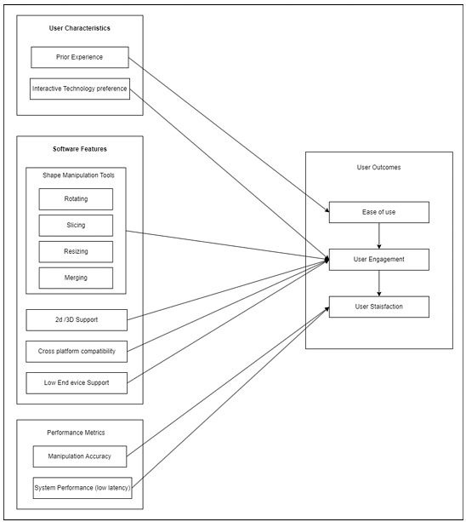
Conceptual framework

Slide 9
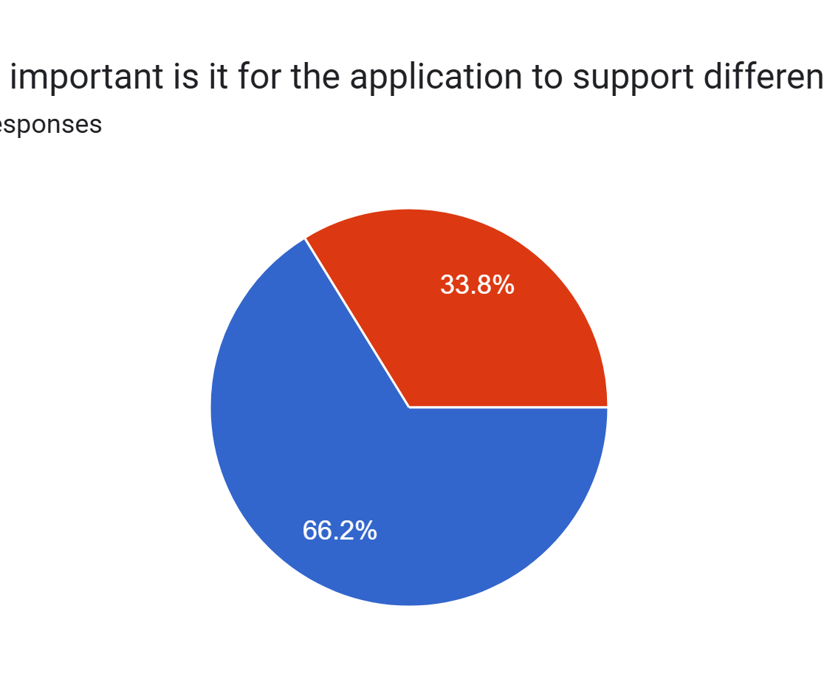
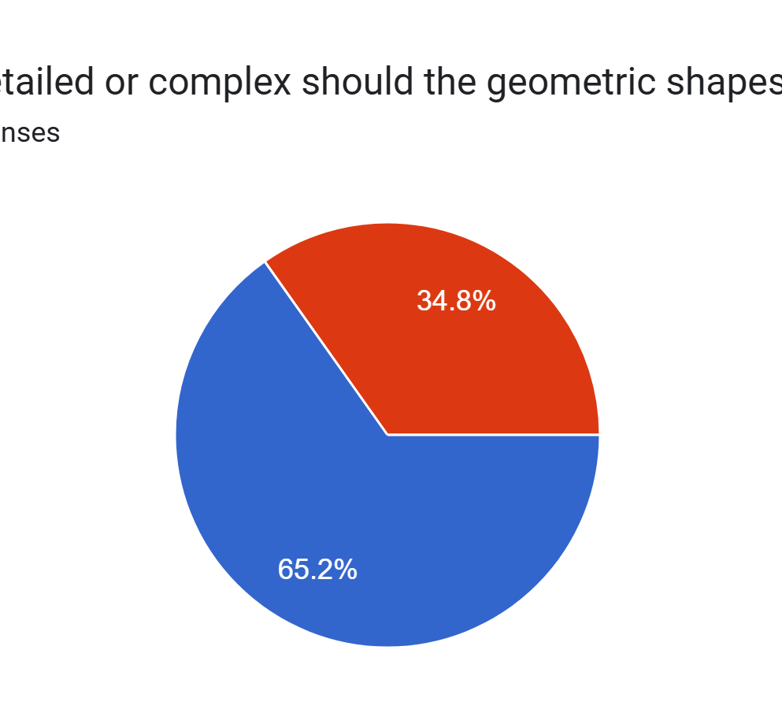
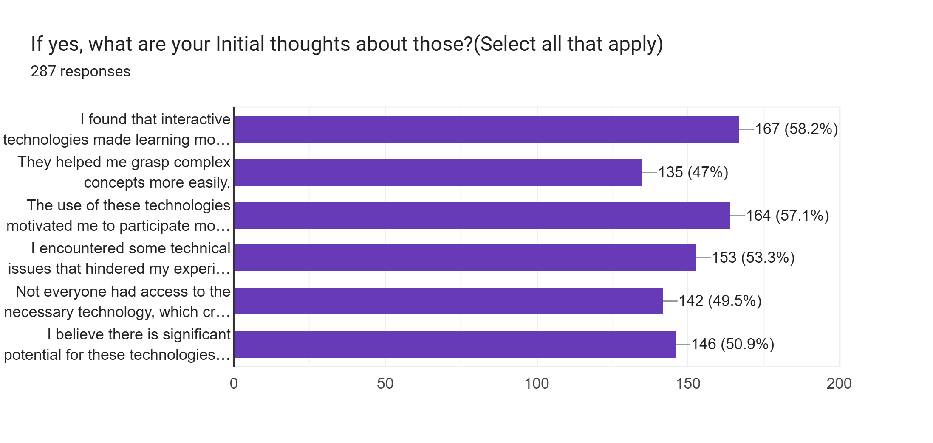
User Response analysis for user expectation gathering
Descriptive Analysis

Slide 10
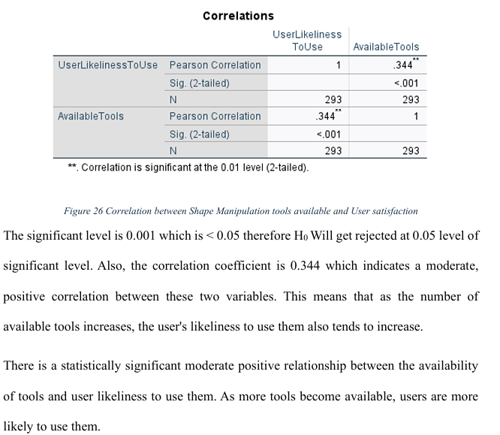
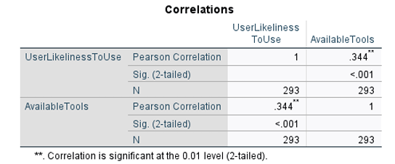
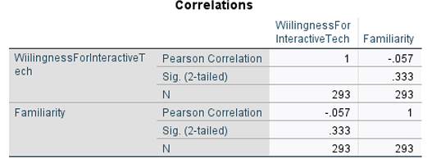
Inferential Analysis
To identify the statistically significant relationships with hypothesis.

Slide 11
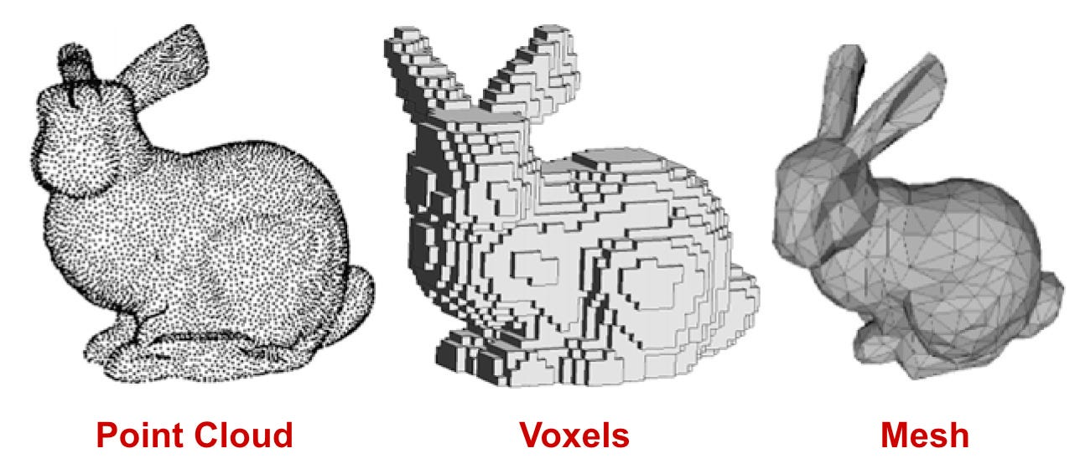
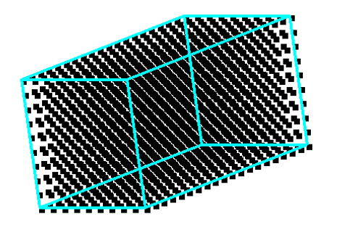
Compared available 3D Object Visualization methods such as Polygon Mesh Representation, Voxel Representation, Parametric/Procedural Representation, Point Cloud Representation.
Introduced voxel inspired node-based representation.

Slide 12
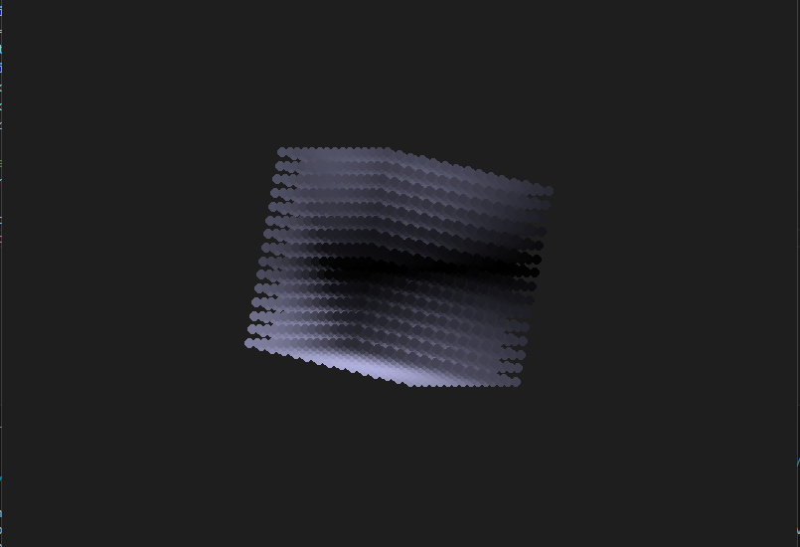
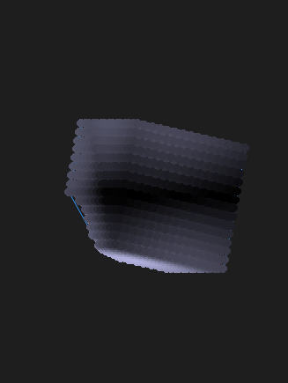
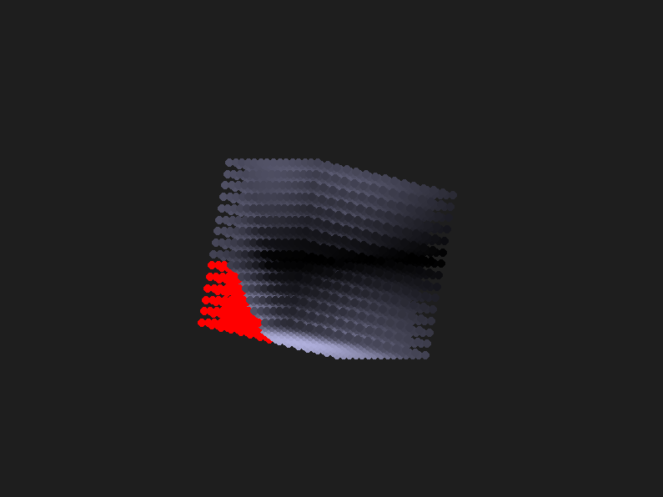
Dissection Feature Implementation

Slide 13
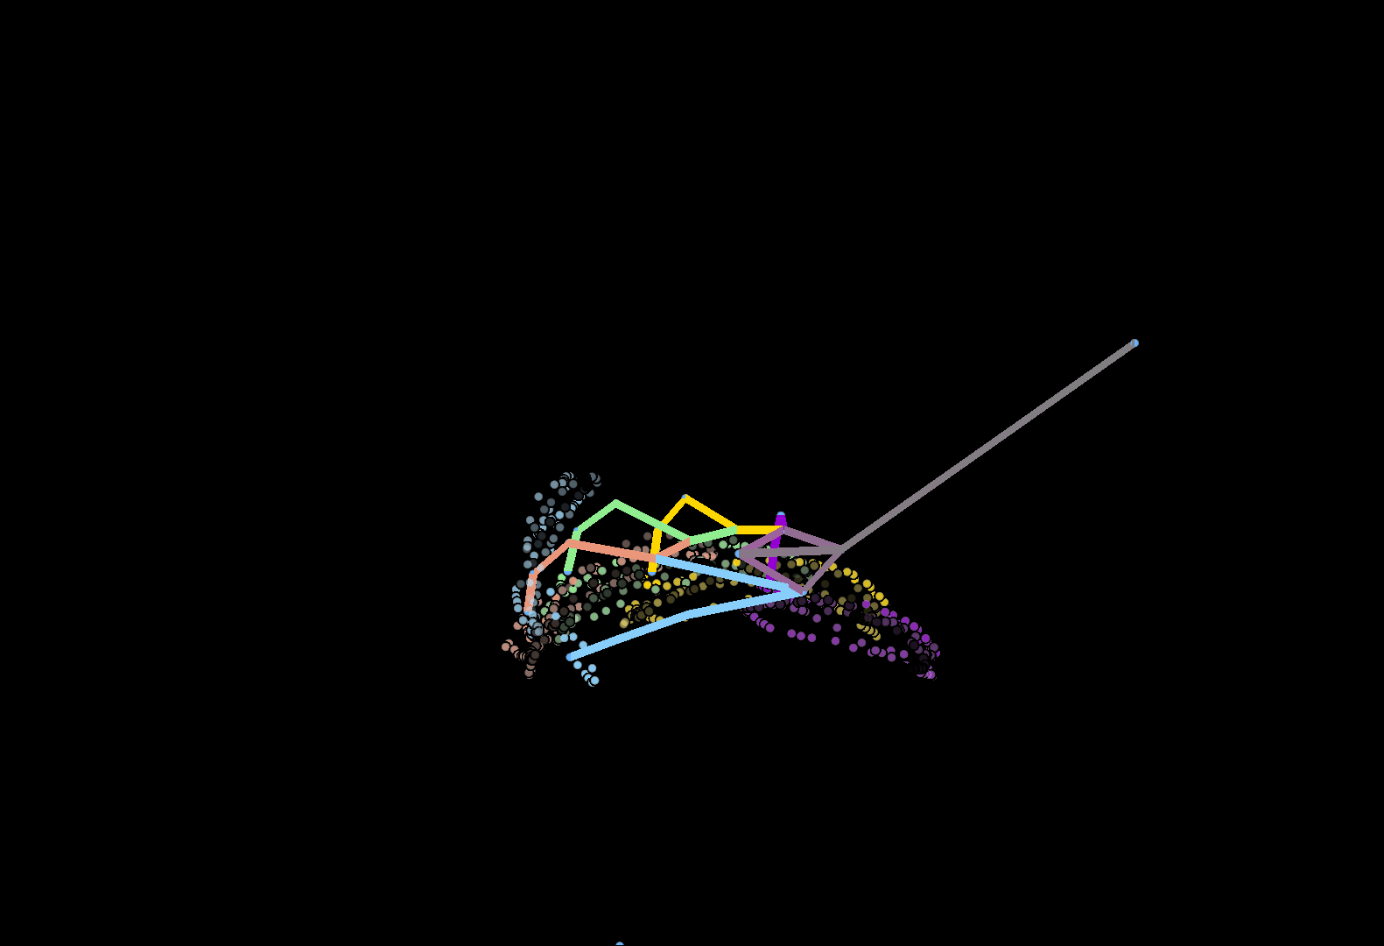

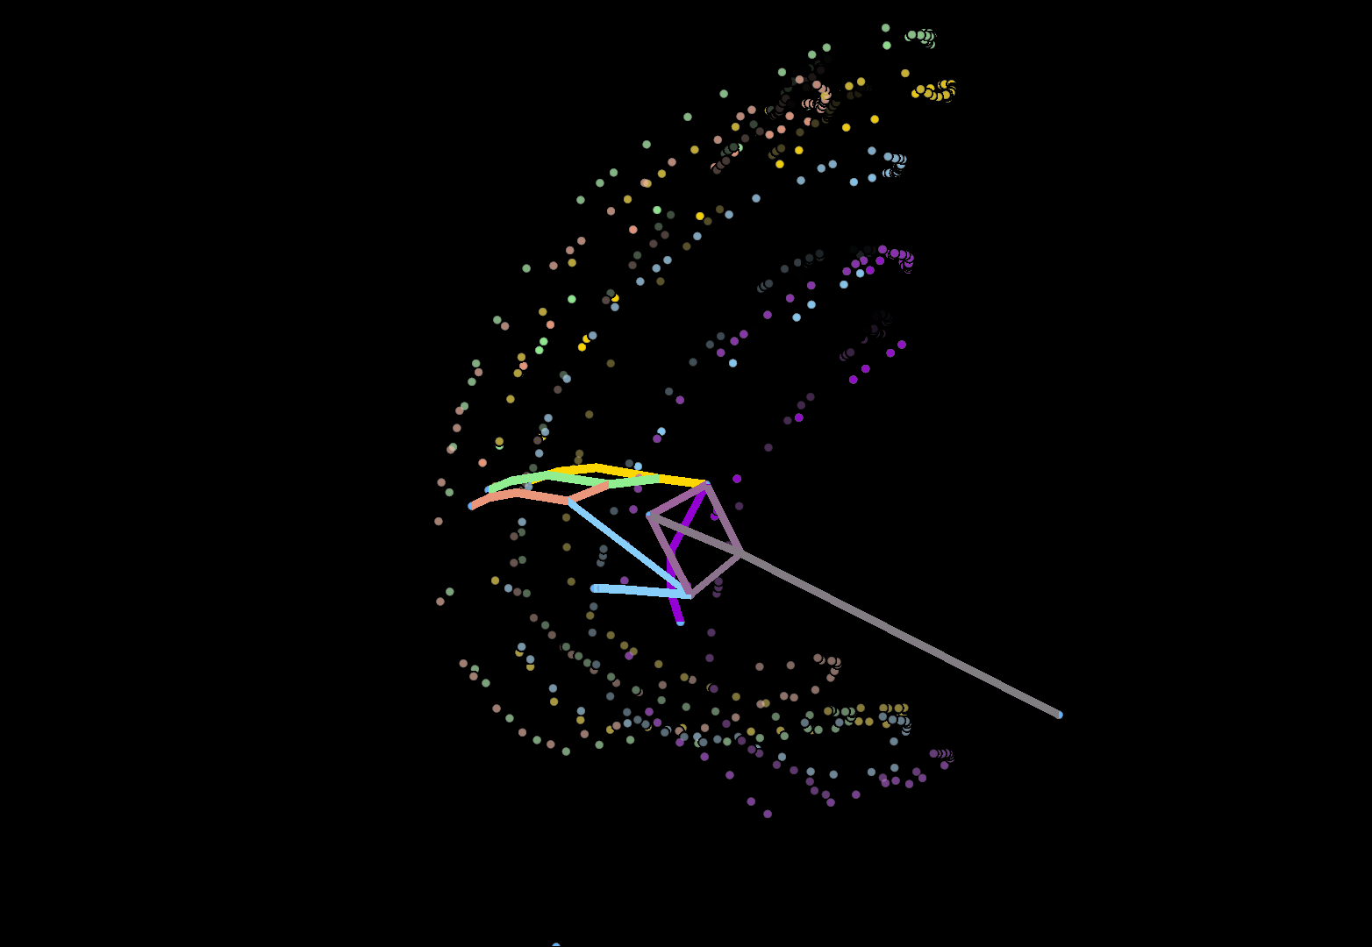
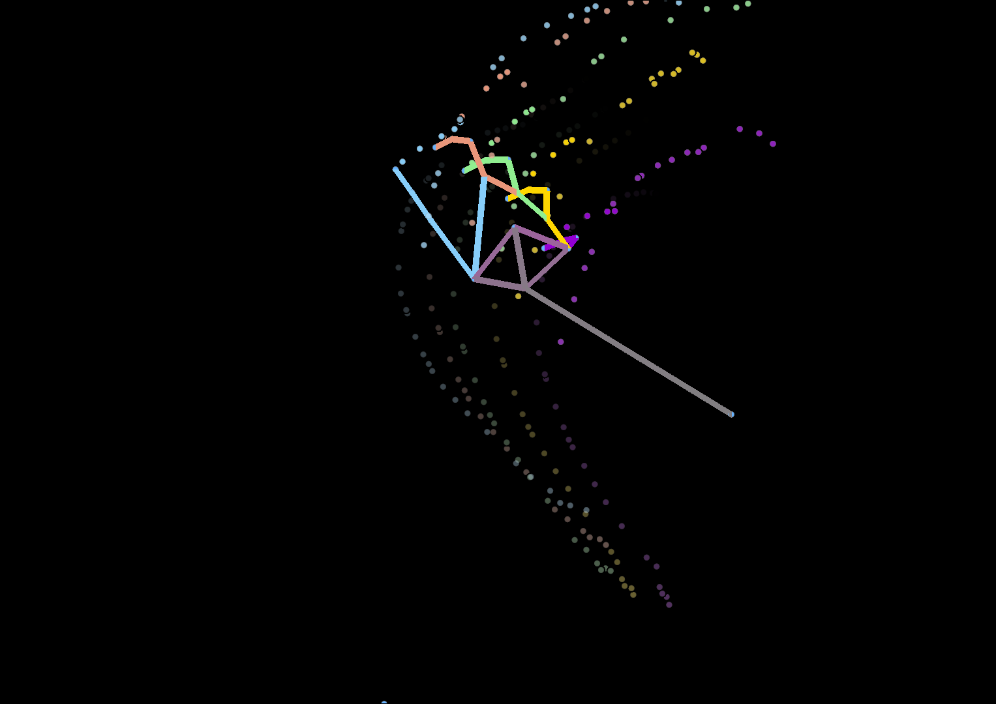
Analyzed existing data sets for gesture recognition systems and identified the most suitable dataset.
The Leap Motion Dynamic Hand Gesture dataset.
Trained a model which predicts gesture movement.

Slide 14
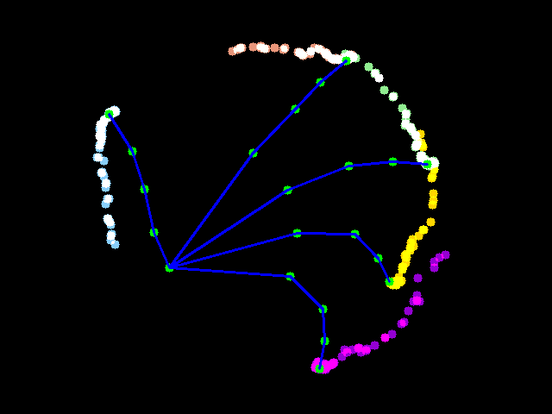
Algorithm to create overlapping image with track points of hand

Slide 15
Research Findings

Slide 16
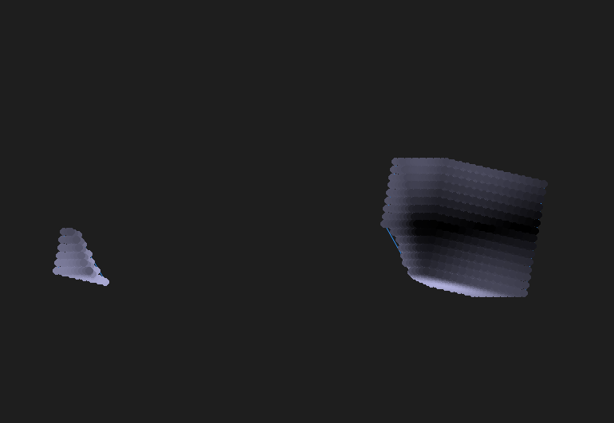
Node-Based Representation for 3D Objects
A node-based system provided reliable, interactive visualization of 3D geometric shapes.
Allowed for accurate dissection and manipulation, which proved suitable for interactive educational applications.
Gesture Tracking System
Implementing gesture tracking, using the Leap Motion Dynamic Hand Gesture dataset.
Using a webcam to capture gestures for rotation and dissection showed promising results but it is not 100% perfect change of the data set is required.

Slide 17
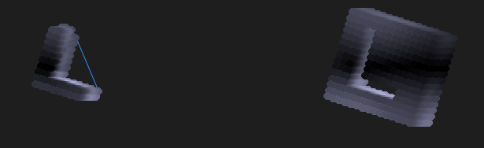
User Engagement and Satisfaction
Interactive Tools - Availability of intuitive manipulation tools (cutting, resizing, rotating) significantly increased user engagement.
Affordability and Low Latency - Affordability, low latency, and support for low-end devices were found to positively impact user satisfaction.
Cross platform support- was found to positively impact user satisfaction.
Details and Complexity of shapes - was found to positively impact user satisfaction.

Slide 18
Performance Challenges
The Pygame library was an improvement over Matplotlib for large-scale, real-time 3D interactions, but performance issues persisted as the shape dimensions increased.
Adding lighting effects using Scipy enhanced 3D perception but further improvements are needed to address depth limitations.

Slide 19
References
Cordeiro, E., Giannini, F., & Monti, M. (2019). A Survey of Immersive Systems for Shape Manipulation. Computer-Aided Design & Applications, 16(6), 1146–1157. https://doi.org/10.14733/cadaps.1146-1157
Chen, Y. (2023). Research and Analysis of VR in the Field of Education. In Research gate. https://www.researchgate.net/publication/369874125_Research_and_Analysis_of _VR_in_the_Field_of_Education
Alam, M. M., & Mahbubur Rahman, S. M. (2020). Affine transformation of virtual 3D object using 2D localization of fingertips. Virtual Reality & Intelligent Hardware, 2(6), 534–555. https://doi.org/10.1016/j.vrih.2020.10.001
Alfalah, S. F. M. (2018). Perceptions toward adopting virtual reality as a teaching aid in information technology. Education and Information Technologies, 23(6), 2633 2653. https://doi.org/10.1007/s10639-018-9734-2
A Comprehensive Guide to 3D Scanning: Technologies, Applications, and Industry Trends. (2023, December 21). Objective3d. https://www.objective3d.com.au/resource/blog/3d-scanning-technologies applications-and-industry-trends/
Campen, M., & Kobbelt, L. (2010). Exact and Robust (Self-)Intersections for Polygonal Meshes. Computer Graphics Forum, https://doi.org/10.1111/j.1467-8659.2009.01609.x
Department of Census and Statistics. (2023). Sri Lanka Labour Force Survey: Annual Report - 2022 [Review of Sri Lanka Labour Force Survey: Annual Report - 2022]. In statistics. Ministry of Finance, Economic Stabilization and National Policies, Sri Lanka. http://www.statistics.gov.lk/Resource/en/LabourForce/Annual_Reports/LFS2022. pdf
F. Hughes, J., van Dam, A., McGuire, M., F. Sklar, D., D. Foley, J., K. Feiner, S., & Akeley, K. (2013). Computer Graphics: Principles and Practice [Review of Computer Graphics: Principles and Practice]. In aiu. Addison-Wesley. https://students.aiu.edu/submissions/profiles/resources/onlineBook/a6A8H5_com puter%20graphics.pdf

Slide 20
Thank you

