Slide 1
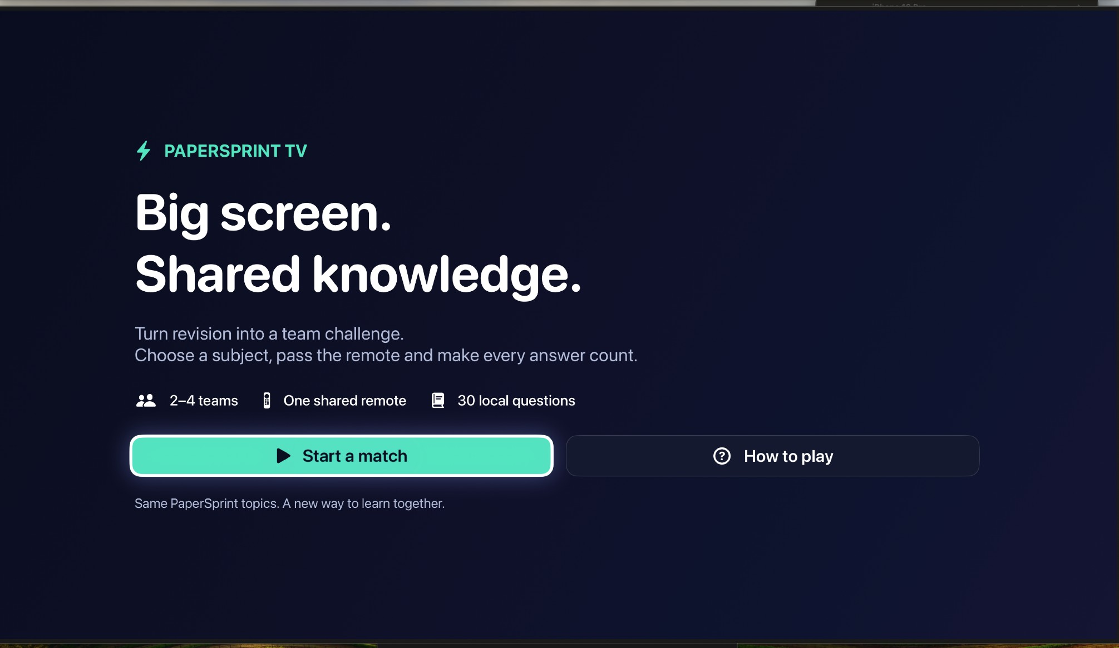
TV-FIRST COLLABORATIVE LEARNING
PaperSprint
TV
Big screen.
Shared knowledge.
Turn individual revision into a friendly,
remote-driven team quiz for the living room
or classroom.
WORKING tvOS PROTOTYPE • APPLE TV SIMULATOR
2–4 teams
30 questions
1 shared remote
PAPERSPRINT TV / SE4041 PART B • HIMSARA MKDL · IT22274298
01 / 12

Slide 2
WHY THIS MATTERS
Revision should not have to be a solo sport.
Students already practise on personal screens. Group revision can be simpler and more social.
01
02
03
Solo-first revision
Setup friction
Underused big screen
Most short quizzes are completed individually, even when friends study together.
Browser links, joining codes and separate controllers can interrupt spontaneous group practice.
An Apple TV can turn questions and answers into an accessible group activity.
LIMITED SHARED MOMENT
MORE STEPS TO START
TV AS A LEARNING SPACE
THE OPPORTUNITY → Fast, face-to-face revision using one television and one shared remote.
PAPERSPRINT TV / SE4041 PART B • HIMSARA MKDL · IT22274298
02 / 12

Slide 3
PRODUCT THESIS
One learning concept. Two complementary screens.
PaperSprint iOS supports individual revision; PaperSprint TV makes it a shared team challenge.
01
READ
02
GATHER
03
PLAY
ON iPHONE
ON APPLE TV
ON APPLE TV
Personal revision
→
Build the match
→
Pass and compete
Study short Swift lessons and review your own quiz results.
Choose a topic, 2–4 teams and an eligible number of rounds.
Take turns with one remote, see instant feedback and celebrate the winner.
SCOPE • The two apps share the subject and question concept, but do not require accounts, cloud sync or phone pairing.
PAPERSPRINT TV / SE4041 PART B • HIMSARA MKDL · IT22274298
03 / 12

Slide 4
PROTOTYPE / FIRST IMPRESSION
Designed for the sofa, not stretched from a phone.
Large typography, few decisions and unmistakable remote focus states.
01
Instant entry
Start a match or view how-to-play instructions directly from the landing screen.
02
Room-ready setup
A television-first layout keeps every major action readable across the room.
03
No extra accounts
The bundled sample question library works locally without a server or join code.
ACTUAL APPLE TV 4K SIMULATOR CAPTURE / HOME SCREEN
PAPERSPRINT TV / SE4041 PART B • HIMSARA MKDL · IT22274298
04 / 12

Slide 5
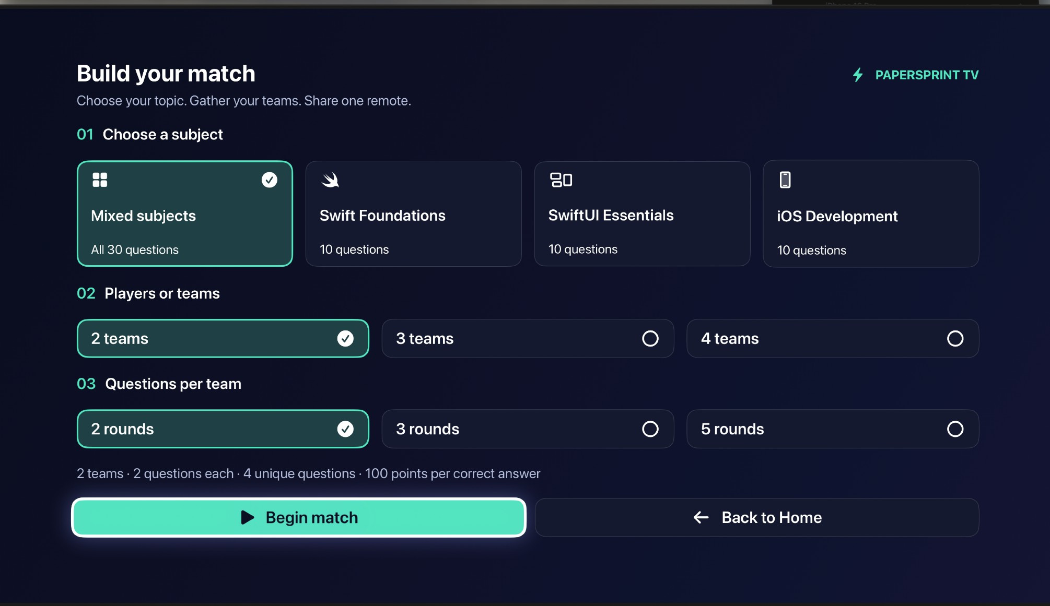
PROTOTYPE / CUSTOMISATION
Build a fair match in seconds.
Choose a topic, team size and supported number of questions per team.
01
Four topic options
Mixed subjects (30) or Swift Foundations, SwiftUI Essentials and iOS Development (10 each).
02
Flexible teams
Set the match for 2, 3 or 4 teams sharing a single remote.
03
Validated rounds
Choose 2, 3 or 5 rounds when enough unique questions exist for that subject.
ACTUAL APPLE TV 4K SIMULATOR CAPTURE / MATCH SETUP
PAPERSPRINT TV / SE4041 PART B • HIMSARA MKDL · IT22274298
05 / 12

Slide 6
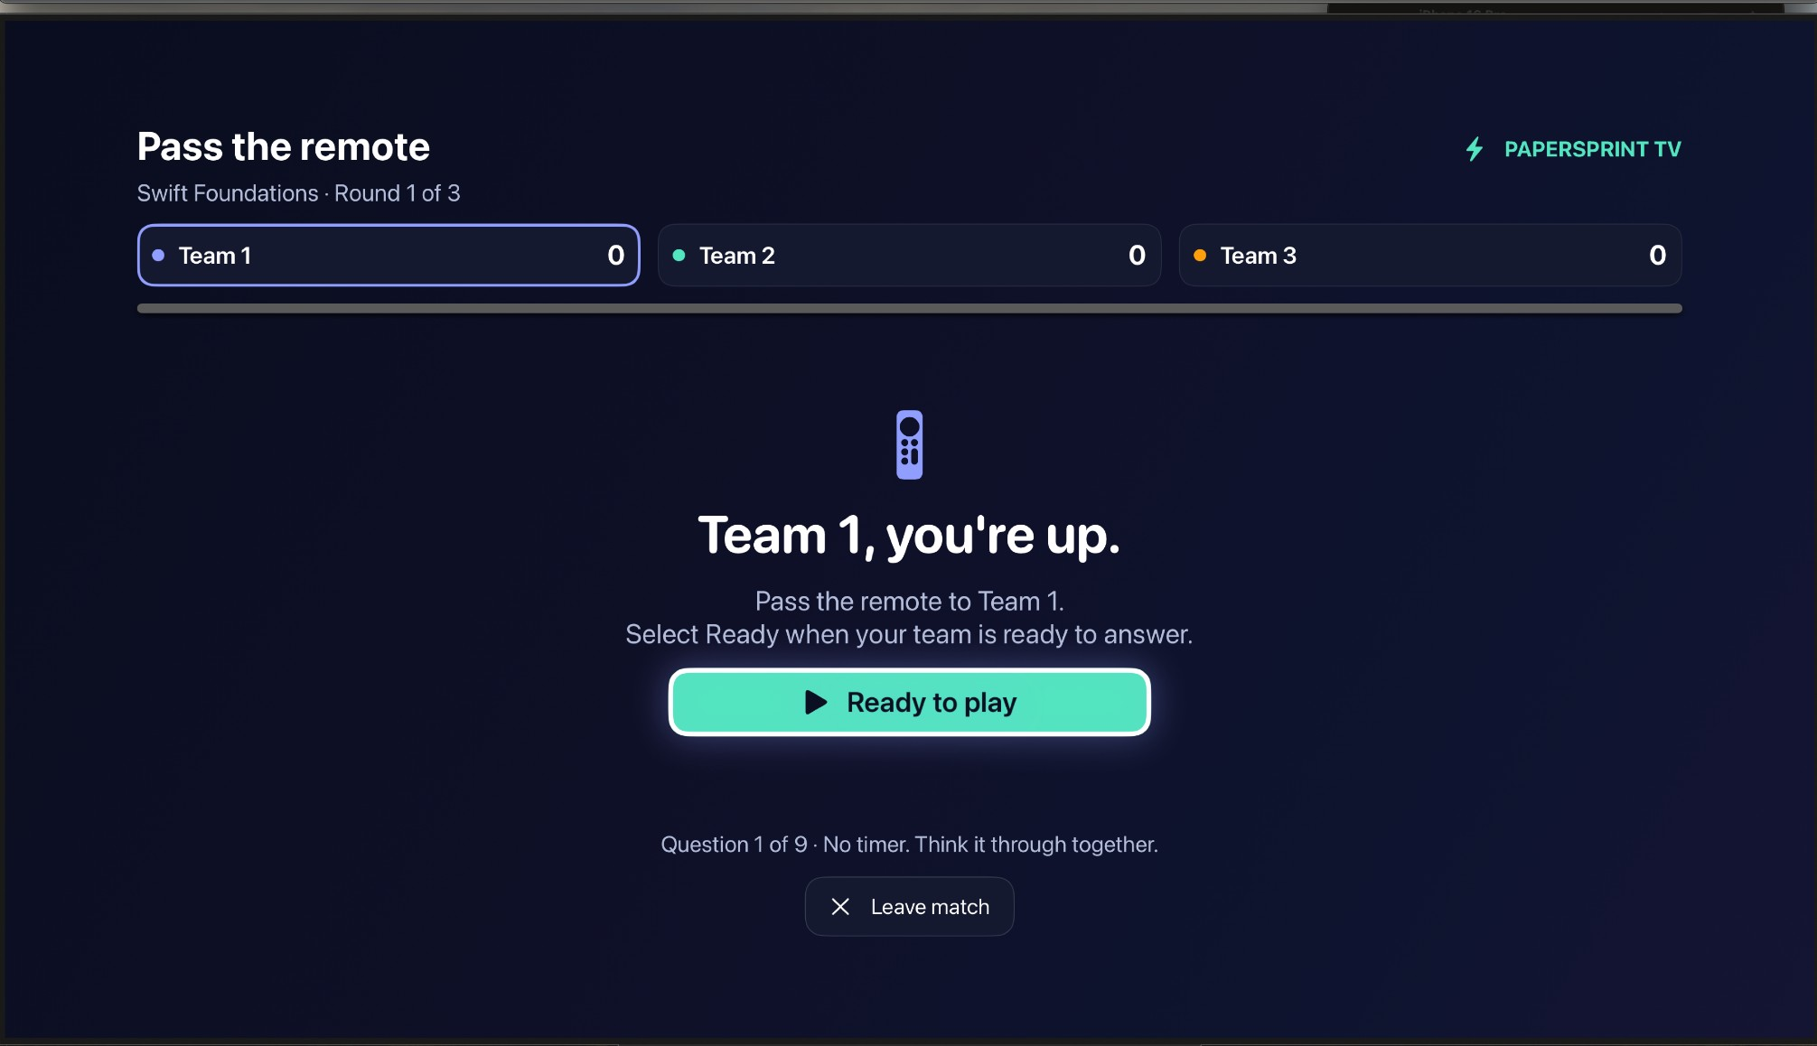
PROTOTYPE / COLLABORATION
One remote becomes the team baton.
A deliberate handoff screen gives everyone an equal turn to participate.
01
Clear active player
The next team is announced before each question begins.
02
One device only
Pass the remote and press Ready to play; no individual phones are needed.
03
Relaxed pacing
No timer or speed bonus—teams can think and discuss before answering.
ACTUAL APPLE TV 4K SIMULATOR CAPTURE / TEAM HANDOFF
PAPERSPRINT TV / SE4041 PART B • HIMSARA MKDL · IT22274298
06 / 12

Slide 7
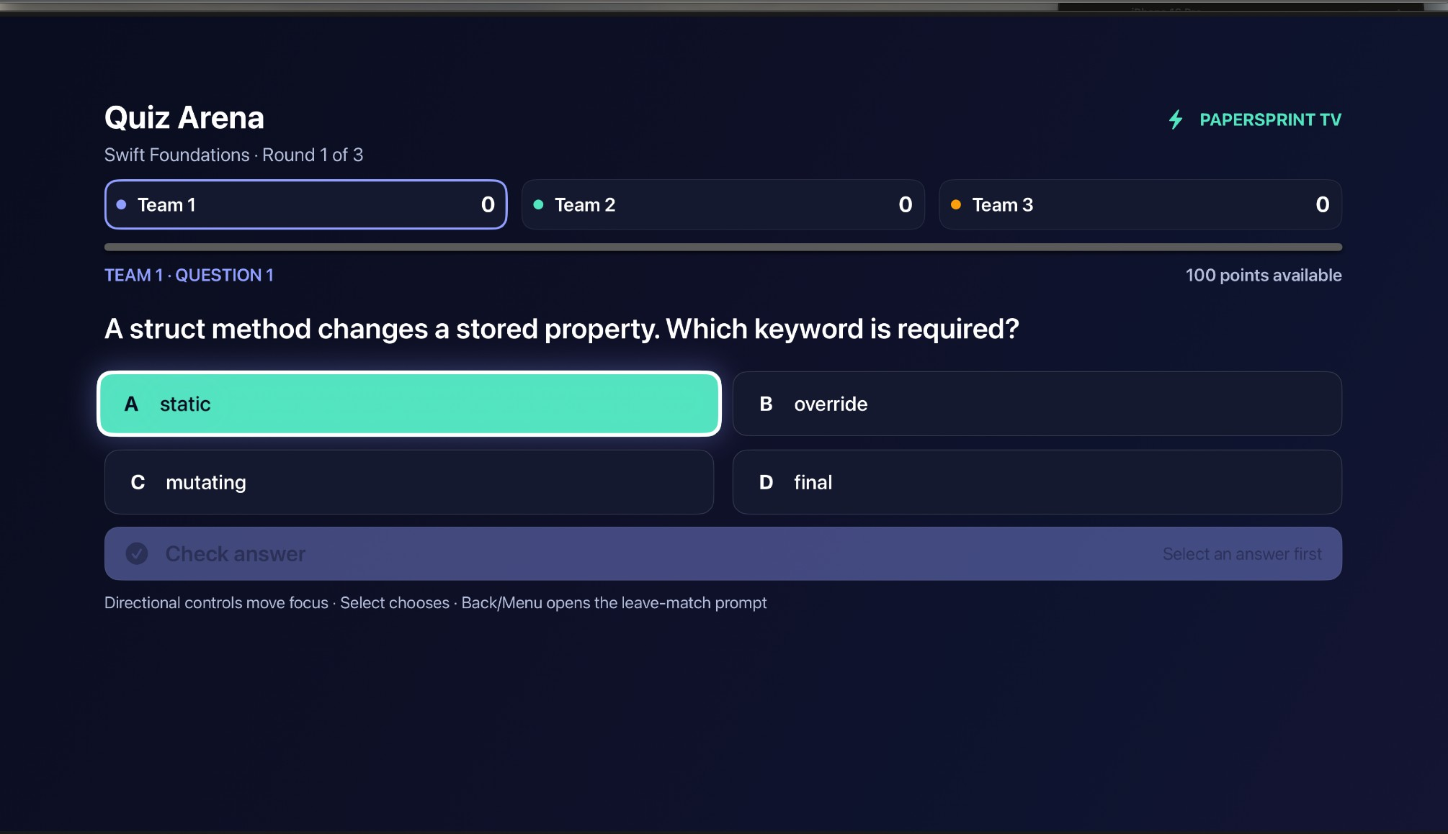
PROTOTYPE / CORE LOOP
Focused answers. Immediate feedback.
Simple directional navigation and a consistent 100-point scoring rule.
01
TV-native focus
Directional controls move between large answer buttons; Select confirms a choice.
02
Clear outcomes
Check Answer shows correct / incorrect feedback before the next turn.
03
Fair scoring
Every correct answer gives 100 points; incorrect answers give zero.
ACTUAL APPLE TV 4K SIMULATOR CAPTURE / QUIZ ARENA
PAPERSPRINT TV / SE4041 PART B • HIMSARA MKDL · IT22274298
07 / 12

Slide 8
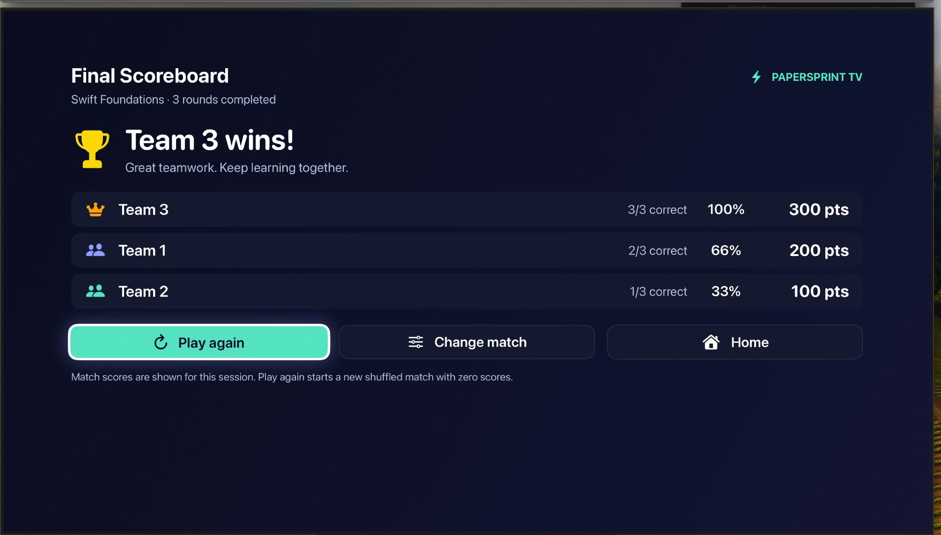
PROTOTYPE / OUTCOME
Every team sees how the result was earned.
A transparent scoreboard completes the session and invites another round.
01
Visible ranking
The captured 3-team demo shows 300, 200 and 100 points respectively.
02
Winner or tie
The session model supports top-score winners and tied joint winners.
03
Replay loop
Play Again reshuffles and resets; Change Match and Home offer easy exits.
ACTUAL APPLE TV 4K SIMULATOR CAPTURE / FINAL SCOREBOARD
PAPERSPRINT TV / SE4041 PART B • HIMSARA MKDL · IT22274298
08 / 12

Slide 9
EXECUTION / TECHNICAL TRUST
Built on native SwiftUI and focused game logic.
A light, local architecture keeps sessions predictable and comfortable on Apple TV.
01
02
03
04
LearningCatalog
→
MatchSettings
→
TVQuizSession
→
SwiftUI Screens
30 bundled MCQs
3 subjects
Subject · Teams
2/3/5 rounds
Turn order · Rules
Scores and phases
Home · Setup · Arena
Final scoreboard
WHAT THE CODE ENSURES
DEMO STATUS
• Unique, valid questions in each match
• Duplicate scoring prevented by match phases
• Equal number of turns per team
Working Apple TV 4K simulator demo
tvOS 18.5 · Manual feature testing
Match scores are session-only
Testing note: automated functional coverage can be expanded; current evidence is the simulator demo and source implementation.
PAPERSPRINT TV / SE4041 PART B • HIMSARA MKDL · IT22274298
09 / 12

Slide 10
CATEGORY / SIMILAR APPLICATIONS
A familiar quiz category—simpler shared-room play.
Comparable products validate game-based learning and group play, while using different participation models.
CLASSROOM QUIZZING
LIVE CLASSROOM QUIZZES
SCREEN-BASED PARTY GAMES
Kahoot!
Wayground
Jackbox Games
Shared question display; players typically answer from their own devices.
Instructor-paced, student-paced and team learning modes.
A shared game screen with players using phones as controllers.
kahoot.com/what-is-kahoot/
wayground.com/home/solutions/live-quizzes
jackboxgames.com/how-to-play
PAPERSPRINT TV / OUR POSITION
A TV-native, pass-the-remote revision quiz: 2–4 teams, local content, no join codes and no player phones.
PAPERSPRINT TV / SE4041 PART B • HIMSARA MKDL · IT22274298
10 / 12

Slide 11
AUDIENCE / REVENUE HYPOTHESIS
Start with small learning groups. Earn expansion.
Commercial opportunities are proposed—not current paid features of this student prototype.
Peer study groups
Tutorial classes
Student communities
Friends revising together before exams.
Facilitators running short team challenges.
Clubs and campus-led knowledge nights.
FREE / PRODUCT ENTRY
FUTURE PREMIUM / PROPOSED
Make it easy to start
Sell useful depth
• Bundled revision topics and local quizzes
• Team play and final scoreboard
• One remote; no account required
• Additional subject and exam-prep packs
• Educator / classroom activity collections
• Optional facilitator reporting tools
MARKET TEST → Track group session completion, replay rate and willingness to try curated topic packs.
PAPERSPRINT TV / SE4041 PART B • HIMSARA MKDL · IT22274298
11 / 12

Slide 12
GO-TO-MARKET / THE ASK
Let’s make revision a shared-screen habit.
From a working simulator prototype to measured group-learning demand.
NOW
NEXT
THEN
Working prototype
Small campus pilot
Build for adoption
Native tvOS quiz; 2–4 teams; local content; manual simulator demonstration.
Invite student study groups and tutorial facilitators; collect usability and replay feedback.
Refine question packs, accessibility, facilitator tools and release readiness.
THE ASK
Pilot partners, learner feedback and education-content collaborators.
Presenter: Himsara MKDL | IT22274298 | SE4041 Assignment 02 — Part B
PAPERSPRINT TV / SE4041 PART B • HIMSARA MKDL · IT22274298
12 / 12

