Slide 1

Presentation on Mini Project
2022-2023
Topic: DHOL DAMAU(MUSIC PLAYER)
By: Himanshu Uniyal
Section: B
Roll number-34
Student ID-21012400

Slide 2

Web development is the building and maintenance of websites; it’s the work that happens behind the scenes to make a website look great, work fast and perform well with a seamless user experience.
Web developers, or ‘devs’, do this by using a variety of coding languages. The languages they use depends on the types of tasks they are preforming and the platforms on which they are working.
Web development skills are in high demand worldwide and well paid too – making development a great career option. It is one of the easiest accessible higher paid fields as you do not need a traditional university degree to become qualified.

Slide 3

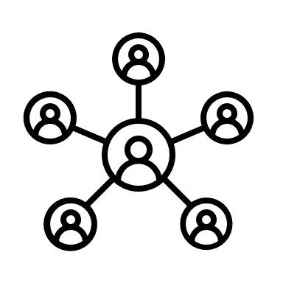
Importance of Web Development
The Internet is ubiquitous:
Accessible through mobile and desktop
Customers/users need to find you/your business
Builds trust in your organization and improves your reputation
Your website is your first round-the-clock salesperson!
▪
The Website Creates first impression of your business:
Create it to suit the needs of your target audience
Reflects your expertise and reputation
Can bring business from any part of the world!
Call to Action –Encourage the users to give you business
▪You need Web Development skills to create a Website!

Slide 4
FRONT END AND BACK-END WEB DEVELOPMENT
FRONT END WEB DEVELOPMENT:
.defined components on the page with html
.make them look pleasing with CSS
.enable interactivity with JavaScript.
BACK-END
WEB DEVELOPMENT:
.Create the page components and content dynamically on the web server
.Send HTML + CSS + JavaScript to web browser.
.Aim to achieve fast response time to end users.

Slide 5
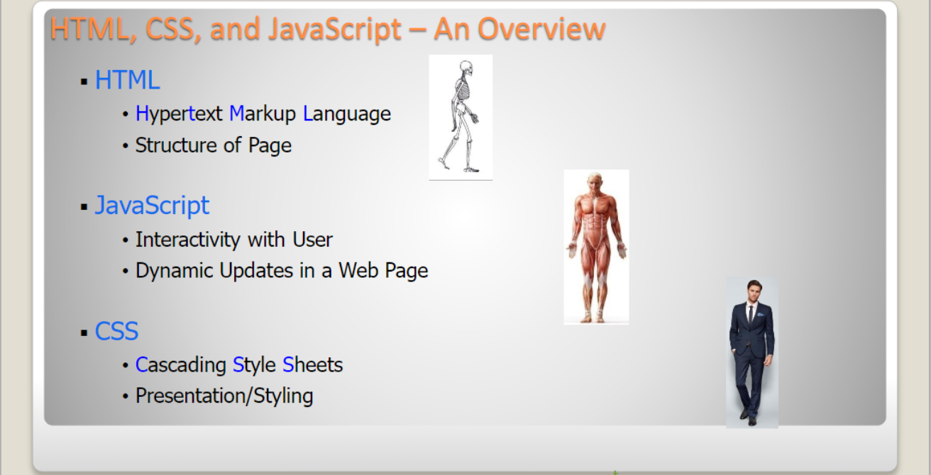

Slide 6
What is Dhol Damau?

Slide 7
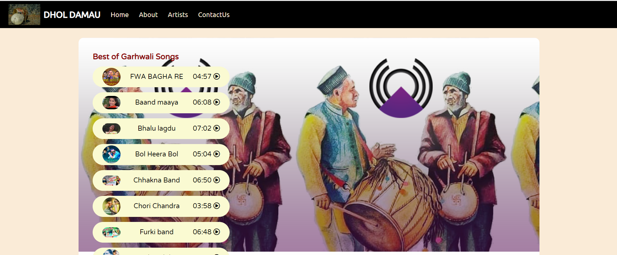
Dhol Damau is a Garhwali
music streaming freemium service

Slide 8
OVERVIEW:
.DHOL DAMAU OFFERS VARIOUS GARHWALI SONGS WITH A USER-FRIENDLY INTERFACE.
.USERS CAN LISTEN TO THEIR FAVOURITE ARTISTS AND DISCOVER NEW MUSIC IN AN EASY MANNER.

Slide 9




USER EMPOWERMENT:
DHOL DAMAU OFFERS A WIDE VARIETY OF MUSIC TO ITS USERS AND CONSTANTLY INCREASES ITS DATABASE OF SONGS.
USERS CAN CHOOSE FROM THEIR FAVOURITE ARTISTS OR A PARTICULAR SONG.
FITS THE USER'S ENVIRONMENT OR MOOD.

Slide 10




GOAL:
THE SHORT-TERM GOAL IS TO EXPAND THE PRODUCT TO INDIA AND ENSURE THAT ITS POPULARITY INCREASES.
TO SPREAD GARHWALI MUDIC AND ITS CULTURE EVERYWHERE IN INDIA.
TO GENERATE MORE FOLLOWING AND LEAD THE GARHWALI MUSIC INDUSTRY.

Slide 11


THANK YOU

