Slide 1
Diabetes Disease Prediction using Machine Learning
An overview of predicting diabetes using a Random Forest Classifier
Submitted By:
Himanshu Uniyal
Sec-H
Roll no-33

Slide 2

Introduction
Diabetes is a chronic condition that affects millions worldwide. Early detection is crucial for effective management and treatment. Machine learning offers tools to predict the likelihood of diabetes based on patient data, enabling earlier interventions and better outcomes.

Slide 3
Data Collection
The dataset used for this project is sourced from 'diabetes.csv'. It contains various features such as:
- Pregnancies
- Glucose
- Blood Pressure
- Skin Thickness
- Insulin
- BMI
- Diabetes Pedigree Function
- Age
The target variable is 'Outcome', indicating the presence or absence of diabetes.

Slide 4
Data Preprocessing
Data preprocessing is crucial to handle missing values and ensure data consistency. In this project:
- Missing values are imputed using the mean strategy with SimpleImputer.
- Features are standardized using StandardScaler to ensure they have a mean of 0 and a standard deviation of 1.

Slide 5
Splitting the Data
The dataset is split into training and testing sets using train_test_split from scikit-learn:
- 80% of the data is used for training.
- 20% is reserved for testing.
Stratification is applied to maintain the proportion of diabetic and non-diabetic cases in both sets.

Slide 6
Model Building
A machine learning pipeline is created to streamline the process:
- The pipeline includes steps for imputation, scaling, and classification.
- A Random Forest Classifier is used for prediction due to its robustness and ability to handle feature importance.

Slide 7
Hyperparameter Tuning
Hyperparameters of the Random Forest model are tuned using GridSearchCV to find the best combination:
- Number of estimators (n_estimators): [100, 200]
- Maximum depth (max_depth): [None, 10, 20]
- Minimum samples split (min_samples_split): [2, 5]
- Minimum samples leaf (min_samples_leaf): [1, 2]
Grid search helps in selecting the model with the highest accuracy.

Slide 8
Model Evaluation
The model's performance is evaluated using accuracy scores on both training and testing sets:
- Training accuracy: High accuracy indicates the model fits well on training data.
- Testing accuracy: Ensures the model generalizes well to unseen data.
Cross-validation is used to verify the consistency of the model performance.

Slide 9
Deployment
The final model is saved using pickle for later use. A Flask web application is developed for user interaction:
- The Flask app provides a web interface to input patient data.
- The model predicts the likelihood of diabetes and returns the result along with prediction probabilities.
- Routes in the app handle home page and prediction requests.

Slide 10
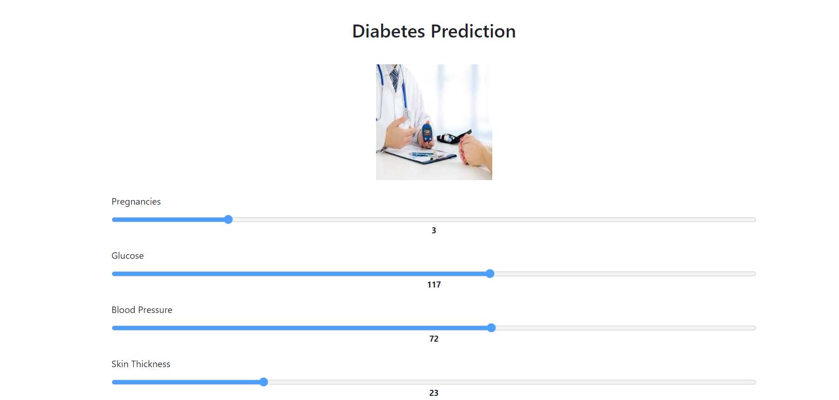
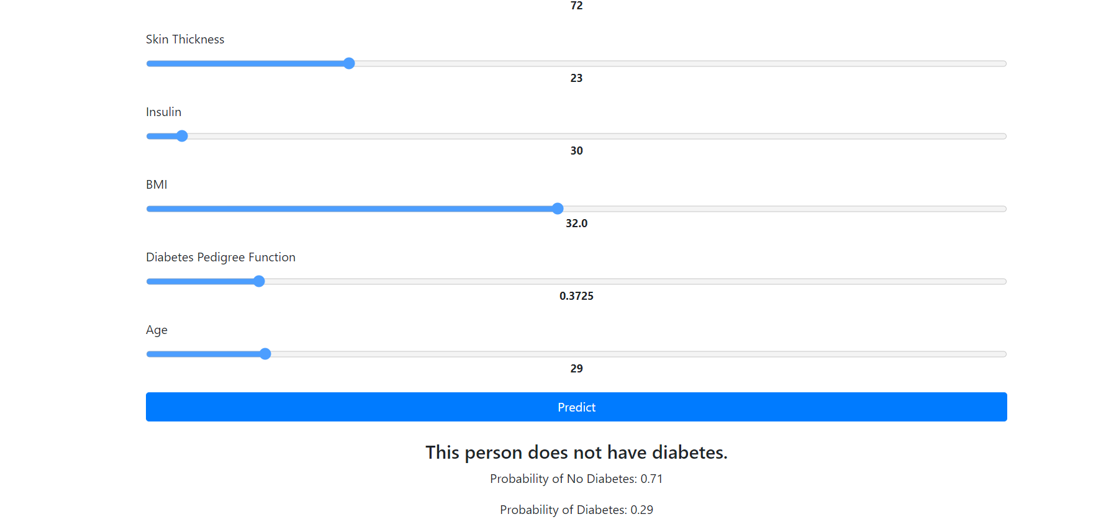
Snippets

Slide 11
Conclusion and Future Work
This project demonstrates a machine learning approach to predict diabetes using a Random Forest Classifier. Key takeaways include:
- Effective preprocessing and model tuning are crucial for high performance.
- The model achieves good accuracy, indicating its potential for real-world application.
Future work could explore:
- Using other machine learning algorithms.
- Improving data quality and feature engineering.
- Deploying the model as a more sophisticated web service.

