Slide 1
AWS SERVICES
(INFRASTRUCTURE
AND SOFTWARE DEVELOPMENT)
Presented By:
Himanshu Uniyal
Date-04/06/24

Slide 2
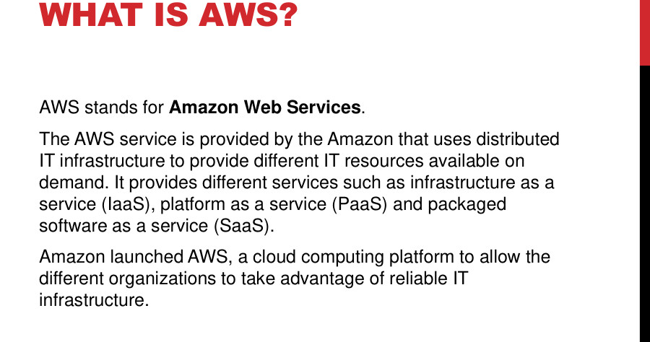

Slide 3
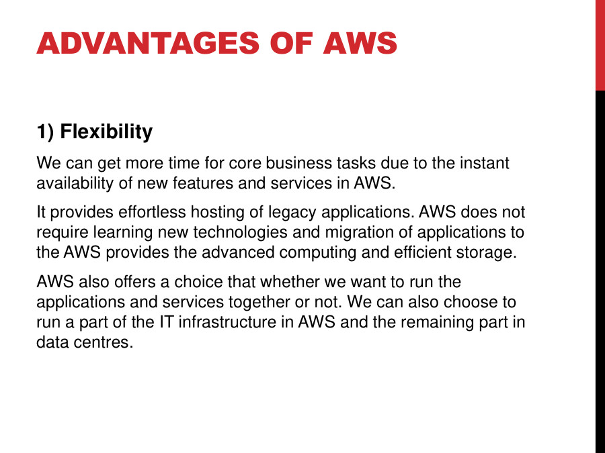
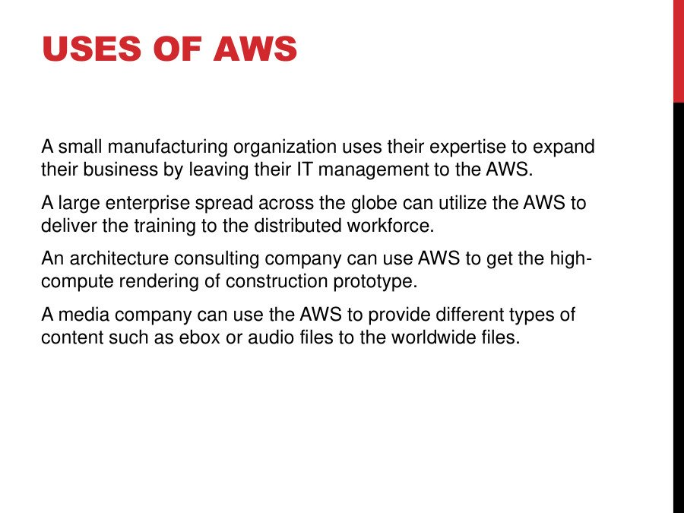

Slide 4
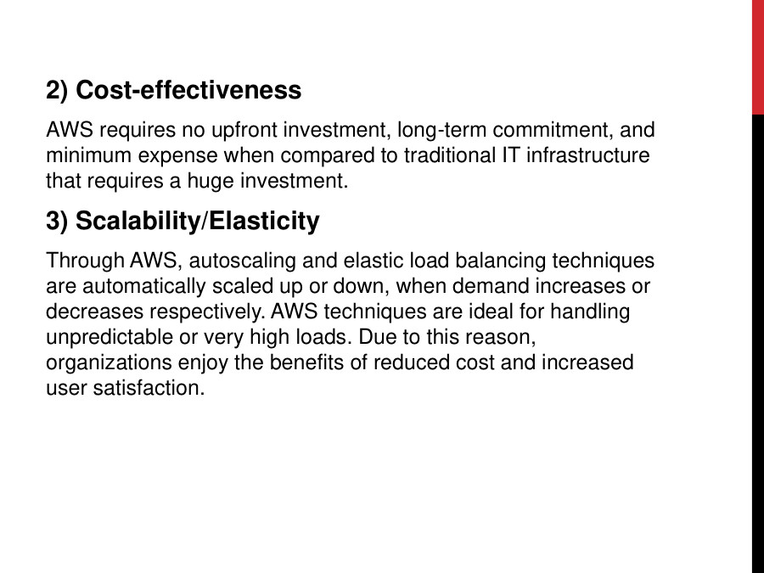
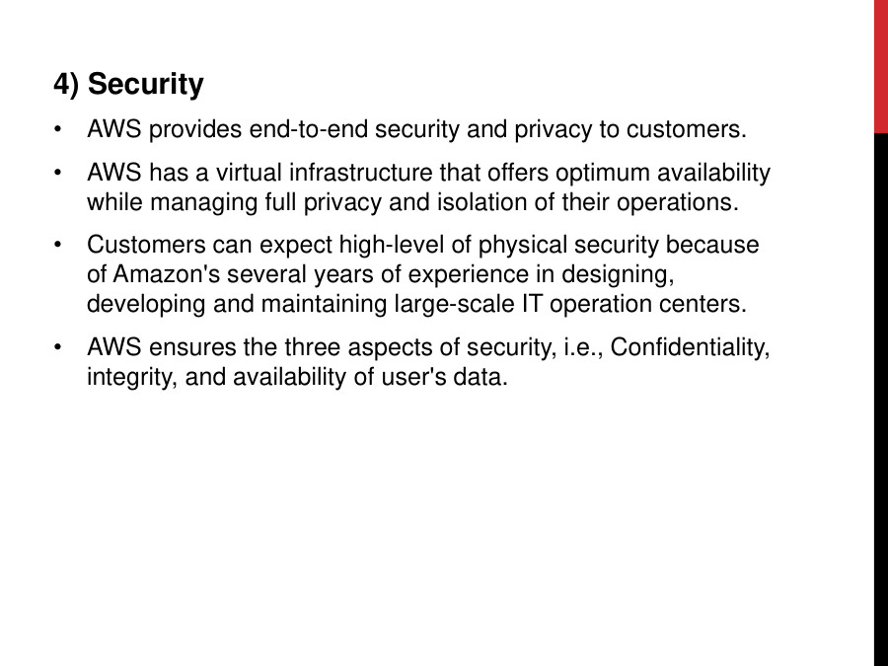
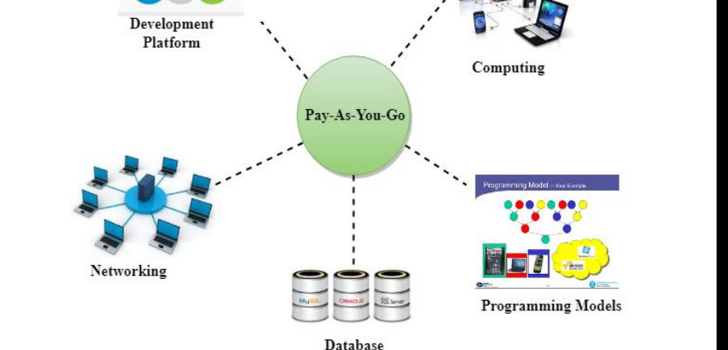
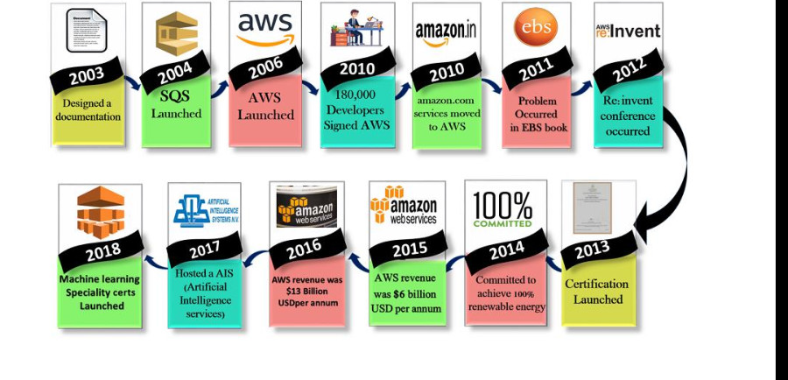

Slide 5
Ec2
Amazon Elastic Compute Cloud (EC2) is a web service that provides resizable compute capacity in the cloud. In simpler terms, EC2 allows you to rent virtual servers (called instances) from Amazon's cloud infrastructure, which you can use to run your applications or services. You can choose the instance type based on your needs, whether it's for general-purpose computing, memory-intensive tasks, or high-performance computing.

Slide 6
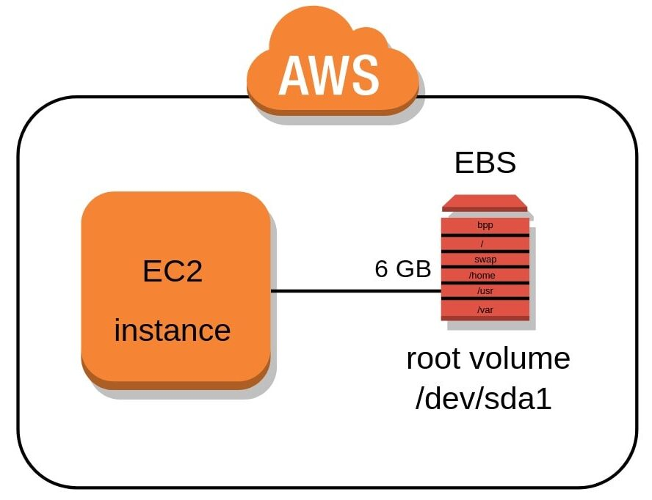

Slide 7
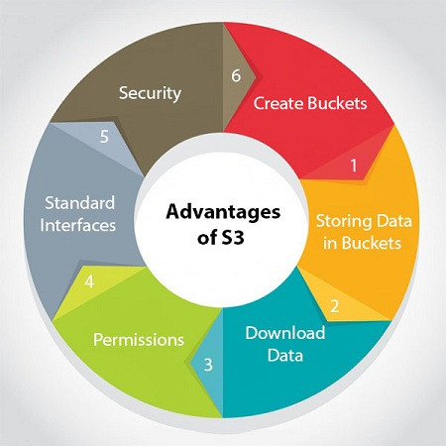
SIMPLE STORAGE SERVICE(S3)
Amazon Simple Storage Service (Amazon S3) is a highly scalable, durable, and secure object storage service designed to store and retrieve any amount of data from anywhere on the web.
Scalability and Durability: Amazon S3 offers 99.999999999% data durability and automatic scaling.
Lifecycle Management: Automated transitions between storage classes and data deletion.
Security and Compliance: Strong encryption, access control, and
compliance with various standards.
Integration: Seamless integration with other AWS services and extensive
API support.
Performance: High throughput, low latency, and S3 Transfer Acceleration
for faster data transfers.

Slide 8
Security Practice

Slide 9
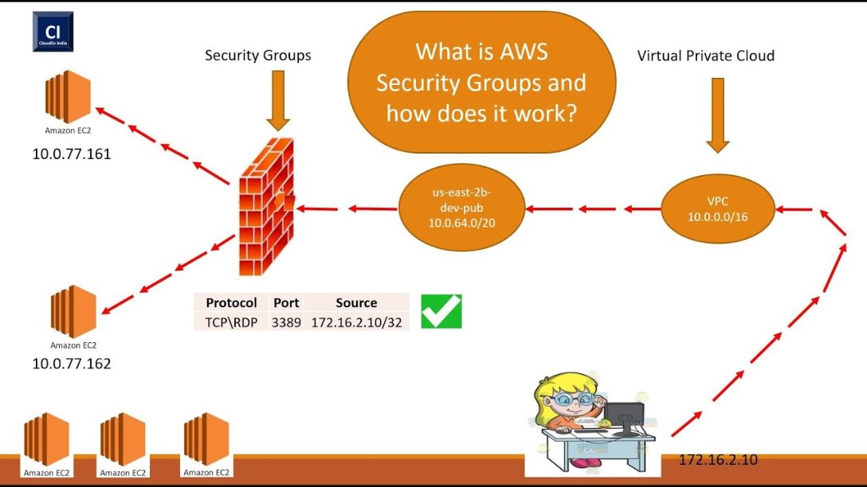

Slide 10
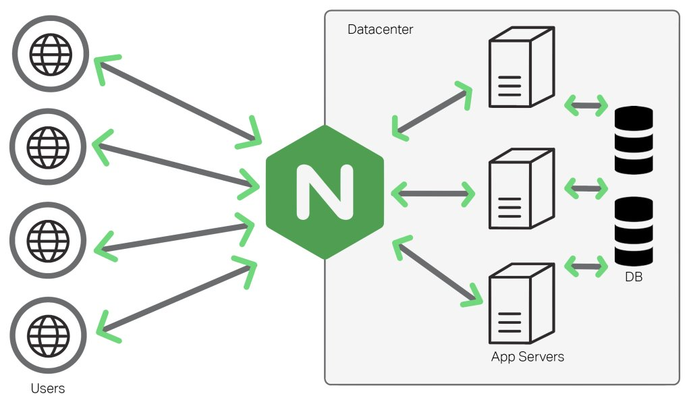

Slide 11
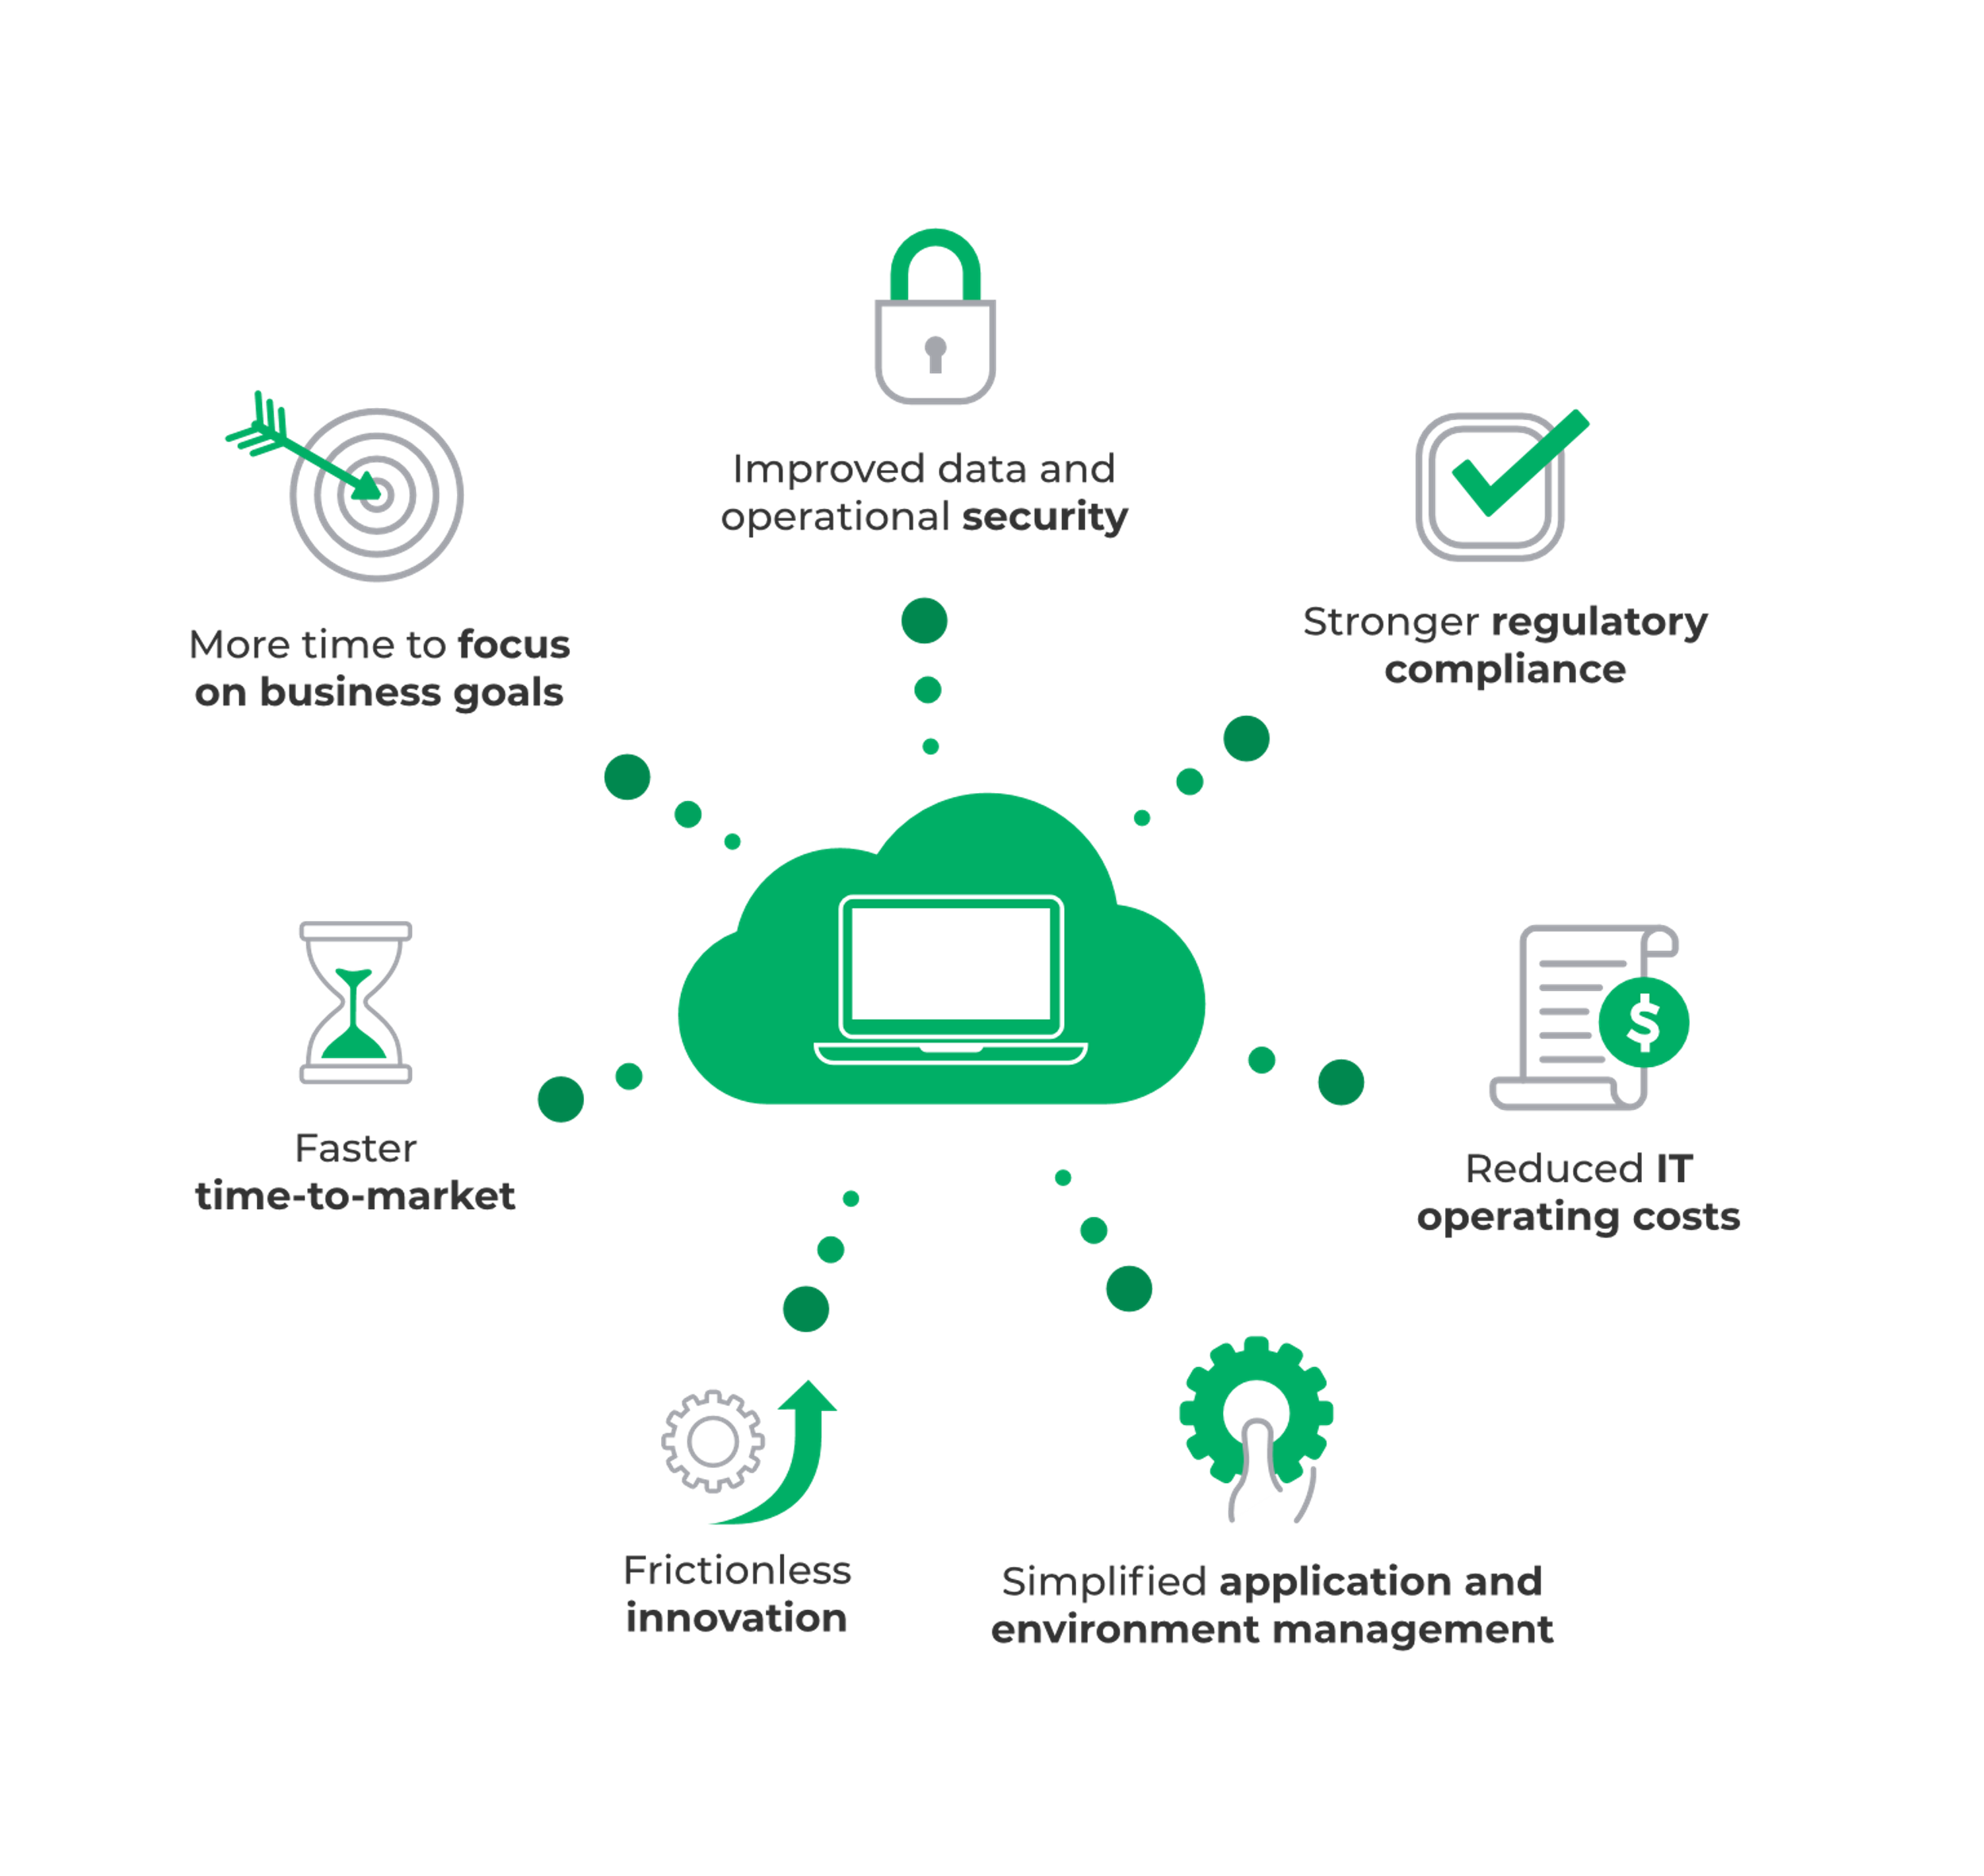
AWS Managed Services

Slide 12
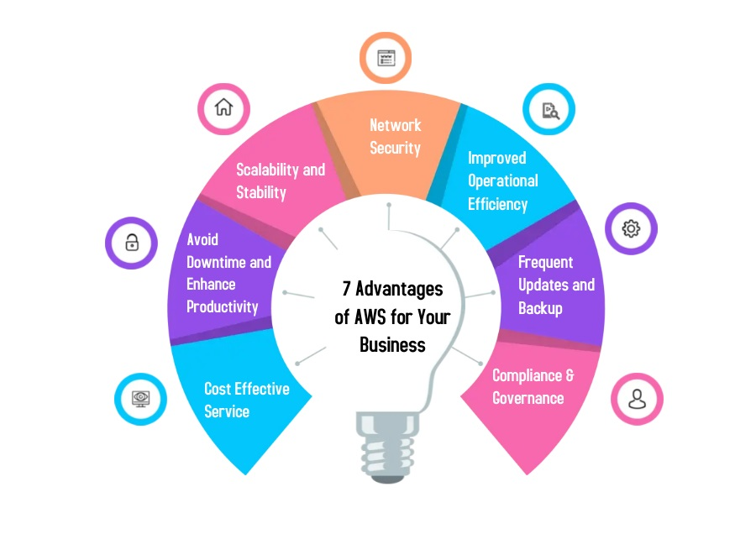
AWS Managed Services Benefit

Slide 13





Development & HOST
Architecture& ci-cd setup
Development
Testing
Git-hub
LAUNCH
First define the architecture of project may be monolithic or micro-service
Now choose any asynchronous framework and do development
Now test on the local system and build the production file
Now push development build file on the git repo
From git-hub you can set direct AWS pipeline to deploy production server

Slide 14

THANK YOU

