Slide 1

AGILE AND SCRUM
PROCESS WORKFLOW
Presented by- HIMANSHU UNIYAL
Date- 02/06/24

Slide 2
Objectives
Review the Software Development Lifecycle and the problems it creates
Understand where Agile Methodology came from
Review the Agile Scrum Process and Roles

Slide 3
Traditional Thinking
Traditional project management used for software development = Waterfall Method
Requirements
Design
Implementation
Verification
Maintenance

Slide 4
Problems with Waterfall Method
Difficult to accommodate change once a process is underway
Phases must be completed in a sequential order
Difficult to respond to changing customer requirements
Few business systems have stable requirements

Slide 5
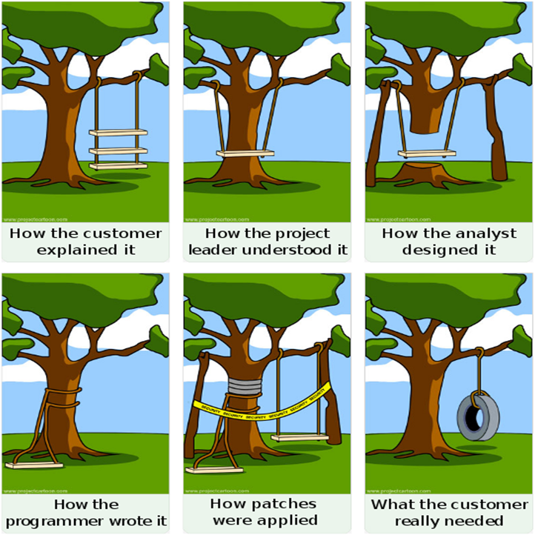

Slide 6
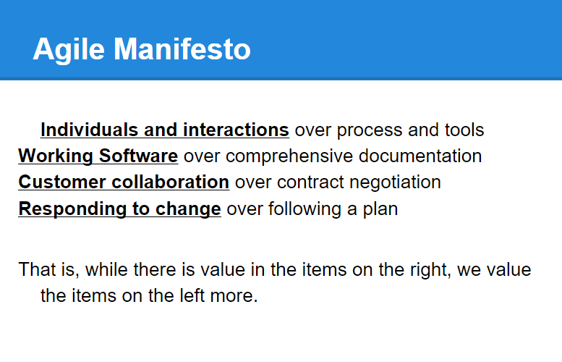
Agile Thinking
A group of software development methodologies based on iterative incremental development
Simply, a different way to manage IT projects, teams, or any work involving a complex process

Slide 7
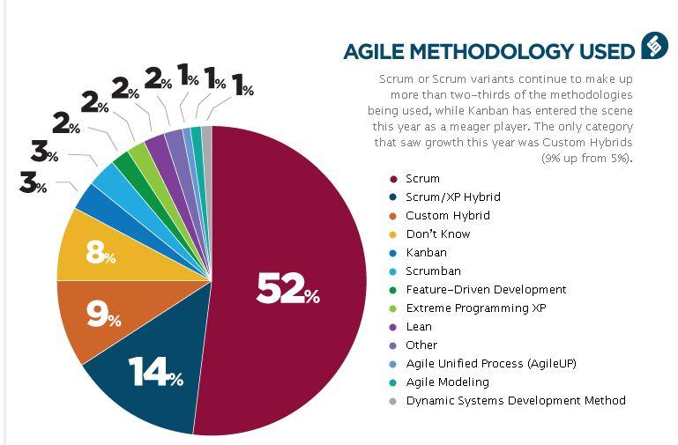
Scrum

Slide 8
Key Scrum Beliefs
People
+
=
Product
Practices
Scrum requires a mental shift in the way people think
A preference of People over Practices: understanding that solving complex problems requires brainpower, not recipes;
An understanding that the best Products are developed by having a Focus on User's Needs rather than relying on a requirements document;
The acceptance that Reality Trumps Expectations, so when reality and expectations don't match, it is the expectations that must change;
The preference for Self-Organizing Teams over either lone-wolf-ism or tightly controlled management; and
The realization that each of us is part of a Team developing Product and that we are not simply People doing Work.

Slide 9
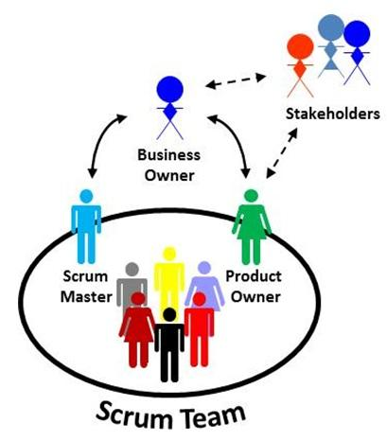
The Scrum Team
The Scrum Team is a small (ideally 5-9) group of people that provides useful Products and Results for Stakeholders.
Stakeholders
The most important role involved in Scrum
The reason a Team is developing a Product
Business Owner (BO)
A special stakeholder, often the Team's sponsor or champion and controls the budget for the Team
Product Owner (PO)
Most important person on the Scrum Team
Works with Stakeholders to represent their interests to the Team
Held accountable for the value of the Team's results
Scrum Team Members
Do the work (analysis, design, code, test, document, data quality checks, or whatever work is required for a desired outcome)
Scrum Master (SM)
Facilitator, moderator, and coach
Manages relationship between the PO and the Scrum Team
Focuses on team improvement

Slide 10
The Product Backlog
A Scrum Team's work is managed with a Product Backlog
A collection of Product Backlog Items
Items (User Stories) represent the stakeholders' needs and wants that add value to a product
Team does not do anything for any Stakeholder unless it's in the backlog
The Product Owner is responsible for prioritizing the Backlog

Slide 11
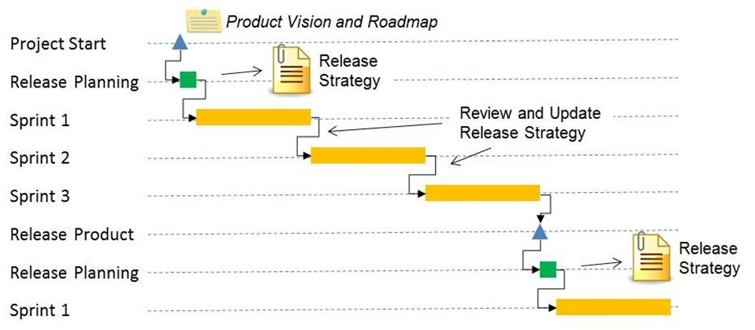
Release Planning
Visioning phase
PO and Stakeholders produce a Product Vision and Product Roadmap
Overall focus is on the Product
Not a part of Scrum Itself
Stakeholders and Scrum Team negotiate what should be accomplished in a Release
Once the Team has a Backlog that supports Release Goals, the Team starts Sprinting

Slide 12
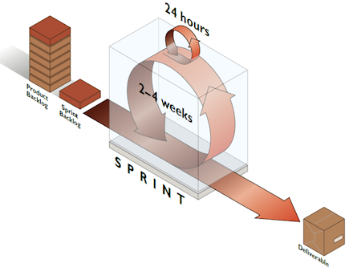
The Sprint
Fundamental process flow of Scrum
A short, fixed-length period of time
Goal is to produce Backlog Items into renewable products that Stakeholders can provide feedback on
Sprint Planning allows the PO to work with the Team to negotiate what Backlog Items the Team will work on in order to meet Release Goals
Scrum Master ensures Team agrees to realistic goals
Sprint Planning
Daily Scrum
Daily Standups
Sprint Review
Sprint Retrospective

Slide 13


