Slide 1

LeetCode Problem-Solving Strategies and Learning Outcomes
Enhancing Coding Skills and Technical Interview Preparation
Presented By:Himanshu Uniyal
Date:10/06/24

Slide 2
Introduction to LeetCode
What is LeetCode?
->A popular online platform for coding practice
and technical interview preparation.
Importance of LeetCode:
->Offers a wide range of problems across different topics.
->Helps in building problem-solving skills
and improving coding proficiency.

Slide 3
Problem-Solving Strategies
Understand the Problem Statement
Read the problem description carefully.
Identify the inputs, outputs, and constraints.
Plan Your Approach
Break down the problem into smaller parts.
Choose the right data structures and algorithms.
Write Pseudocode
Outline your solution using pseudocode before actual coding.
Start Coding
Implement the solution step-by-step.
Focus on getting a working solution first, then optimize.
Test Your Code
Use provided test cases and create your own edge cases.
Debug and refine your code based on test results.

Slide 4

Tips for Effective Practice
Consistency is Key
Focus on Concepts
Practice regularly to build and retain skills.
Understand underlying concepts instead of memorizing solutions.
Time Yourself
Solve a Variety of Problems
Simulate real interview conditions by timing your problem-solving.
Cover different topics like arrays, strings, dynamic programming, etc.

Slide 5

Learning Outcomes
Enhanced Problem-Solving Skills
Improved ability to break down and solve complex problems.
Better Understanding of Algorithms and Data Structures
Mastery over key concepts used in technical interviews
Increased Coding Proficiency
Faster and more efficient coding skills.
Preparedness for Technical Interviews
Confidence and readiness to tackle a variety of interview questions.

Slide 6
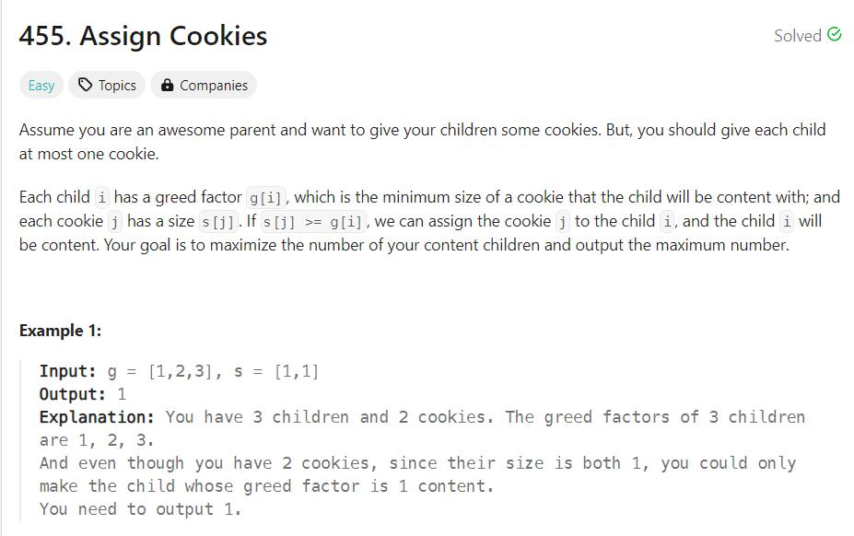
Case Study: Example Problem

Slide 7
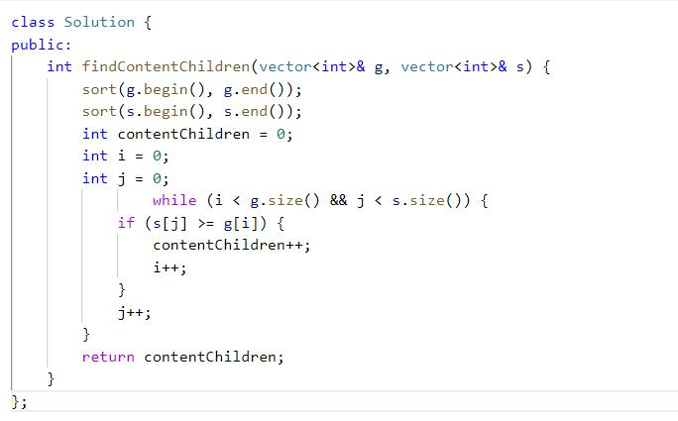
Summary of the Approach
1. Sorting: By sorting both the greed factors and the cookie sizes, the solution leverages the
ordered nature to efficiently find matches. 2. Two-Pointer Technique: The two-pointer technique allows simultaneous traversal of both
lists, ensuring that each comparison and assignment is optimal.
3. Maximizing Content Children: By always attempting to satisfy the next most greedy child
with the smallest sufficient cookie, the solution maximizes the number of content children.

Slide 8

Conclusion
01
Regular practice on LeetCode leads to significant improvement in coding and problem-solving skills.
02
Utilizing effective strategies and tips enhances learning and interview preparedness.

Slide 9

Thanks for
Your attention

